Slide 1
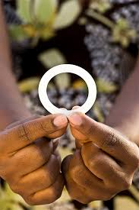
Ensuring timely investment in new HIV prevention interventions for Adolescent young girls and women
ULANDA REGINA MTAMBA
2018 AVAC FELLOW - MALAWI

Slide 2
The background
Over 7,000 new infections each week are acquired globally by young women. In Malawi, the HIV rate among adolescent girls and young women 15-24 years is not going down as fast as projected. Females have a higher HIV prevalence than males 10.8% vs 6.4%, respectively.
Despite Malawi having prevention options available such as VMMC and male and female condoms, the number of new infections still remain high.
The project aimed at contributing to the reducing the new HIV infection amongst Adolescent Young Girls and Women(AYGW) by ensuring that more self controlled HIV prevention options for women are made available such as Dapivirine ring and PrEP.

Slide 3
Goal and objectives
GOAL
To contribute towards the overall reduction of new HIV infections among the adolescent young girls, women and high risk groups.
OBJECTIVES
To advocate for clear next steps on ring approval, access and the development of guidelines for implementation in Malawi by April 2019.
To support advocate efforts to influence rollout and expand of PrEP access as part of combination prevention amongst adolescent young girls, women by April 2019.
To build ongoing ways for advocates to stay updated, informed and involved in discussions around HIV prevention research – so that they are better able to engage and influence the research agenda in Malawi by April 2019.

Slide 4
Strategies & activities
Lobby with policies makers and decision makers to initiate policy discussions for the ring and approval of PrEP guidelines.
Engage with Faith Based Organization, CSO and Local NGOs to influence ring agenda and PrEP.
Engage with media and provide them with information on new HIV prevention technologies such as ring studies, PrEP, and HIV Vaccine.
Conduct Radio and TV Programmes on new HIV prevention technologies.
Develop and distribute information fact sheets for Dapivirine ring and PrEP.
Raise awareness to different stakeholder’s on dapivirine ring studies and PrEP
Lobby for increased support for HIV prevention from PEPFAR- through COP and Global fund processes.
Conduct Interactive stakeholder dialogues session to raise awareness for dapivirine ring trials and PrEP.

Slide 5
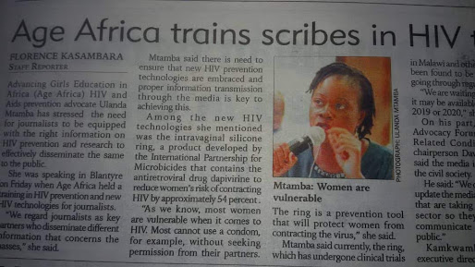
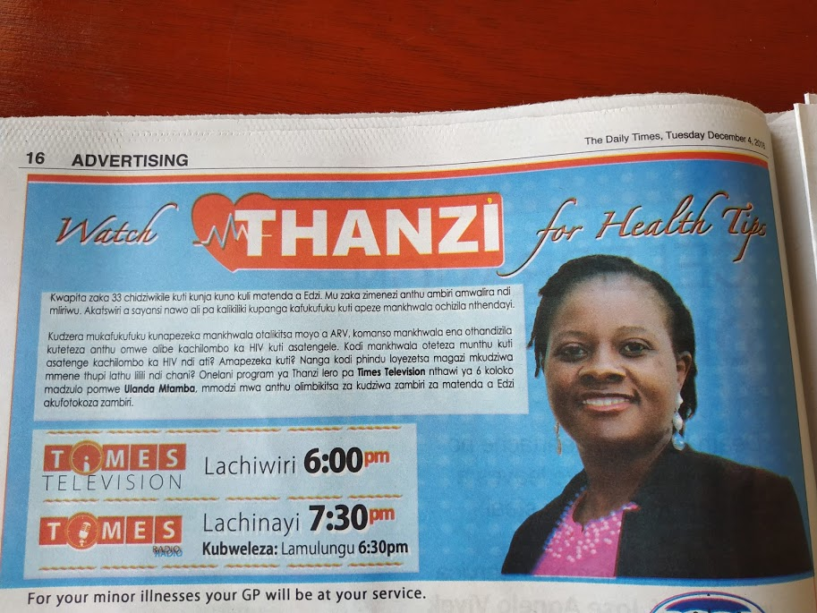
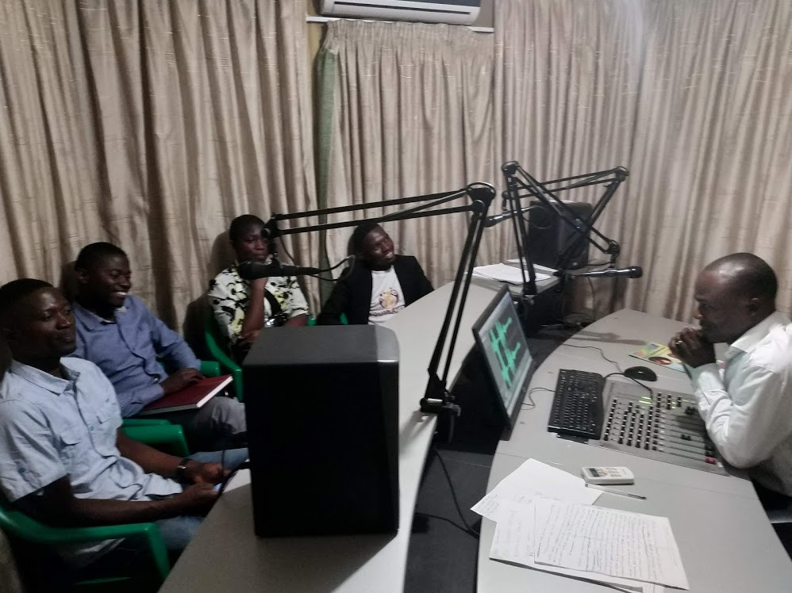
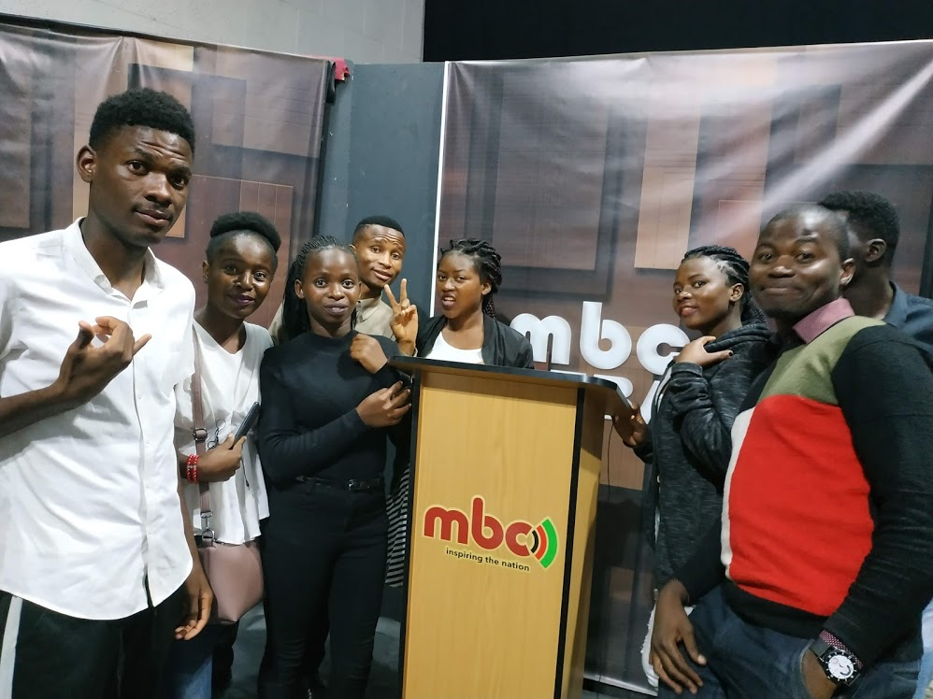
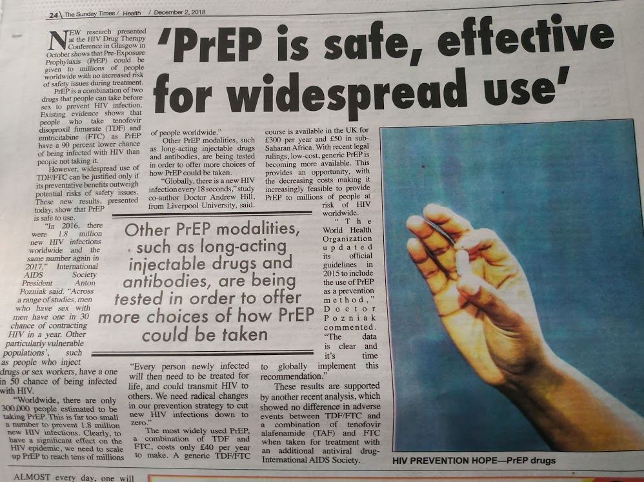
Key achievements
Media Engagement
Established a team of media advocates on biomedical HIV Prevention in Malawi, who has been involved in the HIV prevention new technologies media advocacy.
Conducted 8 radio programmes, 6 TV programmes, public debates and writing newspaper articles on dapivirine ring and PrEP.
Advocacy work gaining recognition: One of our media advocate Talasina Manda Kaipa won an award: The 2019 Health Research Journalist Award because of the dapivirine Ring radio program she produced on MIJ FM
Radio and TV HIV Prevention programs
News paper articles & coverage

Slide 6
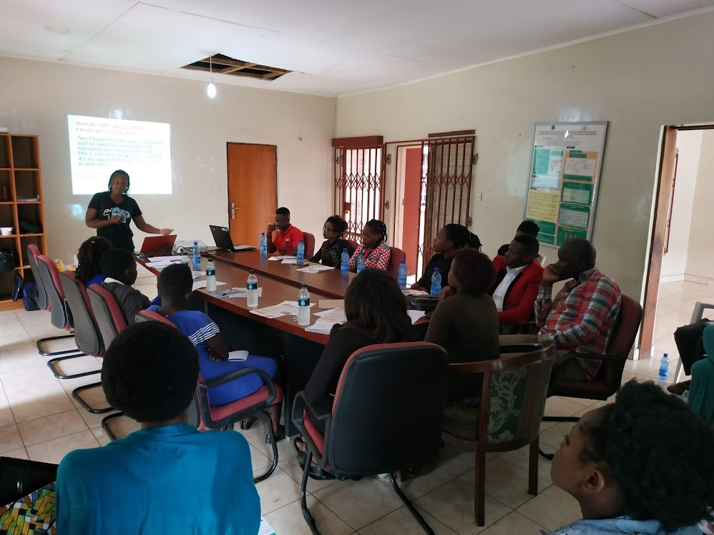
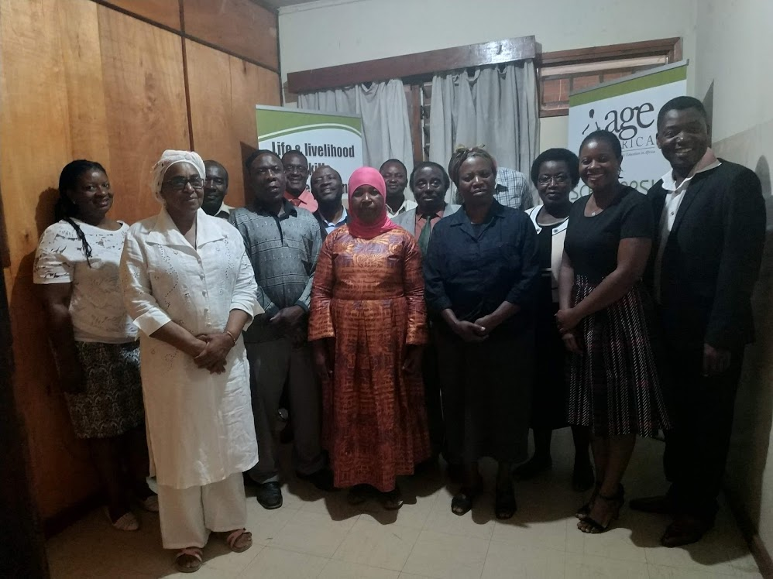
2) Build capacity of CSOs to get engaged in HIV prevention research advocacy
Established a vibrant CSO advocacy forum for southern region.
Built the capacity of CSOs in biomedical research & advocacy, and enable them to fully participate and drive the country’s research agenda.
Together with national CSO advocacy forum, organized and deliver the first ever research conference in Malawi- where CSO, advocates met with researchers, Ethics and regulators.
Supported dapivirine ring and Prep upcoming studies for pregnant and lactating mothers in Malawi: Deliver and Be- protected (MTN 042/MTN 043).
Established biomedical HIV prevention Youth advocates forum and build their capacity on new HIV prevention options, youth are now able to engage, participate in research and influence decision makers to consider new options as part of HIV prevention combination.
A group of youth leaders & advocates during sessions
Blantyre Faith based leaders- after the Biomedical HIV prevention training

Slide 7
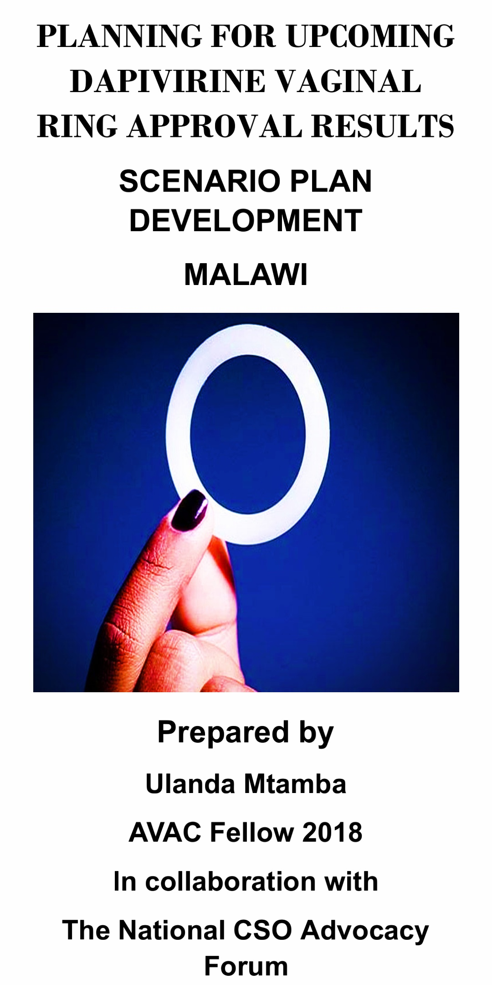
Key achievements
3) Dapivirine ring and PrEP. advocacy
Initiated talks with policy makers on the possible introduction of dapivirine ring as a new HIV prevention option.
Contributed to PrEP policy framework development & guidelines in Malawi where adolescent girls and young women have been considered to be the first at risk group to be considered for PrEP on the first phase.
currently Iam also a member of National PrEP task force and a member of PrEP Service Delivery TWG.
Increased stakeholders knowledge on dapivirine vaginal ring and PrEP.
Developed a ring scenario plan for Malawi and establish task team from the National CSO advocacy forum, to work on ring advocacy after the EMA approval.
https://drive.google.com/file/d/1UNu4YTGbfRWfKtybb-qT8q2i74Id0j8-/view?usp=sharing

Slide 8
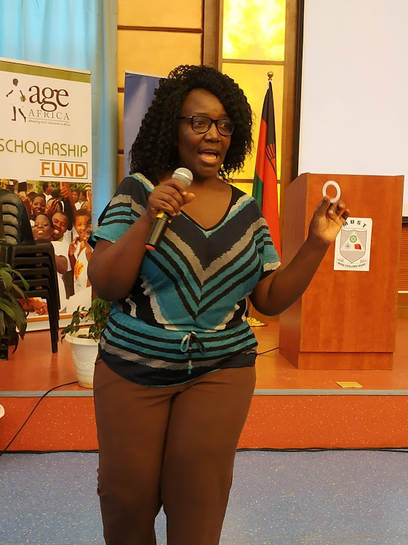
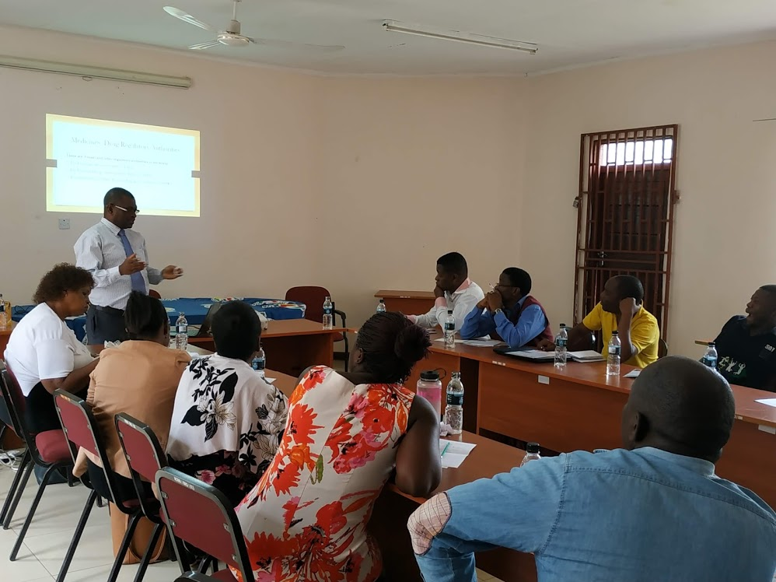
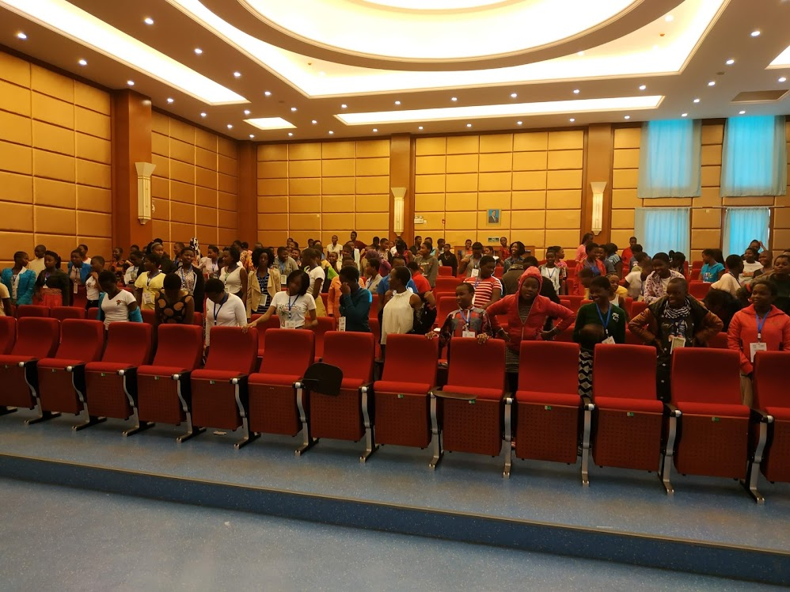
The Study Coordinator- JHU Research center training girls on the new HIV prevention Technologies at the 2018 AGE Africa Science Camp
4) Collaboration and partnership
Established good collaboration between CSOs, Advocates and researchers.
Establish and maintain good collaboration with media house and journalists.
Established effective collaboration with district stakeholders – district health Office, city Council and District Councils.
The Study Coordinator- UNC Research center training CSOs on the new HIV prevention Technologies

Slide 9
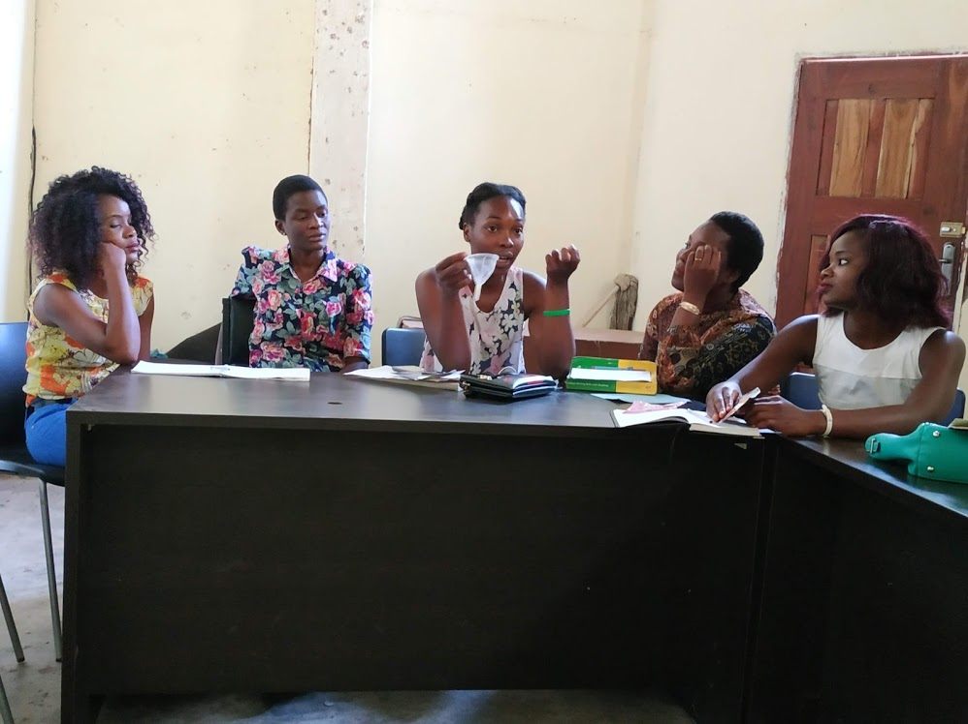
Project Impact
Increased knowledge on new HIV prevention technologies amongst adolescent girl, young women and men.
More young people engaged in HIV research advocacy.
Faith based institutions engaged in HIV prevention technologies such as ring advocacy.
CSOs ably engaging with researchers and helping in moving research agenda in the country.
Informed community on clinical trials being implemented in their communities and in the country.
Strengthen the capacity of southern region CSO HIV advocacy forum.
Network and relations built with media houses – being provided free airspace for HIV preventions programs.
Positive Collaboration between CSOs, Advocates and research centers ( Johns Hopkins in Blantyre and UNC project – in Lilongwe) - working with them to provide trial updates and upcoming trials to CSOs.
More media positive coverage on HIV prevention new technologies – such as dapivirine vaginal ring, PrEP, AMPs, BNABs and vaccine.

Slide 10
The future of this work
Continue to engage with decision and policy makers to influence the ring agenda, to be included as part of the combined HIV prevention once approved.
Get more Civil Society Organization engaged in biomedical HIV prevention advocacy.
Strengthen the engagement platform for researchers, media and CSO Advocates.
Capacity building for advocates to enable them to conduct evidence based advocacy.

Slide 11
Challenges and possible solutions
CHALLANGES
Failing to make head way, to policy makers on the new technologies.
Delays in funding
SOLUTIONS
Worked with Allies, Alumni fellows or CSOs with the country that can help to find a way for you.
It important not always to wait for funding, but find activities in the plan that can be implemented with minimal or no resources.

Slide 12
Lessons Learnt
Passion and persistence in advocacy work is essential.
Advocacy takes time realize the gains, therefore it is important to celebrate the quick gains. This helps to keep the momentum.
Knowing and working with allies is essential, when pushing for an advocacy agenda.
All objectives, sometimes cannot be achieved in your year of fellowship, but you initiative the processes hence celebrate the few gains!
Evidence advocacy is so powerful, to influence decision makers.

Slide 13
Key Recommendations
Ending the epidemic will require multiple responses, hence the need to work jointly.
Prevention options that meet women’s needs, is essential women needs more choices.
I hope the ring will join oral PrEP to give women a new way to protect themselves.

Slide 14
key resources
Material development – Dapivirine vaginal Ring Factsheet
https://drive.google.com/file/d/10BWnjixHM1VMvctlF207IV-aKl6Qm086/view?usp=drivesdk
Vaginal ring: This program, the discussion focused dapivirine Vaginal Ring – defining the ring, where we are with the clinical trials and when should women expert the ring, and addressing myths and misconceptions of vaginal ring. The program was aired at MIJ radio station.
https://drive.google.com/file/d/1B3AaCKotczveQ9uUmib29yC8X_CjIMhv/view?usp=drivesdk
These two programs below, the discussion focused on PrEP. What is PrEP., how does it work, who can access PrEP, benefits of PrEP., why PrEP. For the HIV negative people, whether PrEP. Is available in Malawi and what it is that different stakeholder are doing to ensure timely availability of PrEP. in Malawi. The program was aired at Blantyre Synod Radio station.
https://drive.google.com/file/d/17vgwFejlsMcCws3U6Ezb8NkfrAgqh4z/view?usp=drivesdk
https://drive.google.com/file/d/18fDqlkxViAM_0EmnVzRoXcaDlw6_oE8/view?usp=drivesdk
Television Malawi News outlook- On this program I was invited to brief the nation on what we are doing as AGE Africa on HIV prevention for Young women. This was a reaction after we trained 16 journalist on new biomedical HIV prevention methods.
https://drive.google.com/file/d/1bE21nA8m2BDSZR4yyKQCVRvhLXrsTwUD/view?usp=drivesdk
TV program on HIV prevention The program was aired on Times TV
https://drive.google.com/file/d/1pUx53qg1nYnK-963buC3E9mv---Q0Rpd/view?usp=drivesdk
HIV prevention public debate. Why HIV prevalence rate for the youth continue to be on the increase. What are the challenges, are we doing enough to address the challenges. The guest to this program were: Dr. Andrina. Mwasamba the Policy advisor for National AIDS Commission and Dr. Bilao from Ministry of Health
https://drive.google.com/file/d/1M2Uzn4goSMwbX68ZWOz7DviQdJj7VTYc/view?usp=drivesdk
HIV and Young women: This program, the discussion focused on feminization of HIV- Why young women are at risk and vulnerable to HIV. The program was aired at Blantyre Synod Radio station.
https://drive.google.com/file/d/1FLwceq4C5IH0VMQi1-k_v0W-C9zK2z4O/view?usp=drivesdk
This program, the discussion focused on feminization of HIV- Why young women are at risk and vulnerable to HIV. The program was aired at Blantyre Synod Radio station.
https://drive.google.com/file/d/17vgwFejlsMcCws3U6Ezb8NkfrAgqh4z/view?usp=drivesdk
KEY MESSAGE
Ending the epidemic will require multiple
prevention options that meet women’s needs.
I hope the ring will join oral PrEP to give women a new way to protect themselves.

Slide 15
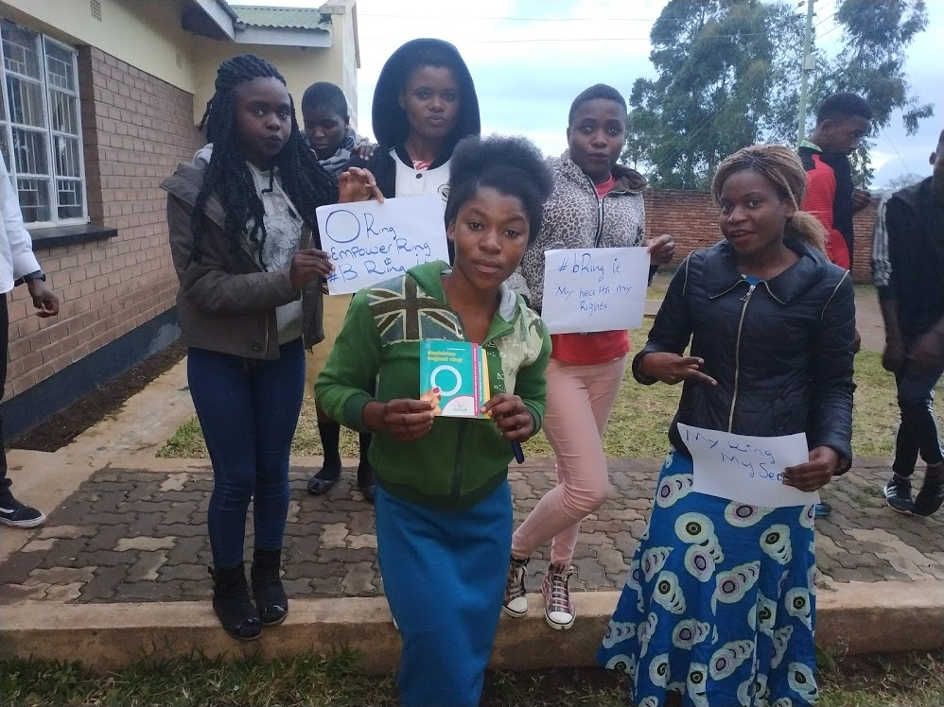
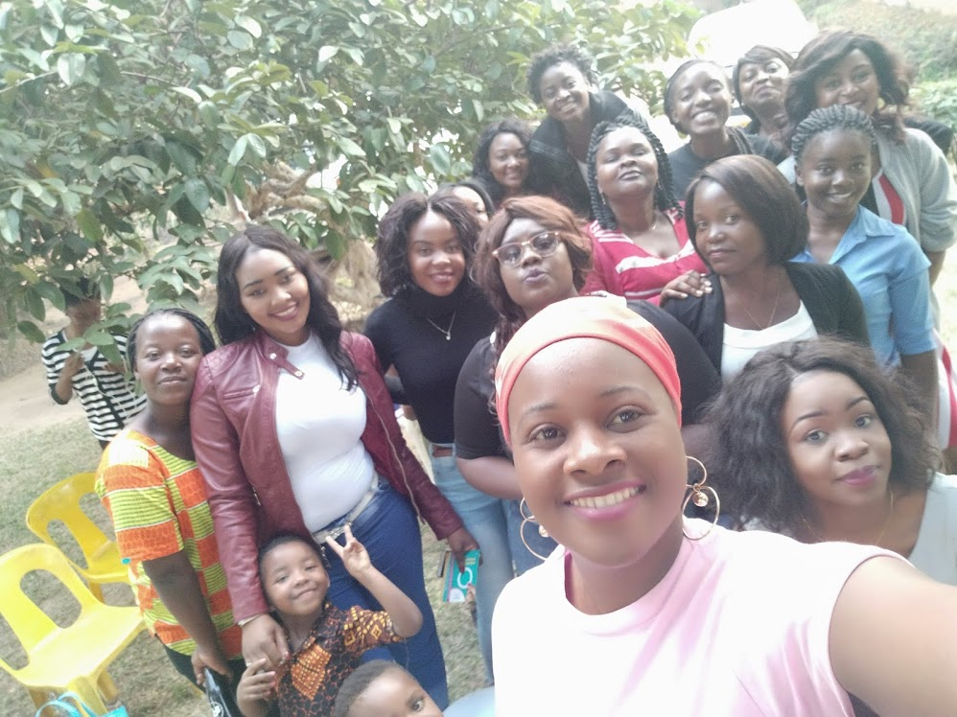
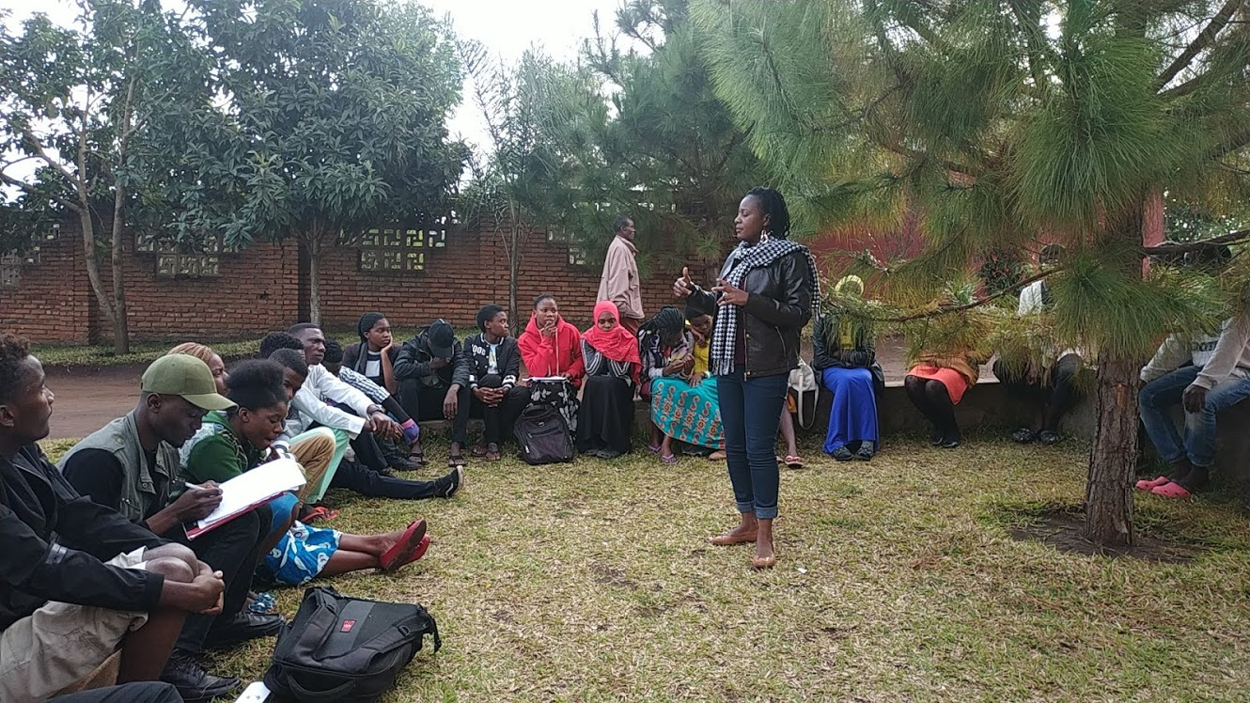
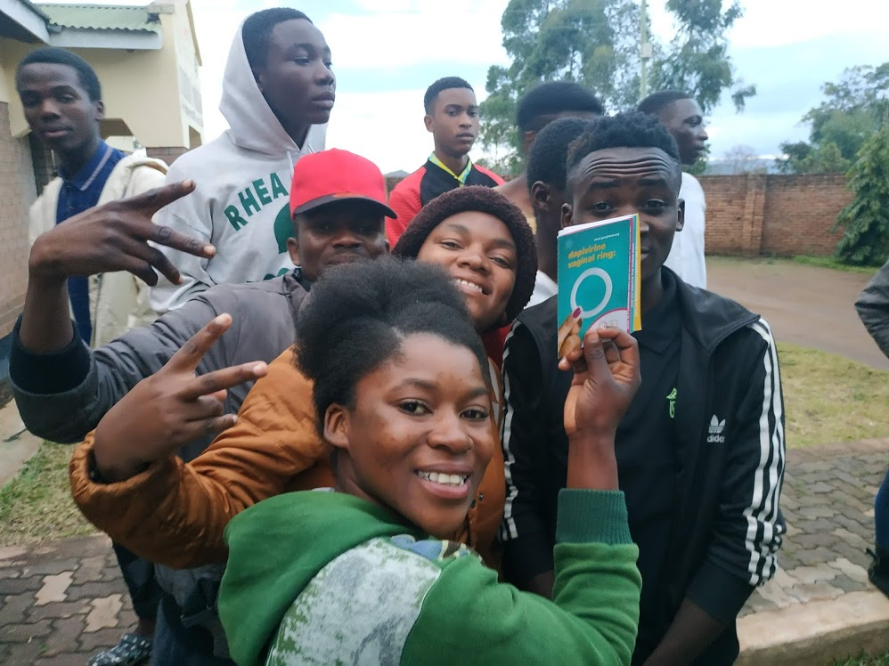
Ensuring timely investment in new HIV prevention interventions for Adolescent young girls and women
‘Getting informed, involved and push for HIV prevention women controlled options’

