Slide 1
HIV Vaccine
Research and Development
Pipeline:
2019 Supplement
May 2019

Slide 2
Overview
Efficacy trials – results to-date; pipeline as of 2019
Pox-protein strategy
Mosaic strategy
PrEPVacc program
Antibody research
Advocacy priorities

Slide 3
HIV Vaccine Efficacy Results to Date
YEAR | TRIAL NAME/ PRODUCT/CLADE | LOCATION | # | RESULT
2003 | VAX003 AIDSVAX B/B | Canada, Netherlands, Puerto Rico, US | 5,417 | No effect
2003 | VAX004 AIDSVAX B/E | Thailand | 2,546 | No effect
2007 | STEP MRK-Ad5 B | Australia, Brazil, Canada, Dominican Republic, Haiti, Jamaica, Peru, Puerto Rico, US | 3,000 | Immunizations halted early for futility; subsequent data analysis found potential for increased risk of HIV infection among Ad5-seropositive, uncircumcised men.
2007 | Phambili MRK-Ad5 B | South Africa | 801 | Immunizations halted based on STEP trial result.
2009 | Thai Prime-Boost/RV 144 ALVAC-HIV (vCP1521) and AIDSVAX B/E | Thailand | 16,402 | Modest efficacy (31.2%)
2013 | HVTN 505 DNA and Ad5 A/B/C | US | 2,500 | Immunizations halted early for futility; vaccine regimen did not prevent HIV infection nor reduce viral load among vaccine recipients who became infected with HIV; follow-up continues.
Notes:
To date, over 200 trials have been performed using a variety of components and methods. Of those, only 5 regimens have progressed to phase IIb or III (later stage) trials
Until recently, results from most of the large efficacy trials have been disappointing—the 2 lead candidates (AIDSVAX and Merck Ad-5) did not prevent HIV infection, and results from the Merck STEP trial in 2007 suggest that the vaccine may even have enhanced HIV acquisition. Remember, human clinical trials are adding to the body of knowledge that we need to eventually design and implement a safe and effective preventive vaccine.
AIDSVAX: the experimental AIDS vaccine made from a component of the HIV envelope (specifically, a sugary protein called gp120) by VaxGen.
ALVAC: a vaccine that delivered synthetic fragments of HIV using a harmless form of a bird virus, canary pox, as a vector.

Slide 4
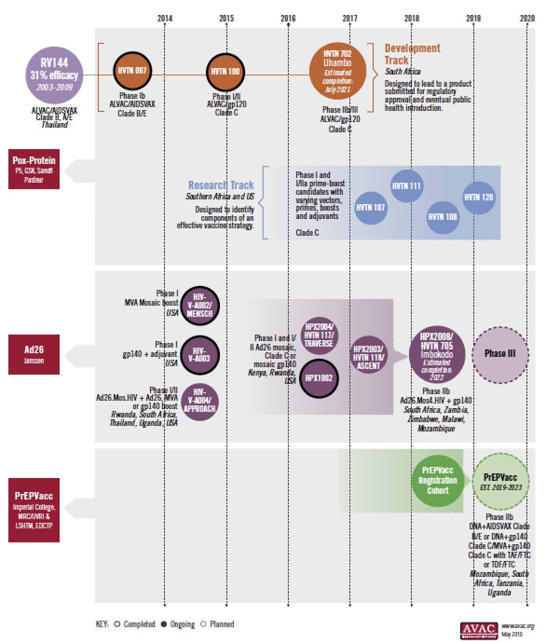
Efficacy Trials Pipeline
Available to download at www.avac.org/infographics.
Notes:
As of 2019, the HIV vaccine field is busier than ever
For the first time since the HIV/AIDS epidemic began over 30 years ago, two large-scale HIV vaccine efficacy trials are underway at the same time, with a third to start later this year.
The Uhambo efficacy trial is testing a vaccine designed to prevent HIV clade C, the most common type of HIV in Southern Africa.
The Imbokodo trial, in sub-Saharan Africa, is testing whether a “mosaic” vaccine will protect against multiple types of HIV. An additional Phase III licensure study for this vaccine regimen among key populations is planned.
PrEPVacc is designed to test two vaccine regimens and two licensed pre-exposure prophylaxis (PrEP) options.

Slide 5
Pox-Protein Strategies
In 2009 a trial in Thailand (‘RV144’) showed that a vaccine can reduce HIV risk
  Moderately effective – 31% protection; not good enough to license
The Pox-Protein Public Private Partnership (P5) formed to determine and implement next steps:
  Several small-scale clinical trials in southern Africa, started January 2015 and ongoing
  A large-scale trial, HVTN 702 (The Uhambo Study), launched in October 2016, using a similar regimen to RV144, but made for South Africa
Notes:
The RV144 trial (Thai prime-boost vaccine trial) showed, for the first time, that the risk of HIV infection can be reduced by a vaccine. This was the largest HIV vaccine trial to date with over 16,000 trial participants. It evaluated the efficacy of a vaccine regimen containing two candidates known as ALVAC (canary pox vector) and AIDSVAX (manufactured HIV protein-GP120)—together the vaccine regimen was to stimulate an antibody response along with a cellular response.
The vaccine regimen reduced HIV risk by about 31% (a modest reduction) but did not affect viral load set point in those who went on to become infected. The evidence that the vaccine was protective is unprecedented.
The RV144 vaccine regimen appeared to work better shortly after immunization, so subsequent strategies building on this are attempting to counter the rapid decrease in protection by administering additional vaccine boosts.
HVTN 702, a phase IIb/III efficacy trial, launched in October 2016 and is testing a modified RV144 regimen, redesigned for the type of HIV that is most prevalent in Southern Africa, known as subtype “Clade C”.

Slide 6
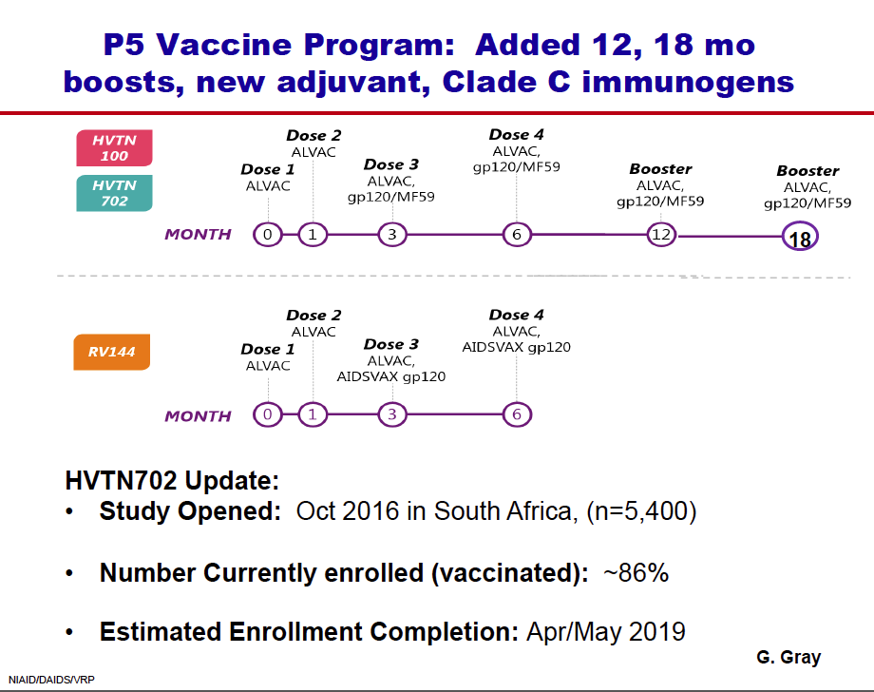
The Journey to HVTN 702
Completed in 2009
Modest 31% efficacy, that waned over time
New adjuvant
Clade C immunogens
Boost at month 12
Additional boost at month 18
Adapted from Glenda Gray & Mary Marovich
Notes:
The vaccine regimen being tested in HVTN 702 builds on the lessons of earlier studies. In a smaller trial called HVTN 100, the RV144 vaccine regimen was redesigned for South Africa by adding:
The MF59 adjuvant (an adjuvant is a substance sometimes used in vaccine development to enhance or modify its immune-stimulating properties)
Clade C immunogens (to protect against Clade C HIV, the most common type in South Africa)
A boost at month 12 (an additional vaccine dosage given to enhance immune response)
In May 2016, the US National Institutes of Health (NIH) announced that HVTN 100 had met its “go” criteria to move forward with the large-scale clinical efficacy trial—HVTN 702—which started in October 2016. HVTN 702 uses the same vaccine regimen as HVTN 100, with the addition of another boost at month 18 to further enhance the durability. Positive efficacy results could lead to licensure of this vaccine regimen.
See the next slide for more information.

Slide 7
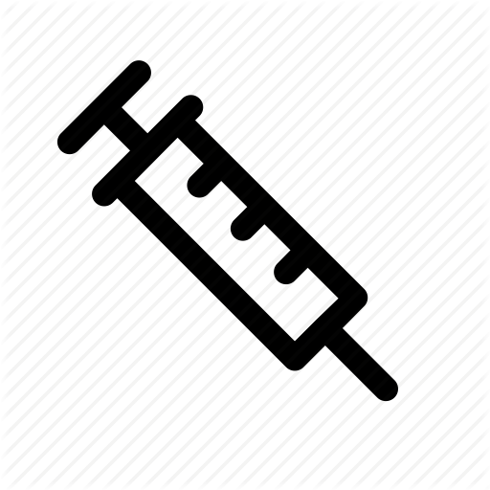

HVTN 702
GROUP | N | PRIMARY VACCINE REGIMEN |  |  |  | BOOSTERS
 |  | Month 0 | Month 1 | Month 3 | Month 6 | Month 12 | Month 18
1 | 2700 | ALVAC-HIV (vCP2438) | ALVAC-HIV (vCP2438) | ALVAC-HIV (vCP2438) + Bivalent Subtype C gp120/MF59 | ALVAC-HIV (vCP2438) + Bivalent Subtype C gp120/MF59 | ALVAC-HIV (vCP2438) + Bivalent Subtype C gp120/MF59 | ALVAC-HIV (vCP2438) + Bivalent Subtype C gp120/MF59
2 | 2700 | Placebo | Placebo | Placebo + Placebo | Placebo + Placebo | Placebo + Placebo | Placebo + Placebo
Total | 5400
“Uhambo” phase IIb/III efficacy trial in South Africa
Timeframe: October 2016 – July 2021
Enrolling 5,400 participants (30-35% men; 65-70% women)
  About 95% enrolled as of May 2019
Notes:
This slide provides the basic overview of the HVTN 702 trial. The trial is now almost fully enrolled.
The table depicts the schema for the trial; participants are randomly assigned to group 1 (receiving the experimental vaccine regimen) or group 2 (receiving a placebo, which has no active drug)

Slide 8
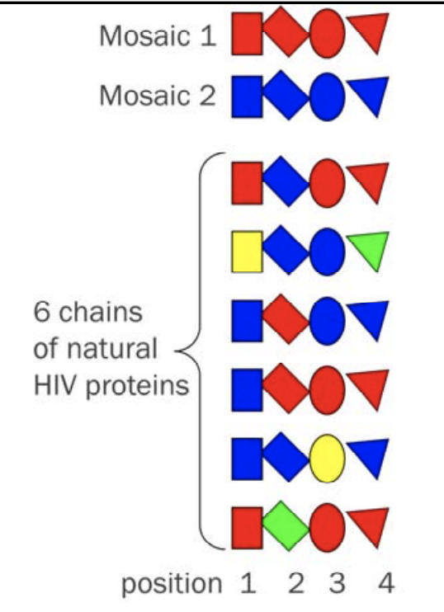
“Mosaic" Vaccines
A so-called “mosaic-based vaccine regimen” is designed to create immune responses to multiple clades
Mosaics use the parts of proteins that cause the strongest immune response– a sort of “greatest hits”
Several mosaics used together in a vaccine could provide broader coverage
Adapted from ‘An Introduction to Mosaic Vaccines for HIV Prevention’, presented by Gail B. Broder, MHS, of the HVTN. Available here: https://www.avac.org/sites/default/files/resource-files/THIS%20IntroMosaicVaxx_AVACposting_notes%5B1%5D.pdf
Notes:
Mosaic vaccines offer one strategy for overcoming the challenge of constantly mutating HIV. Mosaic vaccines are currently under investigation in vaccine research trials.
Proteins are made from chains of amino acids. These amino acids have to be assembled in just the right order to make the proper protein. With a mosaic vaccine, the idea is that the chain of amino acids represented by the mosaic will look like the most common features of HIV that your body might be exposed to in a natural infection.
At the bottom of this graphic you can see six chains of proteins taken from different people who are infected with HIV. The mosaic sequences at the top are formed by taking the most common pieces of protein found at each position in the chain when many versions of a naturally occurring HIV protein are compared. (i.e. blue rectangles are the most common in position 1 and 2, red circles in position 3, and red triangles in position 4).
The hope is that through this design, a mosaic vaccine will help the body recognize and produce a strong immune response against all clades of HIV– likely a key necessity for a global vaccine.

Slide 9
Ad26 Mosaic Vaccine Candidate
Pharmaceutical company Janssen developed an Ad26 vector-based mosaic vaccine, based on HIV genes Gag, Pol and Env for coverage of globally circulating HIV-1 strain
Currently in Phase IIb proof of concept trial (see next slide)
As of May 2019, additional Phase III efficacy trial among key populations is in the planning stage
Development program involved a series of Phase I and I/IIa trials to determine the optimal vaccine components and regimen for efficacy testing
Notes:
Several mosaic candidates have been developed and are undergoing testing now.
A phase IIb efficacy trial, HPX2008/HVTN 705, launched in November 2017 to test a prime-boost regimen of a mosaic candidate. The prime part involves adenovirus vector type 26 (Ad26) that will deliver mosaic components developed by Janssen and partners. The boost consists of gp140 proteins from HIV’s outer layer (or envelope). See the next slide for more information.
A Phase III trial will test this same mosaic candidate in key populations. It is in the planning stage.

Slide 10
HVTN 705/HPX2008/Imbokodo
Ad26.Mos4.HIV
Clade C gp140 (250 mcg + adjuvant)
Adapted from Glenda Gray & Mary Marovich
Phase IIb proof of concept trial in Sub-Saharan Africa
November 2017 – February 2022
Enrolling 2,600 women at moderate to high risk of HIV
  About 95% enrolled as of May 2019
To evaluate vaccine efficacy of Ad26.Mos4.HIV + Clade C gp140 regimen
Notes:
This slide provides the basic overview of the HVTN 705 trial.
The graphic depicts the schema for the trial; participants are randomly assigned to receive the experimental vaccine (Ad26.Mos4.HIV at months 0, 3, 6 and 12 and adjuvenated Clade C gp140 at months 6 and 12) or a placebo at these same time points.

Slide 11
PrEPVacc
Three-arm, two-stage randomized Phase IIb trial
  Testing two experimental vaccines and two options of oral PrEP
  Randomization to one of two vaccine regimens (DNA + gp120 or DNA + gp140 followed by MVA + gp140) or a placebo
  Randomization to TAF/FTC (Descovy) or TDF/FTC (Truvada) as PrEP
Multi-arm multi-stage (MAMS) – use interim lack of benefit analysis to determine whether to continue with an arm
Estimated timeline of PrEPVacc program: 2018-2023
Target enrollment: 1,688; key populations in Mozambique, South Africa, Tanzania, Uganda
Sponsors: Imperial College, MRC/UVRI &LSHTM, EDCTP
Notes:
PrEPVacc features a new, adaptive design called multi-arm, multi-stage (MAMS)
Phase III efficacy trial testing two experimental vaccines vs. a placebo; at the same time, it will compare effectiveness of two types of oral PrEP, Descovy and Truvada
Participants are randomized to vaccine/placebo and PrEP arms at the same time.
Study PrEP provided through week 26; participants are allowed to use PrEP throughout the study.
PrEP helps provide protection while vaccine responses are developing (research has shown vaccine responses peak at week 26).
PrEP effectiveness measured by HIV infection acquired by or before week 26.
Vaccine efficacy measured by HIV infection amongst participants who remain HIV negative until week 26 (during 6 month follow up).
Multi-arm, multi-stage approach:
Do various interim analyses to determine if vaccine candidates are meeting targets for benefit
Low bar in initial analyses, higher bar as candidate progress through the trial
If candidates do not meet a certain bar, they can be swapped out for different candidates
By testing multiple arms at once, can use interim analysis to determine whether to continue with an arm
Registration cohorts: Studying trial communities for background incidence rates and other factors to help inform the clinical trial.
Status (as of May 2019): Registration cohorts initiated in various trial communities/countries; vaccine trial set to begin later in 2019.

Slide 12
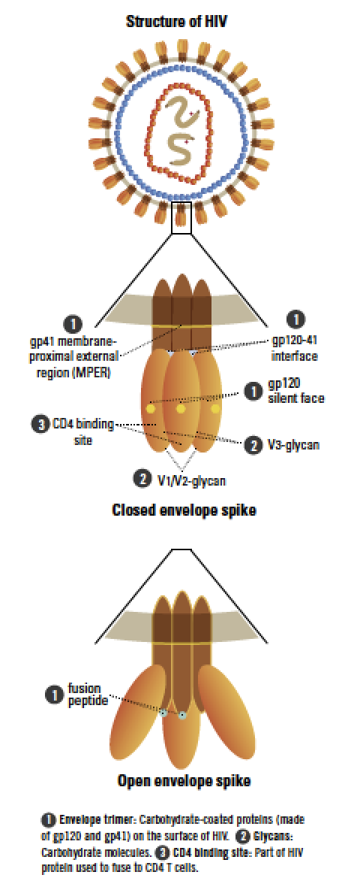
Antibody Research
Broadly neutralizing antibodies (bNAbs) – specialized antibodies that bind to and neutralize multiple strains of HIV
Numerous bNAbs discovered since 2009
Five main targets of bNAbs on the virus envelope
bNAb research may provide insights into vaccine development and/or could be the basis for a prevention strategy on its own
Notes:
Another strategy that has shown great potential is the use of broadly neutralizing antibodies (bNAbs). (As a reminder, antibodies bind to the surface of pathogens to defend the host against them).
Scientists have mapped the shape and structure of these bNAbs and identified the points of contact (binding sites, shown in the graphic) between the antibody and the virus. Understanding the shape of the binding sites for bNAbs is thought to be key to developing a preventive vaccine. An effective immune response will generate bNAbs that can bind to those sites. (A person’s immune system does not make anti-HIV bNAbs until after they have acquired HIV. Most often, it takes a long time after infection for a person’s body to produce bNAbs.)
In addition to informing vaccine design, scientists are also studying whether direct transfer (through intravenous drip) of bNAbs could provide protection to HIV-uninfected individuals and help infected individuals control the virus. This strategy is called passive immunization.
Scientists are also studying whether directly giving bNAb genes (instead of the bNAbs as the final protein products) by immunization could provide protection. This strategy is called gene transfer.

Slide 13
Antibody Research
Direct transfer of antibodies (passive immunization) being tested for prevention, treatment and as part of cure
  Multiple bNAbs tested in early clinical trials: www.bnaber.org
  Many show safety, tolerability, viral reduction among HIV-positive participants
  First proof-of-concept studies of bNAb VRC01 for prevention, the AMP studies, initiated in 2016 and are fully enrolled as of Oct 2018: www.ampstudy.org, www.ampstudy.org.za (see next slide)
  Researchers are identifying and developing more powerful antibodies and easier ways of delivering them
Early phase studies are also testing combination bNAb approaches
Notes:
In addition to informing vaccine design, scientists are also studying whether direct transfer of bNAbs could provide protection to HIV-uninfected individuals and help infected individuals control the virus. This strategy is called passive immunization. However, since it wouldn’t be the body making the antibodies, the levels of infused bNAbs—and any protection they might provide against HIV—would diminish over time.
As of 2019, two large-scale, proof of concept studies (the Antibody Mediated Prevention studies) are testing the safety and efficacy of direct infusions (intravenous drips) of the bNAb VRCO1 in men and transgender people who have sex with men in sites across Brazil, Peru, Switzerland and the US; and in women in sites across sub-Saharan Africa. The trial was fully enrolled as of Oct 2018. Results of this study will help inform antibody research, and help guide vaccine design. See the next slide for more information.

Slide 14
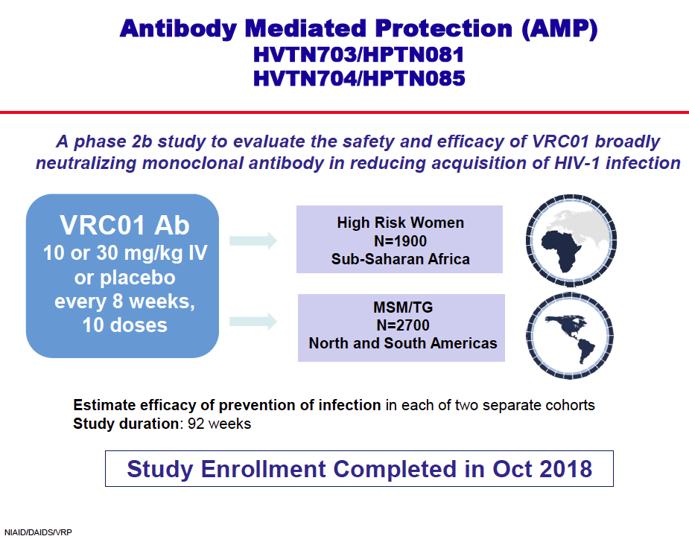
The AMP Studies
HVTN 703/HPTN 081
HVTN 704/HPTN 085
AMP = Antibody Mediated Protection
Phase IIb Proof of Concept Studies in North and South America, Europe, Sub-Saharan Africa
March 2016 – October 2020
Enrolled 1,900 women and 2,700 men and transgender people who have sex with men; completed enrollment in October 2018
To evaluate safety and efficacy of VRC01 broadly neutralizing monoclonal antibody in reducing HIV infection
Notes:
This slide provides the basic overview of the AMP studies. The trial is now fully enrolled.
Participants are randomized to receive either a low dose of VRC01, a high dose of VRC01 or a placebo through an intravenous (IV) drip at weeks 0, 8, 16, 24, 32, 40, 48, 56, 64, and 72 (10 doses total).

Slide 15
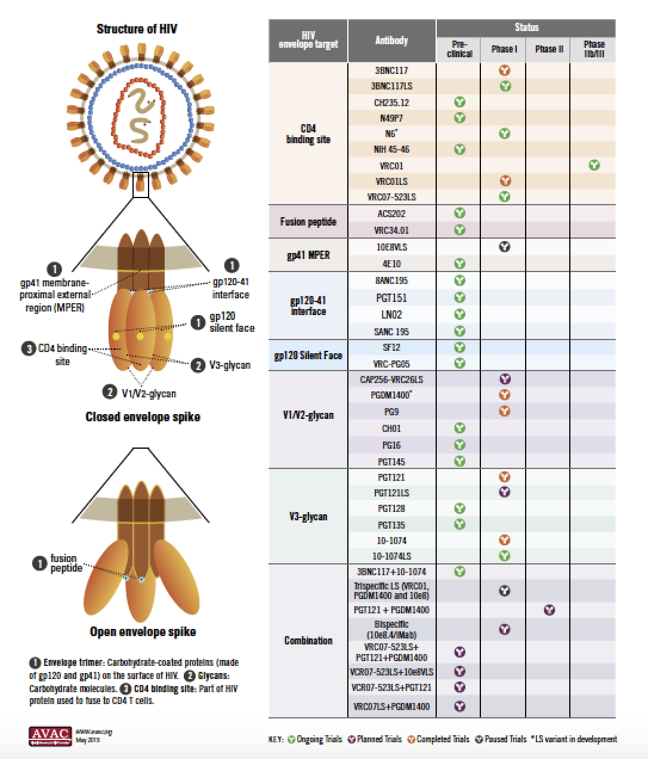
Antibody Research Pipeline
Notes:
Other ’next generation’ antibodies are currently being developed to be able to last longer in the body, to work against a wide range of HIV strains, and be administered via different routes (including subcutaneously). Some of these bNAbs, including a variant of VRCO1 (VRCO1LS) are moving to early phase studies.
The graphic shows key sites on the HIV viral envelope, and the important bNAbs that that bind to those sites to neutralize the virus. The graphic also identifies the bNAbs currently being studied in human clinical trials.

Slide 16
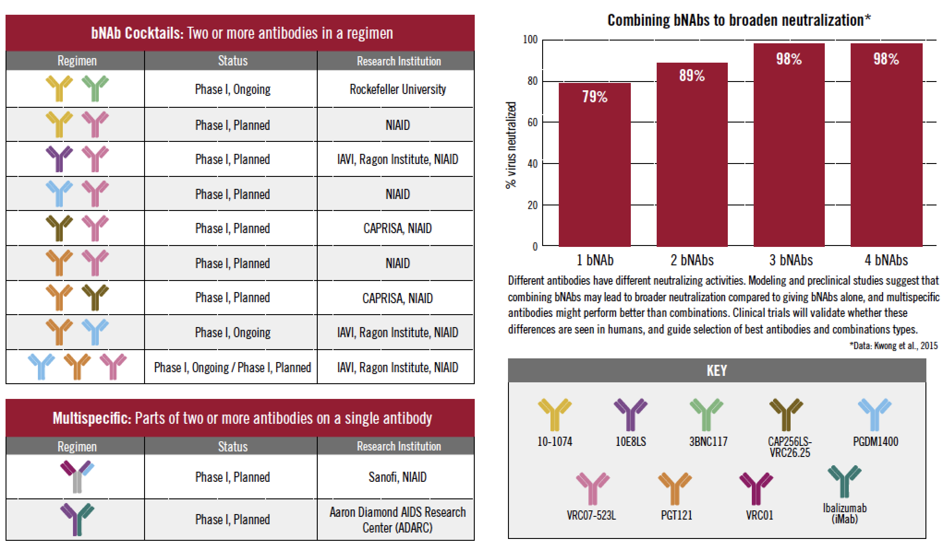
Combo Antibody Research Pipeline
*
Notes:
As with antiretroviral combinations, passive immunization of broadly neutralizing antibodies (bNAbs) to protect against HIV will likely require two or more bNAbs that target different parts of the virus. Combining bNAbs may be necessary to overcome HIV’s diversity, avoid resistance and improve antibodies’ performance. There are many factors to consider when selecting bNAb combinations, including how many bNAbs and which ones work best together.
Here we outline the bNAb combinations being explored in early clinical studies.

Slide 17
Advocates’ Checklist
Emphasize that sustained control and the eventual end of the HIV epidemic will depend on a range of methods, including a vaccine and other methods that provide long-lasting protection
Promote continued investment – public and private – to sustain momentum in HIV vaccine research
Ensure vaccine trials are well-conducted, conform to Good Participatory Practices, and react quickly to the changing realities of the HIV response
Demand that stakeholders have a role in planning with researchers for outcomes and next steps from ongoing vaccine trials
Support global partnerships to ensure researchers work together to manage the pipeline of vaccine and antibody candidates
Notes:
The momentum in the field shows an HIV vaccine is possible and an important part of a comprehensive, integrated and sustained strategy.
HIV vaccine development requires sustained financial support and is a wise investment
Researchers, advocates and communities must work together to ensure that trials conform to GPP
Advocates should demand that stakeholders have a role in planning for outcomes and next steps from ongoing trials
Global partnerships have made a positive impact on the HIV vaccine field and are essential for success moving forward

Slide 18
Key Resources
AVAC: www.avac.org/vaccines
Center for HIV/AIDS Vaccine Immunology and Immunogen Discovery (CHAVI-ID)
    Duke: www.chavi-id-duke.org; Scripps: www.cavi-id.org
Collaboration for AIDS Vaccine Discovery: www.cavd.org
European AIDS Vaccine Initiative (EAVI 2020): www.eavi2020.eu
European HIV Vaccine Alliance (EHVA): www.ehv-a.eu
Global HIV Vaccine Enterprise: www.vaccineenterprise.org & http://www.iasociety.org/Global-HIV-Vaccine-Enterprise
HIV Px R&D Database (PxRD): http://www.avac.org/pxrd
HIV Vaccines & Microbicides Resource Tracking Working Group: www.hivresourcetracking.org
HIV Vaccine Trials Network (HVTN): www.hvtn.org
International AIDS Vaccine Initiative (IAVI): www.iavi.org
NIAID: www.niaid.nih.gov/topics/hivaids/research/vaccines/Pages/default.aspx
NIH Vaccine Research Center (VRC): www.vrc.nih.gov
Pox-Protein Public-Private Partnership (P5): www.hivresearch.org/media/pnc/9/media.749.pdf
US Military HIV Research Program (MHRP): www.hivresearch.org
Vaccine Advocacy Resource Group (VARG): http://www.thevarg.org

Slide 19
Connect with AVAC
Questions, comments and requests for materials should be sent to avac@avac.org
Information about HIV prevention generally at www.avac.org and vaccines specifically at www.avac.org/prevention-option/hiv-vaccine
For the latest news and updates, sign up for our Advocates’ Network mailing list at www.avac.org/signup or follow us on Facebook at www.facebook.com/hivpxresearch and on Twitter at www.twitter.com/hivpxresearch

