Slide 1
HIV Vaccines
The Basics and Status Update
May 18, 2021

Slide 2
Overview
What is a vaccine?
Why we need an HIV vaccine
HIV vaccine approaches
Immune responses
What are the challenges and opportunities for HIV vaccine development?
Current HIV vaccine efficacy trials
Vaccine hesitancy
Building on Lessons from COVID
Key resources

Slide 3
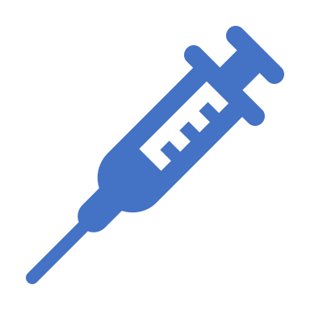
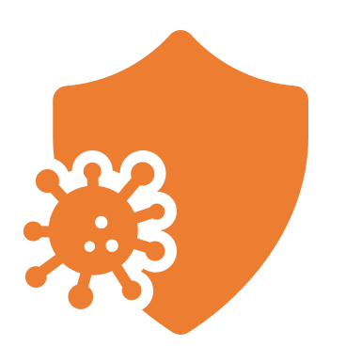
What is a Vaccine?
A substance that teaches the body how to recognize and protect itself against a disease-causing agent, e.g. a virus or bacterium
The body is exposed to a substance designed to elicit an immune response
The immune system mounts an immune response and ‘memory’ against the pathogen
If the immune system is exposed to the pathogen again, it will be prepared to prevent and/or control infection
Most licensed vaccines are over 90 percent effective
No effective HIV vaccine is available today
HIV vaccines cannot cause HIV

Slide 4
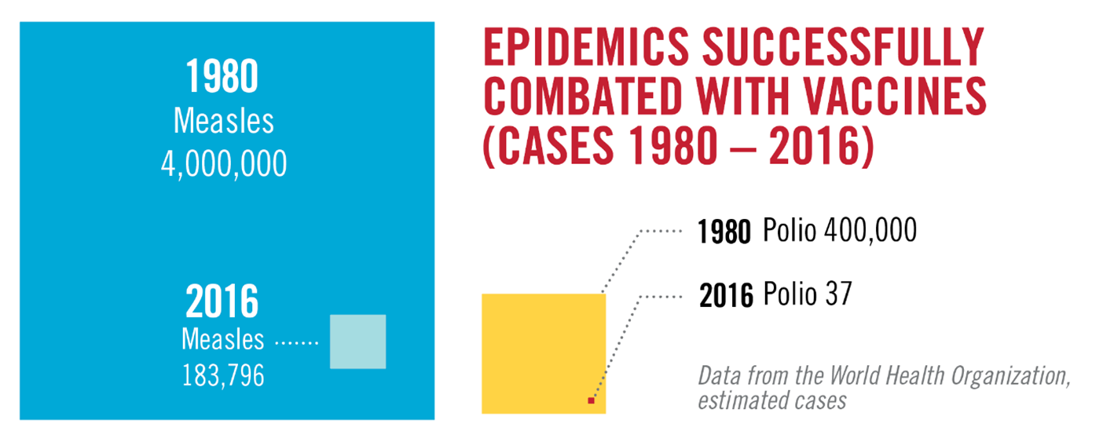
Vaccines Work
Notes:
Vaccines that protect people from getting infected are powerful and effective tools to control and even eradicate diseases. We hope one day an HIV vaccine will be added to the list of successful vaccines.
In 1980 there were 4 million cases of measles. Due to widespread global vaccination with the measles vaccine (standalone or in combination with rubella and mumps vaccine), cases of measles dropped substantially to less than 200,000 in 2016.
The polio epidemic has been successfully controlled because of the development of a polio vaccine and global vaccination efforts, which began in 1988. Cases of polio dramatically reduced from 400,000 in 1980 to 37 in 2016.

Slide 5
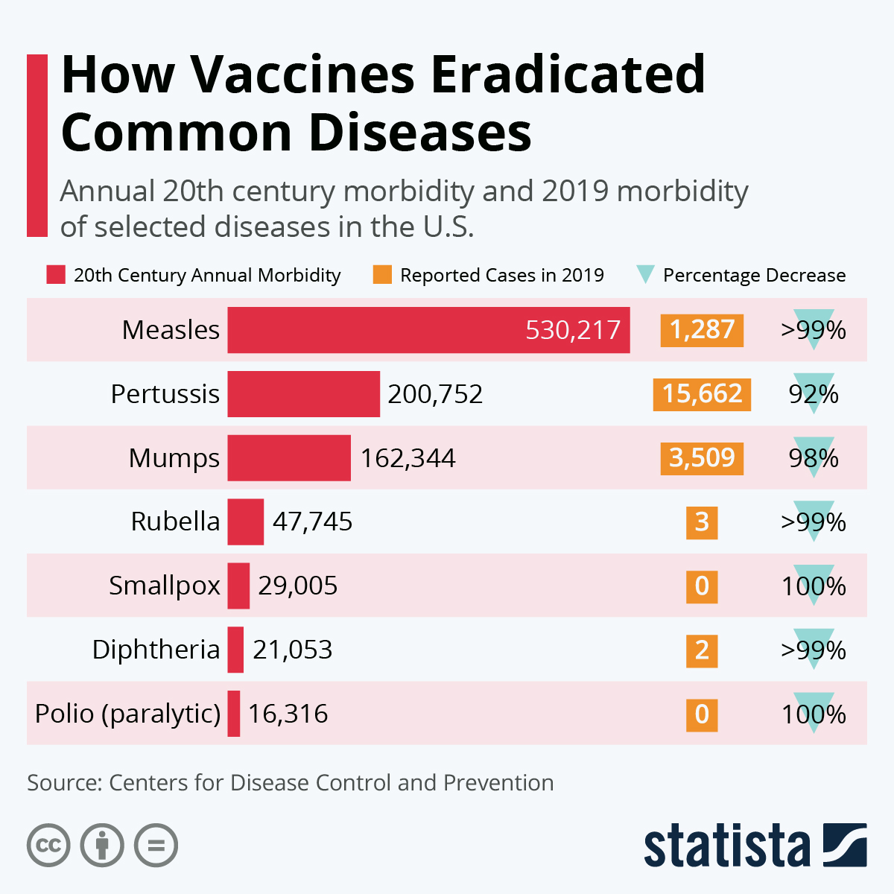
Vaccines Work
Vaccines are one of the most powerful public health tools available.
Smallpox has been eradicated because of vaccines.
Diseases such as polio and measles have become exceedingly rare because of vaccines.
Vaccines will be essential to ending the COVID-19 pandemic, and ending the global health challenge of HIV

Slide 6
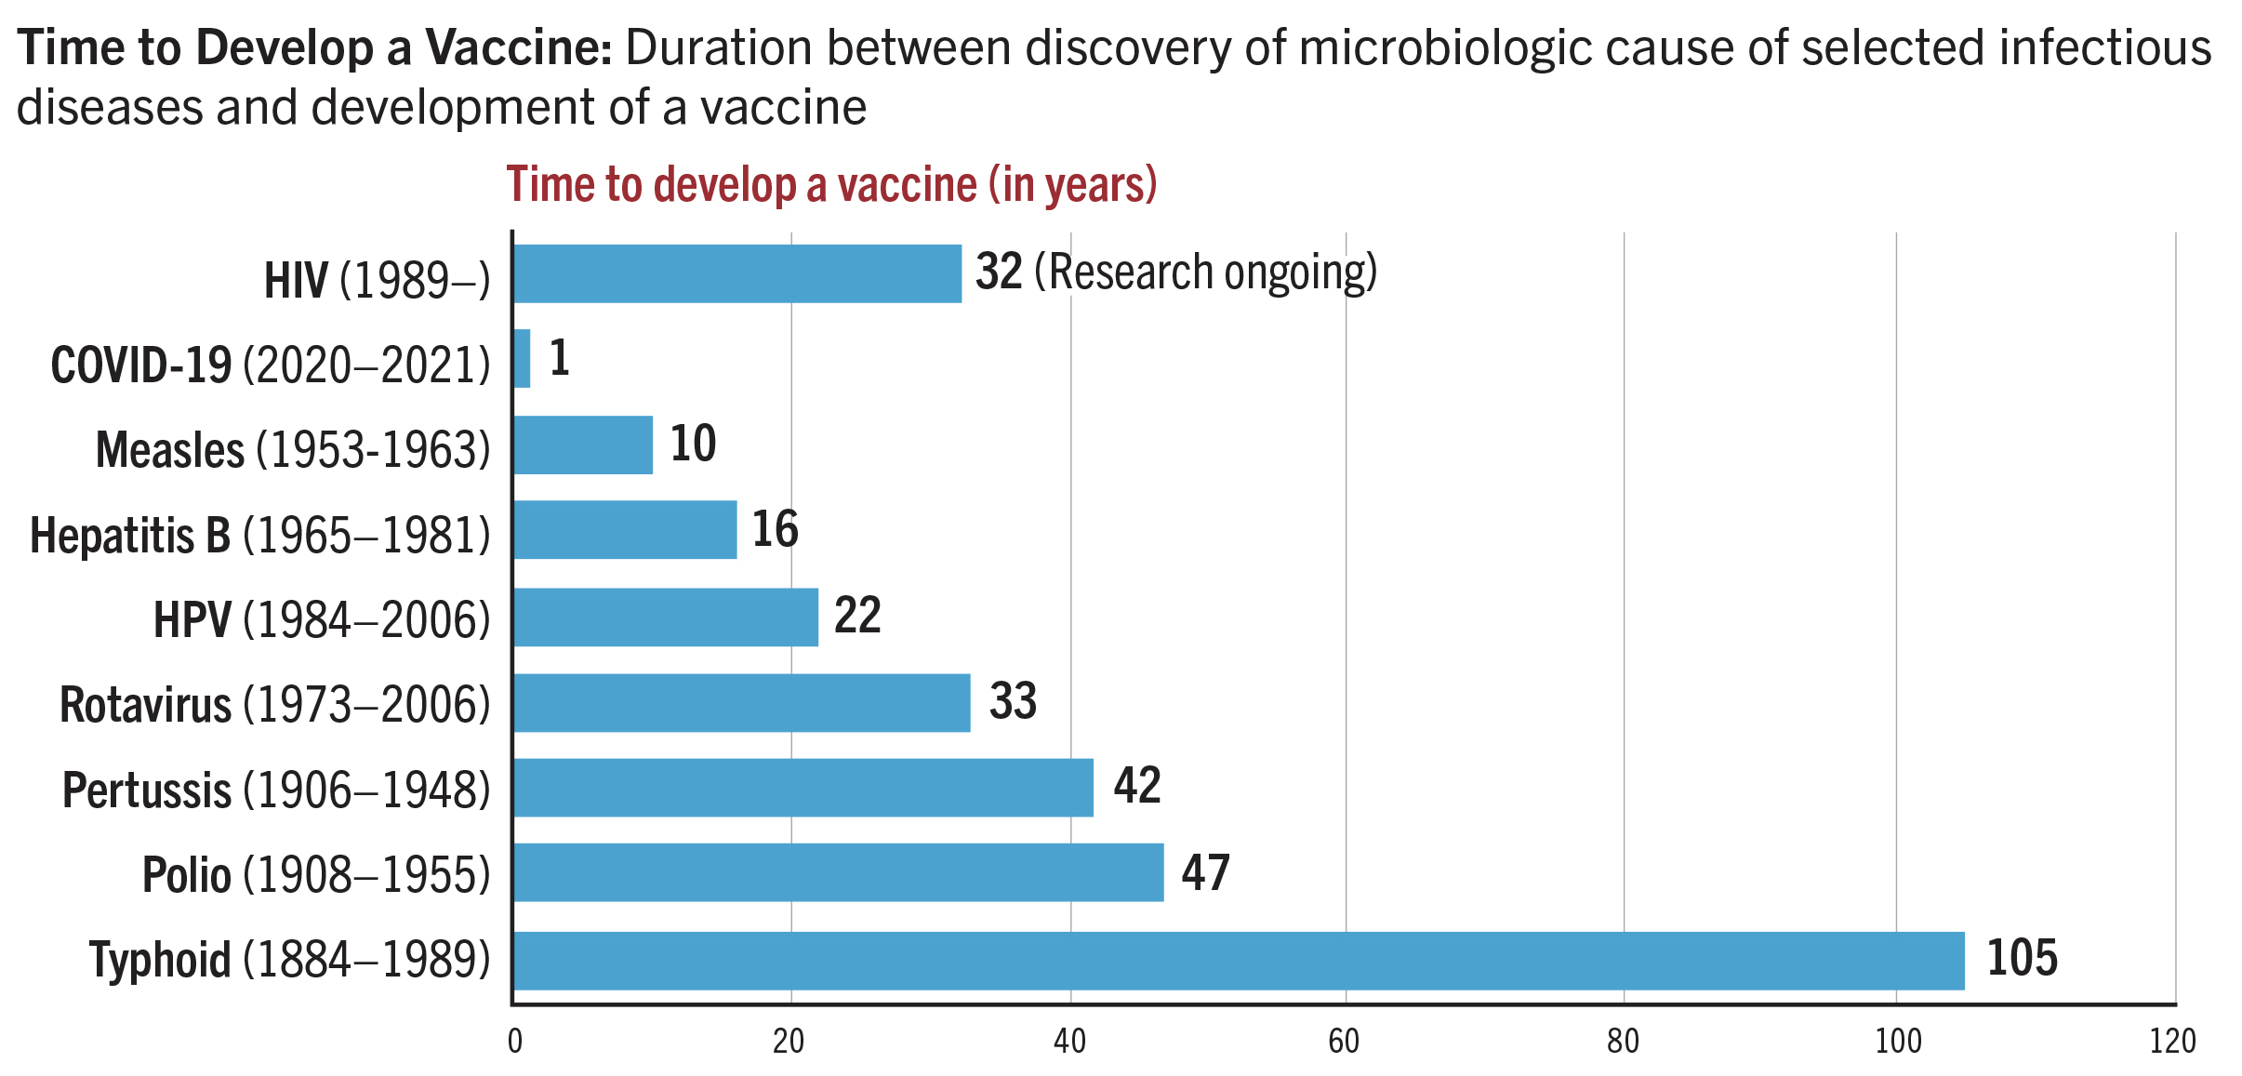
Vaccine Development in History
Notes:
It can take a long time to develop a vaccine, even after we know the cause of a disease.
While this long time-frame is especially frustrating with HIV, we are actually on par with the timelines seen for other diseases.
See “Developing an HIV Vaccine is Difficult” slide for further info.

Slide 7
Why is an HIV Vaccine Needed?
The use of available prevention and treatment has slowed HIV’s spread, but over a million people continue to get newly infected each year
To end the epidemic, a safe and effective HIV vaccine is needed.
Notes:
Why is an HIV vaccine needed? Proven HIV prevention options (i.e., oral PrEP, male and female condoms, behavior change counseling, voluntary medical male circumcision, treatment as prevention, needle exchange, harm reduction) have slowed the spread of HIV, but thousands of people continue to get infected daily.
Many of today’s HIV prevention methods require daily use or regular adherence. A vaccine requiring just several shots to provide long-lasting protection might be easier to deliver than many current HIV prevention strategies, and when used in combination with other proven options, could help end the epidemic.
Vaccines are the world’s most effective public health tools.
Because a single or several doses can provide protection for years, they are usually very cost-effective compared to treatment. But, we won’t know actual cost for an HIV vaccine until we have one.

Slide 8
Types of HIV Vaccines in Research
Preventive vaccines
Designed for people who are not infected with HIV, to:
reduce the risk of infection
reduce viral load following infection, allowing the body to better control the disease
Therapeutic vaccines
Designed for people who are living with HIV, to:
train the body’s immune system to help control HIV in the body
The remainder of this presentation will focus on preventive vaccines
Notes:
Most research focuses on preventive HIV vaccines to lower the risk of infection for people who are not infected with HIV.
The viral load set point is the amount of virus (measured by HIV RNA) that the body settles at within a few weeks to months after infection with HIV. Immediately after infection, HIV multiplies rapidly and a person’s viral load is typically very high. After a few weeks to months, this rapid replication of HIV declines and the person's viral load drops to its set point.
Therapeutic vaccines are relatively newer; they are being explored for various diseases, including HIV and certain cancers. The first therapeutic cancer vaccine was licensed by the US Food and Drug Administration in 2010.

Slide 9
How Might an HIV Vaccine Work?
A preventive vaccine would teach the body to recognize and fight HIV
The vaccine would carry or induce the production of a component that ‘looks and feels’ like a part of HIV
The body would react by generating an immune response (antibodies and/or killer cells and a memory response), which would prevent and/or control HIV infection
The whole virus – killed or weakened – is not used in experimental HIV vaccines. A HIV vaccine cannot cause HIV infection
Notes:
When you are vaccinated, a small piece of the virus or a copy of the virus is introduced into your blood in a weakened, killed or simulated version.
In making HIV vaccines, pieces of the virus are copied; the whole virus is not being used, which is one of the reasons we can confidently say that HIV vaccines cannot cause infection. Many different parts of the HIV virus are currently being explored to form a vaccine (including some of the key proteins that make up the envelope, DNA fragments and more).
An HIV vaccine would introduce these virus copies into your bloodstream to generate an immune response. Your body would then react by creating the right antibodies or killer cells. These stay in your bloodstream.
Your body is now primed to fight HIV because these antibodies and killer cells stay in your bloodstream. As a result, if you were to be exposed to the real virus, the antibodies and killer cells would be there already, waiting to attack it.

Slide 10
Why HIV Vaccine Development is Challenging
No roadmap of protection
Nobody has ever eliminated HIV with their own immune system
Viral Variability
HIV makes many copies of itself and mutates, making it unrecognizable to the immune system and leading to different subtypes of the virus throughout the world
Immune-targeting
HIV kills the very immune cells the body uses to defend against disease
Transmission
Transmission of HIV happens in multiple different ways
Notes:
Developing an HIV vaccine is challenging for a number of reasons:
Our bodies are not able to mount an effective immune response and clear HIV on their own. When making an HIV vaccine, this means scientists are in uncharted territory. They must develop a vaccine that stimulates a stronger immune response than what the body can do on its own.
The virus is extremely effective at evading the immune system because it can mutate (change its outer layer) within an individual, meaning it can learn how to avoid the effects of a vaccine. Mutation also leads to different subtypes (or clades) of the virus throughout the world. Each subtype reacts differently to different vaccine candidates. For this reason, testing in many countries is necessary.
HIV kills the very immune cells (T Cells) the body uses to defend against disease.
HIV is transmitted in various ways.

Slide 11
Types of Vaccines
Vaccines are developed using various ‘platforms’
DNA-based vaccines work by inserting synthetic DNA of viral gene(s) into small DNA molecules (called plasmids). Cells take in the DNA plasmids and follow their instructions to build viral proteins, which are recognized by the immune system, and prepare it to respond to disease exposure
Viral vector vaccines insert a gene for a viral protein into another, harmless virus (replicating or non-replicating), which delivers the viral protein to the vaccine recipient, triggering an immune response.
RNA vaccines introduce an mRNA sequence coded for a disease-specific antigen. Once this antigen is reproduced within the body, it is recognized and triggers an immune response
Subunit vaccines introduce a fragment of the virus into the body. This fragment is enough to be recognized by the immune response and stimulate immunity.
Inactivated vaccines consist of the whole virus, which has been killed with heat or chemicals so it can't cause illness.
Live attenuated vaccines are made up of whole viruses that have weakened in a lab. They tend to elicit a stronger immune response than inactivated vaccines.
Notes:
This slide shows vaccine platforms generally. HIV vaccine research is currently using only DNA and viral vector platforms. Plans are underway to apply mRNA technology.

Slide 12
HIV Vaccine Strategies
Viral vector
Viral vector vaccines insert a gene for a viral protein into another, harmless virus (replicating or non-replicating). The viral protein triggers an immune response. Replicating viral vectors are able to produce copies of the viral protein, potentially triggering an enhanced immune response
DNA-based
Work by inserting synthetic DNA of viral gene(s) into small DNA molecules called plasmids. DNA cells take in the DNA plasmids and follow their instructions to build HIV viral proteins, which are recognized by the immune system, and prepare it to fight the disease.
Germline targeting
An approach where the immune system is manipulated to elicit a very specific antibody response, through a process known as ‘affinity maturation’.
Notes:
Article on germline targeting: https://www.thebody.com/article/new-research-findings-could-lead-to-hiv-vaccine

Slide 13
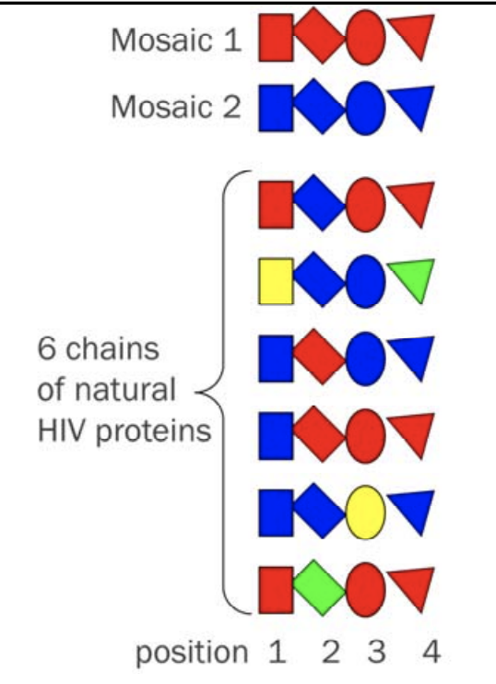
“Mosaic" Vaccines
A so-called “mosaic" vaccine is designed to create immune responses to multiple HIV clades
A mosaic will not look anything like a natural virus
Several mosaics used together in a vaccine could provide broader coverage
Mosaic immunogens can be inserted into viral vectors, e.g. Adenoviruses
Adapted from ‘An Introduction to Mosaic Vaccines for HIV Prevention’, presented by Gail B. Broder, MHS, of the HVTN. Available here: https://www.avac.org/sites/default/files/resource-files/THIS%20IntroMosaicVaxx_AVACposting_notes%5B1%5D.pdf
Notes:
Mosaic vaccines offer one strategy for overcoming the challenge of constantly mutating HIV. Mosaic vaccines are currently under investigation in vaccine research trials.
Proteins are made from chains of amino acids. These amino acids have to be assembled in just the right order to make the proper protein. With a mosaic vaccine, the idea is that the chain of amino acids represented by the mosaic will look like the most common features of HIV that your body might be exposed to in a natural infection.
At the bottom of this graphic you can see six chains of proteins taken from different people who are infected with HIV. The mosaic sequences at the top are formed by taking the most common pieces of protein found at each position in the chain when many versions of a naturally occurring HIV protein are compared. (i.e. blue rectangles are the most common in position 1 and 2, red circles in position 3, and red triangles in position 4).
The hope is that through this design, a mosaic vaccine will help the body recognize and produce a strong immune response against all clades of HIV– likely a key necessity for a global vaccine.

Slide 14
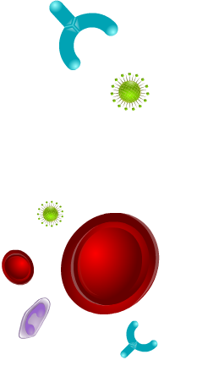
Immune Responses: Humoral
Preventive HIV vaccines are designed to elicit two arms of the immune system – humoral and cellular
Humoral immunity
Primary action of humoral arm is creating antibodies: Y-shaped proteins produced by B cells in response to a pathogen to prevent infection
Antibodies have multiple functions: attaching to and helping destroy pathogens (opsonization), keeping the pathogens from entering host cells (neutralization) and calling other cells into action (sensitization).
Antibody
HIV virus
B cell
Notes:
Preventive vaccines seek to stimulate one or two parts of the immune system.
The first line is the humoral. The part of your acquired immune system that creates antibodies (mainly B cells). These are proteins shaped to attach to a specific part of invaders like HIV. They lock onto the outside of the pathogen/invader and coat it, making it inactive and marking it so other immune cells can come and kill it. Antibodies also prevent the virus from entering the host cells, preventing infection altogether (neutralization) and call other cells into action to help block and/or limit the activity of pathogens.
How does this relate to HIV? Our immune system has a hard time fighting off HIV because the virus can change its outer layer to avoid recognition of antibodies.

Slide 15
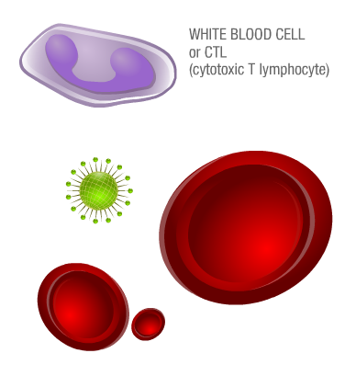
Immune Responses: Cellular
Preventive HIV vaccines are designed to elicit two arms of the immune system – humoral and cellular
Cellular immunity
T cells recognize HIV-infected cells. There are two types:
T-helper cells coordinate the immune response
Cytotoxic T lymphocytes (CTLs) kill infected cells
HIV virus
B cells
Notes:
Cellular immunity seeks out already infected cells to kill them, helping to control the foreign invader that has already taken hold in the body’s cells. This process is coordinated by T cells (cytotoxic/killer T cells and helper T cells).
T-helper cells coordinate the immune response and prompt other parts of the immune system to act. Cytotoxic T lymphocytes (CTLs) kill infected cells. Because the HIV virus needs to be inside human cells to make more copies of itself, killing these infected cells helps to control the replication of the virus. Vaccines using this part of the immune system are referred to as “T cell based”.
How does this relate to HIV? T cells recognize HIV-infected cells. T cells are also the targets of HIV, so they become infected themselves. HIV hijacks the very immune cells used to fight the virus.

Slide 16
Eliciting HIV Immune Responses
Scientists are exploring many types of HIV vaccines designed to elicit different immune responses
T cell-mediated response: Stimulate branch of immune system (mainly T cells) that recognizes and destroys cells infected with HIV so it cannot multiply and spread
Neutralizing antibody response: Induce antibodies that block HIV in the blood, preventing HIV from infecting the body’s cells
Non-neutralizing antibody response: Induce antibodies that recognize HIV and recruit other immune cells to help destroy the virus
Combination responses: Stimulate multiple parts of the adaptive immune system to recognize and defend the body against HIV
Notes:
Because we don’t yet know which immune response will protect against HIV, scientists are exploring many types of vaccines designed to elicit different immune responses:
T-cell mediated response: Stimulate branch of immune system (mainly T cells) that recognizes and destroys cells infected with HIV so it cannot multiply and spread.
Neutralizing antibody response: Induce antibodies that block HIV in the blood, preventing HIV from infecting the body’s cells.
Non-neutralizing antibody response: Induce antibodies that recognize HIV and recruit other immune cells to help destroy the virus.
Combination responses: Stimulate multiple parts of the adaptive immune system to recognize and defend the body against HIV.

Slide 17
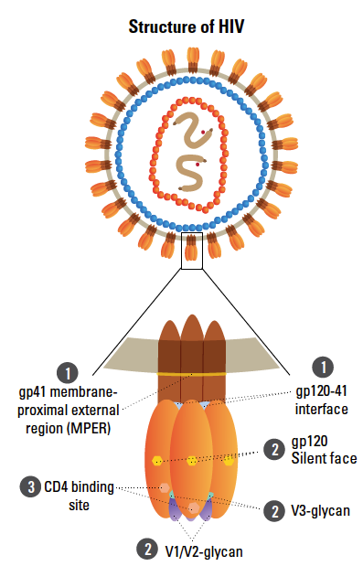
Antibody Research
Broadly neutralizing antibodies (bNAbs) – specialized antibodies that bind to and neutralize multiple strains of HIV
Numerous bNAbs discovered since 2009
Five main targets of bNAbs on the virus envelope
bNAb research (and the recent AMP study results) may provide insights into vaccine development
A germline-targeting vaccine designed to elicit antibody maturation has shown success in a Phase I trial in humans (IAVI-G001 trial). Plans are underway to deliver this vaccine using mRNA technology.
Notes:
Another strategy that has shown great potential is the use of broadly neutralizing antibodies (bNAbs). (As a reminder, antibodies bind to the surface of pathogens to defend the host against them).
Scientists have mapped the shape and structure of these bNAbs and identified the points of contact (binding sites, shown in the graphic) between the antibody and the virus. Understanding the shape of the binding sites for bNAbs is thought to be key to developing a preventive vaccine. An effective immune response will generate bNAbs that can bind to those sites. (A person’s immune system does not make anti-HIV bNAbs until after they have acquired HIV. Most often, it takes a long time after infection for a person’s body to produce bNAbs.)
In addition to informing vaccine design, scientists are also studying whether direct transfer (through intravenous drip) of bNAbs could provide protection to HIV-uninfected individuals and help infected individuals control the virus. This strategy is called passive immunization.
Scientists are also studying whether directly giving bNAb genes (instead of the bNAbs as the final protein products) by immunization could provide protection. This strategy is called gene transfer.

Slide 18
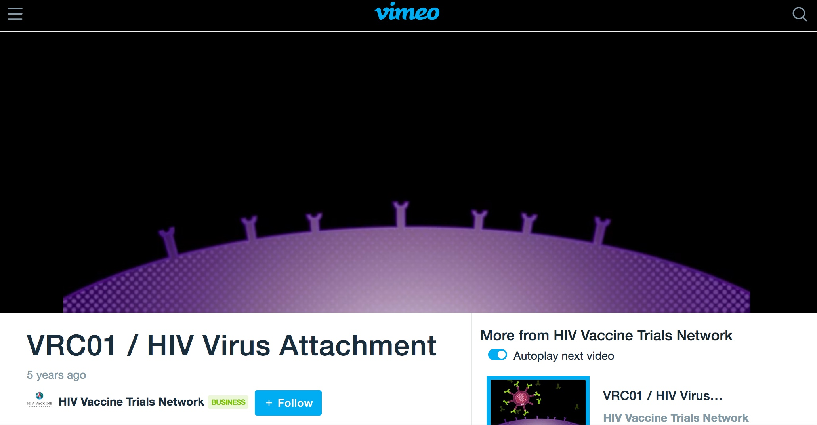
Antibody Research
https://vimeo.com/138669232
Notes:
This video shows how an antibody is designed to work, by attaching to the spikes of the HIV virus

Slide 19
Antibody Research: AMP trial results
The results of the AMP trial, testing whether infusions a broadly neutralizing antibody (bNAb), VRC-01, could prevent HIV infection, were released in 2021.The results suggest that:
An antibody can partially protect people against HIV strains that are very sensitive to VRC-01
A single antibody may not be protective
A better understanding of the types of HIV that are circulating in a community is critical.
https://www.avac.org/prevention-option/antibody-related-research
https://www.nejm.org/doi/full/10.1056/NEJMe2101131
https://www.avac.org/podcast/amp-trials
Notes:
Another strategy that has shown great potential is the use of broadly neutralizing antibodies (bNAbs). (As a reminder, antibodies bind to the surface of pathogens to defend the host against them).
Scientists have mapped the shape and structure of these bNAbs and identified the points of contact (binding sites, shown in the graphic) between the antibody and the virus. Understanding the shape of the binding sites for bNAbs is thought to be key to developing a preventive vaccine. An effective immune response will generate bNAbs that can bind to those sites. (A person’s immune system does not make anti-HIV bNAbs until after they have acquired HIV. Most often, it takes a long time after infection for a person’s body to produce bNAbs.)
In addition to informing vaccine design, scientists are also studying whether direct transfer (through intravenous drip) of bNAbs could provide protection to HIV-uninfected individuals and help infected individuals control the virus. This strategy is called passive immunization.
Scientists are also studying whether directly giving bNAb genes (instead of the bNAbs as the final protein products) by immunization could provide protection. This strategy is called gene transfer.

Slide 20
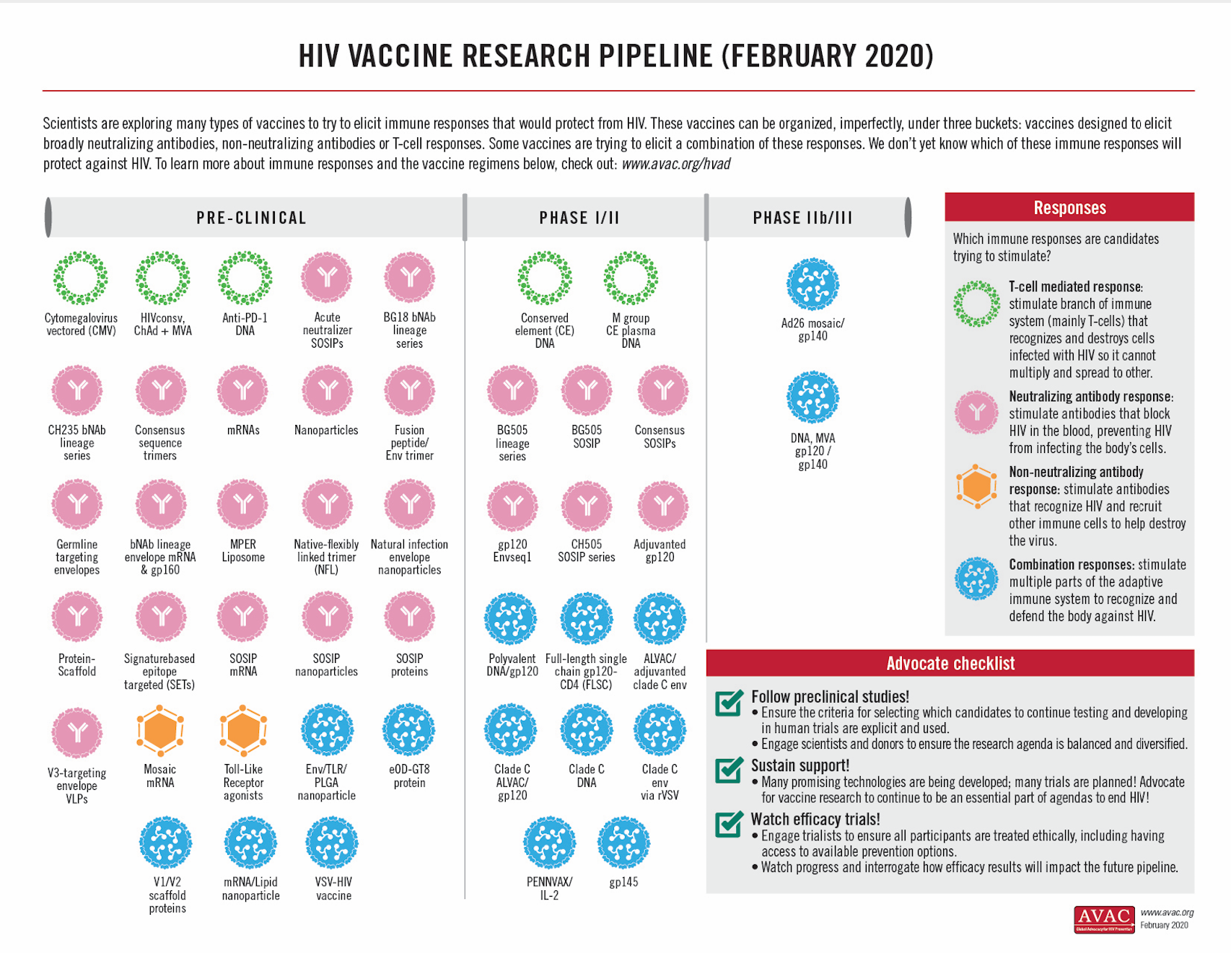
Sustaining HIV Vaccine Research
https://www.avac.org/infographic/vaccine-pipeline
Notes:
While other interventions are rolling out, HIV vaccine research must continue, and we must advocate for research to continue to ensure sustained decline in infections and a durable end to the epidemic.
A successful response to the HIV epidemic requires a range of prevention methods; there is no silver bullet.
Other HIV prevention options are needed in tandem with a vaccine for a number of reasons:
An HIV vaccine will likely be delivered through a series of shots. An individual won’t experience full protection until receiving the final shot in the series, and will therefore need another prevention method to provide protection in the interim.
If an HIV vaccine does not achieve adequately high efficacy, other prevention options might be recommended for individuals at particularly high risk.
Even if an adequately efficacious vaccine is discovered, alternative prevention methods will likely be needed until the vaccine can be fully scaled up and sustainably accessible (available and affordable) in all parts of the world. This requires sustainable investments, effective health delivery systems, health worker training, education campaigns and buy-in and collaboration of global partnerships, governments and public and private stakeholders.
Not everyone may choose a vaccine for prevention. Investigation has shown that some individuals, especially those who go through periods of risk in their lives, may prefer to have something that would clear the system and/or that they could control, like an ARV-based product that is delivered on a more regular basis.

Slide 21
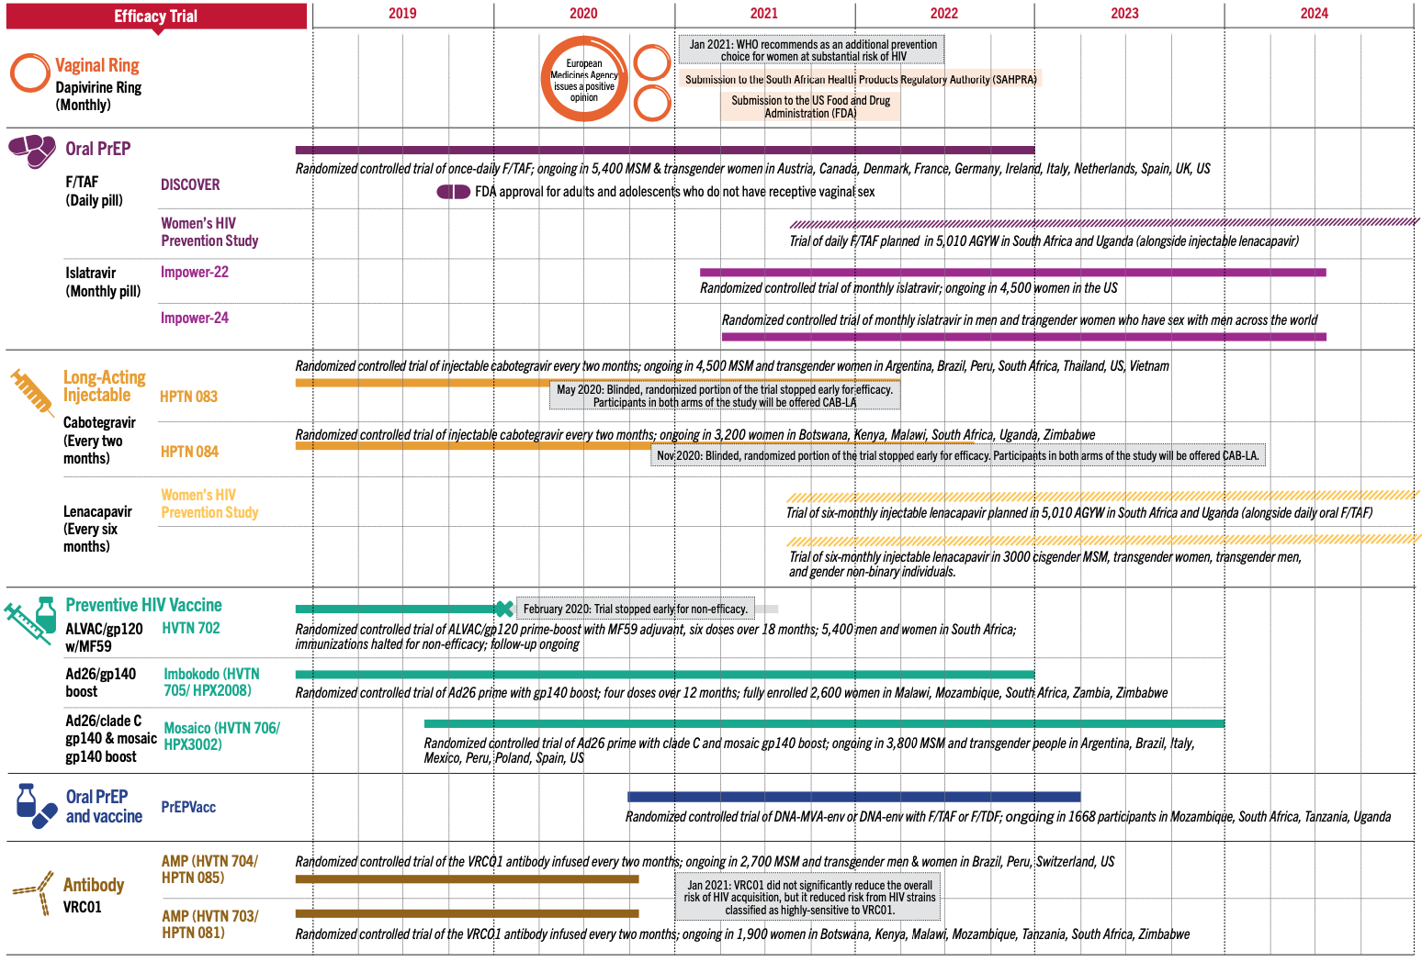
Current HIV Prevention Trials
https://www.avac.org/sites/default/files/infographics/YearsAheadHIVPreventionResearch_April15_2021.png
Notes:
This graphic shows the updated status of large-scale prevention trials through 2024. The research pipeline is robust, with trials of new, long-acting PrEP agents (monthly pill, monthly injection (for cis-women), 6-monthly injection, and two large vaccine studies.

Slide 22
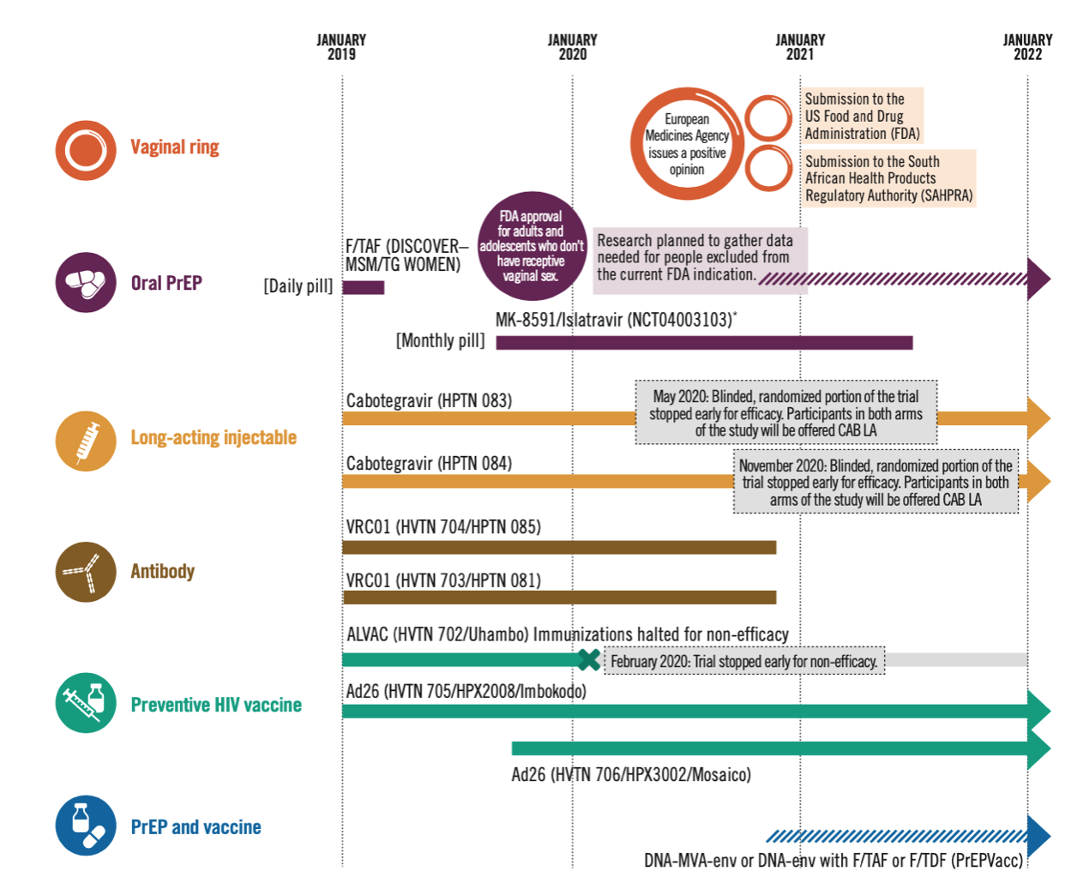
Current HIV Prevention Trials
Notes:
This graphic also shows the updated status of large-scale prevention trials through 2024, focusing in on the vaccine efficacy trials

Slide 23
Current HIV Vaccine Trials
https://www.avac.org/sites/default/files/infographics/BiomedicalHIVpreventTrials_Nov2020.png
Notes:
This graphic focuses in on the vaccine efficacy trials

Slide 24
Current HIV Vaccine Trials
Vaccine Trial | Regimen | Trial Participants (Duration)
Uhambo HVTN 702 | ALVAC/gp120 MF59 adjuvant boost, 5 doses in 12 months (placebo-controlled) | 5,400 Men & women in South Africa/ (2018- 2020)
Imbokodo HPX2008/ HVTN705 | Ad26/Mosaic + gp140 boost (placebo-controlled) | 2,600 Cis-gender Women in Malawi, Mozambique, South Africa, Zambia, Zimbabwe (2018-2022)
MOSAICO HPHPX3002/HVTN706 | Ad26.Mos4.HIV + Adjuvanted Clade C gp140 and Mosaic gp140 boost (placebo-controlled) | 3800 MSM and Trans-Women USA, Argentina, Italy, Mexico, Peru, Poland, Spain (2019-2024)
PrEPVacc | Three-arm, two-stage HIV prophylactic vaccine trial with a second randomization Vaccine A: DNA/CN54gp140 (trimer) X2 + MVA/protein X2. Vaccine B: DNA/AIDSVAX* X 4. F/TAF (Descovy) TDF/FTC (Truvada) | Men and Women in Uganda, Tanzania, Mozambique, South Africa (2018–2023)
Stopped early for futility
Notes:
This table focuses in on current HIV vaccine efficacy trials

Slide 25
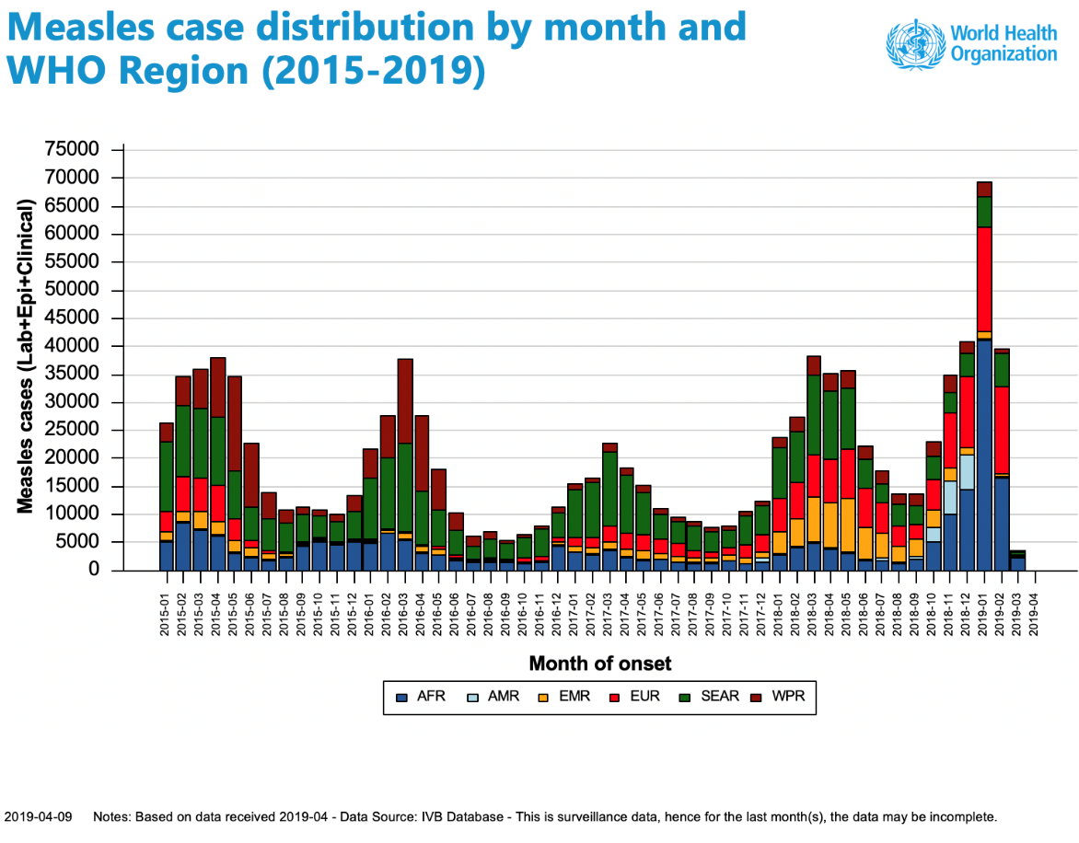
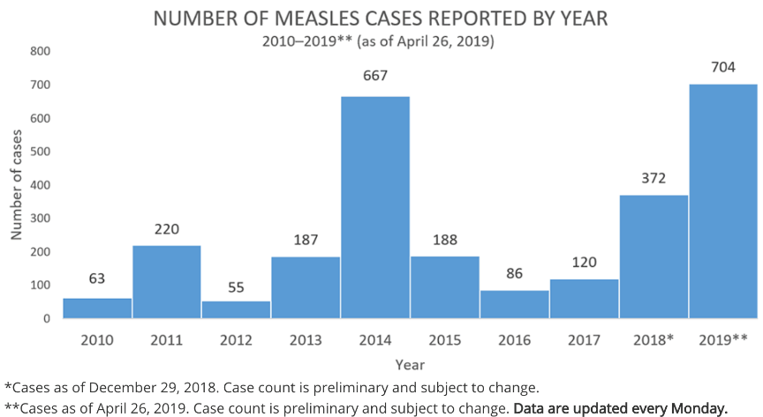
Vaccine Hesitancy
WHO declared ‘vaccine hesitancy’ one of the top 10 threats to global health in 2019
GLOBAL IMPACT
UNITED STATES
In 2019 a resurgence of vaccine hesitancy caused the greatest number of measles cases reported since 1994 and since measles was declared eliminated in the US in 2000.

Slide 26
Vaccine Hesitancy: COVID-19
The global COVID-19 pandemic has also exposed alarming rates of vaccine hesitancy, linked to a global “infodemic.” This may become a major obstacle for HIV vaccines, too.
Strong, consistent community engagement is key to building confidence in HIV vaccine research.
The Good Participatory Practice (GPP) guidelines. developed for HIV and recently updated for COVID, provide a critical roadmap for ethical, inclusive research practice.
Source: World Health Organization
Notes:
Not everyone believes in the power of vaccines, which has led to serious consequences.
In 2000, measles was considered eliminated in the US. Around 2018, vaccine hesitancy began causing a resurgence of measles, both in the US and globally.
The WHO named vaccine hesitancy as one of the top 10 threats to global health in 2019, further making the case for the importance of vaccines for sustainable disease control.

Slide 27
Vaccine Advocacy in 2021
HIV Vaccine Research: Building on Lessons from COVID
Sufficient and diversified research funding
Enhanced global coordination and collaboration
Support for research innovation and novel trial designs
Strengthened political commitment and urgency
Placing communities at the center of vaccine research
Planning early for success and equitable access
Notes:
Even though and an effective HIV vaccine may be years away, these lessons from COVID can help support and speed up the search for a safe and effective HIV vaccine:
1. Sufficient and diversified research funding
2. Enhanced global coordination and collaboration
3. Support for research innovation and novel trial designs
4. Strengthened political commitment and urgency
5. Placing communities at the center of vaccine research
6. Planning early for success and equitable access

Slide 28
Key Resources
AVAC: www.avac.org/vaccines
Center for HIV/AIDS Vaccine Immunology and Immunogen Discovery (CHAVI-ID)
At Duke: www.chavi-id-duke.org
At Scripps: www.cavi-id.org
Collaboration for AIDS Vaccine Discovery: www.cavd.org
European AIDS Vaccine Initiative (EAVI 2020): www.eavi2020.eu
European HIV Vaccine Alliance (EHVA): www.ehv-a.eu
Global HIV Vaccine Enterprise: https://www.iasociety.org/Global-HIV-Vaccine-Enterprise
HIV Px R&D Database (PxRD): http://www.avac.org/pxrd

Slide 29
Key Resources
HIV Vaccines & Microbicides Resource Tracking Working Group: www.hivresourcetracking.org
HIV Vaccine Trials Network (HVTN): www.hvtn.org
International AIDS Vaccine Initiative (IAVI): www.iavi.org
NIAID: www.niaid.nih.gov/topics/hivaids/research/vaccines/Pages/default.aspx
NIH Vaccine Research Center (VRC): www.vrc.nih.gov
PrEPVacc trial: https://www.prepvacc.org/
Pox-Protein Public-Private Partnership (P5): www.hivresearch.org/media/pnc/9/media.749.pdf
US Military HIV Research Program (MHRP): www.hivresearch.org
Vaccine Advocacy Resource Group (VARG): http://www.thevarg.org

Slide 30
Connect with AVAC
Questions, comments and requests for materials should be sent to avac@avac.org
Information about HIV prevention generally at www.avac.org and vaccines specifically at www.avac.org/prevention-option/hiv-vaccine
For the latest news and updates, sign up for our Advocates’ Network mailing list at www.avac.org/signup or follow us on Facebook at www.facebook.com/hivpxresearch and on Twitter at www.twitter.com/hivpxresearch

