Slide 1
The Next-Generation of Biomedical Prevention Now What
Mitchell Warren, Executive Director
7-8 October 2020
PEPFAR Scientific Advisory Board

Slide 2
Outline
Options and Choice
Balancing the Portfolio; Product Considerations; People Considerations
Timelines and Pipelines for Context
Dapivirine Vaginal Ring (DVR)
Long-acting Injectable Cabotegravir (CAB-LA)
Implications for PEPFAR

Slide 3
Prevention Paradigm circa 2006
Different Strokes for Different Folks
Method | Contraception | HIV Prevention
Behavior | ✓ | ✓
Barrier Methods | ✓ | ✓
Gels | ✓
Rings | ✓
Oral pill | ✓
Injectables | ✓
Implants | ✓
Surgical procedures | ✓
Treatment

Slide 4
Prevention Paradigm circa 2019
Different Strokes for Different Folks
Method | Contraception | HIV Prevention
Behavior | ✓ | ✓
Barrier Methods | ✓ | ✓
Gels | ✓ | ✓– not registered
Rings | ✓ | ✓– with regulatory body
Oral pill | ✓ | ✓
Injectables | ✓ | ? – 1 ARV, 1 bNAb, 2 vax in phase 3; others in development
Implants | ✓ | ? – multiple in preclinical
Surgical procedures | ✓ | ✓
Treatment |  | ✓

Slide 5
Prevention Paradigm 2020 & beyond
Different Strokes for Different Folks
Method | Contraception | HIV Prevention
Behavior | ✓ | ✓
Barrier Methods | ✓ | ✓
Gels | ✓ | ✓– not registered
Rings | ✓ | ✓– EMA positive opinion
Oral pill | ✓ | ✓✓(for some) ? – monthly, dual px in development
Injectables | ✓ | ✓ – ARV (for some) ? – 1 bNAb, 1 vax in Phase 3, 1 new ARV entering Ph 3; others in development
Implants | ✓ | ? – multiple in preclinical
Surgical procedures | ✓ | ✓
Treatment |  | ✓

Slide 6
Language Check
Options
Biomedical methods that are safe and effective
Requires R&D of additional options to add to the “method mix”
Choice
The ability for an individual to select from an array of options
Requires policy makers, donors, governments & implementers to make the “mix” available, accessible & affordable

Slide 7
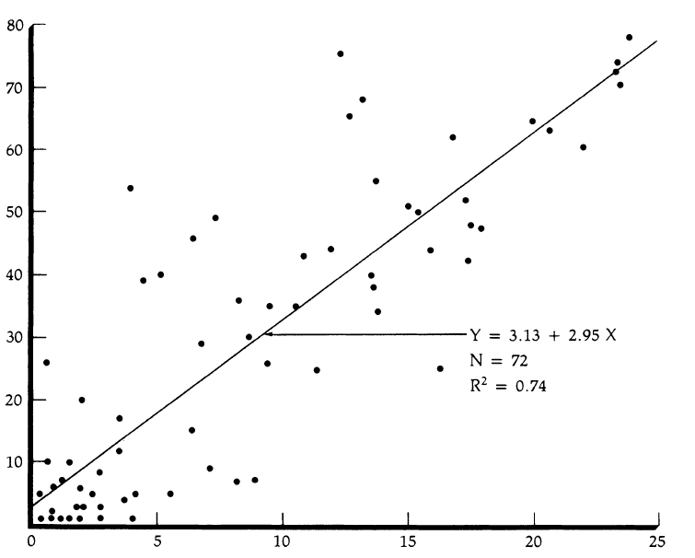
Choice Matters
WHO systematic review (231 articles) showed increased choice associated with:
Increased persistence on chosen method
Better health outcomes
12% increase in contraceptive prevalence for each additional method
Similar to contraceptive needs: different people have different HIV prevention needs at different times
Contraceptive prevalence rate
Index of Contraceptive Availability
Buchbinder SFDPH 2020; Gray et al RHRU 2006; Jain AK Stud Fam Planning 1989

Slide 8
Product Considerations
For each product, understand and balance:
Clinical
Biologic efficacy
Dosing/duration
Reversibility
Side effect profile
Systemic/Topical
Policy & Programs
Delivery channel(s)
Health system burden
Product cost
Program cost
Provider training
Demand creation
Personal
User effectiveness
User preference
User burden
Discretion of use
Contribution to stigma
AND, it’s never just “the product” – it’s the program

Slide 9
Parallel HIV Px Universes
Users
Providers & Health Systems
What do I want?
Do I want an HIV test?
Where do I want to get an HIV test?
Do I need and want HIV prevention?
What kind of HIV px do I want?
Who do I want to talk with about sex and relationships?
Where and from whom do I want it?
Oral, ring, injectable, condoms, DPP?
Who is at risk?
Where do I find them?
What do I tell them?
Where can I provide px info and products to them?
What px options can I provide them?
Oral, ring, injectable, condoms, DPP?

Slide 10
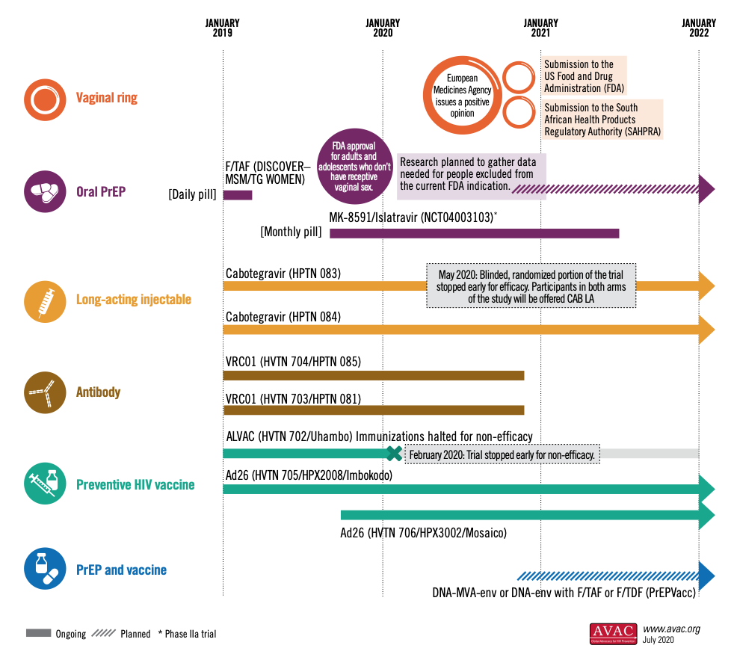
Timeline 2020
Trial completed; results expected Q4 2020

Slide 11
Dapivirine Vaginal Ring
Flexible silicone vaginal ring developed by IPM
Woman-initiated
Self-inserted monthly
Discreet
Does not interfere with sex
Excellent safety profile; non-systemic
ARV dapivirine (developed by Janssen/J&J) slowly released over one month
Reduced HIV risk in Phase III trials: 35% in The Ring Study, 27% in ASPIRE
Open-label extension studies saw increased adherence, suggested greater risk reduction (increasing to 63% and 39% from Phase III)
First long-acting HIV prevention product

Slide 12
Dapivirine Vaginal Ring

Slide 13
Regulatory Opinion(s)
On July 24, European Medicines Agency (EMA) announced a positive scientific opinion on DVR as an additional HIV prevention option for cisgender women age 18 and older in developing countries to reduce their HIV risk
Considered under EMA’s Article 58, in cooperation with WHO, to “facilitate access to essential medicines in developing countries using the same rigorous standards as for products intended for use in the European Union”
EMA opinion can facilitate accelerated WHO prequalification & guidelines; and the EMA/WHO combination can expedite approvals from African National Medicines Regulatory Authorities (NMRAs)
WHO considered DVR at meeting Consolidated Guidelines for Treating and Preventing HIV Infection, 28 Sept-2 Oct – guidance expected to be released in coming months

Slide 14
Regulatory Next Steps
European Medicines Agency (EMA) Art 58 Positive Opinion
Positive scientific opinion on use of a product in developing countries, via Article 58 procedure, adopted July 2020
World Health Organization (WHO)
WHO participated in EMA Article 58 procedure and facilitates WHO abbreviated prequalification (PQ) and Collaborative Registration Procedure (CRP), beginning with Guidelines Review, Sept/Oct 2020
Amendment of HIV Guidelines
IPM application for WHO abbreviated PQ
Expression of Interest (EOI)
African National Medicines Regulatory Authorities (NMRAs) decisions, including SAHPRA – possible first half 2021
IPM request to WHO,
NMRAs and
SRA to use
Collaborative Review
Procedure (CRP)
IPM submits dossiers via CRP
Planned submissions 2020 onward
US Food and Drug Administration (FDA) decision
Planned submission Q4 2020
Note: Timelines are estimates and subject to change

Slide 15
R&D Next Steps
Phase IV post-authorization study among cisgender women ages 18-25 to better understand the ring’s efficacy among younger women
Additional MTN research underway:
REACH: Safety and use of DVR & oral TDF/FTC among adolescent girls and young women ages 16-21 in South Africa, Uganda, Zimbabwe
DELIVER: Safety and acceptability of DVR and oral TDF/FTC among pregnant women
B-PROTECTED: Safety and acceptability of DVR and oral TDF/FTC among breastfeeding women
Also in development:
3-month DVR
3-month combination dapivirine-levonorgestrel ring

Slide 16
Programmatic Next Steps
Initiate program planning to act on WHO guidance (expected late 2020) and initial national regulatory approvals (expected early 2021)
IPM leading manufacturing; need potential pooled procurement
Country & community readiness/preparedness activities needed now
Initially assessed Dapivirine Ring Early Introduction Considerations: 7 Country Analysis (PEPFAR/USAID-funded OPTIONS)
Country-specific market research & policy planning underway in priority countries
Strategic implementation plans designed and begin roll-out in 2021
Common Agenda to Plan for Introduction, developed by OPTIONS with IPM; updated with PEPFAR/USAID-funded PROMISE & CHOICE
Now need to develop country-specific introduction plans
Not necessarily stand-alone “DVR projects”, but integrated into existing platforms – oral PrEP; DREAMS; integrated SRH

Slide 17
Long-acting Injectable Cabotegravir
HIV integrase strand transfer inhibitor developed by ViiV/GSK – and an analogue of dolutegravir
Nano-formulated, low-solubility crystalline drug suspended in an aqueous solution
600 mg administered as one 3 mL intramuscular injection in the gluteal muscle, every two-months
Two HIV prevention efficacy trials underway, under the HPTN, comparing CAB injections every two months to oral TDF/FTC
CAB-LA in combination with injectable rilpivirine from J&J developed as a treatment
Approved in Canada and currently under FDA review

Slide 18
CAB-LA Efficacy Studies

Slide 19
CAB-LA Efficacy Study Design

Slide 20
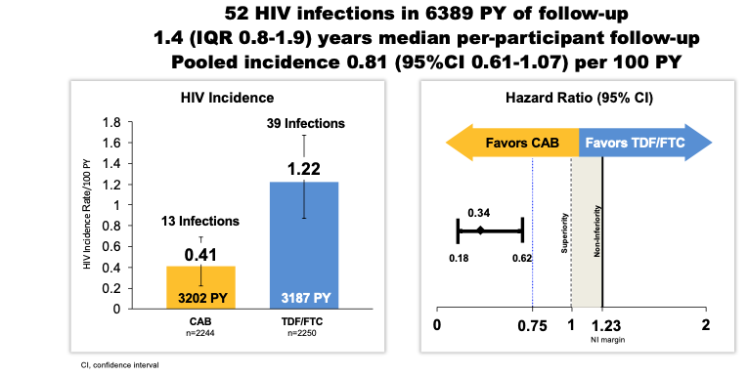
HPTN 083 Interim Results
HIV Incidence CAB vs. TDF/FDC
Landovitz RJ et al. AIDS 2020, #OAXLB01

Slide 21
HPTN 083 Interim Results
Both CAB & TDF/FTC were safe and highly effective for HIV prevention
PrEP regimen containing CAB-LA was statistically superior to daily oral regimen of TDF/FTC in HPTN 083, with a 66% reduction in risk of HIV infection observed in participants receiving CAB compared to TDF/FTC
CAB-LA was well tolerated despite injection site reactions
CAB is first long-acting agent to demonstrate HIV prevention efficacy in MSM/TGW
Awaiting results for cisgender women in HPTN 084, as well as sub-studies in both 083 and 084
Landovitz RJ et al. AIDS 2020, #OAXLB01

Slide 22
R&D Next Steps
HPTN 083:
Understand breakthrough infections for both products and role of adherence and potential resistance profiles
Understand role of oral lead-in phase and the potential pharmacologic “tail”
Currently moving to offering all participants choice between the two safe and effective options
Formal Open Label Extension phase of the trial in development
HPTN 084:
Fully enrolled; ongoing follow-up of participants
Next DSMB scheduled for November, then every six months
Additional sub-studies underway

Slide 23
Programmatic Next Steps
ViiV publicly stated its commitment to file for a broad label for all populations at risk and are in process of compiling data and discussing pathways with various regulatory agencies
Earliest regulatory submission likely in mid-2021
Build px platforms with oral TDF/FTC programs that can integrate DVR and CAB-LA – while assessing specific service delivery needs that might be needed for an injectable
Gates-funded Biomedical Prevention Implementation Collaborative (BioPIC) working with ViiV and numerous stakeholders, including PEPFAR, to develop a comprehensive, coordinated product introduction and access strategy – currently being updated given early results of HPTN 083

Slide 24
Time to Market
| | 2020 | | | 2021 | | | 2022 | | | 2023 | | | 2024
Positive EMA Opinion
Probable regulatory approval & introduction
DVR
Early 083 results
Possible 084 results
Assumes 084 stops early
Possible FDA Submission
Possible regulatory approval & introduction
CAB-LA
Possible DPP regulatory approval & intro
DPP
Daily oral F/TAF efficacy trial in cisgender women
F/TAF
Monthly oral Islatravir efficacy trials
Islatravir
Earliest time to market

Slide 25
Px Option Summary
Px Option | Populations | Time to Market | Next Steps
Male & female condoms | All at risk | Approved for decades | Market at scale
VMMC | Heterosexual men | 2007 Recommended in 14 priority counties in E/SA since | Re-energize post-COVID restrictions
Daily Oral TDF/FTC | All at risk | 2012 US approval ; 2015 first African approvals | Scale-up demand creation and support for continuation
Event-driven Oral TDF/FTC | MSM | 2019 WHO recommendation | Integrate as per guidelines
Daily Oral TAF/FTC | All except “those at risk via receptive vaginal sex” | 2019 FDA partial approval; ±2024 for cisgender women | Efficacy trial in cisgender women in Africa start 2021
Dapivirine Vaginal Ring | Women | 2020 positive EMA opinion; WHO guideline and abbreviated PQ review | National regulatory approvals & product intro in 2021
Dual Px Pill (TDF/FTC/COC) | Women | Likely earliest approvals ±2022 | Bioequivalence studies
Injectable Cabotegravir | Studied in multiple populations | Likely earliest approvals ±2022 | Continue 084; regulatory submission in 2021
Ad 26 Vaccine | Studied in multiple populations | Likely earliest approvals ±2024 | Efficacy trials continuing
Monthly Oral Islatravir | To be studied in multiple populations | Likely earliest approvals ±2024 | Efficacy trials to start 2021
VRC 01 bNAb infusion | Studied in multiple populations | NA – not intended for licensure | Multiple bNAbs in development

Slide 26
Conclusions
More safe and effective px options – entering market & in development
But oral TDF/FTC only PrEP option widely approved and with clear programmatic guidance, targets, product availability, etc.
Now timely for PEPFAR to integrate DVR into px programming
No one option will be THE choice for all people, all the time – or for one person, all the time
Biomedical product use & coverage need not be perfect to have impact

Slide 27
Conclusions
Much accomplished; much to do:
Fill the product introduction gaps:
Accelerate time from regulatory approval to intro to impact
Demand-creation and program platforms for prevention generally
Differentiated (and integrated) service delivery for px
Fill the product development gaps:
Longer-acting & event-driven
User-friendly & developed WITH users
Dual-purpose & multi-purpose methods

Slide 28
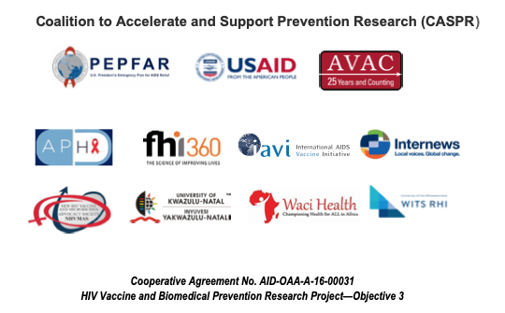
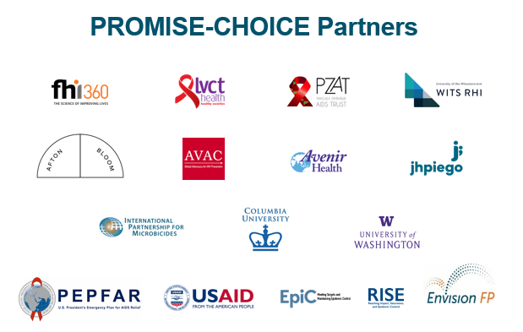
Acknowledgements
Susan Buchbinder
Sinead Delany-Moretlwe
Sharon Hillier
Brian Kanyemba
Grace Kumwenda
Raphy Landovitz
Kenneth Mwehonge
Definate Nhamo
Yvette Raphael
Zeda Rosenberg
Kristine Torjesen

Slide 29
Resources
European Medicines Agency Adopts Positive Opinion on Monthly Vaginal Ring to Reduce HIV Risk
Understanding the EMA Opinion and Next Steps for the Dapivirine Vaginal Ring
HPTN 083 Results presentation at AIDS 2020
An Advocates’ Primer on Long-Acting Injectable Cabotegravir for PrEP
Biomedical Prevention Implementation Collaborative (BioPIC)
www.avac.org
www.PrEPWatch.org

