Slide 1
Module 2:
THE PROVISION OF ORAL PrEP
IN THE CONTEXT OF AGYW
Version: June 2019

Slide 2
Outline of training
Module 1: Introduction to oral PrEP
PrEP: the basics
What is combination prevention?
How effective is oral PrEP?
What are the differences among PrEP, PEP, and ART?
Overview of country-specific guidelines
Module 4: Oral PrEP provision for AGYW: getting started
Generating demand: reaching AGYW
Risk assessments
Addressing myths, misconceptions, and fears
Factors influencing decisions to initiate or stay on oral PrEP
Key issues to discuss with AGYW in relation to PrEP
Module 2: The provision of oral PrEP in the context of AGYW
Why oral PrEP for AGYW?
Adolescence: a dynamic time of change and transition
Providing oral PrEP in the context of adolescent- and youth-friendly services
Checking in with ourselves: our personal views and values about AGYW and oral PrEP
Unpacking youth-friendly services
Module 5: Monitoring, follow-up, and adherence support for AGYW on oral PrEP
Promoting adherence and retention for AGYW using oral PrEP
Frequently asked questions
Module 6: Wrapping up
Key take-home messages
Resources for providing oral PrEP to AGYW
Module 3: Important factors to consider when providing oral PrEP to AGYW
Combination prevention: related services and entry points to PrEP
Gathering the evidence: what have we learned about oral PrEP and AGYW?
Addendum: Initiation and clinical management of oral PrEP
Notes:
PrEP - pre-exposure prophylaxis for HIV prevention
AGYW - adolescent girls and young women

Slide 3
Why oral PrEP for AGYW?

Slide 4
Definitions: adolescents and young women
Adolescents are people ages 10–19 (WHO).
Youth are people ages 15–24.
Young people refers to the broader age band of 10–24 years (UNAIDS).
Definitions also vary based on the cultural context and guidelines of individual countries.*
Notes:
*edit info to be country specific
For example, the DOH National Adolescent & Youth Health Policy 2017, defines young people as….

Slide 5







HIV in context: what do the data say?
1
70%
More than 70% of all HIV infections occur in sub-Saharan Africa.
56%
66%
Women
Young women
(ages 15–24)
2
AGYW are 2–3 times more likely to be infected with HIV than their male peers.
3
Women are at higher risk of contracting HIV at a younger age.
Men are less likely to know their HIV status or receive HIV treatment.
Younger women have older male sexual partners. This dynamic, and age-mixing in sexual relationships, contributes to the high risk of HIV among AGYW.
http://www.unwomen.org/en/what-we-do/hiv-and-aids/facts-and-figures
http://www.unaids.org/sites/default/files/media_asset/UNAIDS_FactSheet_en.pdf
http://aidsinfo.unaids.org/
Gouws E, Williams BG. Age mixing and the incidence of HIV among young women. The Lancet. November 30, 2016.
Notes:
1 – 70% of HIV infections are in Sub-Saharan Africa. 56% of these are in females. Of this 56% young women aged (15-24) make up 66%.
Insert country specific data if available

Slide 6
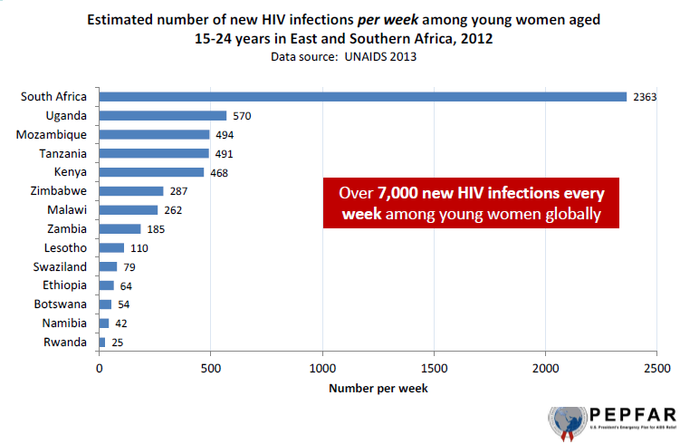
One-third of new infections globally occur in young African women
Notes:
HIV incidence is highest in adolescent girls and young women aged 15-24 years
Every week 7000 adolescent girls and young women are newly infected with HIV
A third of these infections occur in young women in South Africa.
This is despite a doubling of people on ART from 16% in 2008 to 31% in 2012
AIDS-related illnesses are still the leading cause of death in this age group

Slide 7
AGYW intersections with key populations/groups most at risk
AGYW who inject drugs
AGYW may also:
Have multiple sexual partners.
Have STIs.
Have partners who are HIV-positive or have unknown HIV status.
Be engaged in transactional sex.
Most at-risk populations:
People who inject drugs
Transgender people
Sex workers
AGYW in many sub-Saharan African countries
Transgender AGYW
AGYW may be part of high-risk groups, adding additional layers of vulnerability.
AGYW sex workers
AGYW as part of sero- discordant couples
Notes:
Import to note that AGYW may also be part of key populations and most at risk groups – adding additional layers of vulnerability

Slide 8

HIV risk factors in women
Women
Gender-based violence
Genital inflammation
Other STIs (e.g., HPV)
Low vaginal lactobacilli (e.g., BV)
Low condom use
Age-disparate relationships
Early sexual debut
Low adherence to oral PrEP
Low dual protection (contraception plus condoms)
HSV-2 infection
Transactional sex
Structural
Behavioural
Biological
Adapted from:

Slide 9


HIV in context: social and structural drivers for AGYW
  Lack of
  AGYW-friendly services
  GBV, IPV,
  and sexual violence
HIV among AGYW is fueled by a combination of factors that contribute to increased risk.
  Inadequate legal and policy protections for women and girls
Harmful social and cultural norms
  Inaccurate knowledge about HIV
  and SRH
  Social/cultural inequities or stigma
  Shaming AGYW for being sexually active
UNAIDs GAP report, 2016.
“Advancing Human Rights and Access to Justice for Women and Girls.” What Works for Women and Girls.
Notes:
Gender-based violence, particularly intimate partner and sexual violence, is widespread, greatly increasing risk of acquiring HIV. In some settings, up to 45% of adolescent girls report that their first sexual experience was forced (1).
Globally, only 3 in every 10 adolescent girls and young women aged 15-24 years have comprehensive and accurate knowledge about HIV and other sexual and reproductive health issues (1).
SRH and HIV services are not generally friendly to the concerns and needs of AGYW, particularly for those who are unmarried.
Lack of legal rights reinforce the subordinate status of women, including rights to divorce, to own and inherit property, to sue and testify in court, and to open bank accounts (2).
Cultural constraints and/or stigma against AGYW for being sexually active outside of marriage can affect delivery of and access to SRH and HIV services for AGYW.

Slide 10
Gender dynamics and HIV
Points for discussion:
How do gender-related dynamics contribute to HIV and sexual and reproductive health and rights in AGYW?
Optional group activity: see Attachment 2: Act Like a Man, Act Like a Woman

Slide 11
Adolescence: a dynamic time of change and transition

Slide 12
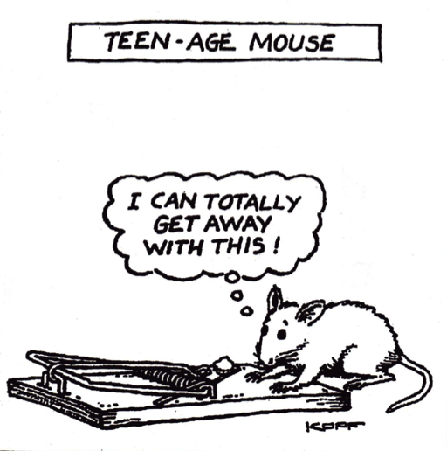
Adolescent development
Adolescents are not mini adults.
Less developed frontal lobe capacities for executive function, impulse control, and long-term decision making.
More developed limbic lobe favoring emotions, impulsive behaviour, and short-term gratification.

Slide 13
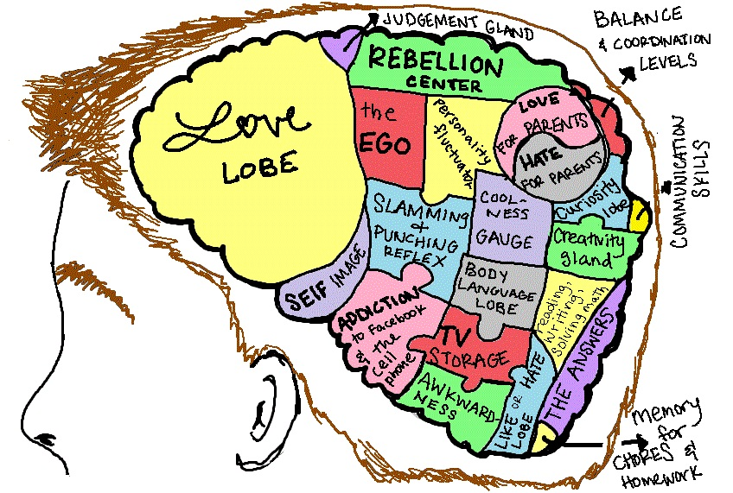
Adolescent development (cont.)
A time of physiological, sexual, and social changes.
Changing bodies and hormones create sexual desire and a focus on sex.
Peer pressure is highly influential.
A time of experimentation, testing limits, and questioning authority.
Not all negative and problematic: a dynamic time of shaping one’s identity, discovering self, and becoming more independent.
Notes:
Graphic Acknowledgement: Moving Traditions. The Teenage Brain: Still Under Construction https://www.movingtraditions.org/teen-brain-still-construction/ (downloaded August 2018)

Slide 14
Thinking about young people and oral PrEP
Points for discussion:
What are the typical stereotypes related to adolescents and young people (e.g., assumptions, commonly held views, generalisations)?
In your experience, what typically characterises young clients (i.e., adolescents and young people)?
  Which of the above may be potential barriers to effective PrEP use?
  Which of the above are strengths and opportunities to leverage for effective PrEP use?
We speak of AGYW: what are the similarities and differences between adolescent girls and young women?
Notes:
AGYW not a homogenous group. Age differentiation important. Differences exist between early, late adolescence, and early adulthood
WHO divides adolescents as EARLY 10-15 years; MIDDLE 14-17 years; LATE 16-19 years with associated differences in physical, cognitive, emotional, social differences, as well as sexual development and maturation.
http://apps.who.int/adolescent/second-decade/section/section_2/level2_2.php

Slide 15

Risk and protective factors for prevention
Risk factors
Poverty
Peer pressure
Sexual coercion
Transactional sex
Age-disparate relationships
Teenage pregnancy
Physiological vulnerability
Barriers to using health services
Dropping out of school
Being an orphan or in a child-headed household
Protective factors
Youth-friendly services
Positive role models
Guidance and engagement on staying in school
Access to HIV prevention options
Protective factors
Factors contributing to vulnerability:

Slide 16
Providing oral PrEP in the context of adolescent- and youth-friendly services

Slide 17
Model for effective service provision for PrEP and AGYW
Quality health care
Youth-friendly, youth-sensitive services
HIV, SRH, and sexual health services
PrEP for AGYW

Slide 18

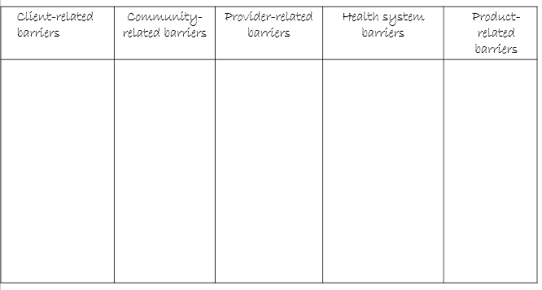
Challenges and barriers to SRH and HIV services for AGYW
GROUP
DISCUSSION
Group discussion:
It is very important to identify and dismantle potential barriers for young people accessing health care.
PrEP services need to be provided within the context of adolescent-friendly services.
Group activity:
Work in small groups to identify potential barriers that prevent AGYW from utilising HIV prevention, SRH, and PrEP services. Start by making the following five columns on a page:
Client-related barriers
Community-related barriers
Provider-related barriers
Health system barriers
Product-related barriers
Notes:
Issues relating to access…
Inflexible and inconvenient clinic opening/closing times
Clinic location, distance from home and availability, and the need for money for transport
Sitting in waiting rooms with adults, some of whom may know them
The attitude of staff – receptionists, clerks and nurses – who may be rude and judgemental
Nurses who may not give enough information or clarity; lack of confidentiality, privacy and sufficient time
The physical environment which looks intimidating, clinical and unattractive
Lack of accessible information developed to address the concerns, language and level of young people, which is easy to read and relevant to their lives
Issues related to quality of care…
Barriers relating to the quality of care that may discourage youth from using the clinic or completing treatment, e.g. drug stock-outs; having to walk through a waiting room with a urine sample; etc.
Anxiety about confidentiality and privacy
Issues related to communication… …
Impatient and unsympathetic staff who do not deal well with the embarrassment or problems young people encounter
Staff with poor listening skills
Embarrassment of provider who cannot discuss issues related to sexuality and safer sex
Language used and how well the health worker explains to the patient the nature of the problem and prevention/treatment options

Slide 19
Client-related barriers | Community-related barriers | Provider-related barriers | Health system barriers | Product-related barriers
Don’t know where to go Don’t have resources to get to the service Staff attitude (e.g., judgmental, reprimanding) Feel uncomfortable, embarrassed, scared to be seen by community Low self-esteem, stigma, shame (including self-stigma, self-shame) Myths, misconceptions Lack of sexual partner’s support Fear of partner disapproval | Cultural, religious, moral perspectives related to adolescent girls and unmarried young women having sex Myths, misconceptions Low community awareness of PrEP Lack of parental support | Providers believe young people don’t use the service Providers believe young people are difficult especially adolescent girls Providers lack confidence to provide services to adolescents, are especially uncomfortable discussing sex and sexuality Myths, misconceptions Providers have doubts about whether adolescent girls can take PrEP daily Providers are concerned that using PrEP may lead to disinhibition (this means more careless; lack of restraint; take more risks) | Legal/policy frameworks are unclear/unsupportive Time of service conflicts with school/work Lack of clear guidelines and protocols/providers not trained in provision of SRH services Service unavailable or clients told to return Time constraints for providing adolescent-friendly care, too many people in queue, providers overworked Commodities/supplies not available No, few, inadequate referral agencies for youth | Unfavorable dosing schedules Unfavorable packaging, size, color of product

Slide 20

Questions for reflection
Which of the barriers on the list specifically apply to your context?
How can these barriers be dismantled?
Notes:
This would be a time to pause for reflection, group participation…allow people 5-10 minutes to reflect on their own, break into groups to look at barriers and how these can be mitigated

Slide 21
Checking in with ourselves: our personal views and values about AGYW and oral PrEP

Slide 22
Personal reflection
Working with young people and adolescents:
How do my own personal views affect the manner in which I communicate with young clients?
Optional group activity: see Attachment 3.
Notes:
An optional activity is provided – see Attachment #3 for two participatory exercises.

Slide 23


Health care providers’ feelings about oral PrEP
What are your fears, misgivings, anxieties, and reservations about offering oral PrEP to clients in general, and to AGYW specifically?
Optional group activity: see Attachment 3
Notes:
Use this slide to open up discussion about fears and misgivings
Misgiving: a feeling of uncertainty, apprehension, or doubt
Collins English Dictionary. Copyright © HarperCollins Publishers

Slide 24
The importance of sensitising all who will be involved in the provision of oral PrEP
Providing PrEP involves talking about risk and sex and being aware of our own values, attitudes, prejudices, and moral judgments. This includes our feelings and attitudes about other peoples’ lifestyles, sexual preferences, and behaviours and how these may affect our communication (e.g., verbal, non-verbal) and the services we render.
Being sensitised paves the way for trust and meaningful engagement.

Slide 25
Health care provider concerns
Examples of commonly held concerns:
Adherence/effective use
  Will adolescent girls be able to take PrEP daily (adherence) during periods of substantial risk (effective use)?
Risk compensation
  Will people start behaving more recklessly (and take more risks) now that they are protected against HIV by oral PrEP?
Drug resistance
  Will oral PrEP increase HIV drug resistance?

Slide 26
Addressing commonly held concerns
Ongoing adherence support is vitally important – see Module 5
Oral PrEP trials and demonstration projects show:
    No increase in number of sexual partners.
    No change in condom usage.
    No change in “any unprotected sex”.
    Inconclusive results regarding PrEP and STI incidence.
    Some research reflect no increase, and others show an increase (e.g. Traeger et al 2018).
      Note: Several papers argue that STIs have generally been increasing in the last decade, and we cannot attribute this increase to PrEP.
      The importance of the promotion of condom use to protect against STIs is highlighted.
Ongoing oral PrEP demonstration projects continue to measure these behaviours and monitor changes.
Notes:
MA Montano, et al. Changes in sexual behaviour and STI diagnoses among MSM using PrEP in Seattle, WA. 2017 CROI, Seattle. Abstract 979.
Harawa NT, et al. Serious concerns regarding a meta-analysis of pre-exposure prophylaxis use and STI acquisition. AIDS. 2017 Mar 13;31(5):739-740.
Samuel M Jenness, Kevin M Weiss, Steven M Goodreau, Thomas Gift, Harrell Chesson, Karen W Hoover, Dawn K Smith, Albert Y Liu, Patrick S Sullivan, Eli S Rosenberg; Incidence of Gonorrhea and Chlamydia Following Human Immunodeficiency Virus Preexposure Prophylaxis Among Men Who Have Sex With Men: A Modeling Study, Clinical Infectious Diseases, Volume 65, Issue 5, 1 September 2017, Pages 712–718, https://doi.org/10.1093/cid/cix439
Traeger MW et al. Effects of pre-exposure prophylaxis for the prevention of human immunodeficiency virus infection on sexual risk behaviour in men who have sex with men: a systematic review and meta-analysis. Clinical Infectious Diseases, March 2018. doi: 10.1093/cid/ciy182. See abstract here.
“A meta-analysis of 17 studies of HIV pre-exposure prophylaxis (PrEP) in gay men and other men who have sex with men (MSM) has found that, while PrEP protected them from HIV, the proportion diagnosed with gonorrhoea, chlamydia or syphilis increased significantly in the period between starting PrEP and follow-up, with an average length of time on PrEP at follow-up of six months (See: http://www.aidsmap.com/Gay-men-get-less-HIV-but-more-STIs-after-starting-PrEP-meta-analysis-finds/page/3284842/ )

Slide 27
Commonly held concerns: HIV drug resistance?
Systematic screening for HIV
  HIV testing on initiation and every 3 months
  Symptomatic screening for acute HIV
  Low risk of HIV drug resistance
The only HIV drug resistance seen in demonstration projects was among those who had an acute HIV infection at initiation that was missed.
  HIV drug resistance with oral PrEP is very rare and only occurs if adherence is sub-optimal.

Slide 28
Staff sensitisation
Questions to the group:
Training alone may not increase staff sensitisation, dismantle barriers, or reduce stigmatisation. How can we go beyond training and ensure services are youth-sensitive?
Is it valuable to have a “Youth Champion” (i.e., a delegated person who takes a special interest, is specifically trained, or oversees the youth program) on staff? What are the advantages and disadvantages?
Notes:
1. In addition to training, other needs may include, for example: management support, team orientation, and sensitisation and buy-in from the entire team
2. The idea of a Youth Champion has pros and cons:
Some examples of pros (for):
A specific member of staff is trained and has the necessary skills to work with young people
It is useful to have a go-to person for matters relating to adolescents/youth
Young people can build up a relationship and trust with a specific member of staff over time
A youth champion can assist in building a youth friendly environment at the facility
The youth champion is there to be the driver and motivator, and ensure youth friendly services are consistently on the agenda
Some examples of cons (against):
The entire team should be youth friendly – not just one person. The team should understand why this is important and be youth champions
Its too dependent on one person – what happens if the youth champion is absent or leaves
Even when the youth champion is only there to be the driver and motivator, all young people get referred to them, and other staff don not develop the necessary skills or commitment to the provision of youth friendly services.

Slide 29
Unpacking youth-friendly services

Slide 30
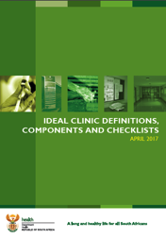
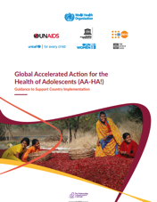
International and local adolescent and youth friendly standards and guidelines
DATE:
14 Sept `16
International
Country-specific*
Adolescent- and youth- friendly standards: 10 standards and 5 priorities
Ideal clinic:
8 adolescent assessment questions
Notes:
*Edit to reflect country-specific guidelines/standards
WHO. Core competencies in adolescent health and development for primary care providers: including a tool to assess the adolescent health and development component in pre-service education of health-care providers 2015.
WHO, UNAIDS. Global standards for quality health-care services for adolescents. A guide to implement a standards-driven approach to improve the quality of health-care services for adolescents 2015.
Global Accelerated Action for the Health of Adolescents (AA-HA!): guidance to support country implementation 2017.
Youth Zone in South Africa aims to:
Promote access to and use of health and other services.
Provide information and increase awareness about health-related issues, sexual and reproductive health rights and the rights of people living with HIV.
Make use of the She Conquers self-assessment roadmaps to empower young people to make informed choices about their health and link to relevant services.
Provide a standardised package of services to young people.
Provide health services which are non-judgemental and free from discrimination and stigmatisation.

Slide 31
Adolescent- and youth-friendly services
In terms of provision of adolescent- and youth-friendly services, in your country:
Do you have national policies/guidelines?
Do you have national standards or a framework for provision of these services?
    Are you familiar with the content?
    To what extent are these being implemented?

Slide 32
Youth-friendly, youth-sensitive, youth-responsive
Services should be sensitive and responsive to the needs of young people, particularly in regard to sexual and reproductive health and rights.
The bottom line
Young people should feel comfortable and positive using health services.

Slide 33

Key components of youth-friendly services
Services:
Are friendly: welcoming, respectful, non-judgmental, private.
Are age-appropriate:
geared to the appropriate age and developmental
stage of the client.
Ensure informed consent: provide information, counselling and encourage informed decision-making.
These key elements need to frame all services focusing on young people.
Core components of youth-friendly services:
Accessible and affordable: Adolescents can obtain the health services that are available.
Acceptable: Adolescents are willing to obtain the health services that are available.
Equitable: All adolescents, not just selected groups, can obtain the health services available.
Appropriate: The right age-appropriate health services (i.e., the ones needed) are provided.
Effective: The right health services are provided in the right way for a positive contribution to health.

Slide 34
Building blocks for providing youth-friendly services
Services should be:
respectful, non-judgmental
private and ensure confidentiality
Where possible:
Provide youth services in areas or times separate from adult services
Use peer educators or peer champions
Use a mix of visual, electronic, and youth-friendly IEC materials
Involve young people in the design of the service
Health care providers should:
Listen
Build trust
Provide the opportunity for honest, non-threatening discussion of risk
A provider who is an oral PrEP champion (i.e., is passionate about PrEP for AGYW) should be the point person for AGYW.
Bottom line: Services should be sensitive and responsive to the needs of young people.
Notes:
IEC –Information, education and communication
BCC – behaviour change communication

Slide 35
GROUP
Breaking down barriers to ensure youth-friendly oral PrEP provision
DISCUSSION
You are planning to provide oral PrEP services for AGYW: What are the five most important changes you will make to ensure that the services are youth-friendly?
Notes:
This could be a small group or partner exercise…

Slide 36
Youth-friendly oral PrEP services
Be accepting of AGYW sexual activity, even if you disapprove. By coming for services, they are taking steps to take care of their health, and you can play an important role in helping them be protected and HIV-free.
Provide information about oral PrEP along with other HIV prevention options. Even if you think other options would be better, make sure AGYW know about oral PrEP as an option.
Explore whether they would like to discuss oral PrEP with their parents or partner. Accept the decision they make about whether to disclose PrEP use.
Maintain confidentiality by not telling an adolescent girl’s parents about her sexual activity or oral PrEP use.
Believe that AGYW can take PrEP daily – even though it may be difficult, with the right support, she can do it!
Encourage AGYW to come with their partners for HIV testing, but don’t make it a requirement. Ensure her individual needs are met.

Slide 37









Acknowledgements
This training package was developed by the OPTIONS Consortium.
If you adapt the slides, please acknowledge the source:
Suggested citation: “OPTIONS Provider Training Package: Effective Delivery of Oral Pre-exposure Prophylaxis for Adolescent Girls and Young Women ”. OPTIONS Consortium, June 2019. https://www.prepwatch.org/resource/effective-delivery-oral-prep-agyw/ (download date)
OPTIONS Consortium Partners
This program is made possible by the generous assistance from the American people through the U.S. Agency for International Development (USAID) in partnership with PEPFAR under the terms of Cooperative Agreement No. AID-OAA-A-15-00035. The contents do not necessarily reflect the views of USAID or the United States Government.

