Slide 1
Module 6:
WRAPPING UP
Version: June2019

Slide 2
Outline of training
Module 1: Introduction to oral PrEP
PrEP: the basics
What is combination prevention?
How effective is oral PrEP?
What are the differences among PrEP, PEP, and ART?
Overview of country-specific guidelines
Module 4: Oral PrEP provision for AGYW – getting started
Generating demand: reaching AGYW
Risk assessments
Addressing myths, misconceptions, and fears
Factors influencing decisions to initiate or stay on oral PrEP
Key issues to discuss with AGYW in relation to PrEP
Module 2: The provision of oral PrEP in the context of AGYW
Why oral PrEP for AGYW?
Adolescence: a dynamic time of change and transition
Providing oral PrEP in the context of adolescent- and youth- friendly services
Checking in with ourselves: our personal views and values about AGYW and oral PrEP
Unpacking youth-friendly services
Module 5: Monitoring, follow-up, and adherence support for AGYW on oral PrEP
Promoting adherence and retention for AGYW using oral PrEP
Frequently asked questions
Module 6: Wrapping up
Key take-home messages
Resources for providing oral PrEP to AGYW
Module 3: Important factors to consider when providing oral PrEP to AGYW
Combination prevention: related services and entry points to PrEP
Gathering the evidence: what have we learned about oral PrEP and AGYW?
Addendum: Initiation and clinical management of oral PrEP
Notes:
PrEP - pre-exposure prophylaxis for HIV prevention
AGYW - adolescent girls and young women

Slide 3
Key take-home messages

Slide 4
Key messages
Oral PrEP is part of a combination prevention package (and does not protect against STIs or pregnancy).
Oral PrEP is one of several prevention options.
Oral PrEP is not for everyone.
Oral PrEP has the potential to empower AGYW and provide additional control over HIV prevention.
Adherence and effective use means adhering to taking the pills as prescribed and returning to the clinic for scheduled visits.
Oral PrEP is client-driven and client-controlled. We can motivate and support, but personal buy-in and ownership is vital!

Slide 5
Resources for providing oral PrEP to AGYW

Slide 6
Job aids
Additional job aids are available for adaptation and use from OPTIONS.
Available from: https://www.prepwatch.org/prep-resources/

Slide 7
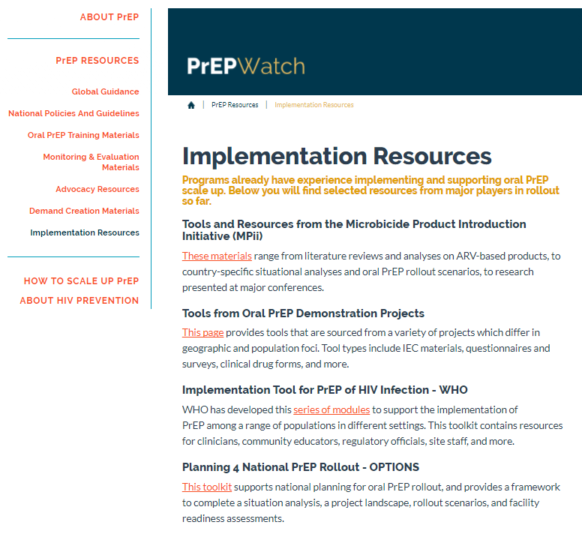
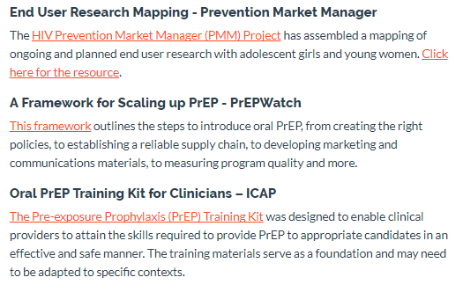
Walkthrough of PrEP Tools and Resources
PrEPWatch.org
https://www.prepwatch.org/prep-resources/

Slide 8
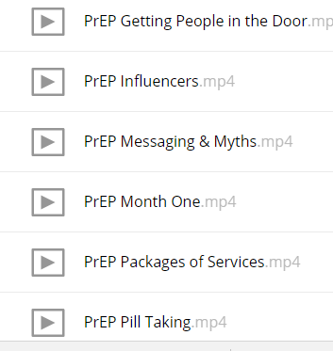
Video clips to support provision of oral PrEP
Topics include:
https://fs.avac.org/index.php/s/it4Peut8D6mH0wc/download

Slide 9
Acknowledgements
This training package was developed by the OPTIONS Consortium.
If you adapt the slides, please acknowledge the source:
Suggested citation: “OPTIONS Provider Training Package: Effective Delivery of Oral Pre-exposure Prophylaxis for Adolescent Girls and Young Women ”. OPTIONS Consortium, June 2019. https://www.prepwatch.org/resource/effective-delivery-oral-prep-agyw/ (download date)
OPTIONS Consortium Partners
This program is made possible by the generous assistance from the American people through the U.S. Agency for International Development (USAID) in partnership with PEPFAR under the terms of Cooperative Agreement No. AID-OAA-A-15-00035. The contents do not necessarily reflect the views of USAID or the United States Government.

