Slide 1
Scenario 1
Imagine that you are part of the study team.
Nankya is 7 months pregnant and is interested in joining the study. She knows that her husband has started to go outside of the relationship and she wants to protect herself and her baby.
Is Nankya a good fit for the study?
Why or why not?
Should Nankya be encouraged to tell her husband about her participation in the study if she enrolls?
What might be some consequences?
If she wants to tell her husband but isn’t sure what to say, what would you advise?

Slide 2
Scenario 2
Nabatanzi enrolled into Group 2 (7-8 months pregnant) and was randomized to PrEP. She made all of her study visits and took her product every day as instructed. She had a perfect pregnancy until Month 9. She came to her clinic visit at the site complaining of a headache and vision changes. Her blood pressure was very high. The site staff referred her to the hospital immediately. At the hospital Nabatanzi had a seizure and died.
How would you react to this scenario?
What will be the community concerns and how should the site address them?
What can the study staff do to prepare the community for possible bad pregnancy outcomes before one happens?

Slide 3
Scenario 3
Asiimwe is a participant in B-Protected; she has been in the study for 2 weeks. Her baby, who is 2 months, has been experiencing very severe diarrhea for 3 days. Asiimwe’s mother and mother-in-law are concerned that the diarrhea is due to the ARV in PrEP and the ring; they tell her to stop taking product. She calls the clinic before she stops.
How common is diarrhea in a 2 month old infant?
What are possible explanations?
How likely is it that the diarrhea is due to ARV?
What are the important messages about these products and breastfeeding that need to be communicated within the community?

Slide 4
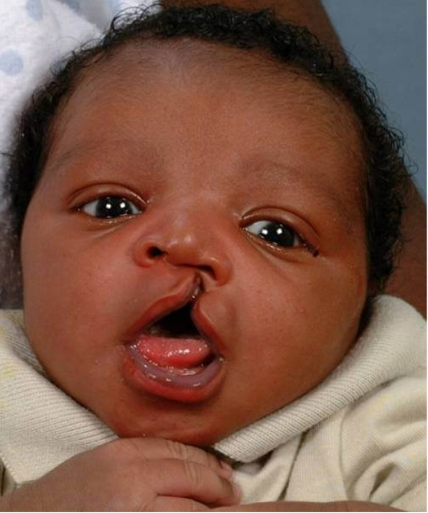
Scenario 4
Imagine that you are part of the study team.
Namyalo enrolled into Group 4 (9 months pregnant) and had a perfect pregnancy. She called the site to inform you that she was heading to the hospital because she was contracting. 5 hours later, Namyalo’s angry parents and in-laws are demanding to talk to you. Namyalo gave birth to a baby with a cleft palate. They want answers! Your study damaged their grandson!
What to you do? What do you say?
When do you reach out to Namyalo?
Will there be community concerns?
Do you notify the other participants?
How can the study team prepare the
community for bad outcomes?

