Slide 1


Overview of Oral PrEP and the Dapivirine Vaginal Ring
Brenda Gati Mirembe, Msc Epi
Makerere University-Johns Hopkins University
Research Collaboration
Ensuring Safe HIV Prevention Methods for Pregnant and Breastfeeding Women
Kampala – 18 June 2019

Slide 2
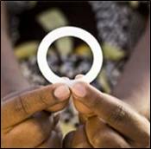
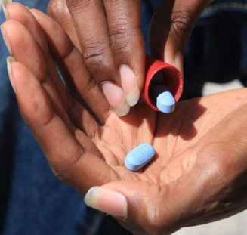
Two HIV prevention methods
The dapivirine vaginal ring is used every month
  Well-tolerated and reduced the risk of HIV in two Phase III trials – ASPIRE and The Ring Study
  Contains an ARV called dapivirine that slowly releases drug into the vagina during the month it is worn
  Is currently under regulatory review – if approved, it would be the first biomedical HIV prevention method developed specifically for women – and the first long-acting method
PrEP is daily use of an ARV tablet (Truvada)
  Is a safe and highly effective method now approved in a number of African countries
  Each tablet contains two ARVs -- tenofovir and emtricitabine
Both must be used consistently to be effective
Notes:
Will talk more about PrEP and the ring tomorrow, during which time we can discuss the rationale and determine whether we are asking the right questions in MTN-042
We wanted to give you an overview of the study and study design before having these more detailed discussions (including the one that follows on ethics)

Slide 3
The Dapivirine Ring

Slide 4
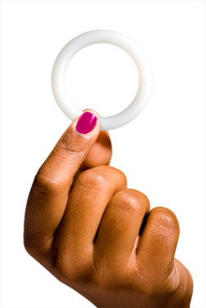


The Dapivirine Ring
Made of flexible silicone, making it easy for women to insert and remove themselves
Intended to be used for a month at a time
  Women rarely feel it
  Is discreet – their partners seldom feel during sex
Slowly releases dapivirine into the vagina – most drug stays in the vagina, the potential site of infection
  Dapivirine is a new drug only being used for prevention – it is not used in treatment of HIV
Developed by the International Partnership for Microbicides (IPM) – a nonprofit group – that is seeking its approval

Slide 5
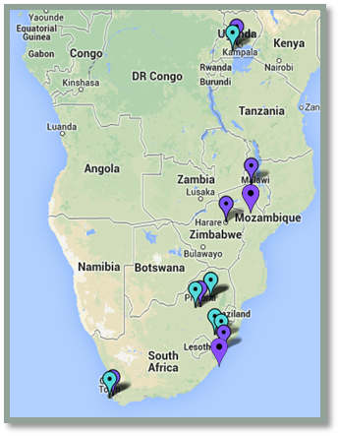
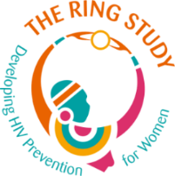

What do we know about the dapivirine ring?
Several studies have been conducted of the ring, including two
large Phase III trials – ASPIRE and The Ring Study
4,588 women in four countries
  Conducted by the Microbicide Trials Network (MTN)
  Enrolled 2,629 women age 18-45 at 15 sites in Malawi, Uganda, South Africa and Zimbabwe
  Conducted by the International Partnership for Microbicides (IPM)
  Enrolled 1,959 women age 18-45 at 7 sites in South Africa and Uganda
Notes:
Women in ASPIRE and The Ring Study were randomly assigned to use either the dapivirine ring or a placebo ring with no drug
We compared the results between these two groups at the end of each study

Slide 6



How did we learn if the ring was effective?
  ASPIRE and The Ring Study were the kind of trials in which participants were randomized into different groups
  One group used the dapivirine ring
  One group used a ring with no active drug – a placebo ring
  The rings looked the same and no one knew who was in which group
  At the end of each study, researchers looked at how many women in each group acquired HIV
  If effective, we would expect that fewer women in the dapivirine ring group would acquire HIV
Vs.
Dapivirine Ring
Placebo Ring
All women received HIV counseling and testing, STI treatment and free condoms
Notes:
Among the 2629 women who were enrolled, 168 HIV-1 infections occurred: 71 in the dapivirine group and 97 in the placebo group (incidence, 3.3 and 4.5 per 100 personyears,
respectively). The incidence of HIV-1 infection in the dapivirine group was lower by 27% (95% confidence interval [CI], 1 to 46; P = 0.05) than that in the placebo
group. In an analysis that excluded data from two sites that had reduced rates of retention
and adherence, the incidence of HIV-1 infection in the dapivirine group was
lower by 37% (95% CI, 12 to 56; P = 0.007) than that in the placebo group. In a post
hoc analysis, higher rates of HIV-1 protection were observed among women over the
age of 21 years (56%; 95% CI, 31 to 71; P<0.001) but not among those 21 years of age
or younger (−27%; 95% CI, −133 to 31; P = 0.45), a difference that was correlated with
reduced adherence. The rates of adverse medical events and antiretroviral resistance
among women who acquired HIV-1 infection were similar in the two groups.
Ring study A total of 77 participants in the dapivirine group underwent HIV-1 seroconversion during 1888 person-years of follow-up (4.1 seroconversions per 100 person-years), as compared with 56 in the placebo group who underwent HIV-1 seroconversion during 917 person-years of follow-up (6.1 seroconversions per 100 person-years). The incidence of HIV-1 infection was 31% lower in the dapivirine group than in the placebo group (hazard ratio, 0.69; 95% confidence interval [CI], 0.49 to 0.99; P=0.04). There was no significant difference in efficacy of the dapivirine ring among women older than 21 years of age (hazard ratio for infection, 0.63; 95% CI, 0.41 to 0.97) and those 21 years of age or younger (hazard ratio, 0.85; 95% CI, 0.45 to 1.60; P=0.43 for treatment-by-age interaction). Among participants with HIV-1 infection, nonnucleoside reverse-transcriptase inhibitor resistance mutations were detected in 14 of 77 participants in the dapivirine group (18.2%) and in 9 of 56 (16.1%) in the placebo group. Serious adverse events occurred more often in the dapivirine group (in 38 participants [2.9%]) than in the placebo group (in 6 [0.9%]). However, no clear pattern was identified.

Slide 7

What did we learn?
The ring is well tolerated – no safety concerns
The ring protects against HIV
  Approximately 30% fewer women acquired HIV in the dapivirine ring group than in the placebo group
  These results include all women – including those who didn’t use the ring regularly
The ring is more effective when it’s used
  In ASPIRE, among women older than 21 – who also used the ring more regularly – HIV risk was reduced by more than half (56%)
  The ring was not effective among 18-21 year-olds – who did not use the ring regularly
Notes:
Safe and effective in women >21years and protection increased with more consistent use
Adherence was better compared to daily use products
With continued use & counselling ring worries reduced...better adherence
Almost all women were able to insert and remove ring on their own following first instructions
Once inserted well, women forgot it was there till when it was time to remove it
Ring did not interfere with sexual activity
Women were able to use the ring discretely
Those who disclosed adhered better

Slide 8

Getting used to the ring
Those who’ve never used a ring have notions that it will be difficult to use
ASPIRE participants said they were unsure about it at first …
But got more confident in using it over time
  When I first saw it, it was like, WOW!
It was easy to use ring and
it was comfortable, I couldn’t feel the ring. Even during my periods, it was no problem at all. During sex, I didn’t have doubts about it.
Notes:
- comparing it to the female condom.

Slide 9

The dapivirine ring was empowering
I like that the ring stays inside you and nobody can see it…. you don’t have to disclose ring use to others if you want. My family doesn’t know that I am using the ring. … And the partner can’t feel it as well.

Slide 10

After ASPIRE and The Ring Study:
HOPE and DREAM
HOPE and DREAM provided former participants of the ASPIRE and The Ring Study the opportunity to use the dapivirine ring for one year
  There was no placebo ring
The HOPE and DREAM studies were designed to collect additional information on safety and adherence to inform potential rollout of the ring should it receive regulatory approval
  One step closer to understanding “real-world” use

Slide 11
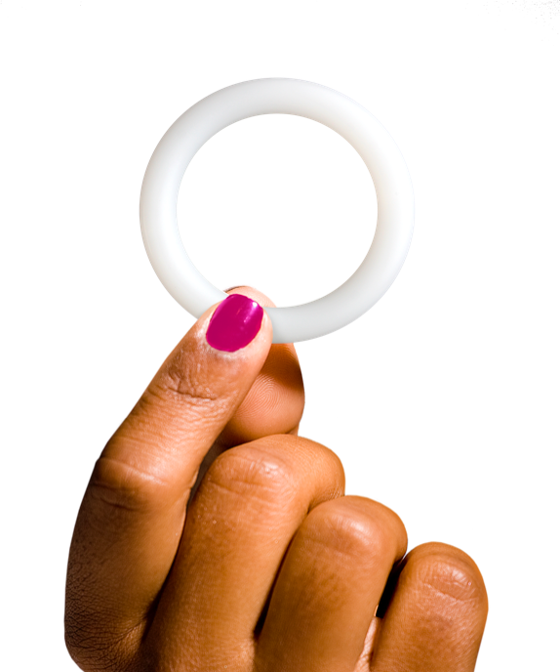
HOPE and DREAM Results . . .
Safety profile similar to ASPIRE and The Ring Study
Women used the ring more consistently than they did in the Phase III trials
  Knowing that they were all receiving the active ring and that it has been found to be safe and effective
Interim results of HOPE and DREAM suggest greater than 50% reduction in HIV risk
Final results of DREAM suggest 63% - HOPE results are due next month
Notes:
Comparisons of HIV incidence using statistical modelling suggested HIV risk was reduced by 54% in both open-label studies – these were results presented last year.
Last week, DREAM reported its final results at the SA AIDS conference in Durban – and the estimated HIV risk reduction was 63%. Final HOPE results will be reported next month.
Keep in mind, that these are estimates… and there is a limitation in how these results should be interpreted, because there is no real comparison group – i,e, a group using an inactive product

Slide 12
The Dapivirine Ring
Now what?

Slide 13
Next Steps for the Dapivirine Ring
Regulatory Process
IPM is applying for approval through European, African and US regulatory authorities
Potential Introduction
Additional Research
Safety studies of ring and PrEP among adolescent girls, pregnant and breastfeeding women in Africa
Notes:
Regulatory:
IPM is regulatory sponsor
Hopeful first approvals in some African countries sometime in 2020
From the beginning of the drug development process, IPM has been making an all-out effort to close all gaps in the time line from efficacy to licensure, including regulatory planning/preparation
Big job
For any product, nce efficacy is shown for any product, it still takes a lot of time and effort between those results and regulatory approval and licensure
Process must be rigorous to ensure that women will benefit from a product that is safe and of high quality that addresses their health needs – need to include more comprehensive safety and quality data
Research – studies planned for 2019-2020

Slide 14

It’s a BIG job
IPM’s master dapivirine ring dossier being submitted to regulatory agencies includes:
  13 years of data and findings from nearly 250 studies
  Consists of 260,000 pages
    When printed could fill a 2X2 meter room!
Notes:
260K PDF pages with 69K links
Digital era: electronic EMA submission was 4.4 GB – equivalent to 3 days of streaming music – and took 15 hours to upload!

Slide 15
Truvada as Oral PrEP

Slide 16


What is PrEP?
  PrEP is an HIV prevention method that involves daily use of an ARV tablet - Truvada
  Truvada contains two ARV drugs – tenofovir (TDF) & emtricitabine (FTC)
  Was already approved for treatment of HIV in combination with other ARVs as part of ART
  Several trials tested Truvada as prevention for HIV
  Was first approved for prevention (PrEP) by the US Food and Drug Administration in 2012
  Now approved in 40 countries
  The World Health Organization (WHO) recommends its use by anyone who is at risk of HIV
Notes:
Many trials tested Truvada for prevention:
iPrEx - in men who have sex with men - (44% effective)
Partners PrEP- in couples with an HIV-infected partner - (75% effective)
TDF-2 - in men and women - (62% effective)
FEM-PrEP - in women - (not effective)
VOICE - in women - (not effective)

Slide 17
What do we know about PrEP?
Daily oral PrEP is safe
Because the drug goes everywhere in the body (is systemic), we know that use of tenofovir (one of the ARVs in Truvada) impacts bone density and markers of kidney health, although we do not know whether this is clinically significant
People using PrEP must be tested for HIV to be sure that they don’t start or continue using PrEP if they are infected
  Although rare, resistance to PrEP drug(s) can arise if the person starts PrEP with undiagnosed HIV and/or if he or she acquires HIV and keeps on taking PrEP afterwards.
Notes:
Good safety
there are rare risks of effects on kidney that are reversible and can be monitored
Must not be HIV infected to avoid resistance
Regular HIV testing to determine not infected
Resistance has not been an issue

Slide 18
What do we know about PrEP?
PrEP is highly effective against HIV, but for it to be protective, adherence is essential
Daily pill taking can be a challenge for some people
Some people have expressed concern about the stigma associated with taking a drug that is also used for HIV treatment

Slide 19
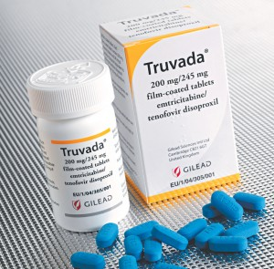
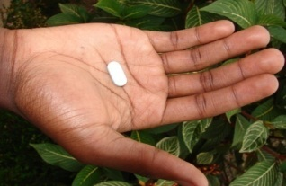
Where are we now?
Several countries have approved Truvada as PrEP, and implementing in different populations.
  People with ability to pay can access PrEP in the private sector
Several ongoing or planned demonstration projects are geared for different high-risk populations.
Notes:
WHO guidelines (Sep 2015) for PrEP: - “oral PrEP containing TDF should be offered as an additional choice for
people at substantial risk of HIV as part of a combination prevention package.” Now licensed for use as PrEP in several countries in SSA. Currently being rolled out to sex workers in South Africa – a key population identified for urgent attention
Partners PrEP study: conducted among serodiscordant couples in Kenya and Uganda. HIV negative partner received Tenofovir based PrEP
FEM PrEP: high pregnancy rate among women on COCs – indicating a possible challenge with a daily pill taking regimen
South Africa has begun implementing PrEP rollout to female sex workers, with men who have sex with men the next targeted population.
Adolescent girls and young women are expected to follow, but several questions remain about delivery channels.

Slide 20
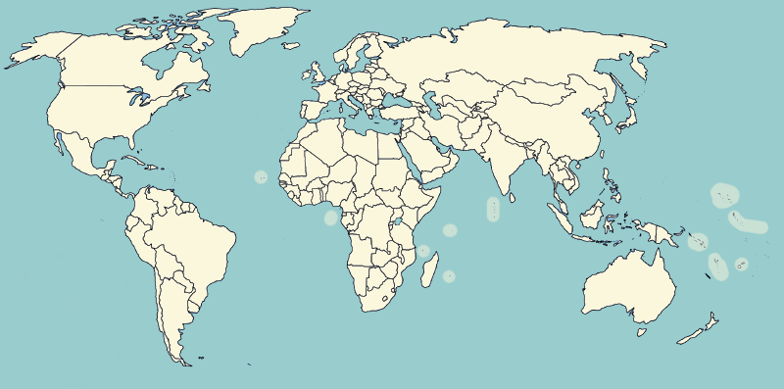
Global Oral PrEP Use by Country Feb 2019
1,700-2,200
1,000-1,500
9,700-10,200
4,300-4,800
4,700-5,200
100-300
1,500-2,000
11,500-12,500
200-400
100-300
260,000-275,000
1,000-1,500
800-1,000
200-400
100-300
100-300
800-1,000
100
100
11,500-12,500
100-300
100-300
50-150
600-800
1,200-1,700
100
53,000-54,000
6,800-7,300
50-150
100
400-600
7,800-8,300
4,000-5,000
100-300
3,500-4,000
300-500
17,000-18,000
5,300-5,800
1,500-2,000
100
8,700-9,200
11,000-12,000
8,000-8,500
1,800-2,300
1,000-1,500

Slide 21
Global Oral PrEP Use by Country Feb 2019
US 275,000
All Others 199,100
Total 474,100

Slide 22
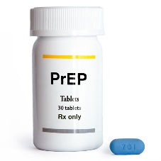
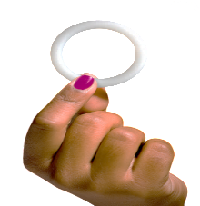
We’ve had longer to learn more about PrEP
 | Truvada as daily PrEP | Monthly Dapivirine Ring
Phase III Trials | 6 | 2
Open-Label Studies (with no placebo) | 20+ | 2
How effective with consistent use? | Very (more than 90%) | Don’t know yet (at least 50% or more)
Where drug goes | Drug goes throughout body – must monitor potential effects | Drug delivered into vagina - little goes elsewhere
Challenges | Daily pill-taking can be difficult; stigma of HIV meds | Vaginal rings unfamiliar; takes time to get used to
Approval Status | Approved in many countries for non pregnant or breastfeeding women | Approval Pending – for non pregnant or breastfeeding women 18 and older
Notes:
Compared with the ring, we have far more experience with PrEP.
6 Phase III trials were conducted of PrEP (in different populations) compared to 2 for the ring.
These had already been completed by the time we started ASPIRE and The Ring Study, and in fact the first approval for PrEP – in the US – was the same year we started (2012).
Since then, there have been more than 20 PrEP “open-label” studies and demonstration projects – the kind of studies in which there is no placebo – everyone gets PrEP. We learned that people were much more willing to use it than in the Phase III trials. And that’s when we saw just how effective PrEP can be when people use it regularly.
Two open-label studies of the ring - DREAM and HOPE - are still ongoing. We are hoping to see a similar effect, with women more interested in using the ring consistently, and there being higher efficacy as a result.
Neither is perfect.
Daily pill taking is not easy for everyone – plus stigma can been a concern. Vaginal rings are not familiar to most African women, and they may not feel comfortable inserting it themselves. It takes time to get used to.

Slide 23
People need choices
Neither PrEP nor the ring is perfect
People’s preferences are different
The more choices in HIV prevention products the more likely that one will be used

Slide 24
Acknowledgements
Thank You!
The Microbicide Trials Network is funded by the National Institute of Allergy and Infectious Diseases (UM1AI068633, UM1AI068615, UM1AI106707), with co-funding from the Eunice Kennedy Shriver National Institute of Child Health and Human Development and the National Institute of Mental Health, all components of the U.S. National Institutes of Health.

Slide 25
What is happening with PrEP in Uganda?

