Slide 1

A quick snapshot:
PrEP, the vaginal ring and the
DELIVER and B-PROTECTED studies
Katie Bunge, M.D.
University of Pittsburgh School of Medicine
Magee-Womens Hospital of UPMC
Ensuring the HIV Prevention Needs of Pregnant and Breastfeeding Women
Kampala – 18 June 2019

Slide 2

The Need
Women may be pregnant or breastfeeding for a significant portion of their lives
Pregnancy and breastfeeding represent periods of high HIV risk
Preventing HIV infection in the mother protects her baby, too

Slide 3
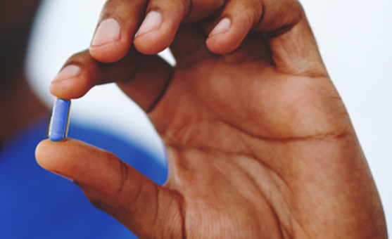
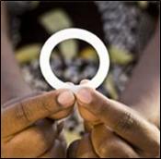


What about PrEP?
What about a vaginal ring?
Two methods could make a difference for women, including women who are pregnant or breastfeeding:
  PrEP: Daily use of an ARV called Truvada
  Vaginal ring: Used continuously for a month at a time
That’s why we’re conducting DELIVER and B-PROTECTED:
Notes:
We’re going to tell you more about these studies, but first …..

Slide 4
How do we know that a medicine is safe during pregnancy or breastfeeding?
Katie Bunge, M.D.
University of Pittsburgh School of Medicine
Magee-Womens Hospital of UPMC
Ensuring the HIV Prevention Needs of Pregnant and Breastfeeding Women
Kampala – 18 June 2019

Slide 5
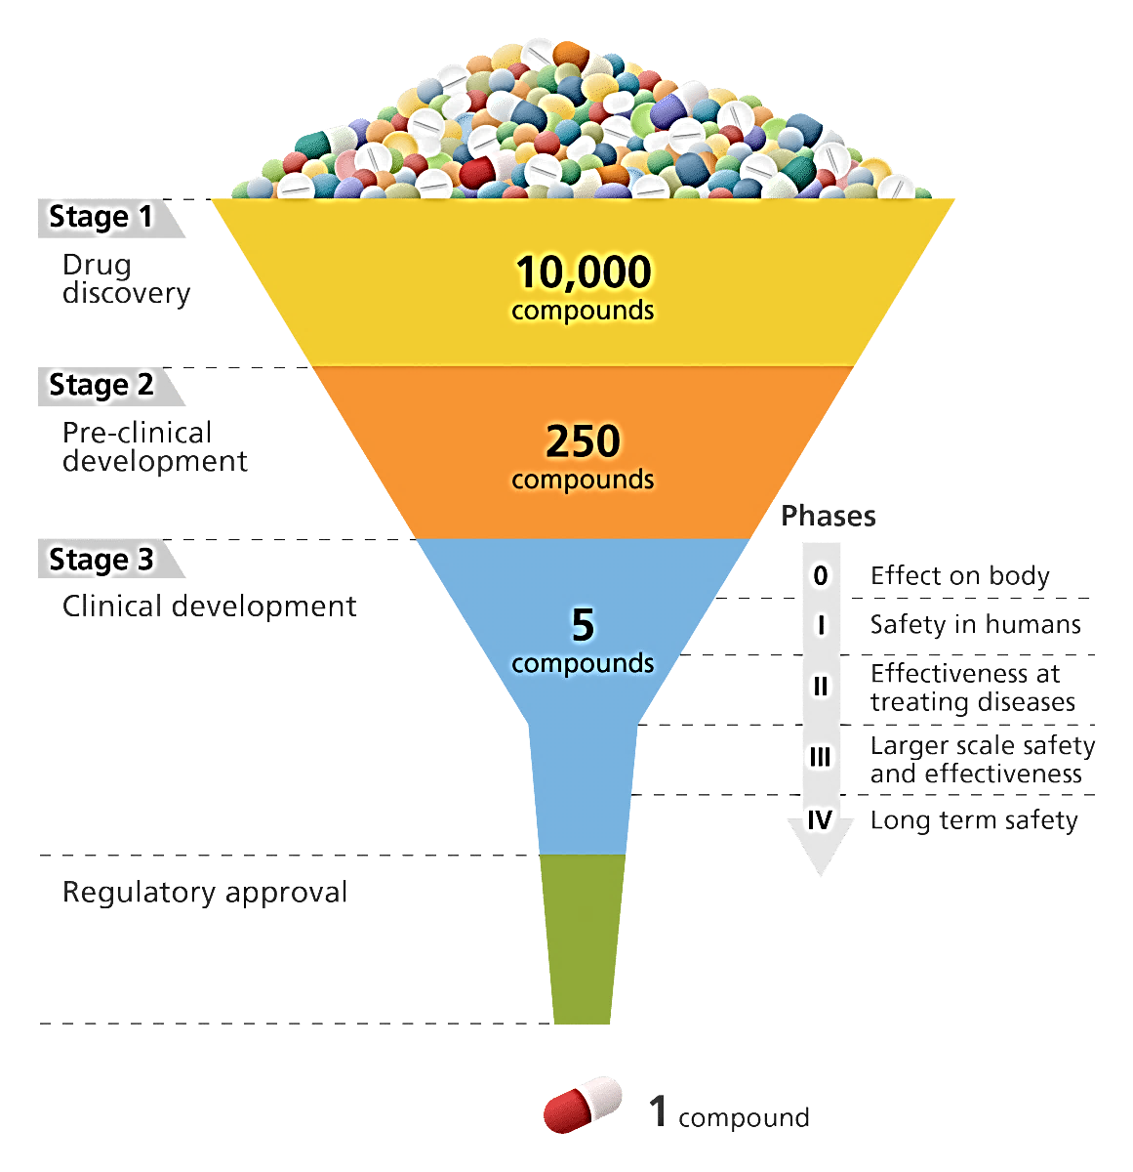

First, where do medicines come from?
The answer is somewhat complicated
The process begins with laboratory and animal studies, then studies in people – it can take 10 years or more
Of 10,000 or so potential compounds, very few make it all the way through the process to become an approved drug
1 approved drug
Notes:
It begins with Research begins in laboratories and in animals before they are tested in people [insert graphic]
The first kinds of studies look to be sure something is safe – involve small number of people, rigorous tests – Phase I studies
Progresses to Phase IIPhase III
Multiple studies like these
Then drug regulatory authorities like the FDA in the US or the Medicines whatever in SA/Malawi decide whether to approve the drug
doctors then can subscribe
It can be purchased at your pharmacy
It can take 10 years from identifying a compound to a Phase III trial – and that’s no guarantee that the product will prove to be safe and effective

Slide 6
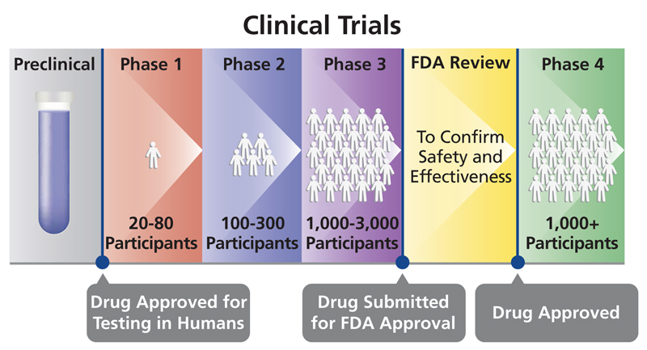
How is a drug determined to be safe and effective in people?
First, Phase I studies look at safety in a very small number of people
If there are no concerns, studies will be conducted in a larger number of people, with safety still a primary concern.
Larger (Phase III) studies are conducted to determine whether the product works as it is intended to (effectiveness)
Regulatory
review
Approval

Slide 7

How do drugs get approved?
If a drug is found to be safe and effective, the company that makes the drug will compile everything there is to know about that drug
  Results of laboratory studies
  Results of animal studies
  Results of clinical studies in people
A drug regulatory agency will decide whether or not to approve the drug based on its review of all this information.
Notes:
like the US Food and Drug Administration or the Malawi Poisons Medicines Control Board

Slide 8
Can anyone take part in a clinical research study?
Researchers are very particular about who can participate in a clinical trial
Each study has its own rules about who can – or cannot participate – called eligibility criteria.
  May be based on age, gender, medical condition, etc.
Safety is the number one concern
Notes:
Because researchers want to make sure that whatever happens in a clinical trial is the result of the new treatment or procedure and not just chance, the people eligible to participate in a clinical trial are limited to a group with very specific characteristics.
So, each study has its own rules about who can — or cannot — participate. This is called “eligibility.” Your eligibility may be based on your age, gender, overall health, type and stage of a disease, treatment history, and other conditions.
In order to become a clinical trial participant, you must qualify by satisfying both the inclusion and exclusion criteria.
Inclusion and exclusion criteria are used to protect a participant’s safety during a clinical trial.

Slide 9
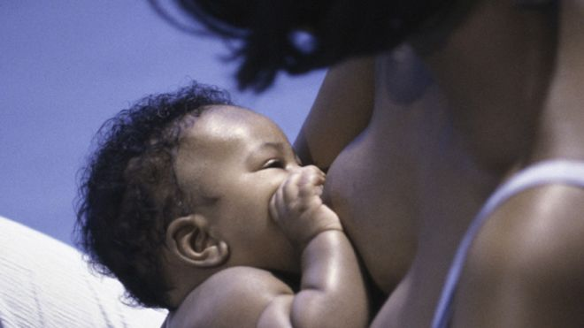
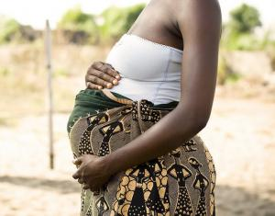
What about pregnant or breastfeeding women?
Most clinical trials, particularly of new drugs, exclude pregnant and breastfeeding women.
­Women who enroll often must use contraception, and if they get pregnant, stop study product
Why?
  To protect the developing fetus or baby from potential harm
Notes:
Pregnant women are often systematically excluded from research studies, but this leaves us with very limited data on effectiveness and safety of drugs for pregnant women. There is a move now towards informed inclusion rather than compulsory exclusion, but still very few drug studies include pregnant women. There are 2 powerful statistics to bring this point home, 95% of all Phase IV drug studies exclude pregnant women. (CLICK) Yet, 78% of women are exposed to a class B/C drug during pregnancy. Class B/C refers to drugs with no adequate and well-controlled studies in pregnant women or when animal studies indicate potential harm. So it’s not that women are not taking drugs during pregnancy, it’s just that we are excluding pregnant women from research.

Slide 10










The approval decision is based on data, but…
If pregnant and breastfeeding women could not participate in any of the clinical trials, there won’t be any information about the drug in these populations.
There will be lots of information about these kinds of people….
Because there were lots of people like them in the trials…
And very few people, if any, like her….

Slide 11


Approval will not apply to pregnant and breastfeeding women
­This means that a drug that is approved will be “contraindicated” in women during pregnancy and breastfeeding
Contraindicated means that the drug should not be used because there is concern that it may cause harm

Slide 12

But what if a woman who is pregnant or breastfeeding needs medicine?
Her care provider must make a decision ….
“This is what I know about this drug in animals…”
“Can I assume it will be safe and effective in women who ARE pregnant or breastfeeding…?”
“It was safe in women who were NOT pregnant or breastfeeding…”

Slide 13
But what if a woman who is pregnant or breastfeeding needs medicine?
What’s the risk?
  Don’t know for certain the drug will be safe for the mom, or that it will work in the same way
  Don’t know for certain that the drug will be safe for the baby
  (sound familiar?)

Slide 14


How do we know that a drug is safe during pregnancy and breastfeeding?
Two approaches:
Follow pregnancy outcomes after product is released and hope that any problems are reported
Intentionally study the safety of these medicines in pregnancy and breastfeeding
Notes:
The reality is that we rely on the first approach for the vast majority of drugs.
BUT here is the case for intentionally studying drugs in pregnant and breastfeeding women

Slide 15
The story of antiretroviral (ARV) drugs
Of 31 approved ARVs, it was on average 5 years AFTER approval before any pregnancy data was collected
  No data in 3/7 drugs approved since 2010
Big unknowns, particularly for newer drugs:
  Does the drug get absorbed in the body of a pregnant woman in the same way?
  Is the drug safe to use during pregnancy and breastfeeding?
  Does the drug affect development of the baby (fetus) if taken during pregnancy?
  Is it safe to use during breastfeeding?
Marisha N. Wickremsinhe, Margaret O. Little, Alice S. Carter, Kristen A. Sullivan, and Anne D. Lyerly.Journal of Women's Health.Jan 2019.ahead of printhttp://doi.org/10.1089/jwh.2017.6857
Published in Volume: 28 Issue 1: January 10, 2019
Online Ahead of Print:August 20, 2018

Slide 16
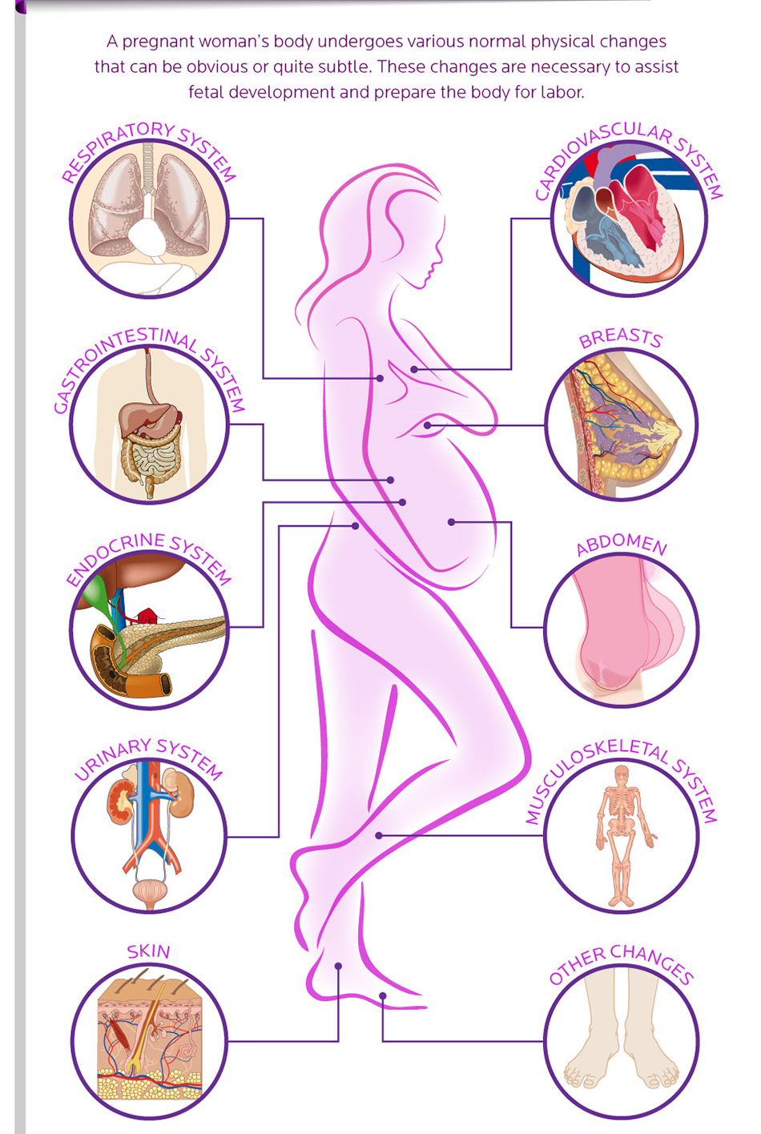
Why we should study drugs in pregnancy rather than leave safety to chance
The body undergoes many changes during pregnancy
A drug may work differently in a woman who’s pregnant
It may pass to the placenta and cause harm to the developing fetus or put the pregnancy (mother/fetus) at risk
Fear of unknown risks may cause women to forgo taking a medication that would benefit them and/or their fetus

Slide 17
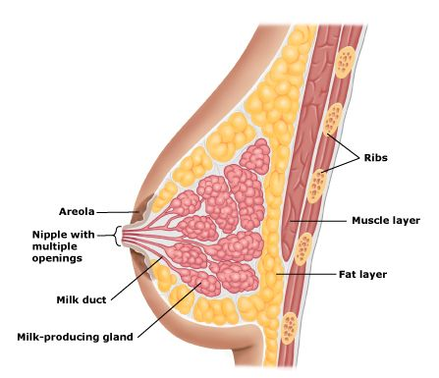
Why we should study drugs in breastfeeding women rather than leave safety to chance
The body undergoes many changes during breastfeeding
Certain drugs may or may not
  impact milk supply
  pass into breastmilk
  be orally absorbed by the infant
  have adverse effects on the infant
If risks of medication are unknown, some mothers may stop breastfeeding, potentially depriving infant of benefits of breast milk and introducing more risk to the infant than the drug would have

Slide 18
What’s the difference between learning about safety in a clinical trial vs in the real world?
If there is a safety problem, in the real world there’s potential to do harm to many more women and babies because there is less monitoring and many more women could be using the drug
In a trial setting, study staff can closely monitor each woman and stop the drug if there is any suggestion of harm
In the real world, there’s not that kind of woman by woman control or oversight of what is happening to her and her pregnancy -- Potentially putting many more women and babies at risk

Slide 19
But what if a woman who is pregnant or breastfeeding needs medication?
  “This is what I know from trials with women who were not pregnant or breastfeeding...”
“Now we can make an informed decision …”
“And here is some information from a study that looked specifically at the safety of this drug in pregnant and breastfeeding women …”
Notes:
With information, Regulatory agencies might consider explanding approval to pregnant women.
Doctors and women themselves are able to make informed choices

Slide 20
Summary
Many experts and ethicists agree that pregnant and breastfeeding women deserve to be included in clinical trials of potentially beneficial drugs
  Mothers benefit, Infants benefit, Clinicians benefit, Science benefits
Women may be pregnant or breastfeeding for a significant portion of their lifespan
Pregnancy and breastfeeding represent periods of high HIV risk
Preventing HIV infection in the mother also protects the baby

Slide 21
Questions?

