Slide 1
IT’S ALL ABOUT SAFETY! DELIVER and B-PROTECTED Studies
Clemensia Nakabiito, MBChB, MMed
Katie Bunge, MD, MPH
Ensuring Safe HIV Prevention Methods for Pregnant and Breastfeeding Women
Kampala, Uganda– 19 June 2019

Slide 2
MTN-042: A Three-Way Safety Net for Two
Study Objective
Understanding the safety of PrEP and the ring during pregnancy
Study Design
A step-wise approach
Study Conduct
Multiple measures to ensure safe participation
So that women can be protected against HIV at all times, including during pregnancy, with methods that are safe for them and their babies

Slide 3
Study Objective

Slide 4
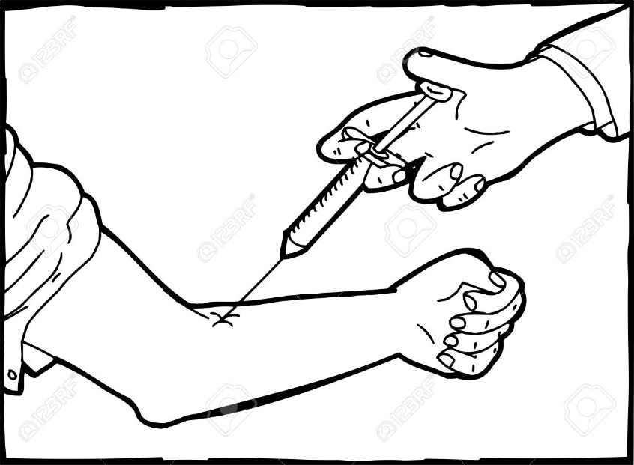
Study objective
The goal of the study is to see whether the two study products are safe for baby and mom
This starts at the site level
Participants will be seen every 1-4 weeks depending on how far along in the pregnancy they are until 6 weeks after delivery
Infants will be seen for a year
Notes:
At every visit, participants will be asked if they are having any problems (for example, a headache, nausea, or pain)
At every visit, the participant and the fetus will be examined by a clinician
At some visits, blood work to check the health of the liver and kidney will be collected

Slide 5
Primary goal: Birth Outcome
In addition to collecting information about problems women might have while in the study we will follow women through delivery
We will know how the pregnancy ended- “the outcome”
Was it a normal delivery of a fully developed baby? (full term birth)
Was it an early delivery- more than three weeks before expected? (preterm birth)
Was it a delivery of a baby that was dead when it came out? (still birth)
Was it an early loss of the baby- less than 5 months? (pregnancy loss)

Slide 6
How do we know whether oral PrEP or ring affect birth outcomes?
At the end of the study, we will compare how often women and babies had serious problems AND how often moms had bad pregnancy outcomes
We can compare what happens to women in our study to women delivering at our hospitals who were not part of the study

Slide 7
Other important safety information which will be measured
High blood pressure (hypertensive disorders of pregnancy)
Infection of the womb (chorioamnionitis or endometritis)
Infection in the blood (Puerperal sepsis)
Dangerous bleeding (Hemorrhage)
Water around the baby breaking too early (Preterm premature rupture of membranes)
Fever
This is a “secondary endpoint” because this information is important, but not as important as the “pregnancy outcome”

Slide 8
Study Design

Slide 9
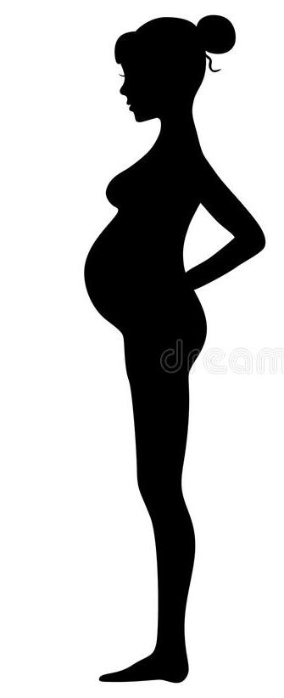
Study design
1
2
3
4
Remember there are four groups
The first group is farthest in pregnancy
Experts will review
outcomes before the
next group is enrolled
Notes:
This is how I would change this slide. Obviousy, formatted pretty
I like the graphic! Would make it bigger
Regarding 2:1 ratio – would not do that in this presentation This may come up in the discussion. Would just be prepared to answer- but not explain why

Slide 10
The importance of design
Most of the study information will come from the last group of enrolled participants
They will use the product for the longest time
Instead of starting with the last and biggest group, we start with the women farthest in pregnancy to be sure the products are safe

Slide 11
A stepwise approach with interim reviews
150 women
?
Group 1
36+ weeks
Post-delivery
Data review
4-6 weeks
150 women
?
Group 2
30-35 weeks
Post-delivery
Data review
7-12 weeks
150 women
Data review
?
Group 3
20-29 weeks
13-22 weeks
Post-delivery
300 women
Group 4
12-19 weeks
Up to 30 weeks
Post-delivery
Study Complete

Slide 12
The experts in the interim review panel
Our 7 person dream team:
1 community representative
1-2 obstetrics care provider from Sub-Saharan Africa
1 obstetrics care provider from the United States
1 pediatrician from Sub-Saharan Africa
1 ethicist
1 maternal-child health expert from the public health sector, most likely from Sub-Saharan Africa
They cannot have any connection to the study so that we know that they speak truthfully

Slide 13
Each group will use the ring or PrEP a longer time
number | Ring or PrEP? | Approximately how long?
150 | 100 will use the ring 50 will use PrEP | 4-6 weeks
Group 1
36+ weeks
Group 2
30-35 weeks
150 | 100 will use the ring 50 will use PrEP | 7-12 weeks
Group 3
20-29 weeks
150 | 100 will use the ring 50 will use PrEP | 13-22 weeks
Group 4
12-19 weeks
300 | 200 will use the ring 100 will use PrEP | Up to 30 weeks

Slide 14
What will the review group see?
Rates of pregnancy and infant outcomes for the PrEP and dapivirine ring groups
Rates of the same outcomes in the population of women from the same hospitals but not in our study as well as published data from studies of pregnancy outcomes from the same regions
Summary of the safety data from all study participants

Slide 15
The process
Safety physicians from the study and study statisticians will be there to answer questions put forward by the safety review panel but will not vote on whether or not the study will proceed
At least 5 of 7 members will have to vote “yes” in order for the study to move forward to the next group
The decision of the interim safety review panel will be communicated to the study team, the IRB, the participants and the community

Slide 16
Study Conduct

Slide 17
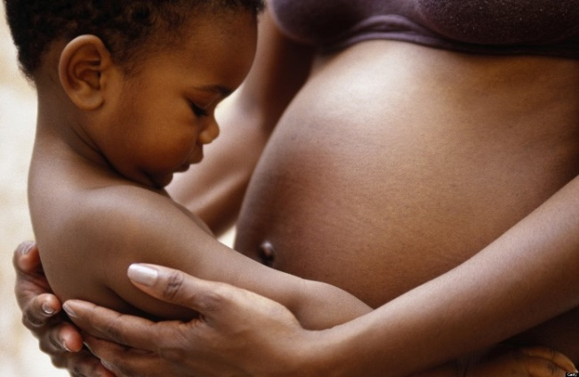
Ensuring safety at several levels
Site clinicians will monitor the safety and well-being of participants at each visit
Deliver has its own safety review team led by safety physicians who will review routine safety data every month and more serious issues in real time
Ongoing oversight by local IRBs/ECs
Study outcomes will be reviewed by an external Interim Safety Review Panel at the conclusion of each group and determine whether the next cohort can be enrolled
Notes:
I left this blank because I am not sure about the layers that you want to include
There are several layers of safety monitoring included in this trial. This includes at the site, local and country level as well as within the United States and by the sponsors and funders of the study.

Slide 18
When there is a problem
This will be detected by the site team
First and foremost, the site will treat the problem or refer to the hospital if necessary
If serious and related to the ring or PrEP, the woman will stop using the product
This is expected to be rare. It did not happen in ASPIRE or the Ring Study. It was rare in PrEP studies
Second, the site notifies the larger study team, who follows problems across all four sites
The site is committed to providing
the best care possible to its participants

Slide 19
Acknowledgements
The Microbicide Trials Network is funded by the National Institute of Allergy and Infectious Diseases (UM1AI068633, UM1AI068615, UM1AI106707), with co-funding from the Eunice Kennedy Shriver National Institute of Child Health and Human Development and the National Institute of Mental Health, all components of the U.S. National Institutes of Health. The content is solely the responsibility of the authors and does not necessarily represent the official views of the National Institutes of Health.

