Slide 1
What do you think?
Uganda Stakeholders Meeting on the
DELIVER and B-PROTECTED Studies
June 19, 2019

Slide 2
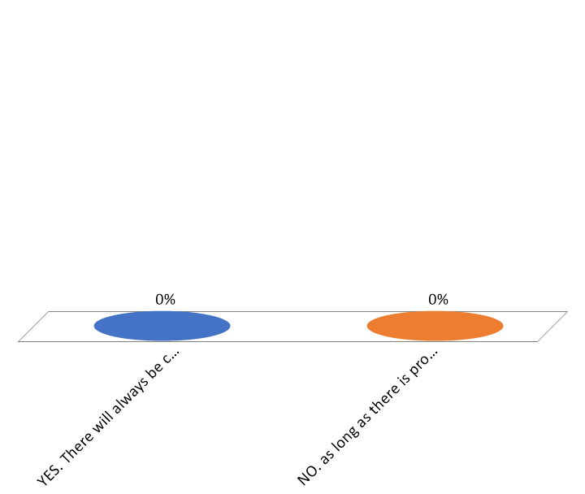
DELIVER AND B-PROTECTED will evaluate PrEP and the dapivirine ring in pregnant and breastfeeding women. Do you think these studies will be a cause for concern in your community?
YES. There will always be concern about the fact that these studies will be involving pregnant and breastfeeding women.
NO. As long as there is proper community and stakeholder engagement prior to and during each of the studies there should be no major problems.

Slide 3
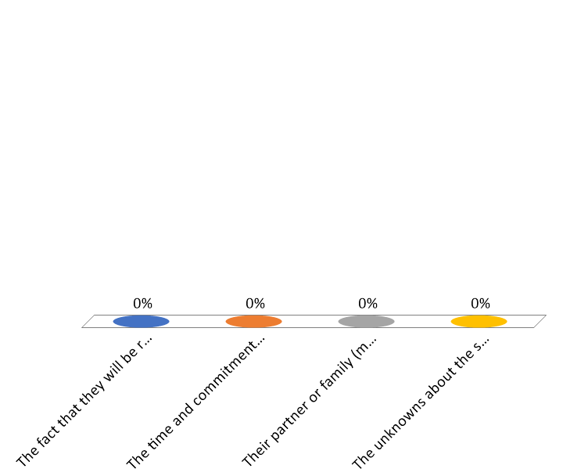
What do you think is the main reason some women will not join the DELIVER or B-PROTECTED studies?
The fact that they will be randomized to use either PrEP or the ring
The time and commitment involved (clinic visits, etc.)
Their partner or family (mother, mother-in-law) not being supportive
The unknowns about the safety of PrEP and the ring in pregnancy and breastfeeding

Slide 4

Which product personally concerns you the most in terms of its use in pregnant women?
PrEP – because it is systemic (the drug goes throughout the body)
The ring – because it hasn’t been studied enough
The ring – because it would be a foreign object in women’s vaginas
PrEP – because of the stigma of using an ARV

Slide 5


DELIVER: 4 Groups of Women
DELIVER will enroll 750 pregnant women at different times during pregnancy
  Group 1 – 36+ weeks pregnant (about 8-9 months)
  Group 2 – 30-35 weeks pregnant (about 7-8 months)
  Group 3 – 20-29 weeks pregnant (about 5-7 months)
  Group 4 – 12-19 weeks pregnant (about 3-5 months)

Slide 6

The purpose of enrolling women late in pregnancy (Group 1) in DELIVER is…
To determine whether or not PrEP and the ring prevent HIV
To determine whether or not women are willing to put something in the vagina late in pregnancy
To determine whether PrEP and the ring are safe to use late in pregnancy
There is no point in answering this question because women won’t want to enroll in this study anyway

Slide 7

Which group of women will be the most difficult to enroll into the study?
Group 1 – 8-9 months (36+ weeks pregnant)
Group 2 – 7-8 month (30-35 weeks)
Group 3 – 5-7 months (20-29 weeks)
Group 4 - 3-5 months (12 -19 weeks)

Slide 8
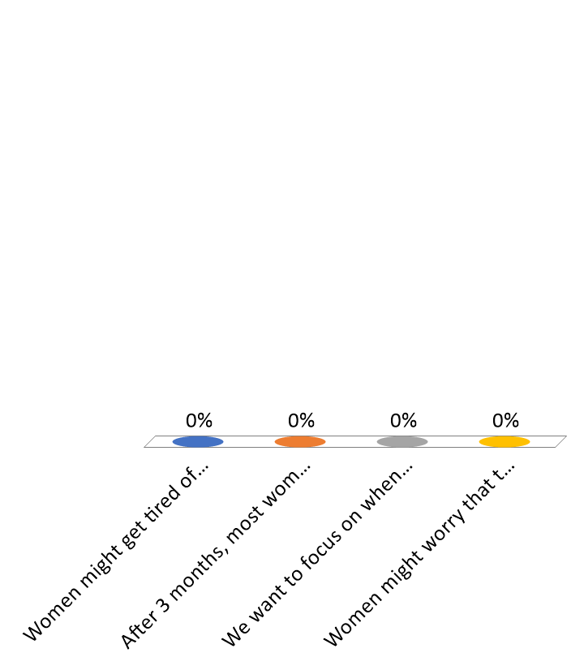
Women in B-Protected will use product for only three months. This is because…
Women might get tired of being in the study for longer than 3 months
After 3 months, most women need to return to work
We want to focus on when women are exclusively breastfeeding
Women might worry that the drugs will make the breast milk taste bitter

Slide 9
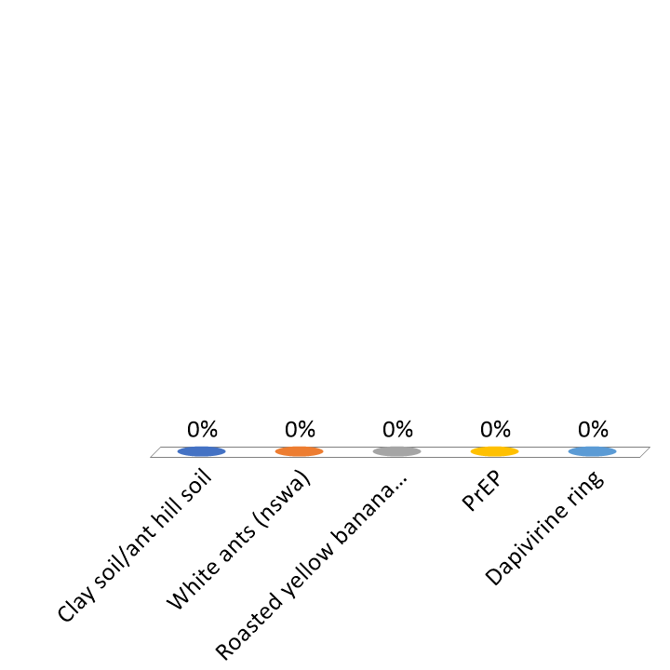
What do pregnant women crave the most?
Clay soil/ant hill soil
White ants (nswa)
Roasted yellow bananas (gonja)
PrEP
Dapivirine ring

