Slide 1
HIV Testing for Advocates
Basics of HIV Testing and Implications for HIV Prevention
Draft for Comment
AVAC
March 2022

Slide 2
Outline
HIV Testing: Quick overview
Types of HIV Tests
WHO Guidelines for HIV Testing
  Recommendations for HIV Testing
  List of WHO Guidelines on HIV Testing
  WHO Guidelines for HIV testing for oral PrEP
Program experiences with HIV testing and oral PrEP
HIV Testing and CAB for PrEP
Current Issues in HIV Testing Policies and Programs
Looking Ahead
Resources and More Information

Slide 3
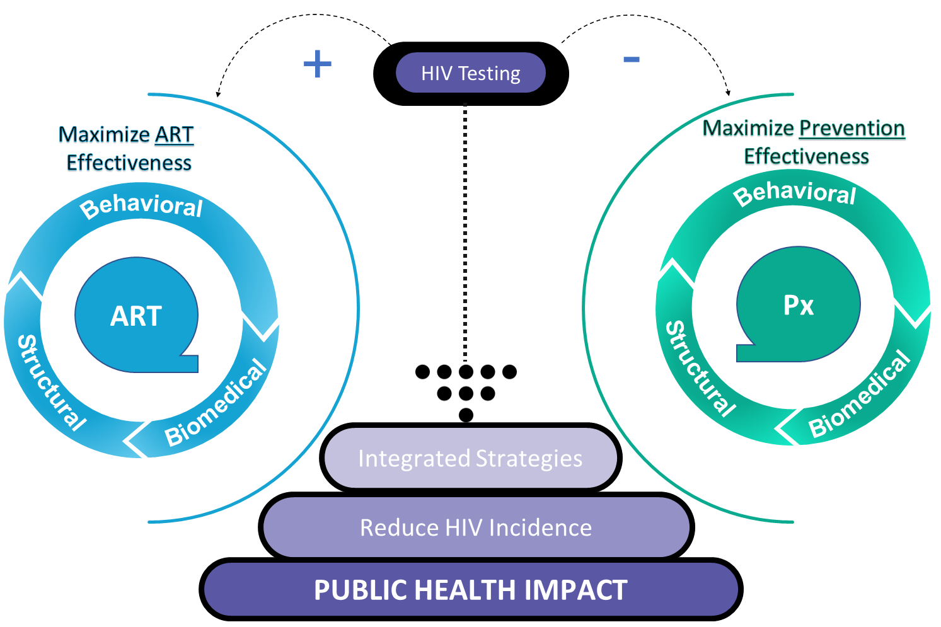
Universal Test and Connect
Testing is pivotal to identifying & referring people for services and support – for treatment & prevention
Notes:
Is this figure ok to start with ?

Slide 4
HIV Testing: Quick overview
HIV testing is a cornerstone of all efforts to address HIV
  Ensuring that all people can know their HIV status to access appropriate services and support for treatment or prevention
  Reaching UNAIDS 95-95-95 targets and eliminating AIDS by 2030
Multiple types and brands of tests are used in settings worldwide for research, screening, diagnosis and monitoring
  Different test types meet different programmatic needs
  WHO processes provide assurance of test quality, performance and operational characteristics
Testing is central to ARV-based HIV prevention programs
  Work ongoing on testing recommendations that balance safety with feasibility as services are decentralized and expand into community settings to improve access

Slide 5
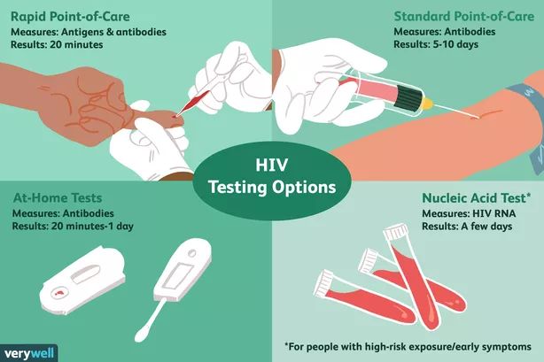
Types of HIV Tests
Four main types of HIV tests are produced, sold and distributed under different brands and packaging
Different types of tests are used for different diagnostic and programmatic purposes
Programs have worked to expand use of rapid tests and self-testing to increase access to testing and to meet program goals
Nucleic Acid Testing (NAT) is not widely available for screening in LMIC
Rapid Diagnostic Test
Results: 1-20 min
Enzyme Immunoassay Test
Results: ≥2.5 hours
Self-test
Results: 1-20 min
Nucleic Acid Test
Results: usually a few days
Notes:
Search for Credit for figure?

Slide 6
Summary of HIV Test Types and Characteristics
Test Type | Sample/ Measures | How Soon to Detection | How Long to Result | Key Considerations
Nucleic Acid Test (NAT) (also called RNA or Viral Load) | Blood from vein HIV RNA | 10 days after exposure | Days to weeks | Not in routine use for screening in LMIC Sometimes used to monitor VL in PLWHIV taking ART Requires laboratory capacity and skilled technicians Expensive to perform and maintain WHO recommends use to diagnose children < 18 months of age
Enzyme Immunoassay Test (EIA) | Blood from vein or finger prick Antibodies and Antigens | 14 days - 1 month after exposure | 2.5 hours – days | 4th generation RDT; quick and easy to use Measures antibodies AND p24 viral proteins (antigens) that are present earlier than antibodies More costly than 3rd generation Not widely available in LMIC
Rapid Diagnostic Test (RDT) | Blood from vein, finger prick; oral sample with swab Antibodies | 4 weeks - 3 months after exposure | Within 20 minutes | Quick and easy to use HIV- result considered definitive; HIV+ result needs confirmation. WHO recommends 2 confirmatory tests Included in national HIV testing algorithms; WHO recommends for HIV diagnosis
Self- Test | Blood from finger prick or oral sample with swab Antibodies | 3 months after exposure | Within 20 minutes | Quick and easy to use; helps expand access and privacy HIV+ result needs confirmation; WHO recommends 2 confirmatory tests Use has expanded during COVID WHO guidance evolving to expand access; some countries still slow to adopt

Slide 7
HIV Test: Nucleic Acid Test (NAT)
Test Type | Sample/ Measures | How Soon to Detection | How Long to Result | Key Considerations
Nucleic Acid Test (NAT) (also called RNA or Viral Load) | Uses blood from vein Measures HIV RNA in blood | 10 days after exposure | Results can take days to weeks depending on the type of test used | NAT is not in routine use for screening in LMIC Sometimes used to monitor viral load in PLWHIV taking ART Requires laboratory capacity and skilled technicians Test is expensive to perform WHO recommends using NAT to diagnose children < 18 months of age

Slide 8
HIV Test: Enzyme Immunoassay Test (EIA)
Test Type | Sample/ Measures | How Soon to Detection | How Long to Result | Key Considerations
Enzyme Immunoassay Test (EIA) | Uses blood from vein or finger prick Measures both antibodies and antigens | Antigens can be detected 14 days – 1 month after exposure | Results take 2.5 hours – days depending on test type | 4th generation rapid diagnostic test Quick and easy to use Measures antibodies AND p24 viral proteins (antigens) that are present and detectable earlier than antibodies More costly than 3rd generation tests Not widely available in LMIC

Slide 9
HIV Test: Rapid Diagnostic Tests (RDT)
Test Type | Sample/ Measures | How Soon to Detection | How Long to Result | Key Considerations
Rapid Diagnostic Test (RDT) | Depending on test type, tests use blood from vein or finger prick, or oral oral sample with taken with a swab Measures Antibodies | Tests can detect antibodies 4 weeks - 3 months after exposure depending on specific test type | Test results available within 20 minutes | Specific characteristics vary by test type and brand Tests are quick and easy to use A negative test result is considered definitive A positive result needs confirmation; WHO recommends 2 confirmatory tests. RDTs are included in national HIV testing algorithms Recommended by WHO for HIV diagnosis in individuals > 18 months of age
Notes:
These separate slides on test types added in response to suggestion from Navita – any other details that would be helpful to include?

Slide 10
HIV Test: Self-Tests
Test Type | Sample/ Measures | How soon to detection | How long to result | Key Considerations
Self-Test | Blood from finger prick or oral sample taken with swab Tests measure antibodies | Generally can detect antibodies 3 months after exposure | Test results available as soon as 20 minutes | Quick and easy to use; Helps expand access and privacy A positive result requires confirmation; WHO recommends 2 confirmatory tests Use has expanded during COVID WHO guidance evolving to expand access Some countries have been slow to adopt self-testing Advocates have worked with WHO to incorporate counseling and mental health services for key populations into self-testing guidelines
Notes:
These separate slides on test types added in response to suggestion from Navita – any other details that would be helpful to include?

Slide 11
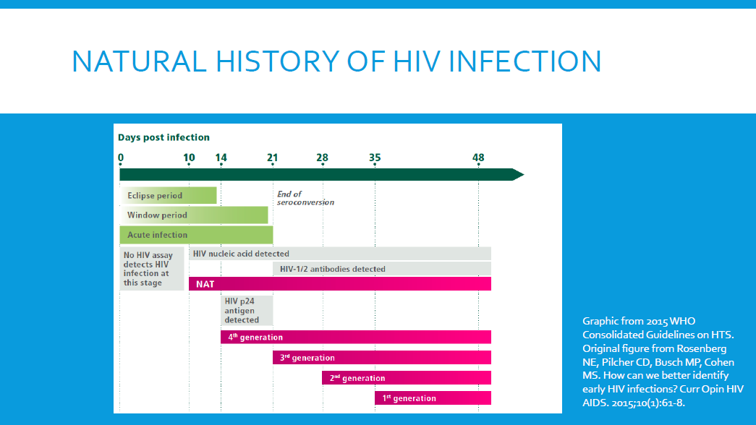
How soon after HIV infection can each type of test detect HIV?
No rapid tests in routine use in LMIC can reliably detect acute HIV infections
No test type can detect HIV until 10 days after infection
Time to detection has shortened with each successive generation of tests developed – but even newer 4th generation antigen/ antibody tests – not widely available in LMIC – cannot reliably detect antigens/ antibodies until 2 weeks after infection
This means a window period of at least two weeks before HIV can be reliably detected by tests currently in use in LMIC

Slide 12
HIV Tests: Operational Characteristics
Test characteristics can determine which type best meets program or research goals
Type of specimen used and how it is collected: blood via needle draw or finger prick; oral specimen via mouth swab
What the test measures: HIV RNA, antibodies or antigens
How long it takes to get the test result
The test’s reliability
The equipment and consumables needed to perform, analyze or interpret the test
Stability of the test and and other consumables needed to administer and interpret it, and the type of storage required
The type of staff needed to administer or interpret the test, and the level of skill and training they need
Requirements for quality assurance of the test as used within a program and outside a program
Aims of the program or research project
Target population for the program or research, and where they can be reached
Feasibility of implementing the particular test type in the program or research setting, and the population of interest
Total cost of test, consumables, equipment and associated services

Slide 13
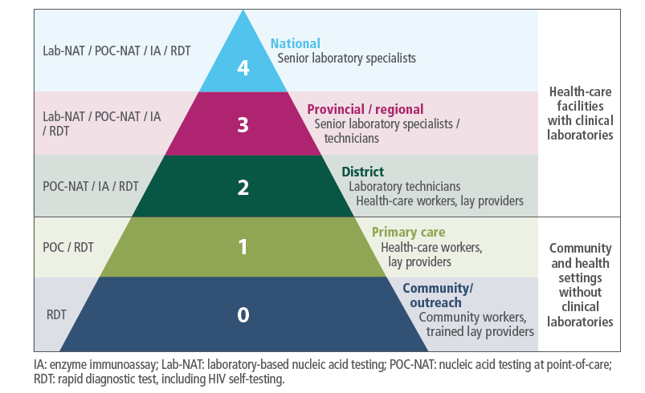
Test types, settings and capacity needs in LMIC
WHO recommends settings for conducting different categories of tests, including the service and provider type and capacity requirements.
Rapid diagnostic tests can be used in primary care and community settings, and can be administered by health care workers, lay providers and community workers.
NAT is only feasible in referral district level health care settings and above that have laboratory capacity.
Source: WHO Consolidated Guidelines on HIV Testing Services (2019)

Slide 14
WHO Recommendations for HIV Testing
WHO’s recommended testing strategy uses a combination of rapid diagnostic tests (RDTs) and/or enzyme immunoassays (EIAs). The RDTs can be based on oral or blood samples.
The HIV testing algorithm of 3 consecutive reactive (positive) tests should meet the standard of at least 99% combined sensitivity, or less than one false positive per 100 people diagnosed with HIV
All individual tests should meet WHO standards of at least 99% sensitivity and 98% specificity
  Sensitivity = the ability of the test to detect a true positive result
  Specificity = the ability of test to detect a true negative result
First tests administered should be highly sensitive, and second and third tests highly specific
Verification of specific combinations of tests in the algorithms is important to ensure products selected work best together
HIV self-testing is advised for triage and to support greater access and implementation
  Self-tests require confirmation for HIV diagnosis
  Self-testing being assessed to expand access in oral PrEP and other programmatic settings
List of WHO Prequalified RDT and EIA

Slide 15
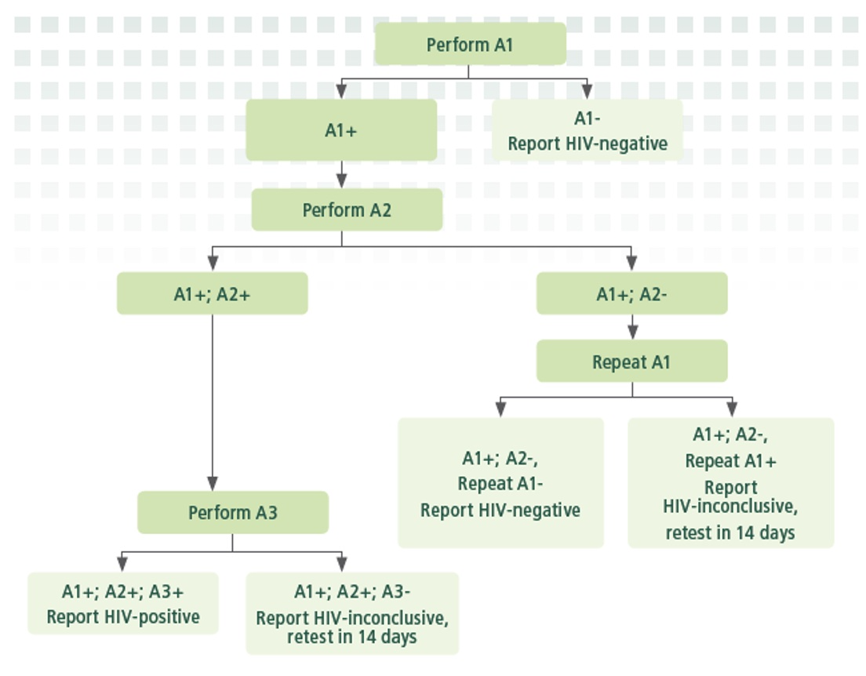
WHO Testing Algorithm/Flowchart
This flow chart depicts WHO recommendations for the way in which different combinations of tests should be used to confirm a positive reactive test for a HIV+ diagnosis.
WHO also recommends that the combinations of specific tests be verified to ensure that they work well together.

Slide 16
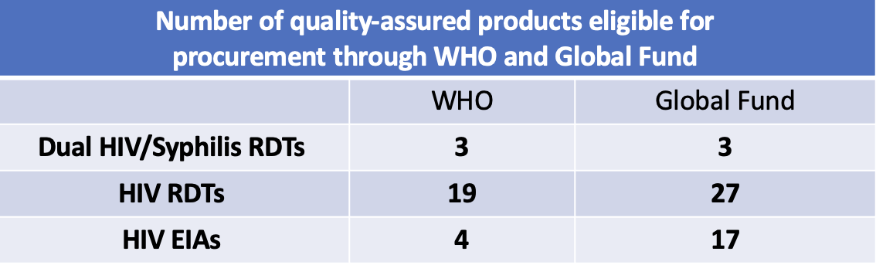
Ensuring Test Quality
Numerous HIV test types and brands have undergone stringent regulatory assessments to assure quality through:
  WHO prequalification (PQ) through which WHO affirms manufacturing quality, performance and operational characteristics and/or
  Review by a stringent national regulatory authority (Australia, Canada, Europe, Japan or US)
HIV tests may also be approved by a country’s national medicines regulatory authority
WHO and the Global Fund have approved multiple HIV testing products for procurement as indicated in this table and listed at the links below.
WHO Prequalified IVDs List, Global Fund Product List
Adapted from Cheryl Johnson, WHO, State of the Field: HIV Diagnostics and Resistance Monitoring, 3 December 2022

Slide 17
List of WHO Guidelines on HIV Testing
WHO guidelines have continued to update recommendations on HIV testing services in different settings, populations and program contexts
WHO Consolidated Guidelines on HIV Testing Services (2019)
  Compiled existing and new guidance on HIV testing across settings and populations
  Testing strategies for HIV diagnosis; demand creation and messaging; implementation considerations for priority populations; and other key issues
  HIV self-testing implementation, service delivery models, linkage to care
WHO Consolidated Guidelines on HIV Prevention, Testing, Treatment, Service Delivery and Monitoring: Recommendations for a Public Health Approach (2021)
  Reinforce recommendations on testing from 2019 guidelines
  New recommendations on HIV testing for infant diagnosis
  Reaffirms recommendations for testing in PrEP programs: HIV testing prior to starting or restarting and regularly (currently every 3 months)
Tools and analysis
  WHO provides numerous analyses and tools for policy development and implementation

Slide 18
WHO Guidelines on HIV Testing and oral PrEP
Recommendations for HIV Testing for Oral PrEP Delivery (from 2021 Guidelines)
Screening for HIV status prior to and during PrEP use is recommended to decrease risk of developing drug resistance.
WHO currently recommends clinical screening + HIV testing before starting or re-starting PrEP, and regularly (such as every 3 months) during PrEP use
  Testing after one month can detect acute infection that may have been present but undetectable at initial screening
Use the same national testing strategy and algorithm for PrEP users and others to align with existing HIV testing programs and products
Currently self-testing is not recommended for PrEP initiation or continuation, but evidence is under review in 2022
WHO Consolidated guidelines on HIV prevention, testing, treatment, service delivery and monitoring (2021)

Slide 19
Lessons from HIV Testing for Oral PrEP Provision
The movement toward simpler, less medicalized and more community-based PrEP services is based on growing evidence that decentralized, people-driven services lead to more oral PrEP uptake and continuation; simpler testing strategies and protocols are key contributors to this progress
Breakthrough infections while on oral PrEP are generally rare; acute infections are also rare, suggesting that testing requirements should not be a barrier to initiation as there are great benefits and relatively low risk related to breakthrough infections.
Few countries have HIV testing guidelines and policies in place that are relevant specifically to PrEP
WHO is currently reviewing its overall testing recommendations for PrEP, including evidence on self-testing for oral PrEP initiation and monitoring
Advocates engaged closely with WHO to ensure that counseling and mental health services for key populations are prioritized as part of HIV self-testing

Slide 20
HIV Testing and Injectable CAB for PrEP
Injectable cabotegravir (CAB for PrEP) is proven effective as PrEP in clinical trials
Some concern emerged on the potential for resistance arising from acute (early) HIV infections in CAB for PrEP users that are not detectable by HIV tests in wide use in LMIC
WHO is currently developing guidelines for CAB for PrEP implementation, including HIV testing
Guidance from the US Food and Drug Administration and the Centers for Disease Control and Prevention recommend NAT testing for PrEP initiation and continuation
NAT testing is not widely available or in routine use in LMIC
  Requiring NAT testing would add cost and complexity to CAB for PrEP, likely severely limiting or curtailing its availability in LMIC
Global health stakeholders are considering whether other HIV test strategies could address concern about resistance with CAB for PrEP such as testing pooled samples with NAT to determine whether resistance is emerging at a population level; and assessing performance of different 4th generation HIV tests in detecting acute infection

Slide 21
Current Issues in HIV Testing Policies and Programs
Adoption of the WHO-recommended 3 test strategy is so far uneven, and currently reflected in national policies in only about half of the countries in Africa
UNAIDS is advocating for Universal Test and Connect (UTC), a community-wide initiative to test people and connect them with services for HIV prevention and treatment that has decreased HIV incidence (by approximately 20–30%) and decreased AIDS-related mortality (by approximately 20%) within three years of implementing a community-wide UTC program compared with current standard care
Programs in many settings are making push toward decentralizing testing with point of care tests that yield quick results – key to increasing access, people-centered care and coverage
Self-testing has potential to increase access further
  COVID has accelerated self-testing in some settings, though some countries have been slow to adopt it
  Recent WHO analysis of HIV self-testing in the context of COVID-19 and ART programs identified its potential to increase coverage and convenience of testing, including for PrEP programs

Slide 22
HIV Testing and Prevention: Looking Ahead
Issues to watch related to HIV testing, including for prevention
Continued policy and program development to support HIV self-testing in countries that have been slow to embrace it, and where expanded uptake could significantly improve access, including for PrEP initiation and continuation
Simplifying HIV testing guidance for oral PrEP to decentralize and de-medicalize PrEP services to support use by meeting the needs and preferences of diverse users, including the role of self-testing for PrEP initiation and continuation
Guidance for CAB for PrEP, including testing strategies, that balances safety with feasibility of offering an important new option for HIV prevention in LMIC and in settings where people can and will access and use it

Slide 23
Resources and more information
Contact AVAC at avac@avac.org to link up with other partners and advocates
WHO Consolidated guidelines on HIV prevention, testing, treatment, service delivery and monitoring: recommendations for a public health approach (2021)
WHO Consolidated Guidelines on HIV Testing Services (2019)
Consolidated guidelines on HIV testing services for a changing epidemic: policy brief (WHO, 2019)
HIV Testing for PrEP Clients (GEMS Project, PrEP Watch)
HIV Testing: What’s involved (Avert)
Basic review of HIV test types (CDC)
HIV Testing and Injectable Cabotegravir for PrEP Think Tank Report, Dec 2021
HIV Self-Testing Strategic Framework: A Guide for Planning, Introducing and Scaling Up (WHO, 2018)
WHO Implementation Tool for PrEP of HIV Infection: Module 10 Testing Providers (2017)
HIV Self Testing Research and Policy Hub

Slide 24
Acknowledgement
We are especially grateful to Cheryl Johnson and her colleagues in the Global HIV, Hepatitis and STI Programmes at the World Health Organization who have contributed slides and background in the development of this presentation. She presented a testing overview at the AVAC/BioPIC/WHO HIV Testing and Injectable Cabotegravir for PrEP Think Tank in December 2021 and a subsequent meeting with advocates in February 2022

Slide 25














Thank You!
This slide deck was developed as part of the
Coalition to Accelerate and Support Prevention Research (CASPR)
Cooperative Agreement No. AID-OAA-A-16-00031
HIV Vaccine and Biomedical Prevention Research Project—Objective 3

