Slide 1
HIV Research & Development at Risk
Tracking the Impact of US Funding Cuts
Published 18 May 2025
Updated 13 August 2025; 24 November 2025

Slide 2
Introduction
Tracking the impact of US Government cuts on HIV R&D, with a focus on biomedical prevention
This document analyzes the impact of US Government funding cuts, terminated projects, and other policy changes on HIV research since January 2025
Since January 2025, USAID funding has been abruptly halted across the agency; for HIV research, putting the future of vaccines, bNAbs, and new PrEP modalities at risk
NIH research cuts have focused (initially) on diversity, equity, inclusion (DEI), gender ideology, vaccine hesitancy and climate with an increased emphasis on “America First” priorities and the pausing of international research, impacting funding for HIV-focused projects
The President’s proposed US Fiscal Year 2026 budget to begin Oct 1 includes even more sweeping rollbacks to R&D – and not clear how Congress will respond
This report will be updated to track ongoing cuts and shifts to this work, and to highlight their implications on the HIV response

Slide 3
Tracking US funding Cuts for HIV R&D
Report outline
NIH: Major retrenchment
DAIDS Networks: In flux
HIV Prevention Pipeline: People's Research Agenda in Crisis
USAID: Dismantled
Potential fallout
Now what?
Resources

Slide 4
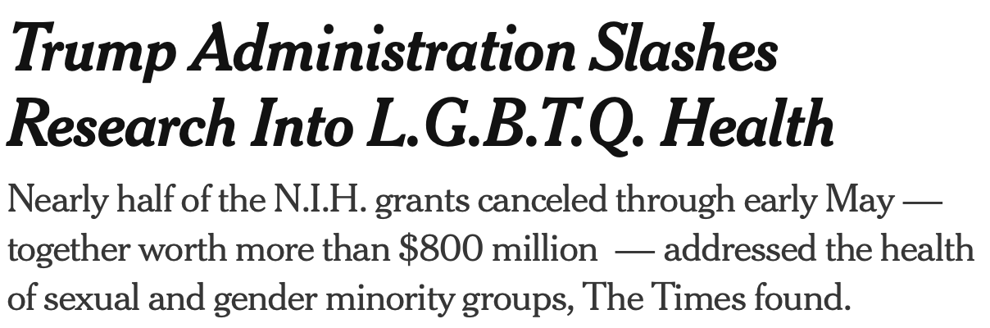
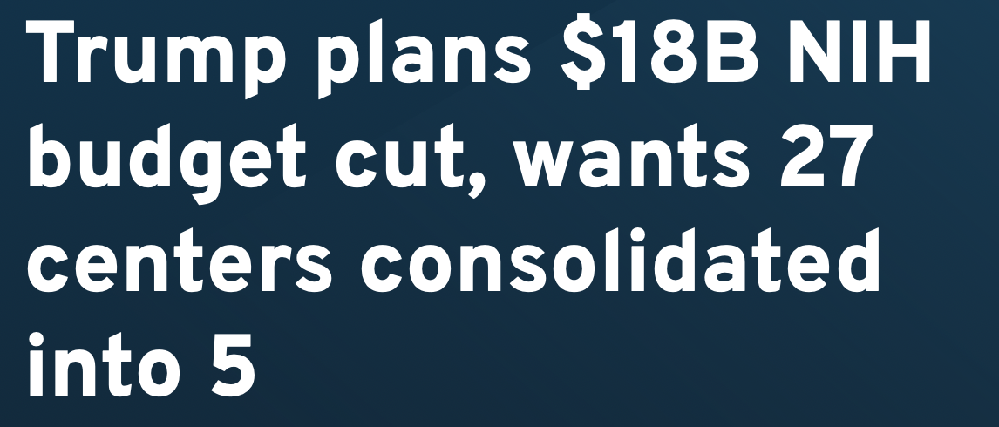
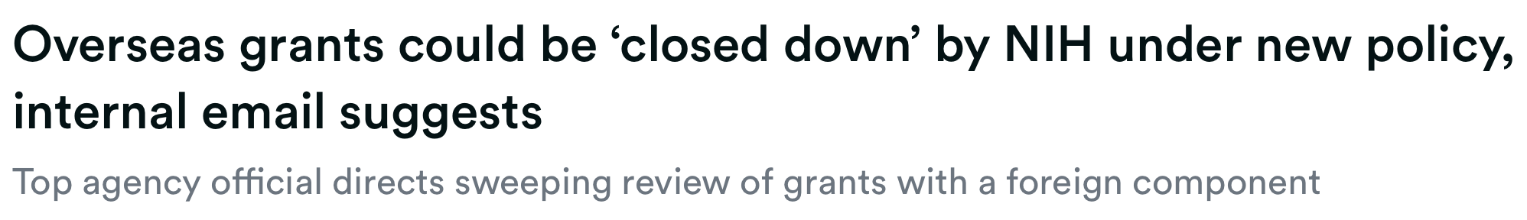
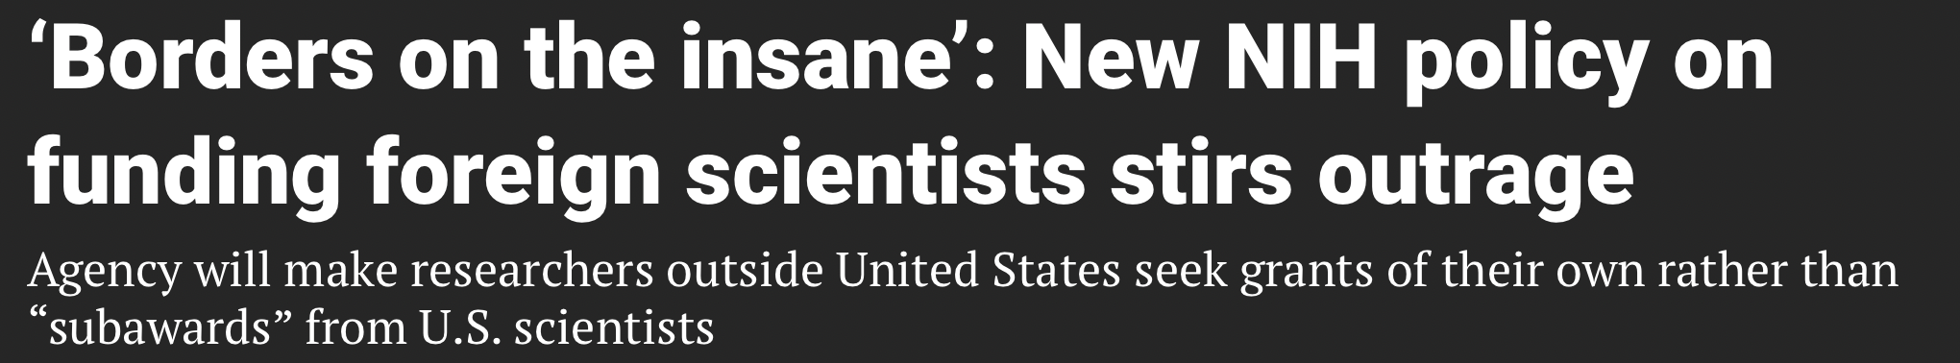
Research Under Assault

Slide 5
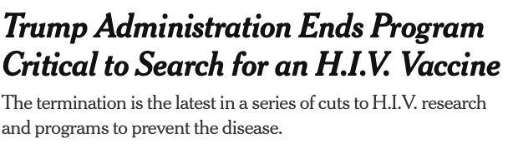
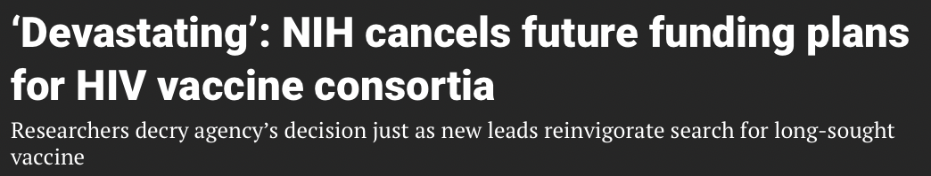
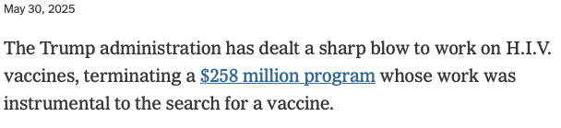
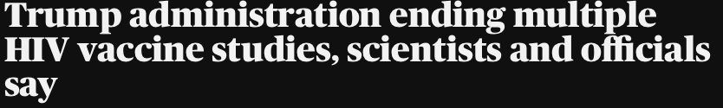
HIV Vaccine Research Decimated
Breaking News: May 30, 2025

Slide 6
Research Under Assault
High-level snapshot of cuts to HIV-related research
"Pause"/ban on international research
LGBTQ study terminations
Cap on indirect rates in grants to US academic institutions, which support core building, lab & training infrastructure
Changes in scientific review processes
Major staff reductions – and forced reassignments
May 30, 2025: NIH cuts Consortia for HIV/AIDS Vaccine Development (CHAVD) – main drivers of upstream HIV vaccine design

Slide 7
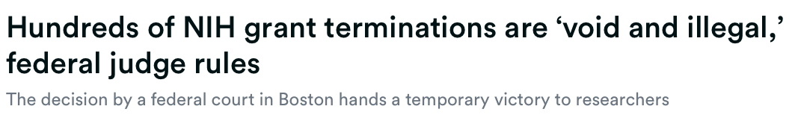
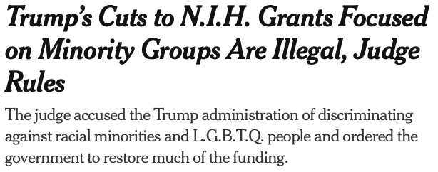
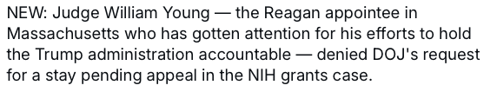
Glimmer of Hope:
Breaking News: June 15, 2025: Federal judge rules hundreds of NIH grant terminations illegal

Slide 8
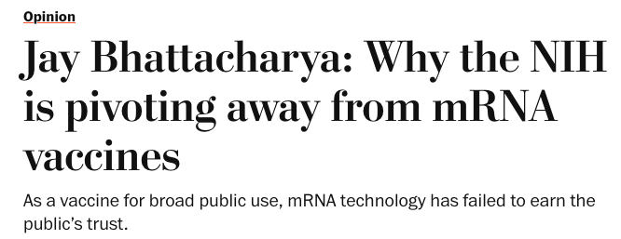

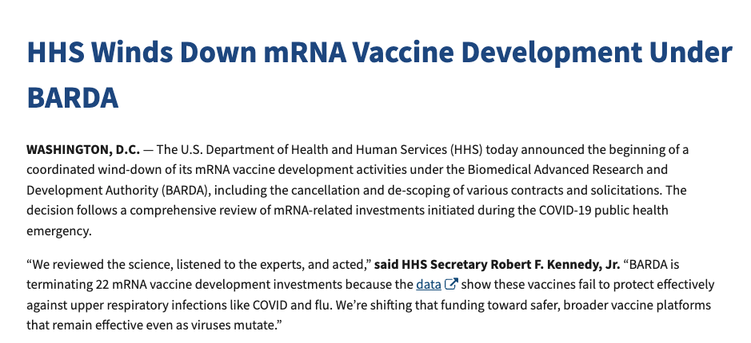
Further Attack on Vaccine Science
Defunding and compromising mRNA science
August 5, 2025: US Health and Human Services Dept, RFK Jr., announce defunding of mRNA vaccine development under Biomedical Advanced Research and Development Authority (BARDA)
  "Reviewed the data" / "listened to experts"
  Claim vaccines in development fail to effectively protect against COVID, flu
August 12, 2025: OpEd in Washington Post by NIH Director Jay Battacharya reinforces disinformation and public mistrust of mRNA vaccines

Slide 9
Further Attack on Vaccine Science
Additional text from HHS statement on mRNA vaccines

Slide 10
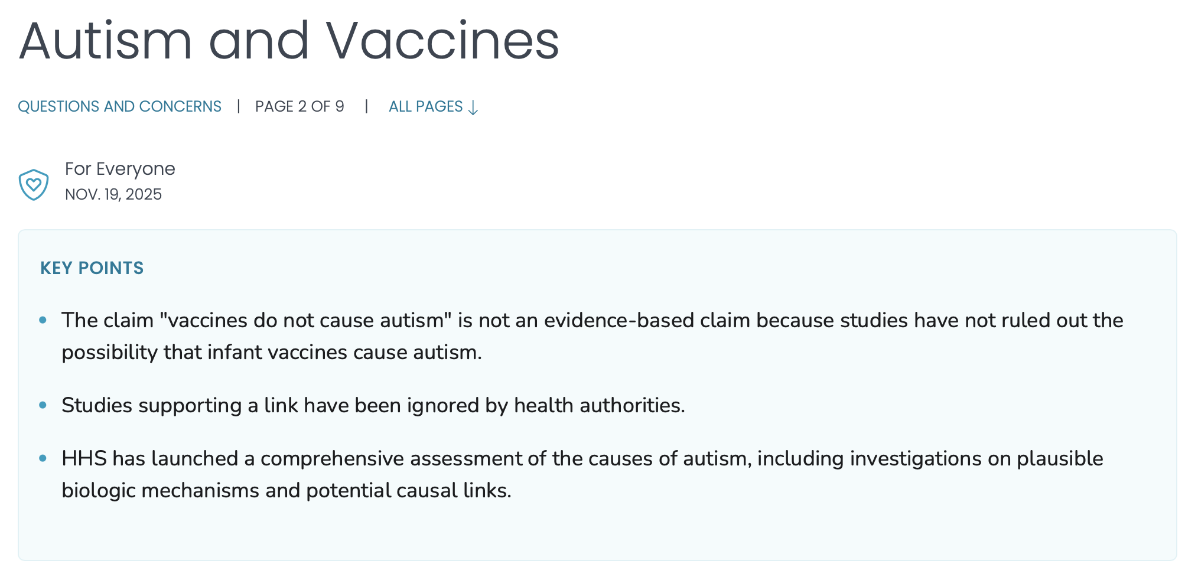
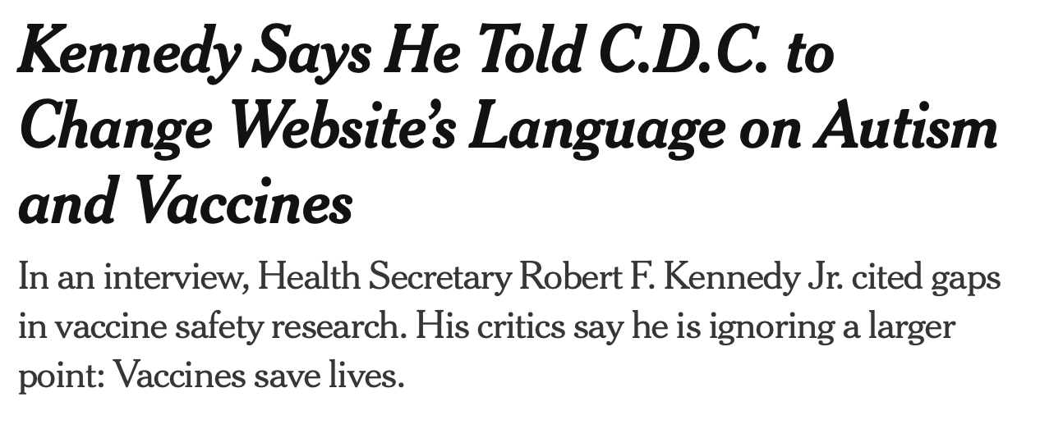
Further Attack on Vaccine Science
Anti-science and anti-vaccine language on CDC website

Slide 11
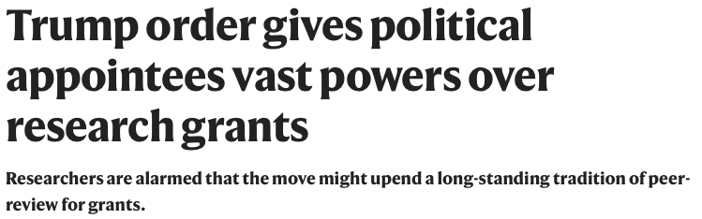
Upending Long-Standing Peer Review Processes
Breaking News – Aug 7: Executive order centralizes power & upends process that US has used for decades to review & award research grants

Slide 12
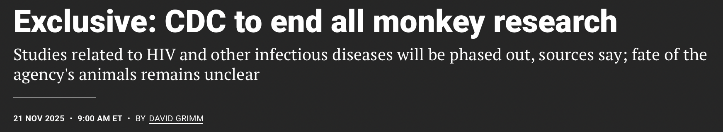
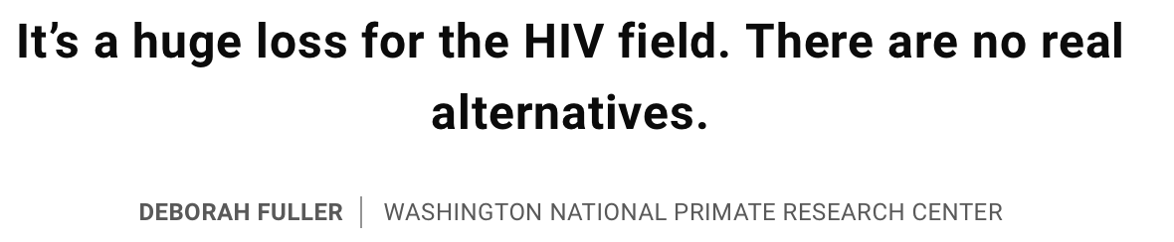
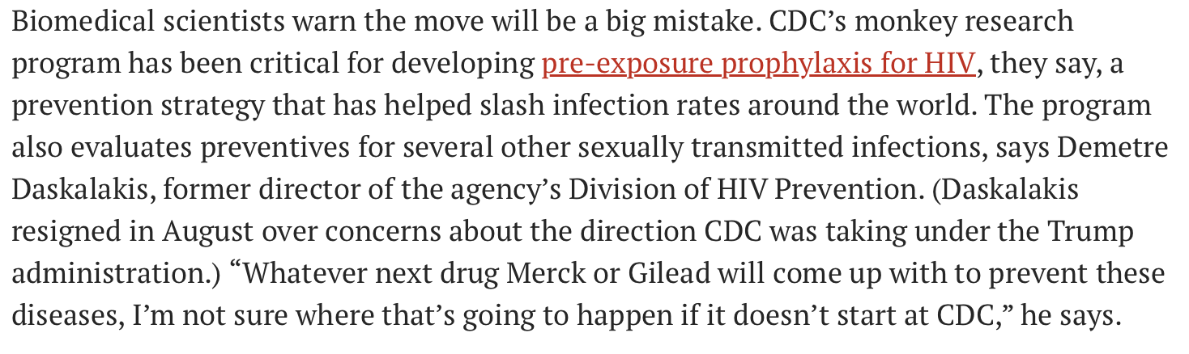
CDC to End All Monkey Research
Breaking News – Nov 21: HHS & DOGE order CDC to phase-out essential non-human primate research

Slide 13
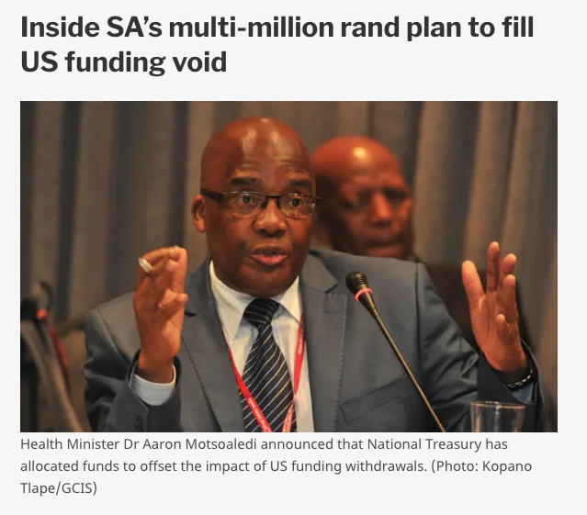
Countries in Response – South Africa
Aug 14: South Africa National Treasury commits emergency funds due to US cuts in programming and research
SA Treasury released R753 million for gaps in health system (~$43M USD)
R590M for provincial health departments' public health responses to TB, HIV, etc.
R132M allocated to research, primarily HIV, TB; possibly followed by R268M in next 2 years
Cost share by R100M each from Gates Foundation, Wellcome Trust
Awarded to SAMRC, to be subgranted
Bridge funding; won't fill full gap from US

Slide 14

HIV Prevention: People’s Research Agenda
Launched in 2024 to amplify advocates' priorities for prevention research
Provides a clear, concise and collaboratively developed set of priorities for how prevention research should be conducted and what products should be developed
A living document and tool for communities to amplify priorities in real time, to hold those with most decision-making power accountable
Reference for funders, product developers and policy leaders to use as crucial decisions are made about what to invest in, where and why
USG cuts bring People's Research Agenda in Crisis – outlined priorities are all under threat; potential for irrevocable damage to critical aspects of research, choice, access
https://avac.org/peoples-research-agenda/

Slide 15
PRA: Key Messages at 2024 Launch
Any product approaching efficacy trials cannot move forward without a clear access plan in place; trials must be conducted in parallel with considerations for access, pricing, and manufacturing
New products should balance filling a gap in the toolbox with additions to existing products that make them more accessible and streamline uptake (e.g., both longer and shorter intervals of dosing; MPTs; novel formulations, mechanisms of action and/or delivery systems)
Product development should move forward with greater focus and investment in social and behavioral science and being mindful of structural barriers such as stigma and discrimination
Field needs realistic Target Product Profiles (TPPs) for all product categories
There is excitement among advocates about the promise of MPTs, but regulatory pathway brings significant complexity
Significant time and energy across stakeholders should rightfully continue to be placed into making newly efficacious products accessible

Slide 16
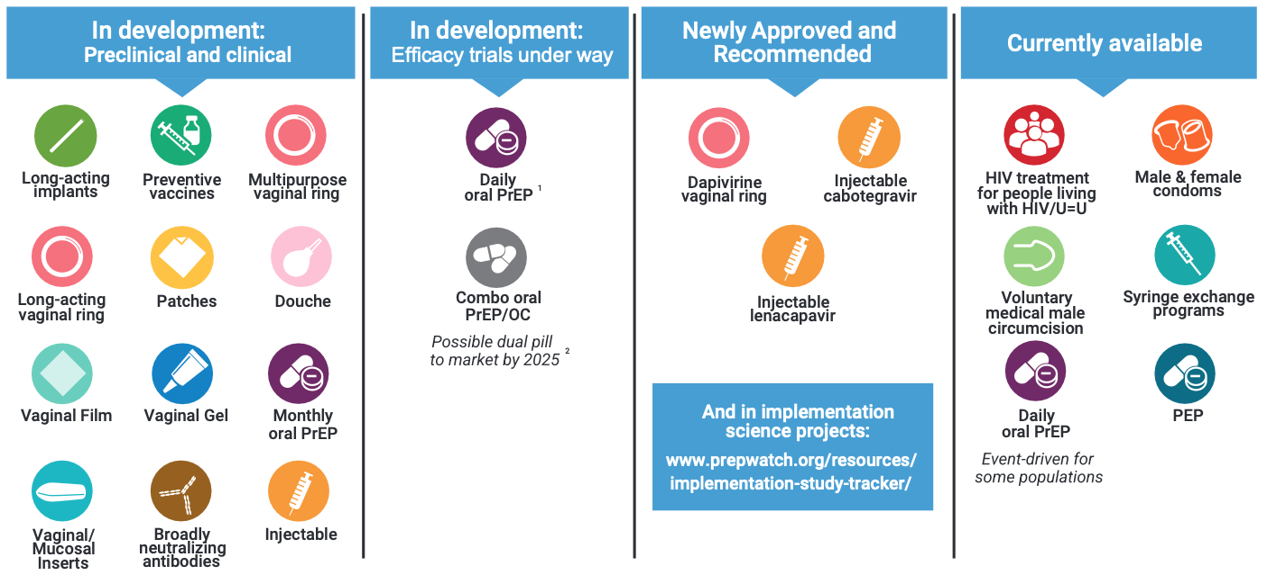
Overview of Biomedical Px Pipeline (circa 2025)

Slide 17
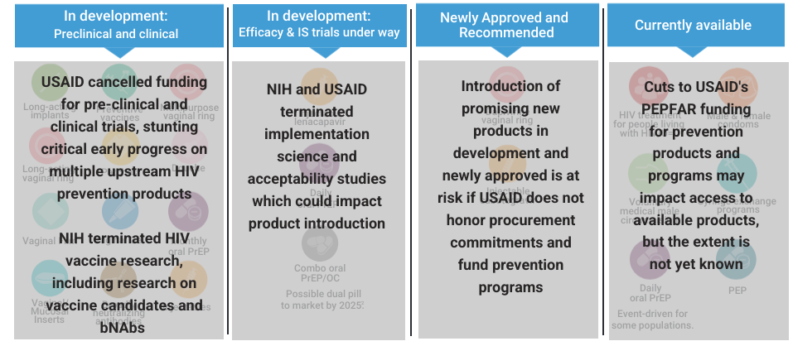
PRA in Crisis: Impact of USAID & NIH Cuts

Slide 18
NIH: Major Retrenchment
Top-line cuts
Thousands of NIH grants terminated as of May 2025
  191 HIV-related grants terminated, worth over ~$200M
  Primary topics for NIH grant termination: DEI, "gender ideology", sexual minorities, vaccine hesitancy, mRNA vaccines, and South Africa
No inclusion of subawards to ANY international partners and awards to be handled directly by NIH – new policy coming Sept 30
NIH’s workforce to be cut by 1,200-1,300 staffers
  Including leaders of NIAID, NIAID’s Divisions of Microbiology and Infectious Diseases and of AIDS, Fogarty International Center, chief bioethicist
President’s “skinny” budget for fiscal year 2026 would codify another 40% reduction, or $18B in funding, plus $3.6B for CDC and $5.2B for NSF

Slide 19
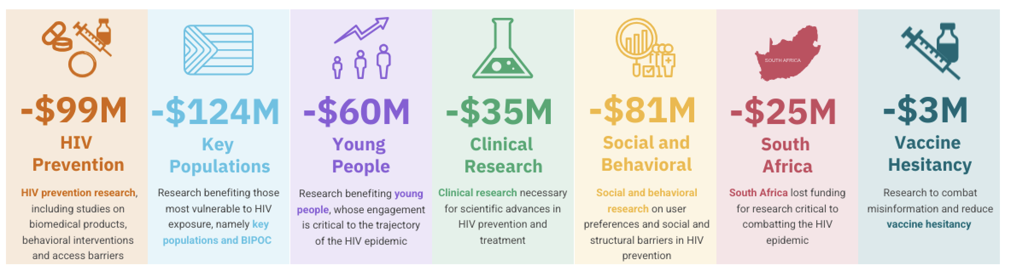
The Cost of Cutting HIV Research
NIH terminated 191 HIV-specific grants in 2025, slashing over $200 million from key HIV prevention research grants¹
¹Grants may cover more than one research area, so total across categories shown here exceeds $200 million in total funding lost

Slide 20
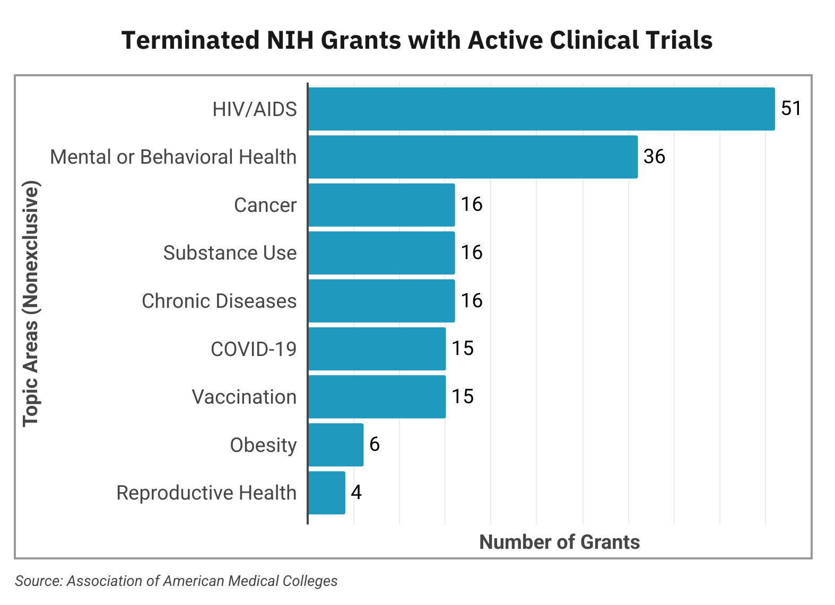
NIH: Cuts to Clinical Trials
Total NIH termination of grants—unprecedented in history of agency
  $19B lost funding = 777 terminated grants
  $643M = 113 active clinical trials terminated
  56% ($~360M) of terminated clinical trials related to HIV

Slide 21
HIV/AIDS Clinical Trials Networks
Details on major clinical trials networks
30% of funding withheld from semi-annual Notice of Awards for NIAID’s DAIDS-funded trial networks (HPTN, HVTN, ACTG, IMPAACT)
  ~$300M per year to networks = ~ $90M cut for just six months
  Restricts funding for international research activities
NICHD-funded Adolescent Medicine Trials Network for HIV/AIDS Interventions (ATN) was halted in March
  $18M cut with immediate effect
  ATN led pioneering work on HIV prevention and treatment interventions for adolescents and young adults
Notes:
Following up on my last couple of messages regarding funding for ACTG, HPTN, HVTN, and IMPAACT. I can confirm that the networks started receiving their notices of funding awards last night / this morning (somewhere ~ April 20). They haven’t all come in yet across the three different funding channels (operations center, data center, and lab center), but they’re expected to all be received very soon. The awards that have been received are partial (about 70% of the expected amount), pending review for things the administration frowns upon…
“….The awards also came with very clear restrictions on using the funds for work in South Africa; funds can only be used to finish ongoing work, and no new participants can be enrolled and new no studies started in RSA. The other restrictions are around things like gender and vaccine hesitancy. The notices make it very clear that the funding can be revoked at any time if these restrictions aren’t followed. Network leaders are now tasked with making decisions on how to apply the funds they’ve received and will be deliberating over the next couple of weeks.”

Slide 22
USAID HIV Research Project Terminations
Tracking the impact of stop-work orders on HIV prevention R&D
Since January 2025, withdrawal of USAID funding has halted HIV clinical trials, implementation science and the rollout of new prevention options
Public records of projects receiving funding from USAID have been erased
Terminations (details on next slide):
  Promising preclinical HIV vaccine research, including mRNA-based candidates (ADVANCE project, ~$32M/yr)
  Early-stage, African-led HIV vaccine R&D (BRILLIANT consortium, ~$9M/yr)
  Next-generation, user-centered PrEP (MATRIX consortium, ~$25M/yr)
  Implementation science on delivering multiple PrEP options (MOSAIC project, ~$17M/yr)

Slide 23
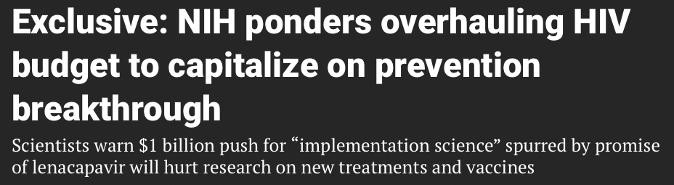
Shifting Research Away from Basic Science
Breaking News: Aug 11, 2025

Slide 24
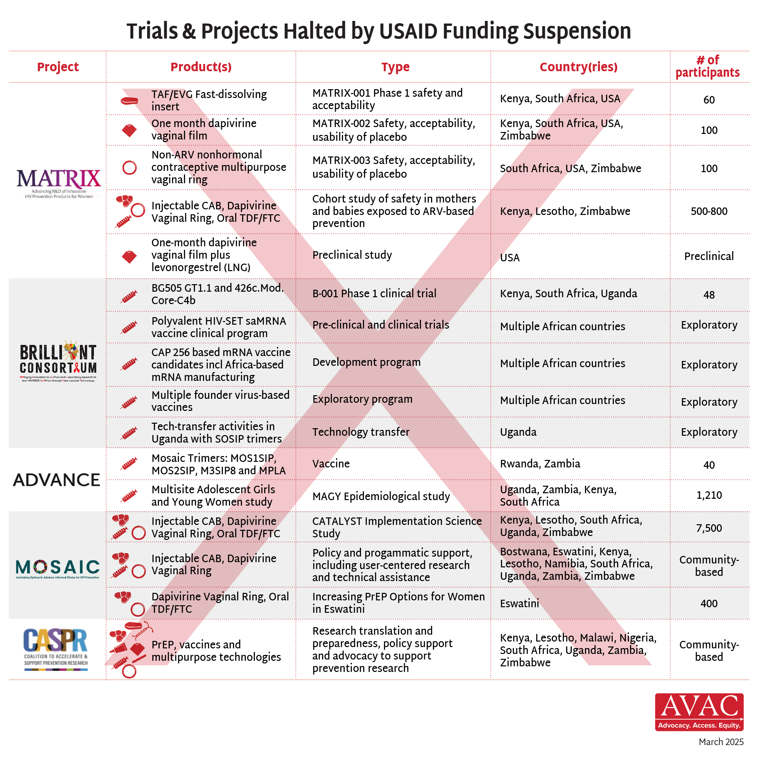
USAID HIV Research Project Terminations: Details

Slide 25
Potential Fallout from Cuts to HIV Prevention
Impacts on trials sponsored by non-USG funders
USG funding is the scaffold on which pharma, philanthropies and other governments invest in transformative HIV & TB science
Trials sponsored by other research funders build on top of core and other funding provided to clinical trials units and research sites through NIH awards
USG cuts risk infrastructure, staff/talent, training the next generation of scientists, community engagement, data sharing, biorepositories, etc.
If South African and other international study sites and participants are excluded from enrollment, follow-up, study completion, and data collection and analysis, ongoing and planned trials are likely underpowered to produce meaningful results, wasting years of work and tens or hundreds millions of dollars
Trials no longer able to enroll internationally will face delays and increased costs as they seek new sites and study participants elsewhere
Treatment Action Group

Slide 26
Now what?
Action to prevent further harm and continue funding for HIV R&D
Lawsuits against NIH & USAID
Advocacy directed at US Congress
  Monitor, advocate, and activate national and local political action around Fiscal Year 2026 US Budget
Monitor DAIDS network funding and renewal after 2026
Advocacy with national governments
  Potential domestic resources to maintain scientific infrastructure
  Ensure ethical follow-up with clinical trial participants
  Adapt People’s Research Agenda to develop national priorities and accountability mechanisms

Slide 27
Further resources
People’s Research Agenda, AVAC
Science in the Crosshairs: Research Advocacy in a Time of Crisis, The Choice Agenda webinar recording, slides and resources
The Best Investment You Didn’t Know You Made: How NIH Funding Fuels Innovation and Economic Growth, amfAR
Quick Take: HIV Research Matters for America, amfAR & O’Neill Institute
Impact of NIH Grant Terminations, Association of American Medical Colleges
Research Matters Advocacy Toolkit, AVAC, TAG, HIVMA
NIH halts more collaborations with South Africa on HIV/AIDS trials, Science
We do the sums: The NIH funds $350-million (R6.65-billion) of research in SA, Bhekisisa
Inside the Bloodbath at the NIH, The Nation
Weekly Global Health Watch, AVAC

Slide 28
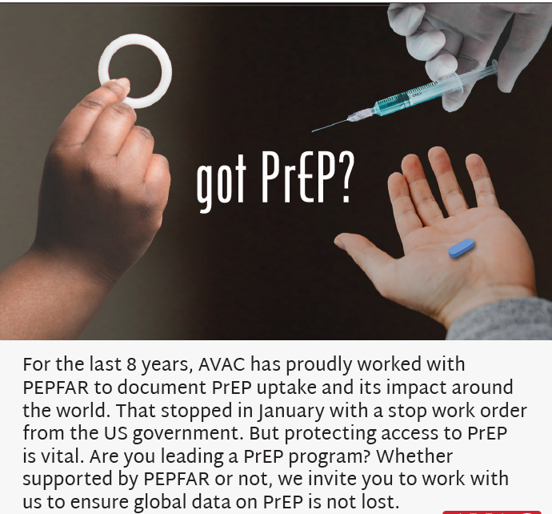
Further Resources
PEPFAR Stop Work Order Tracker – a live version of this slide deck
HIV Prevention R&D at Risk – highlighting the impact of US cuts on the pipeline of HIV prevention R&D
PrEPWatch.org – data, information, and PrEP resources
Global PrEP Tracker – tracking PrEP initiations by country over time

