Slide 1
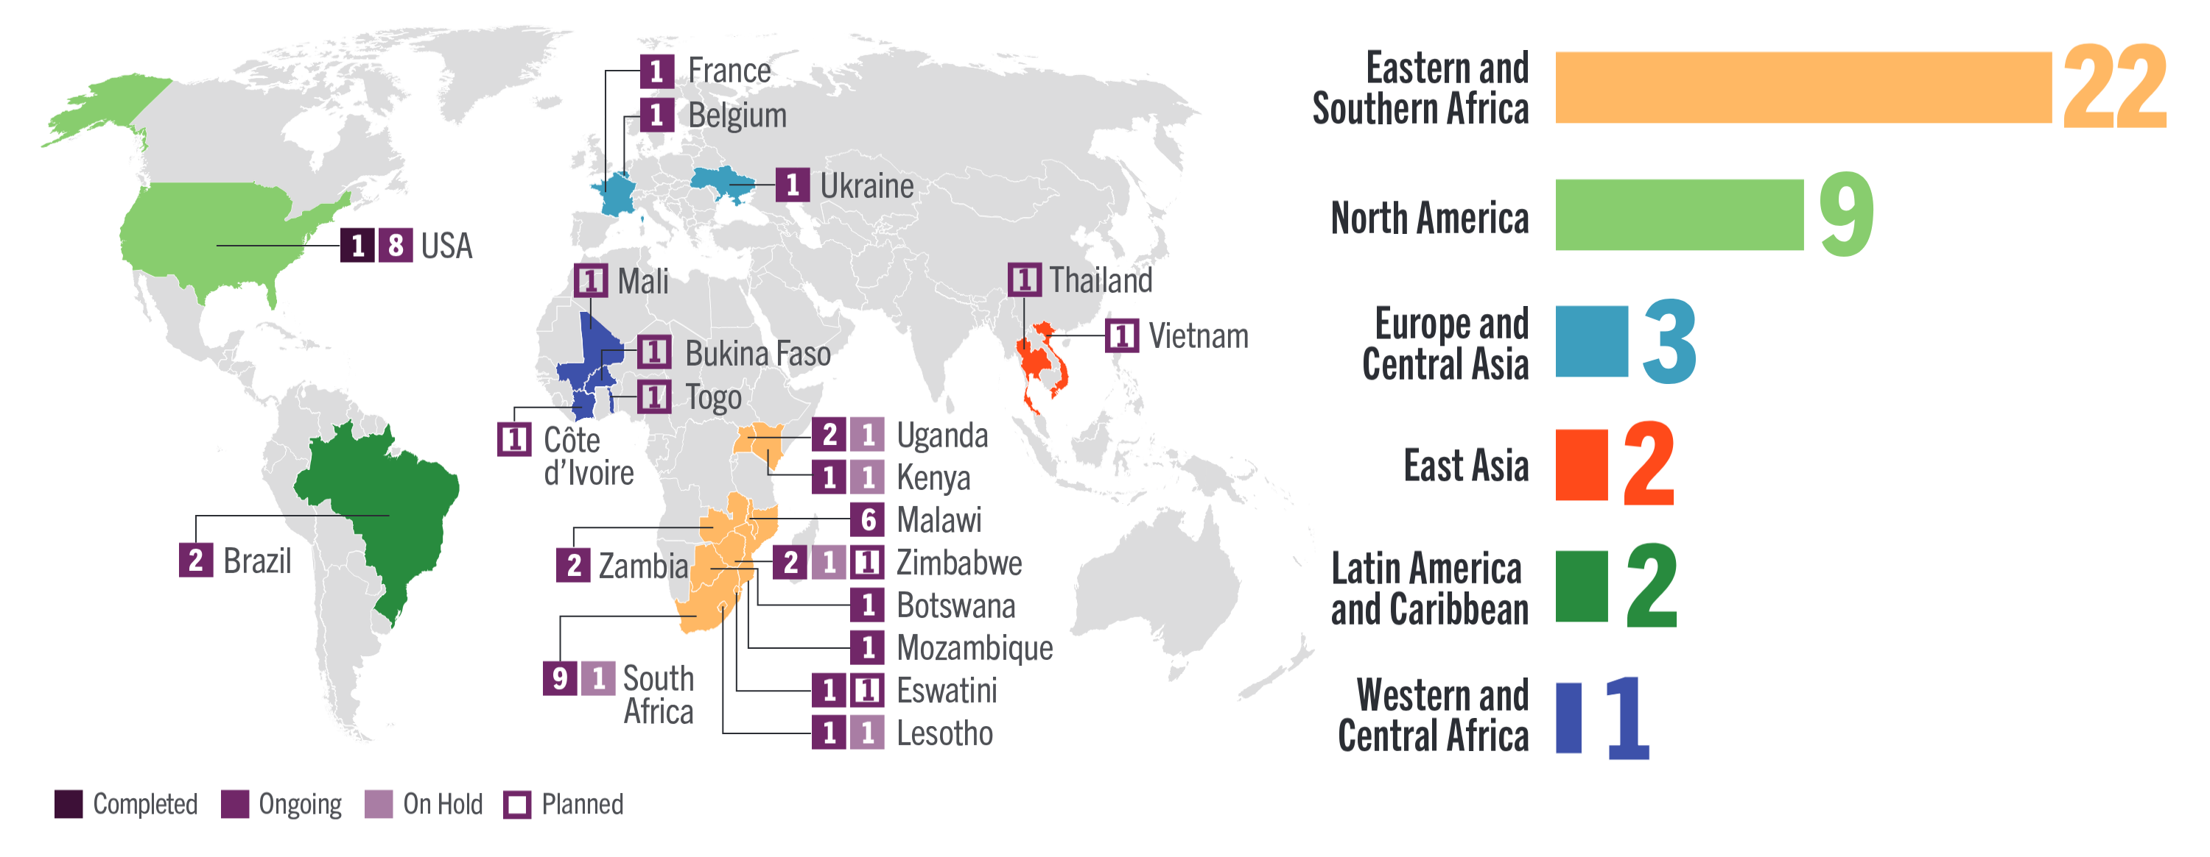
CAB Implementation Science Studies
38 completed, ongoing, or planned, and 2 on hold for CAB in 22 countries

