Slide 1
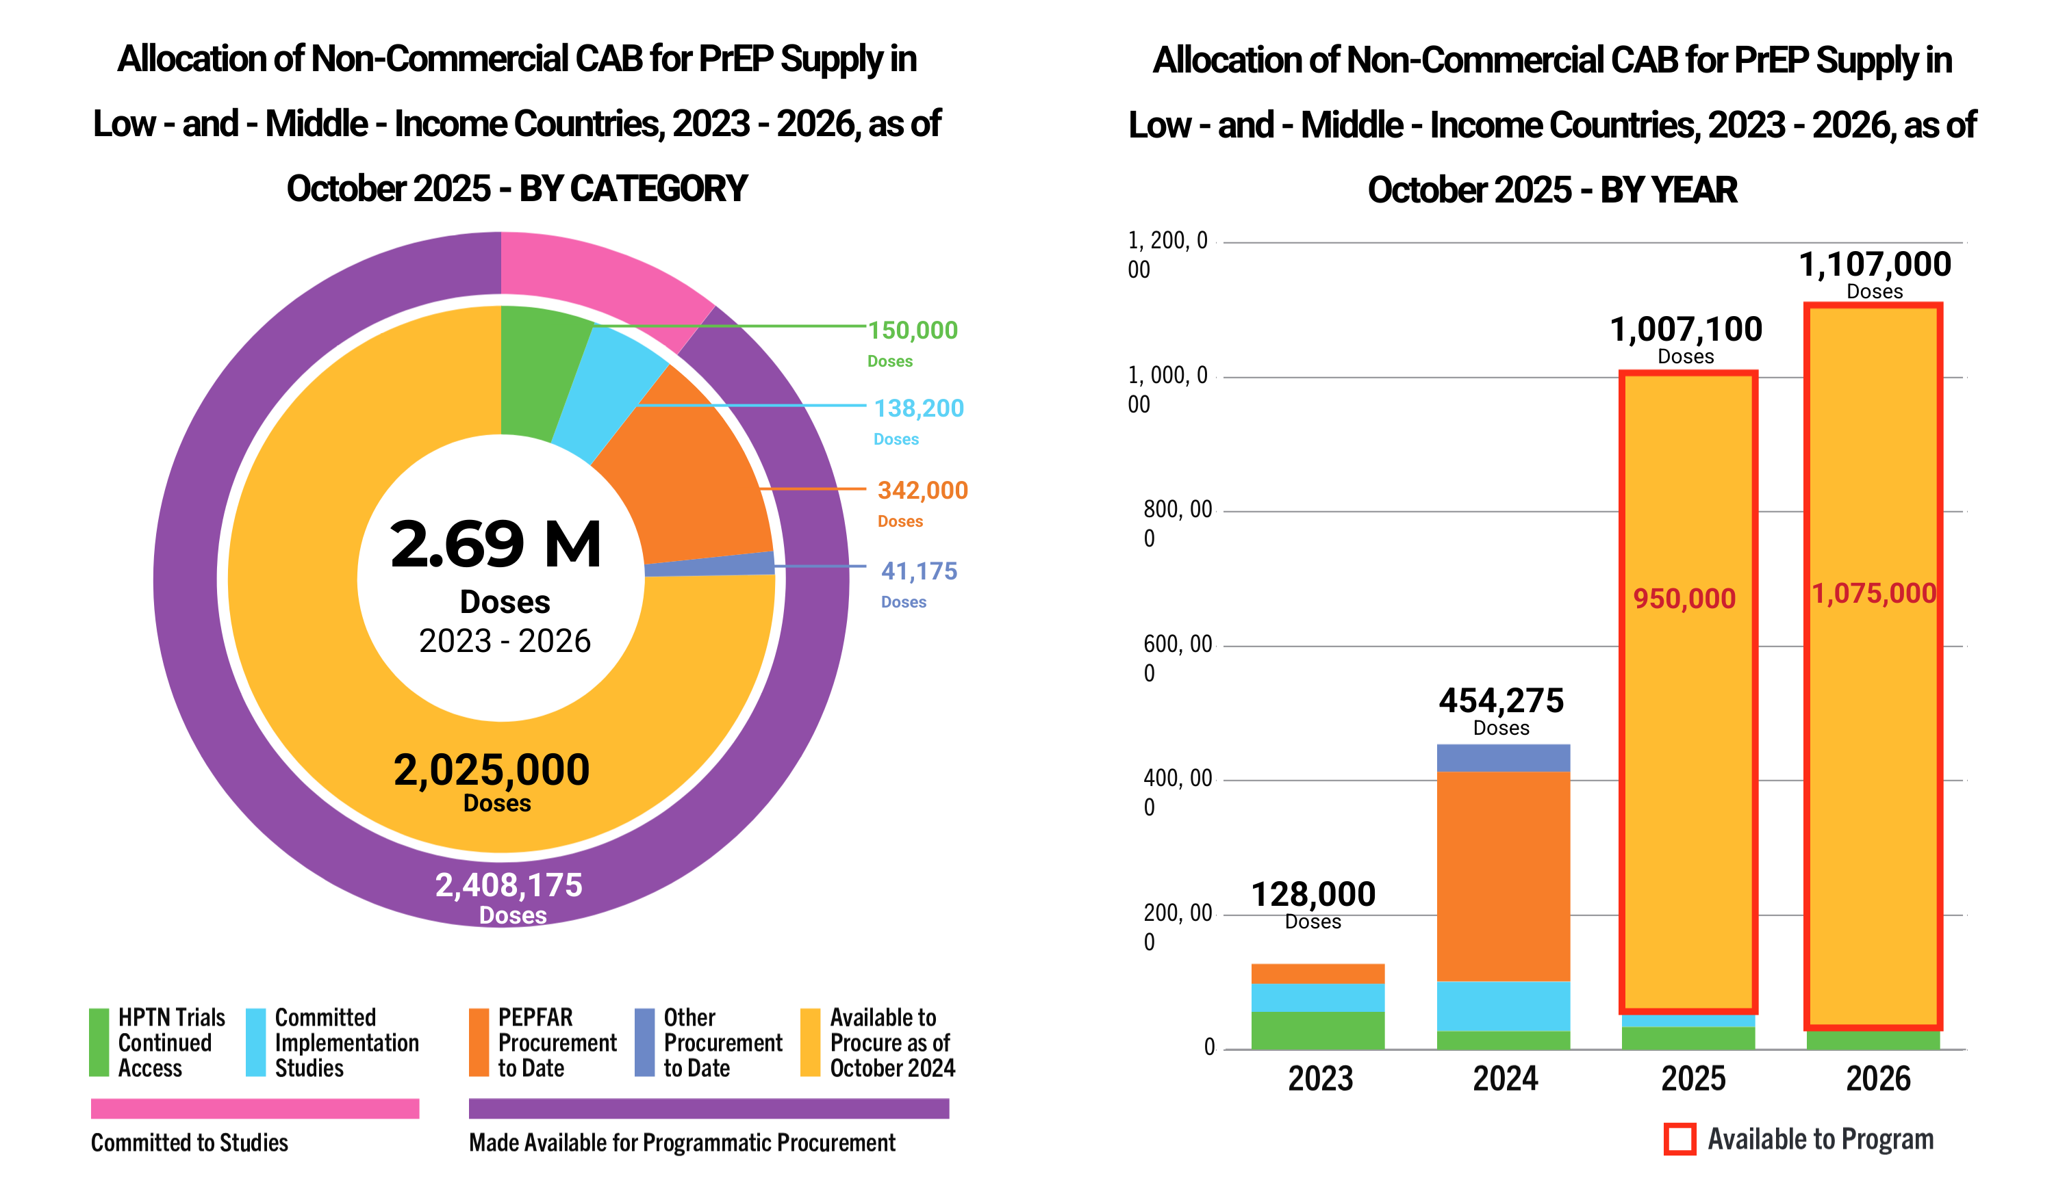
CAB Supply Available to LMICs

