Slide 1
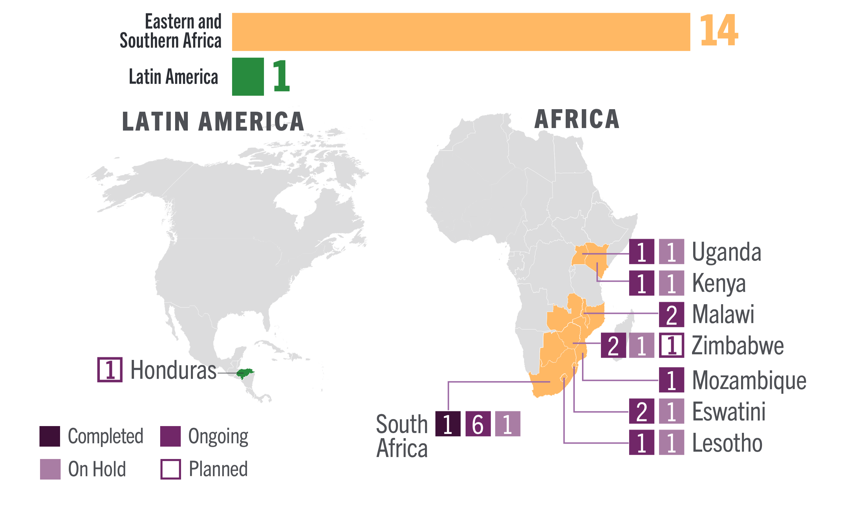
DVR Implementation Science Studies
13 completed, ongoing, or planned, and 6 on hold for DVR in 10 countries

