Slide 1
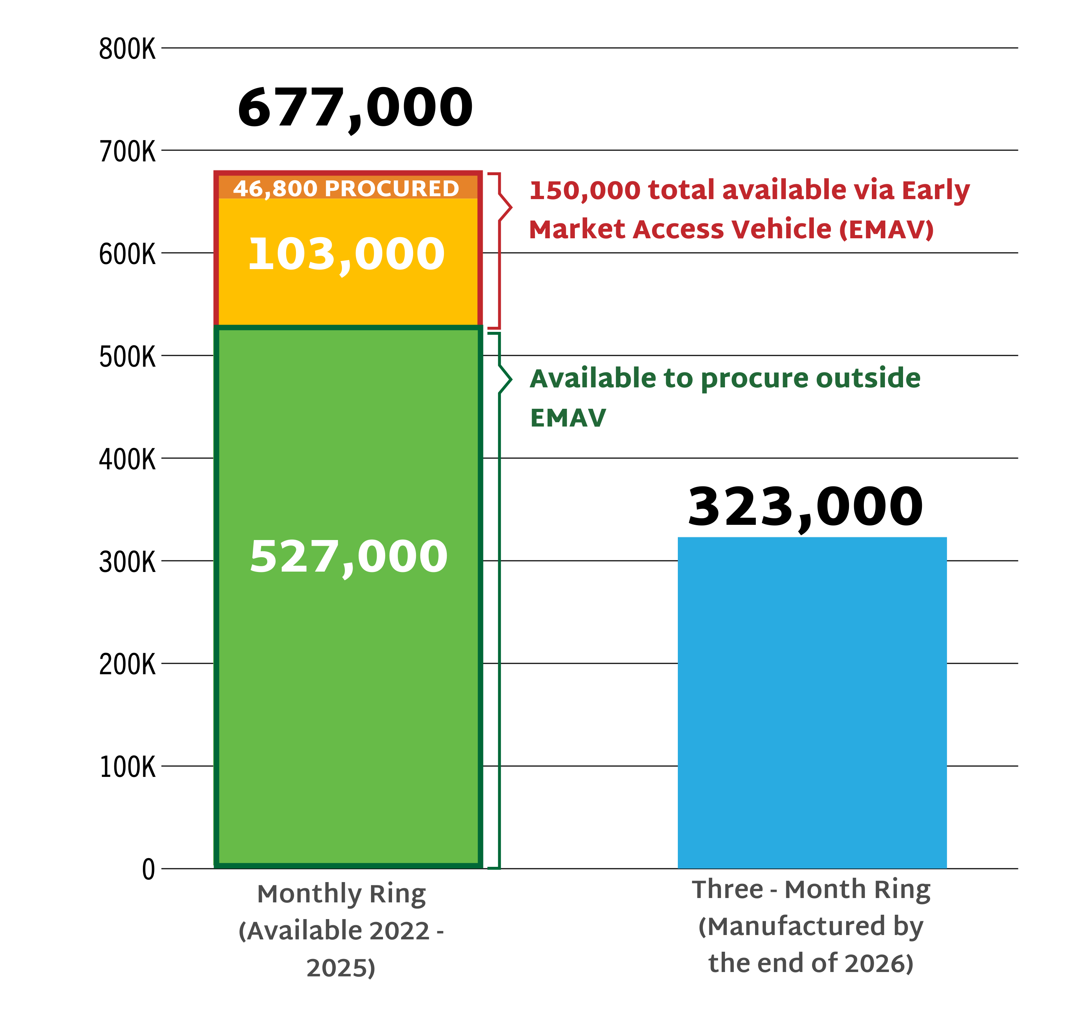
DVR Supply Available to LMICs

