Slide 1
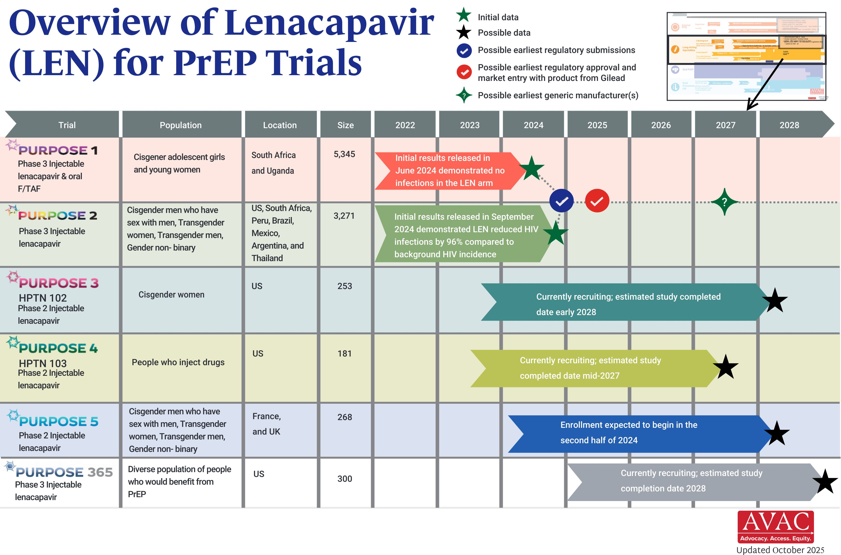
Overview of Lenacapavir Trials
Updated Oct 2025

