Slide 1
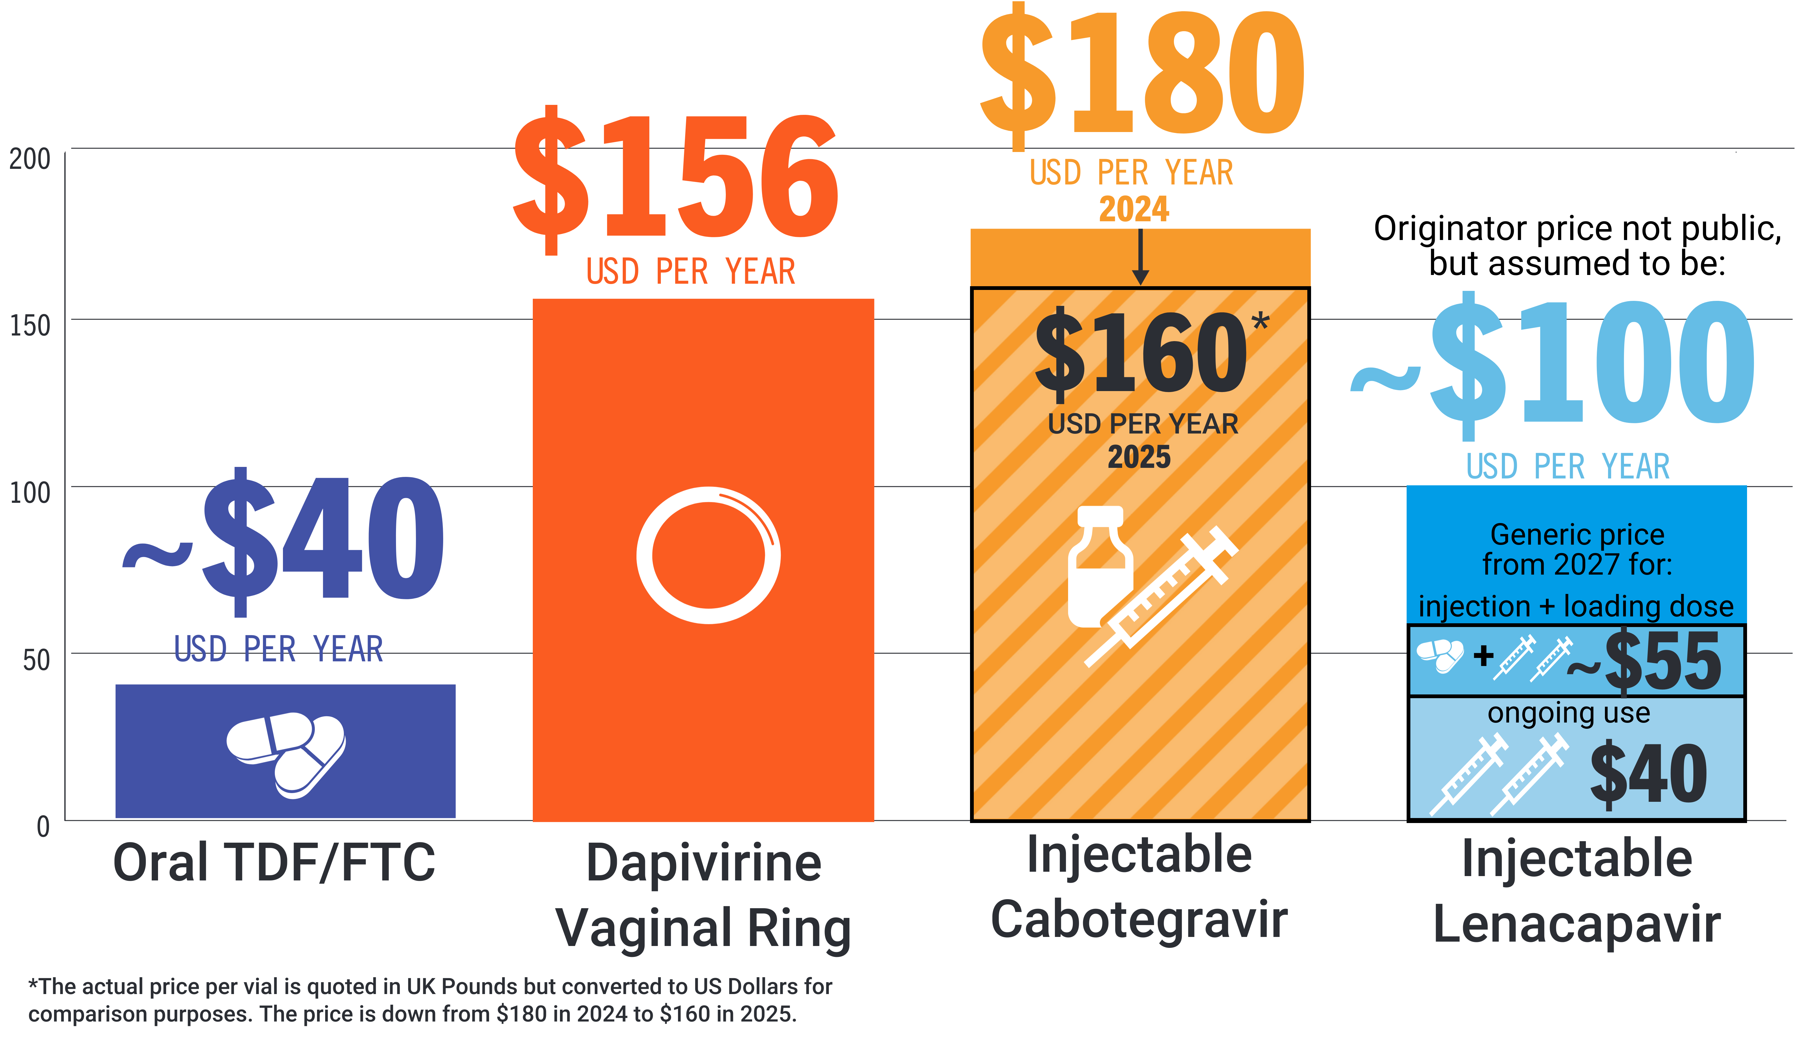
PrEP Price Comparison for LMICs
Cost for each reflects price per person per year

