Slide 1
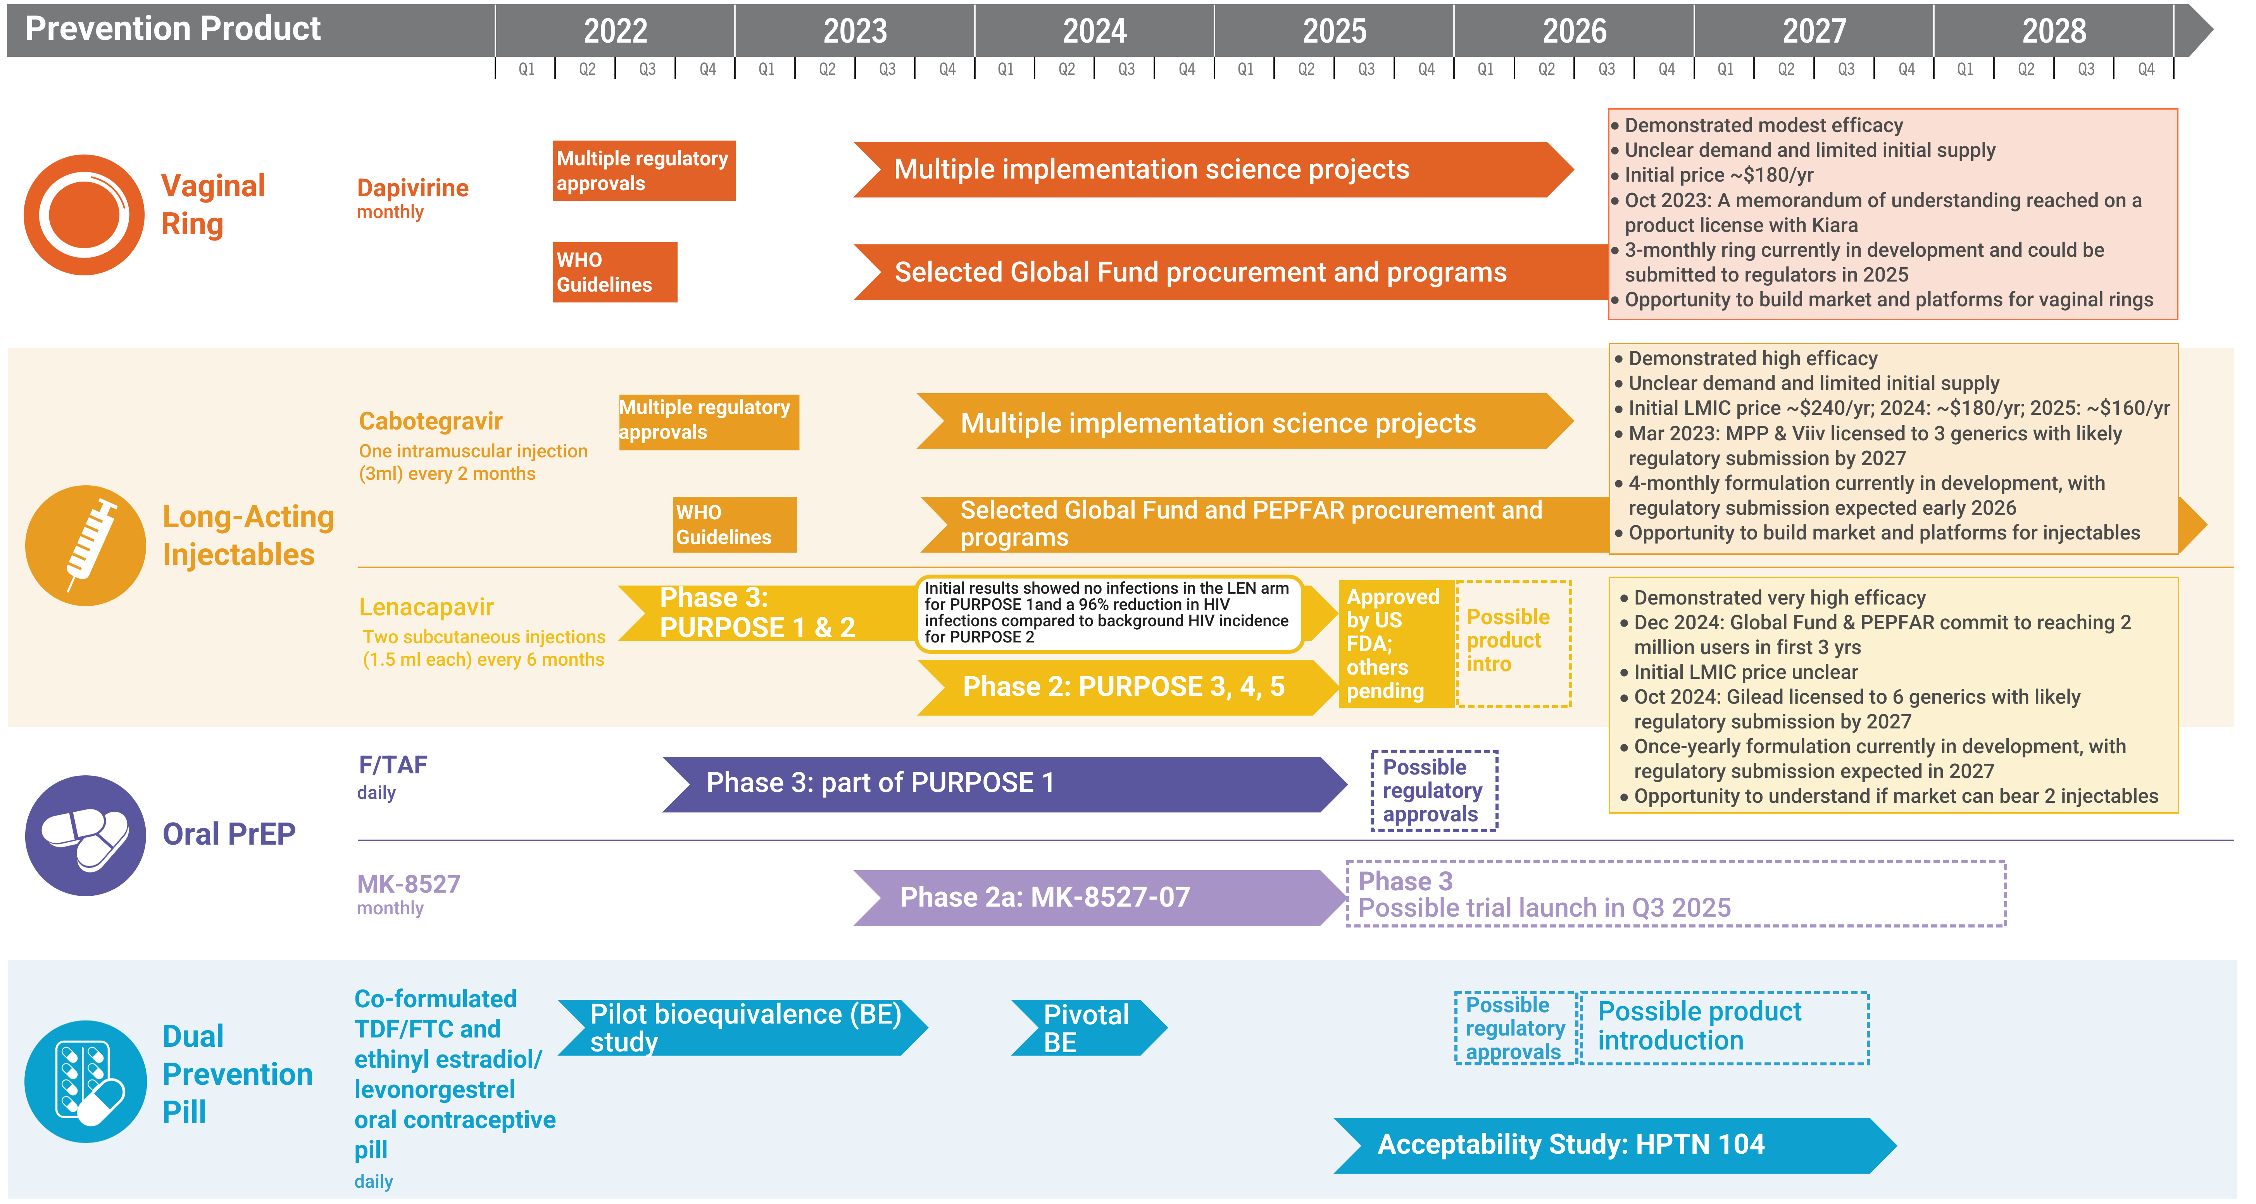
Years Ahead in HIV Prevention Research
Time to Market

