Slide 1
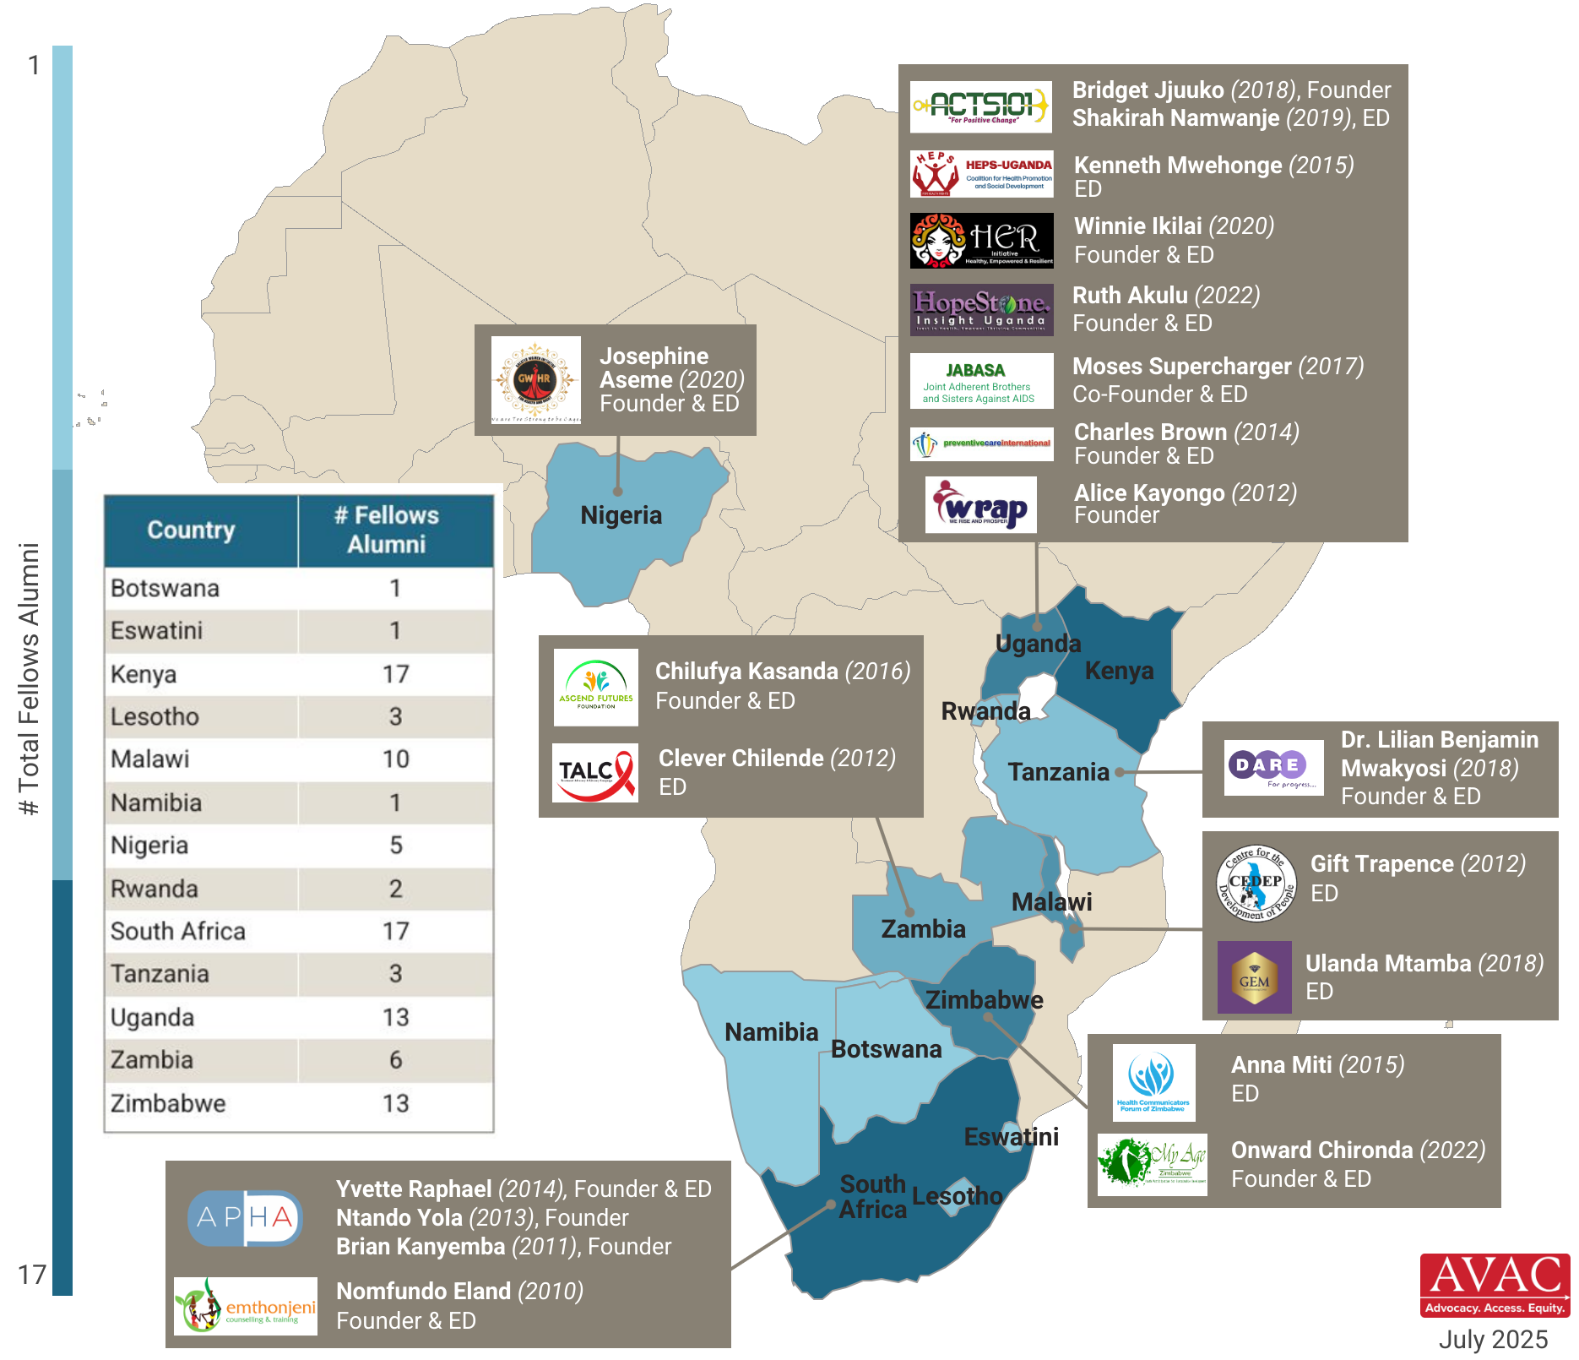
AVAC Fellows Alumni Leadership in Africa
The AVAC Advocacy Fellows Program has supported 92 Fellows from Africa since 2009. Twenty Fellows Alumni have since founded or are currently leading an organization that partners with AVAC.

