Slide 1
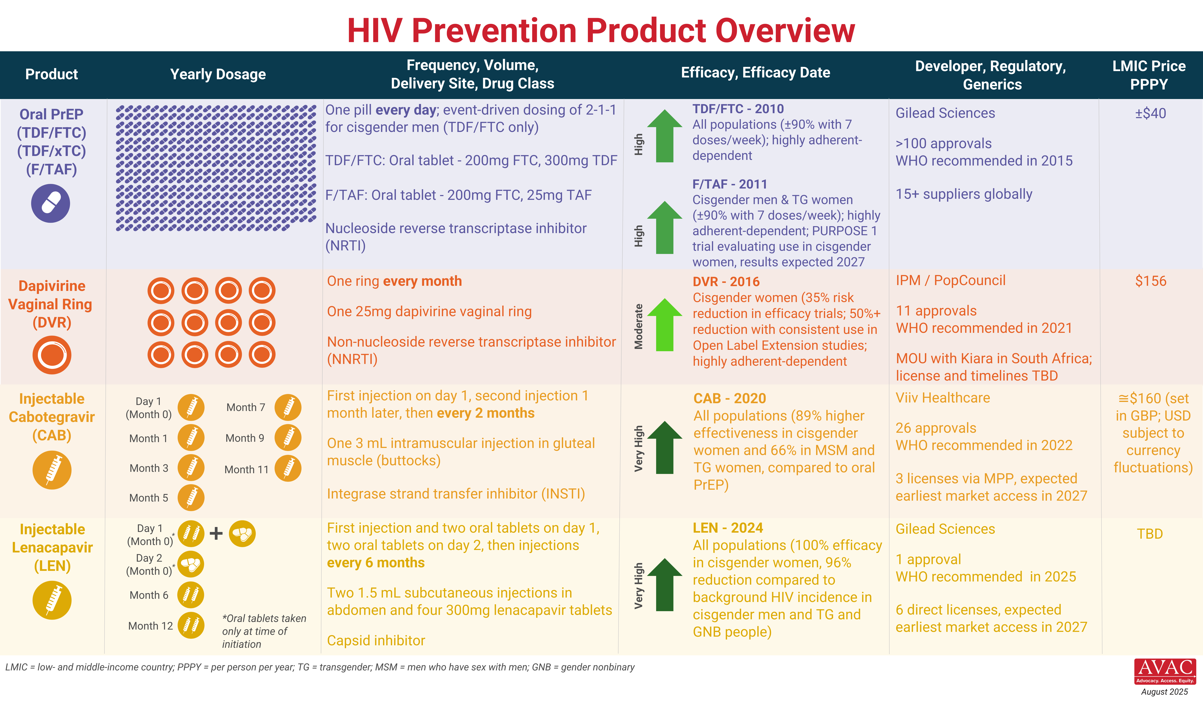
HIV Prevention Product Overview

