Slide 1
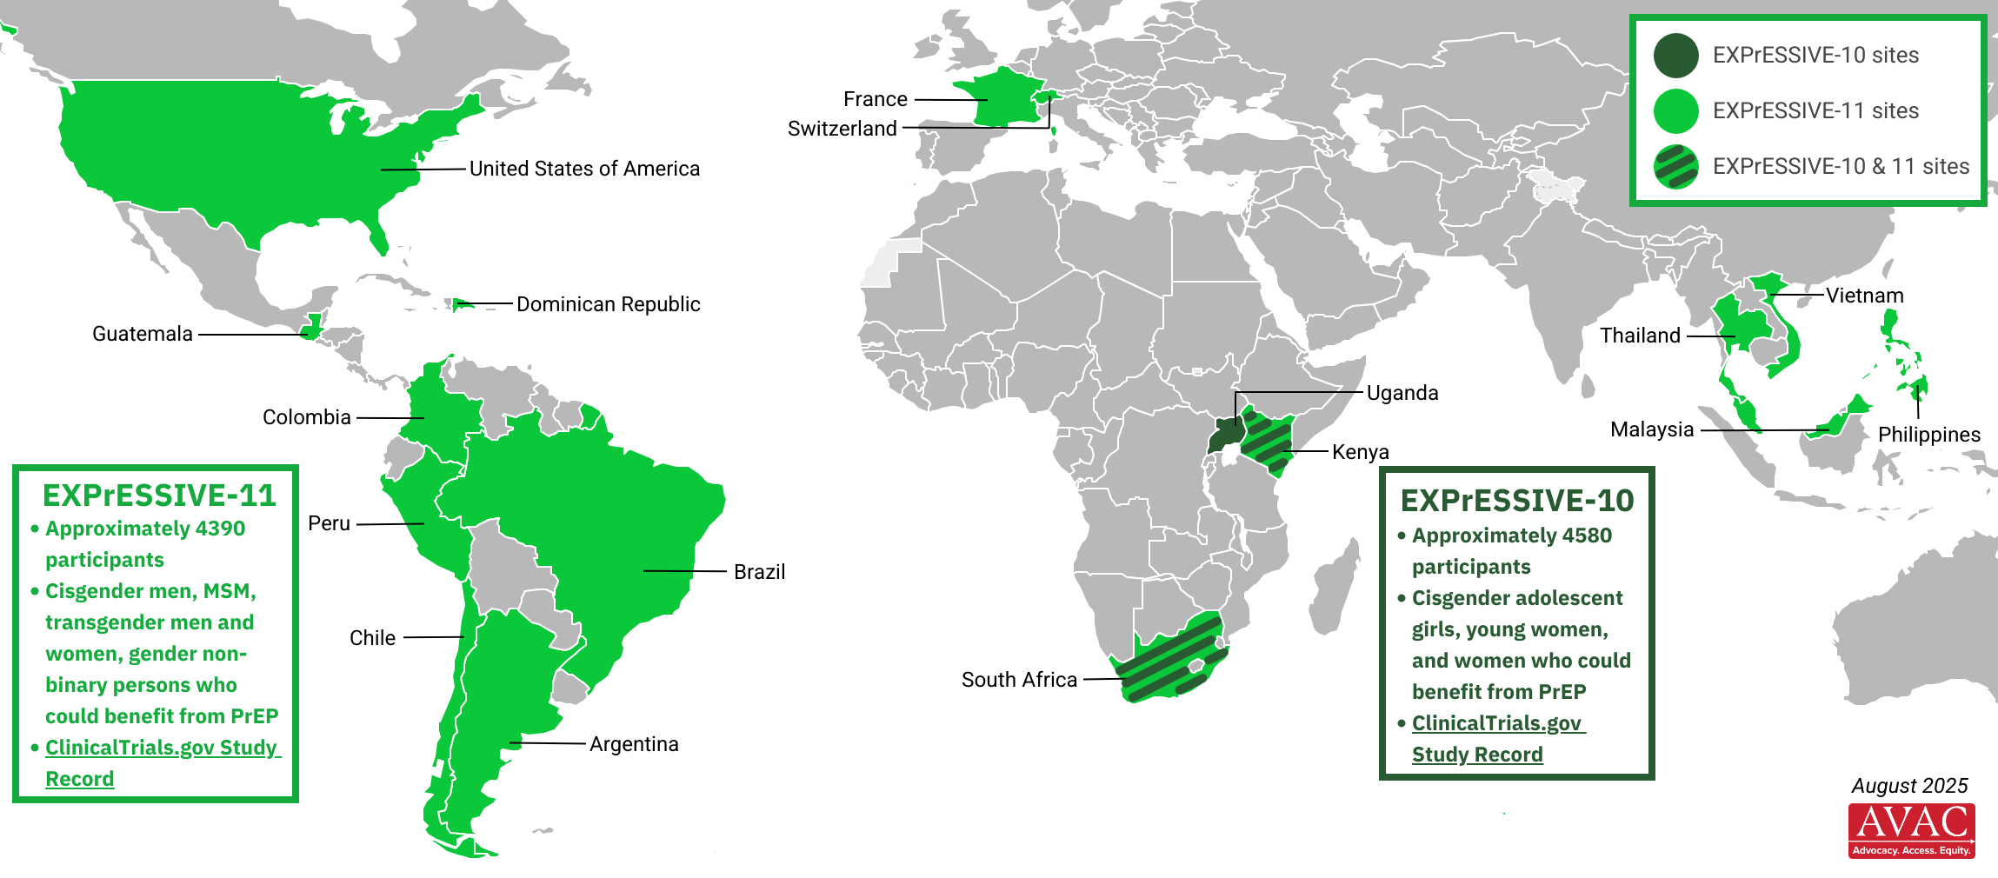
EXPrESSIVE Phase 3 Trial Countries
Seventeen countries in total are hosting sites for Merck’s Phase 3 trials of the monthly PrEP pill, MK-8527. Launch expected Q3 2025.
EXPrESSIVE-10: https://clinicaltrials.gov/study/NCT07071623
EXPrESSIVE-11: https://clinicaltrials.gov/study/NCT07044297

