Slide 1
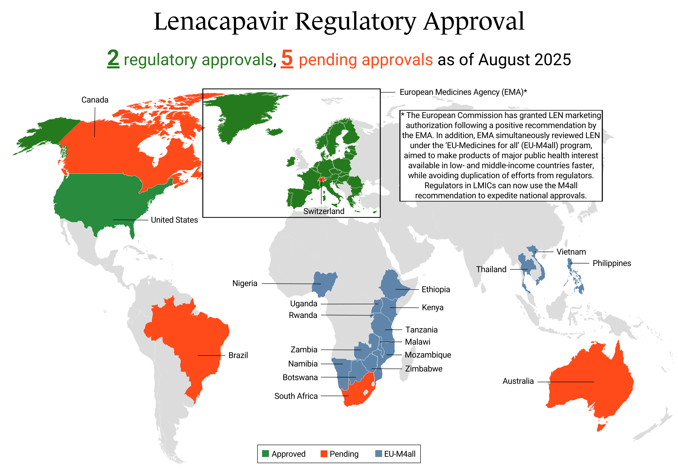
Lenacapavir Regulatory Approvals Map

