Slide 1
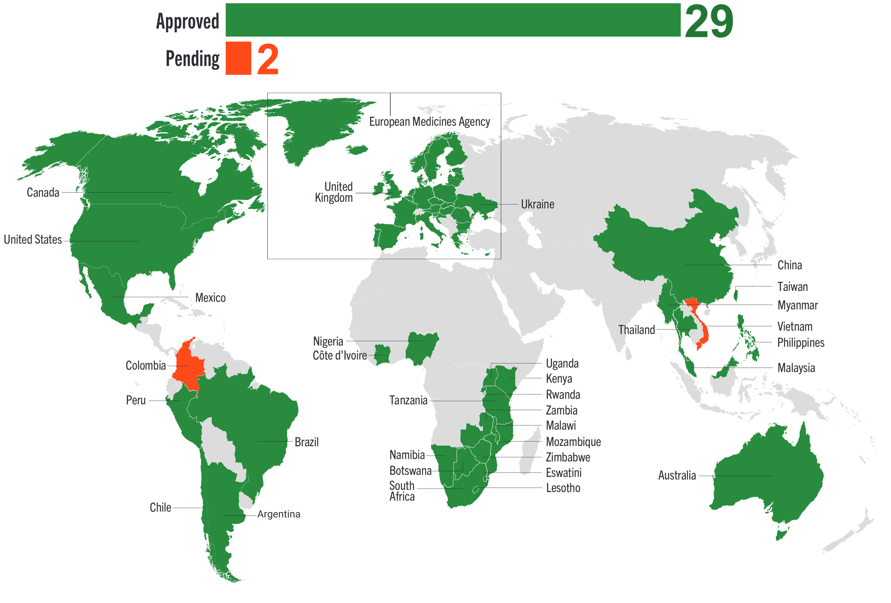
Cabotegravir Regulatory Approval
29 regulatory approvals (61 countries), 2 pending as of October 2025; Argentina, Chile, Mexico and Rwanda are newly approved in Q3 2025

