Slide 1
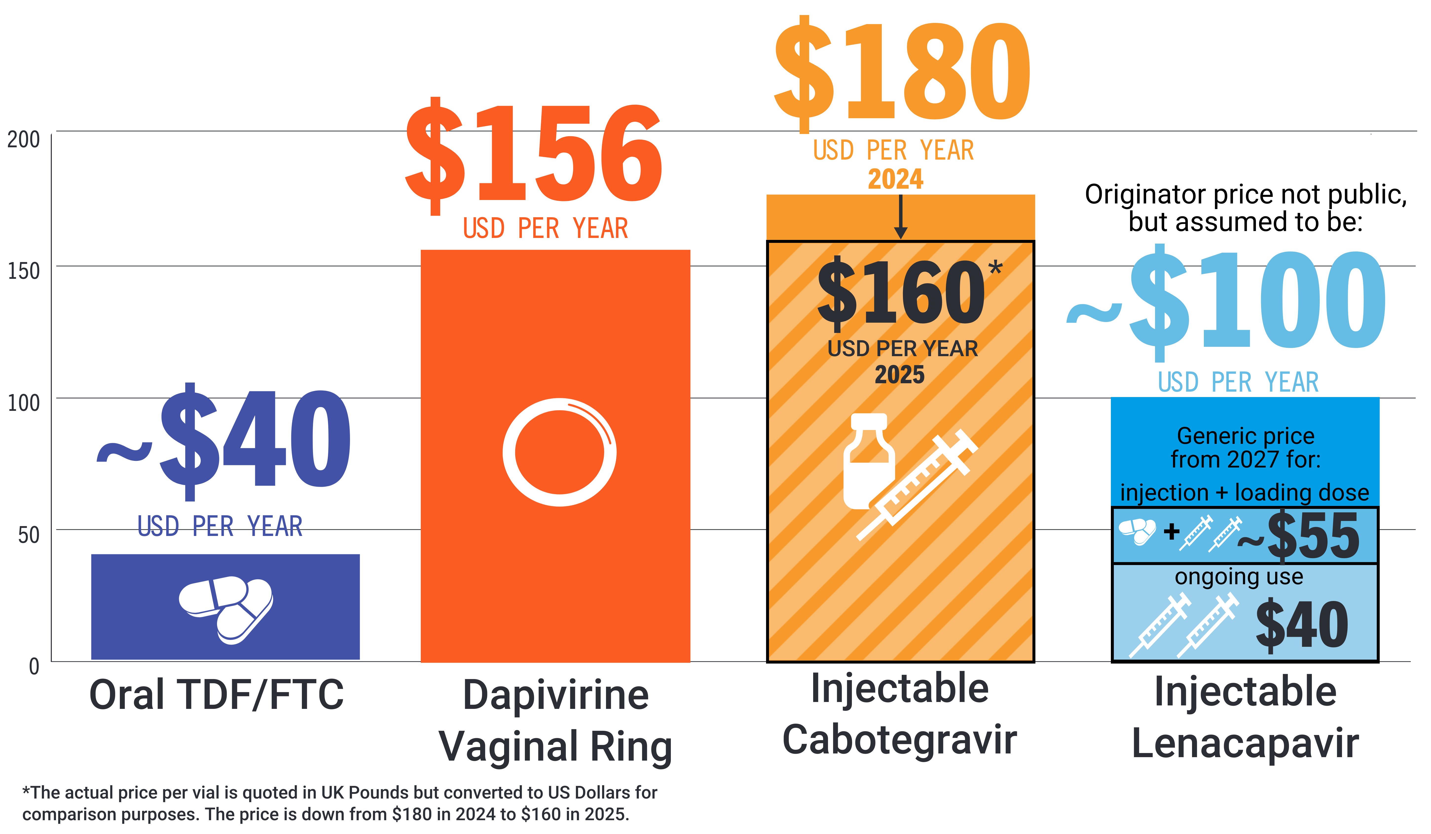
PrEP Prices for LMICs
Price comparison per person per year

