Slide 1
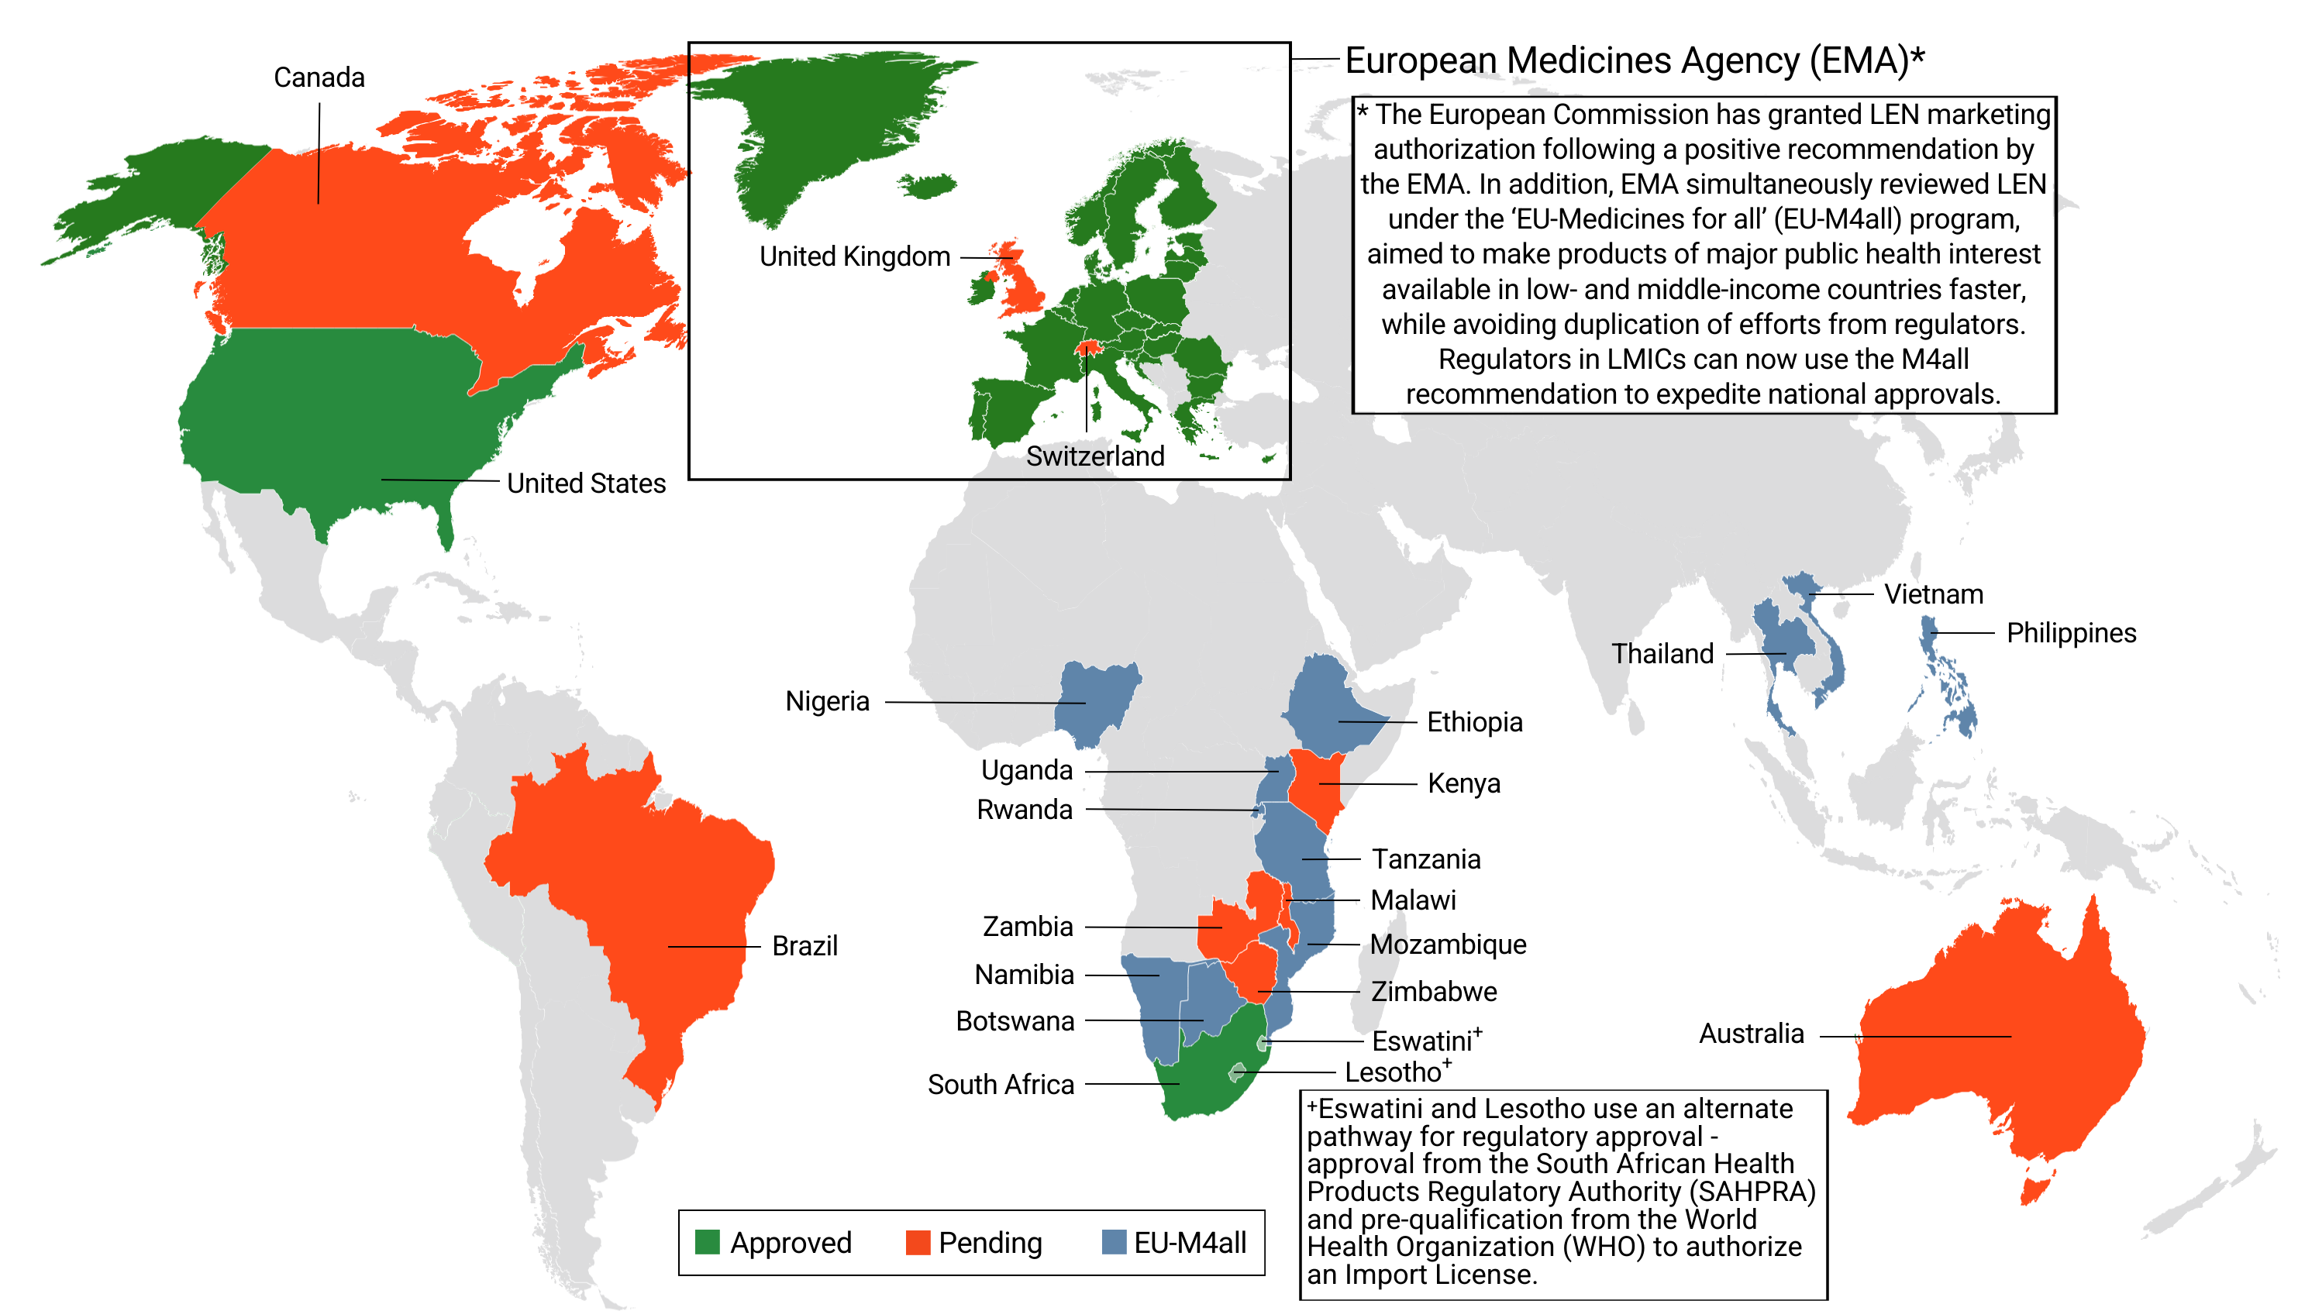
Lenacapavir Regulatory Approval
3 regulatory approvals, 9 pending approvals as of October 2025

