Slide 1
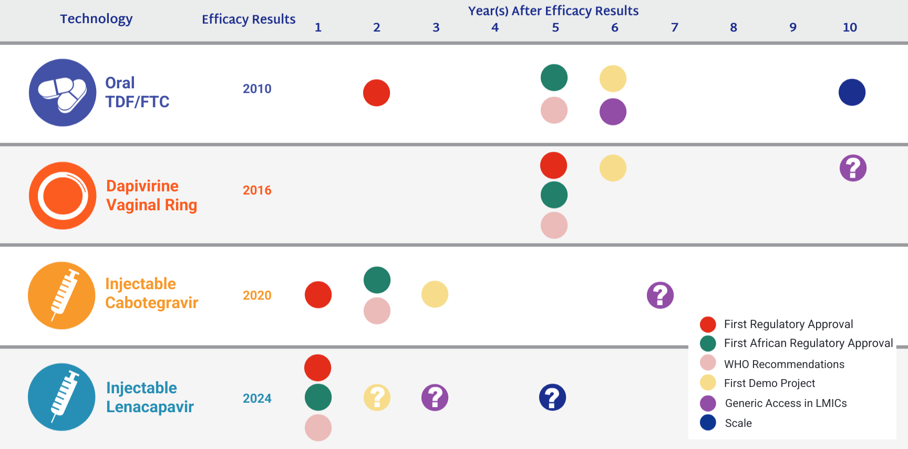
Moving a Product to the Real World

