Slide 1
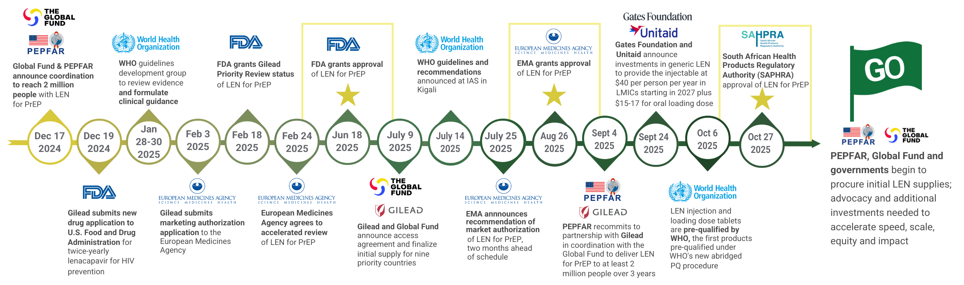
Where We Are Now with LEN for PrEP

