Slide 1
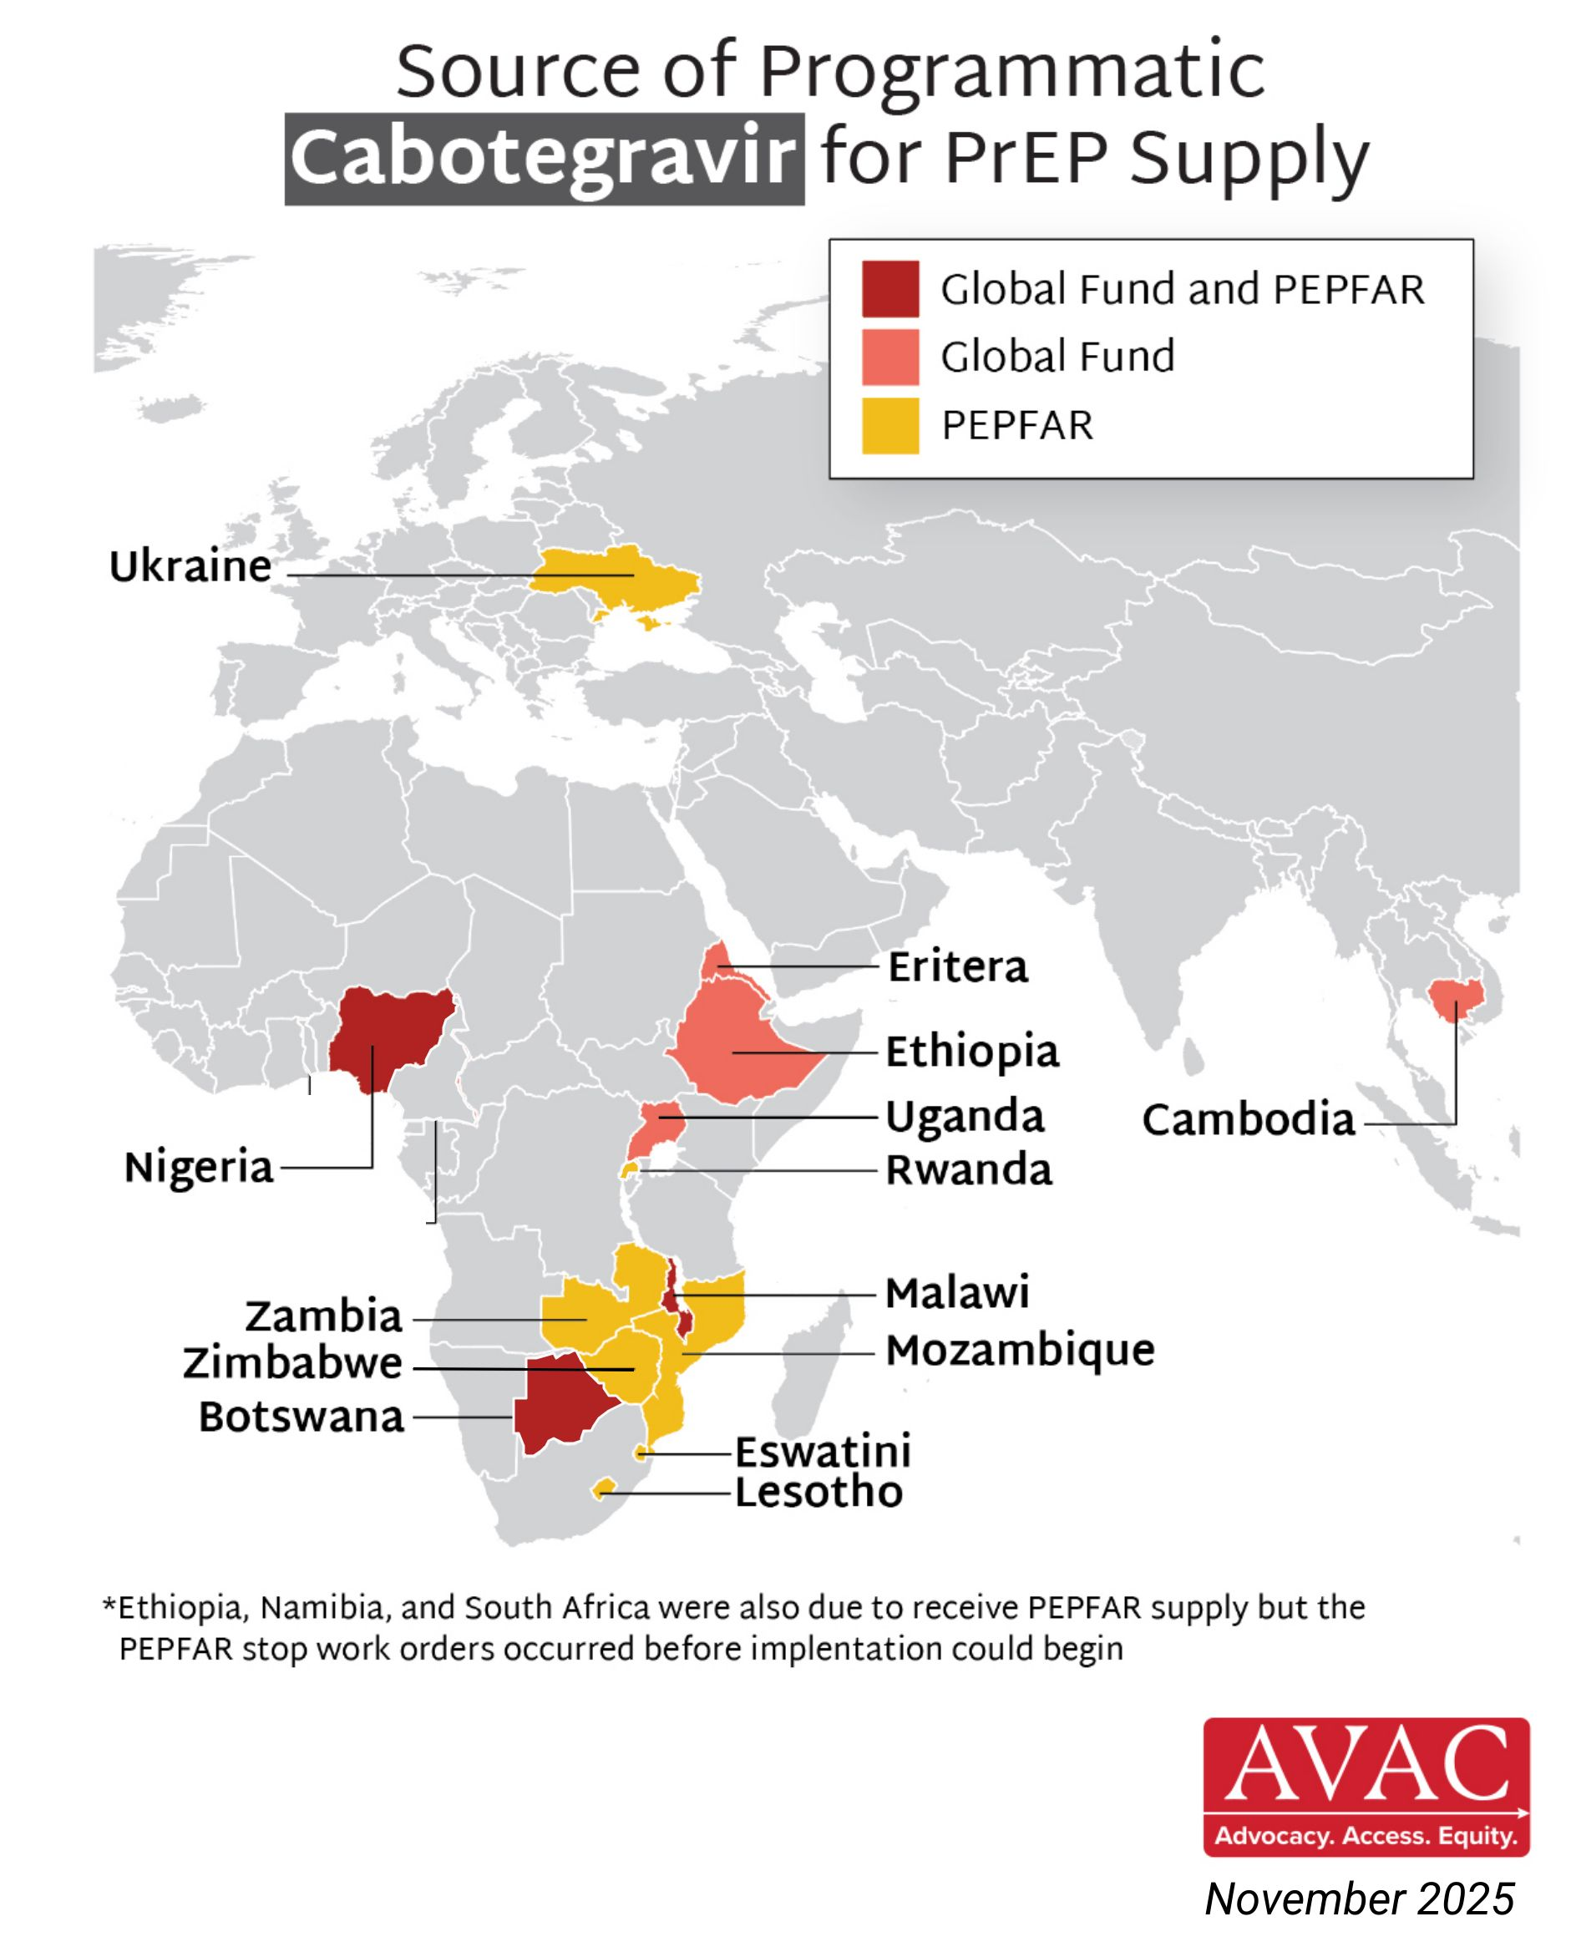
Source of Programmatic Cabotegravir for PrEP Supply

