Slide 1
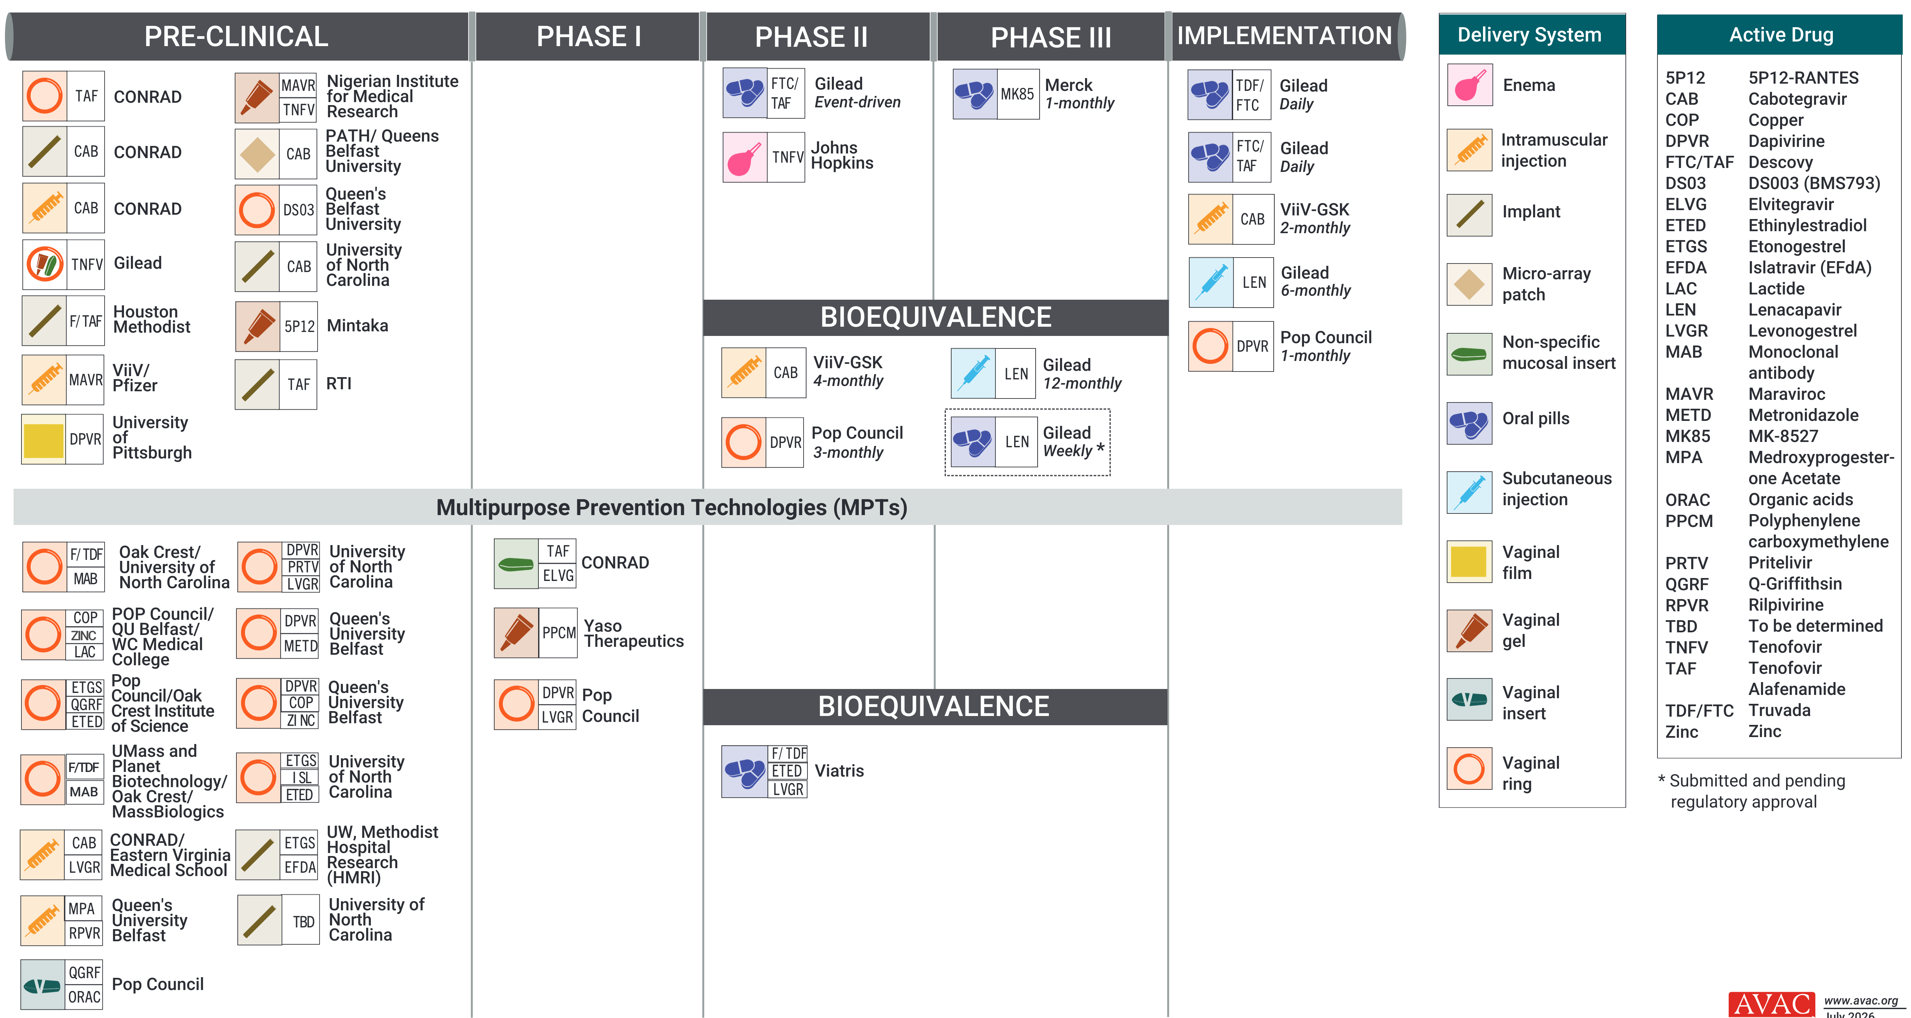
ARV-Based and MPT R&D Pipeline

