Slide 1
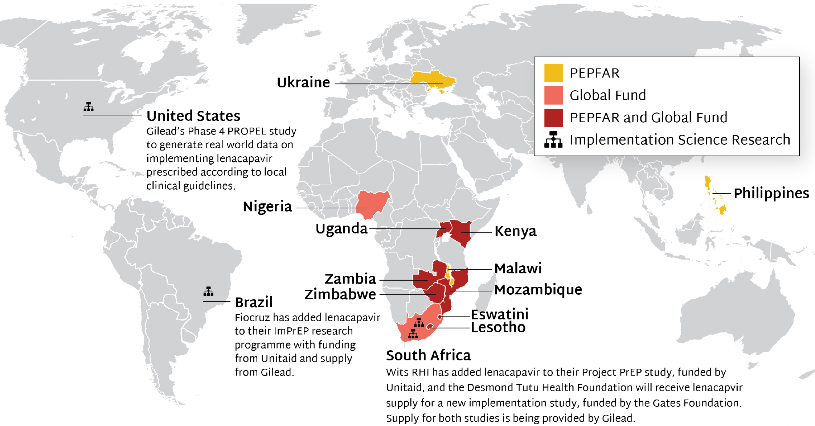
Source of LEN Supply to Early Adopter Countries
PEPFAR and GF are supporting 12 countries with early access to programmatic supply for LEN; Unitaid, Gates and Gilead are supporting 4 IS projects

