Slide 1
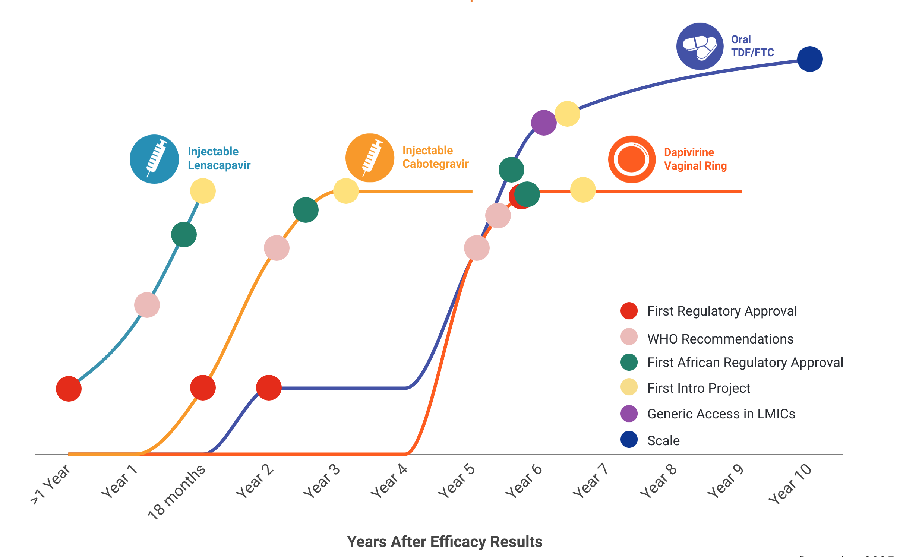
Learn Lessons, Accelerate Access, Reduce Time to Impact
In the first year since efficacy results were reported, LEN for PrEP has achieved critical milestones in record time compared to oral PrEP, DVR, and CAB; speed, scale and equity are still needed to deliver impact

