Slide 1
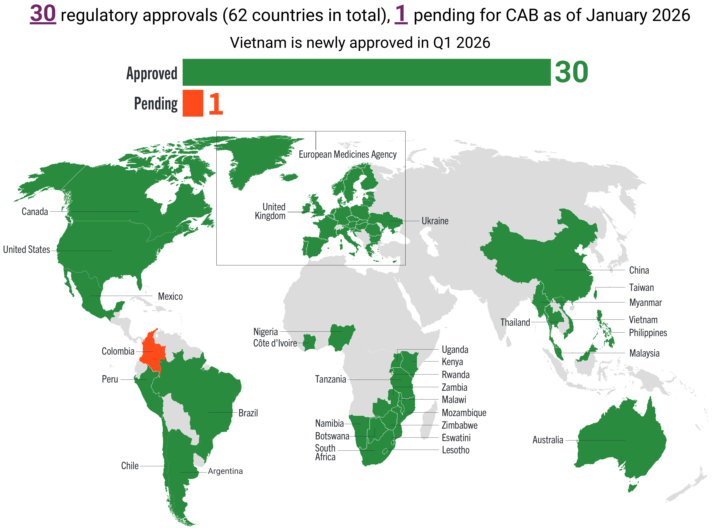
Cabotegravir Regulatory Approvals Map

