Slide 1
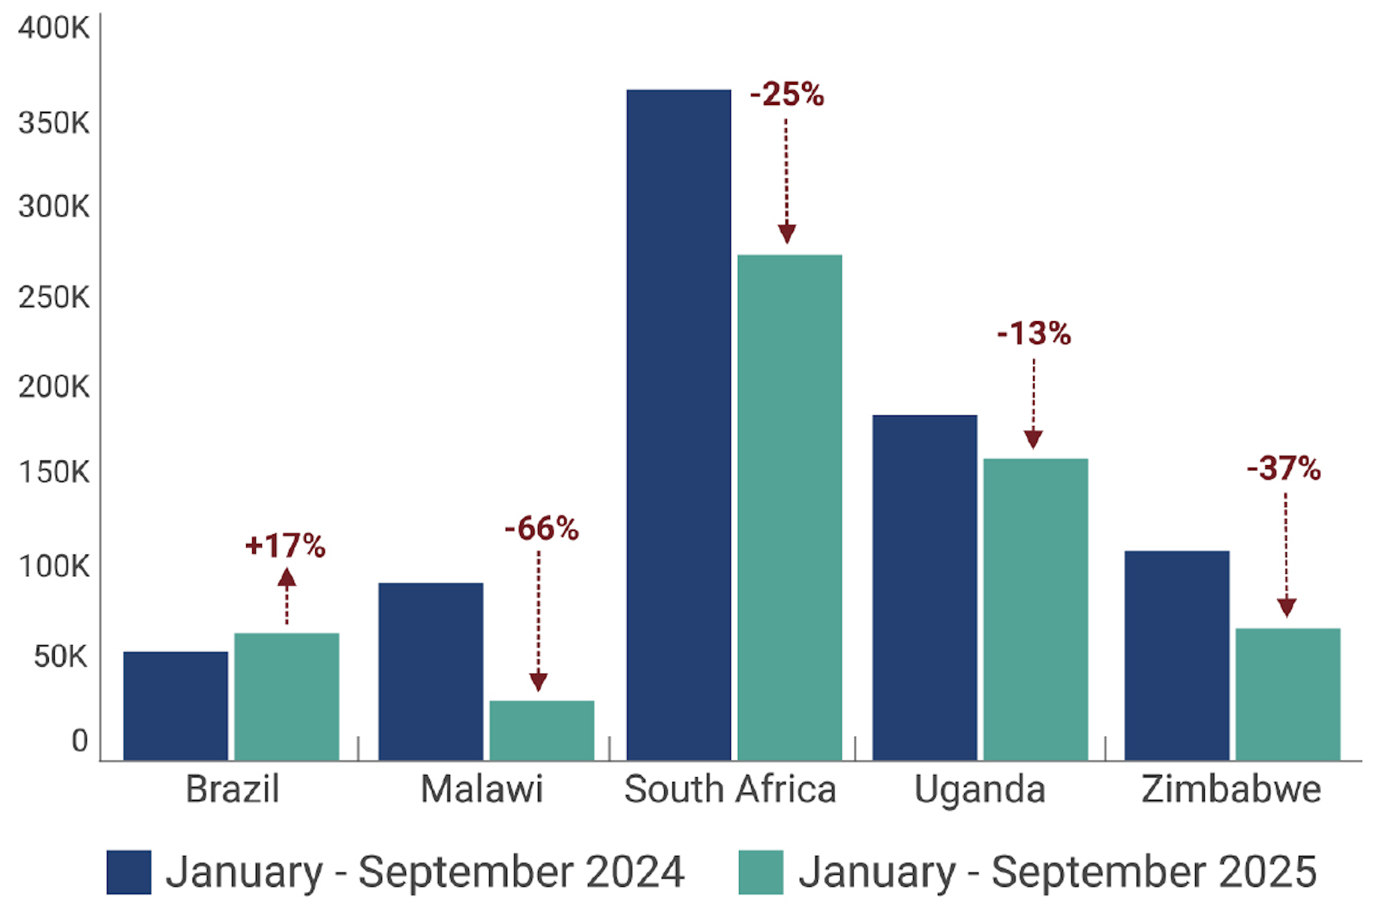
Change in PrEP Initiations from 2024-2025 in Five Countries

