Slide 1
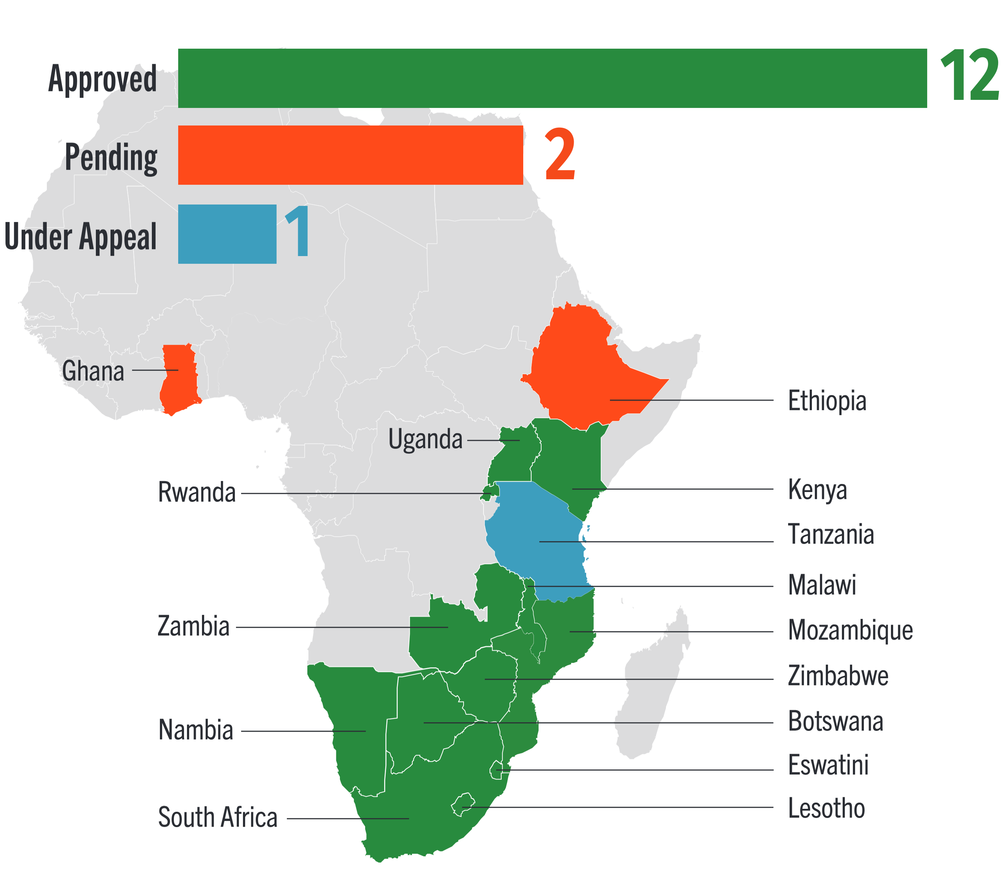
One Month Dapivirine Ring Regulatory Approvals Map
12 regulatory approvals; 2 pending; 1 under appeal as of January 2026

