Slide 1
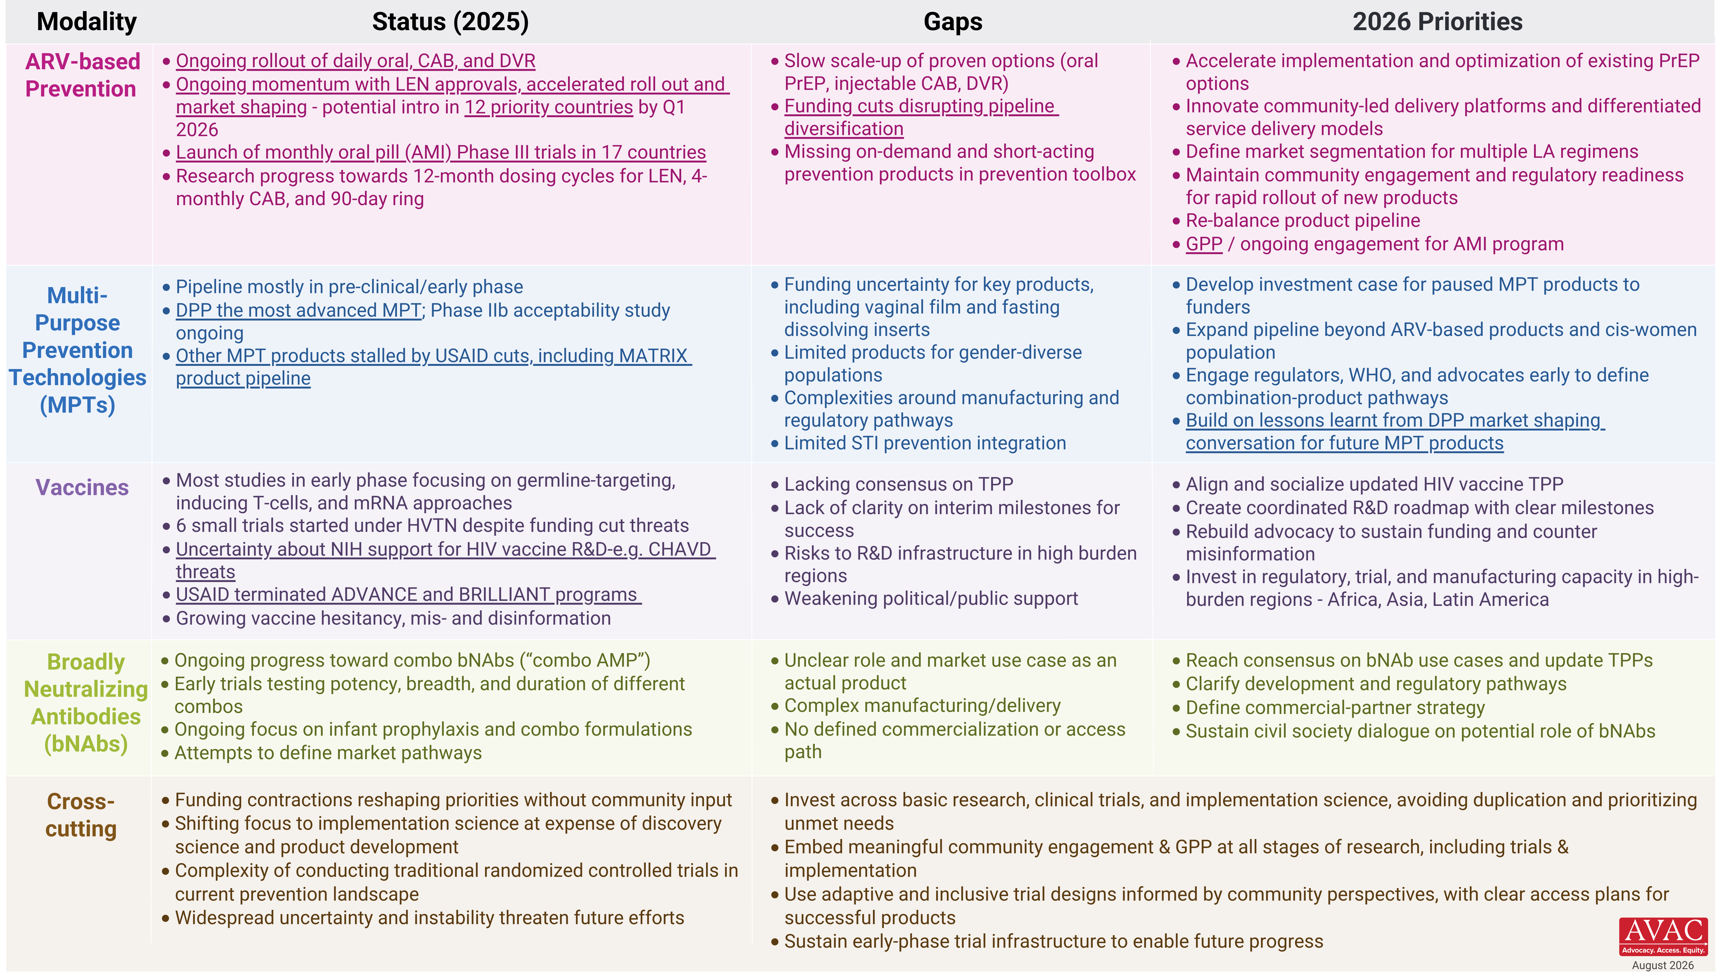
People’s Research Agenda Summary Table

