Slide 1
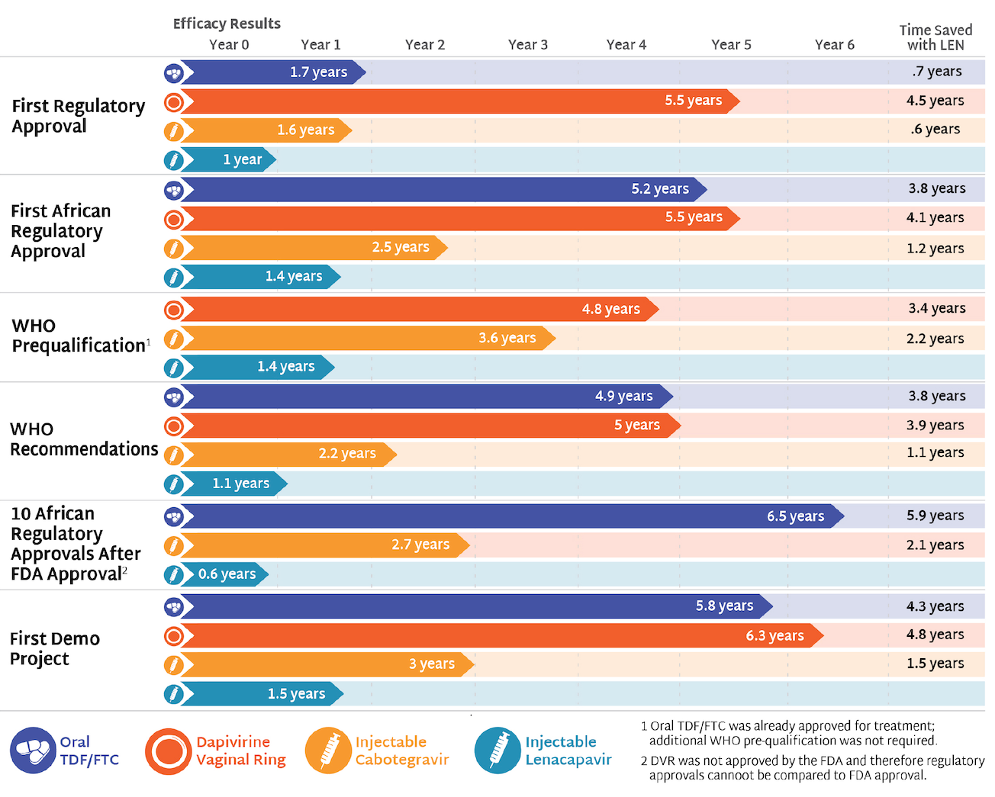
Speeding Up Access to PrEP
Time from efficacy results to key milestones

