Slide 1
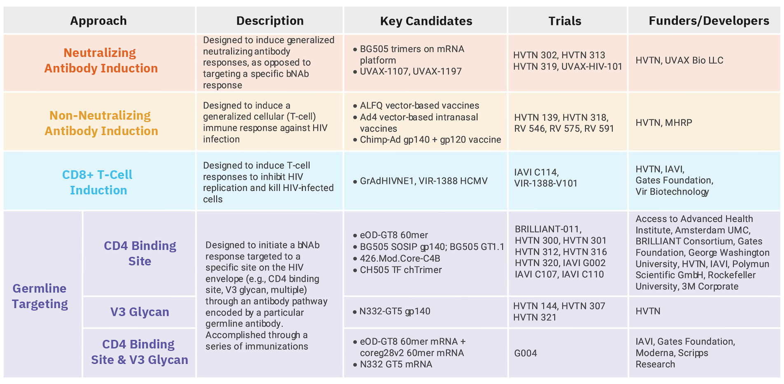
HIV Vaccine Clinical Trials Pipeline

