Slide 1
AVAC Infographics
CROI 2026

Slide 2
Table of Contents
HIV Prevention Pipeline
  Years Ahead in HIV Prevention Research: Time to Market
  ARV-Based and MPT R&D Pipeline
  HIV Prevention Pipeline: Products to Watch
  People’s Research Agenda Summary Table
PrEP
  Innovation Pile-Up in Next-Generation PrEP
  Speeding Up Access to PrEP
  Learn Lessons, Accelerate Access, Reduce Time to Impact
  EXPrESSIVE Phase III Program Countries of MK-8527
  Where We Are Now with LEN for PrEP
  Lenacapavir Regulatory Approval
  Lenacapavir Implementation Studies
  Source of LEN for PrEP Supply to Early Adopter Countries
  Cabotegravir Implementation
  PrEP Prices for LMICs
  Overview of Lenacapavir Trials

Slide 3
Table of Contents (cont.)
MPTs & STIs
  MPT R&D Pipeline
  Spotlight on MPTs Addressing STIs
  Current Status of Vaccine Development
Preventive Vaccines
  HIV Vaccine Clinical Trials Pipeline
bNAbs
  Broadly Neutralizing Antibodies and HIV
  Broadly Neutralizing Antibody Combinations
Impact of US Funding Cuts
  HIV Prevention Pipeline: Impact of USAID & NIH Cuts
  The Cost of Cutting HIV Research
  NIH: Cuts to Clinical Trials
  PrEP Delivery Imperiled
  Impact of US Funding on Services for Key Populations

Slide 4
HIV Prevention Pipeline

Slide 5
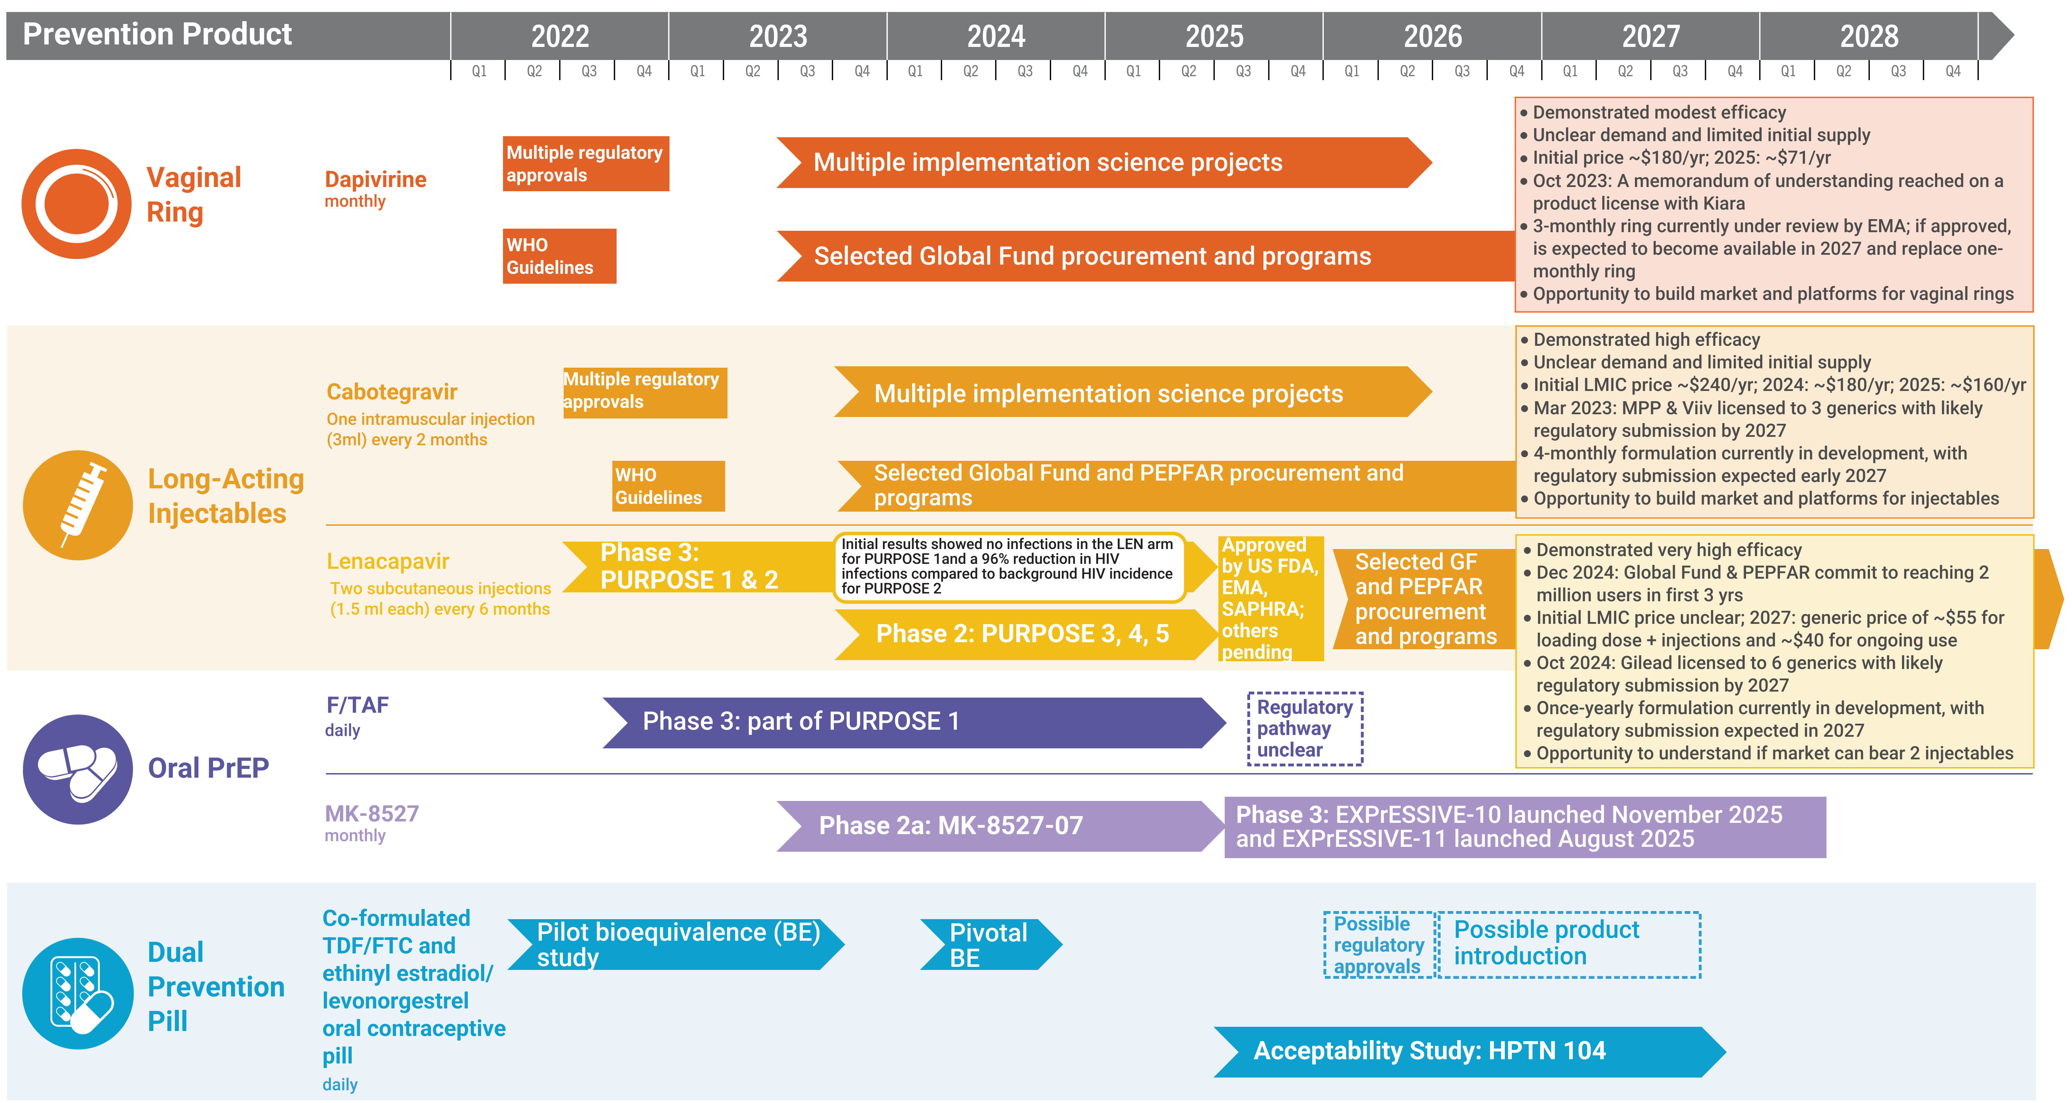
Years Ahead in HIV Prevention Research:
Time to Market

Slide 6
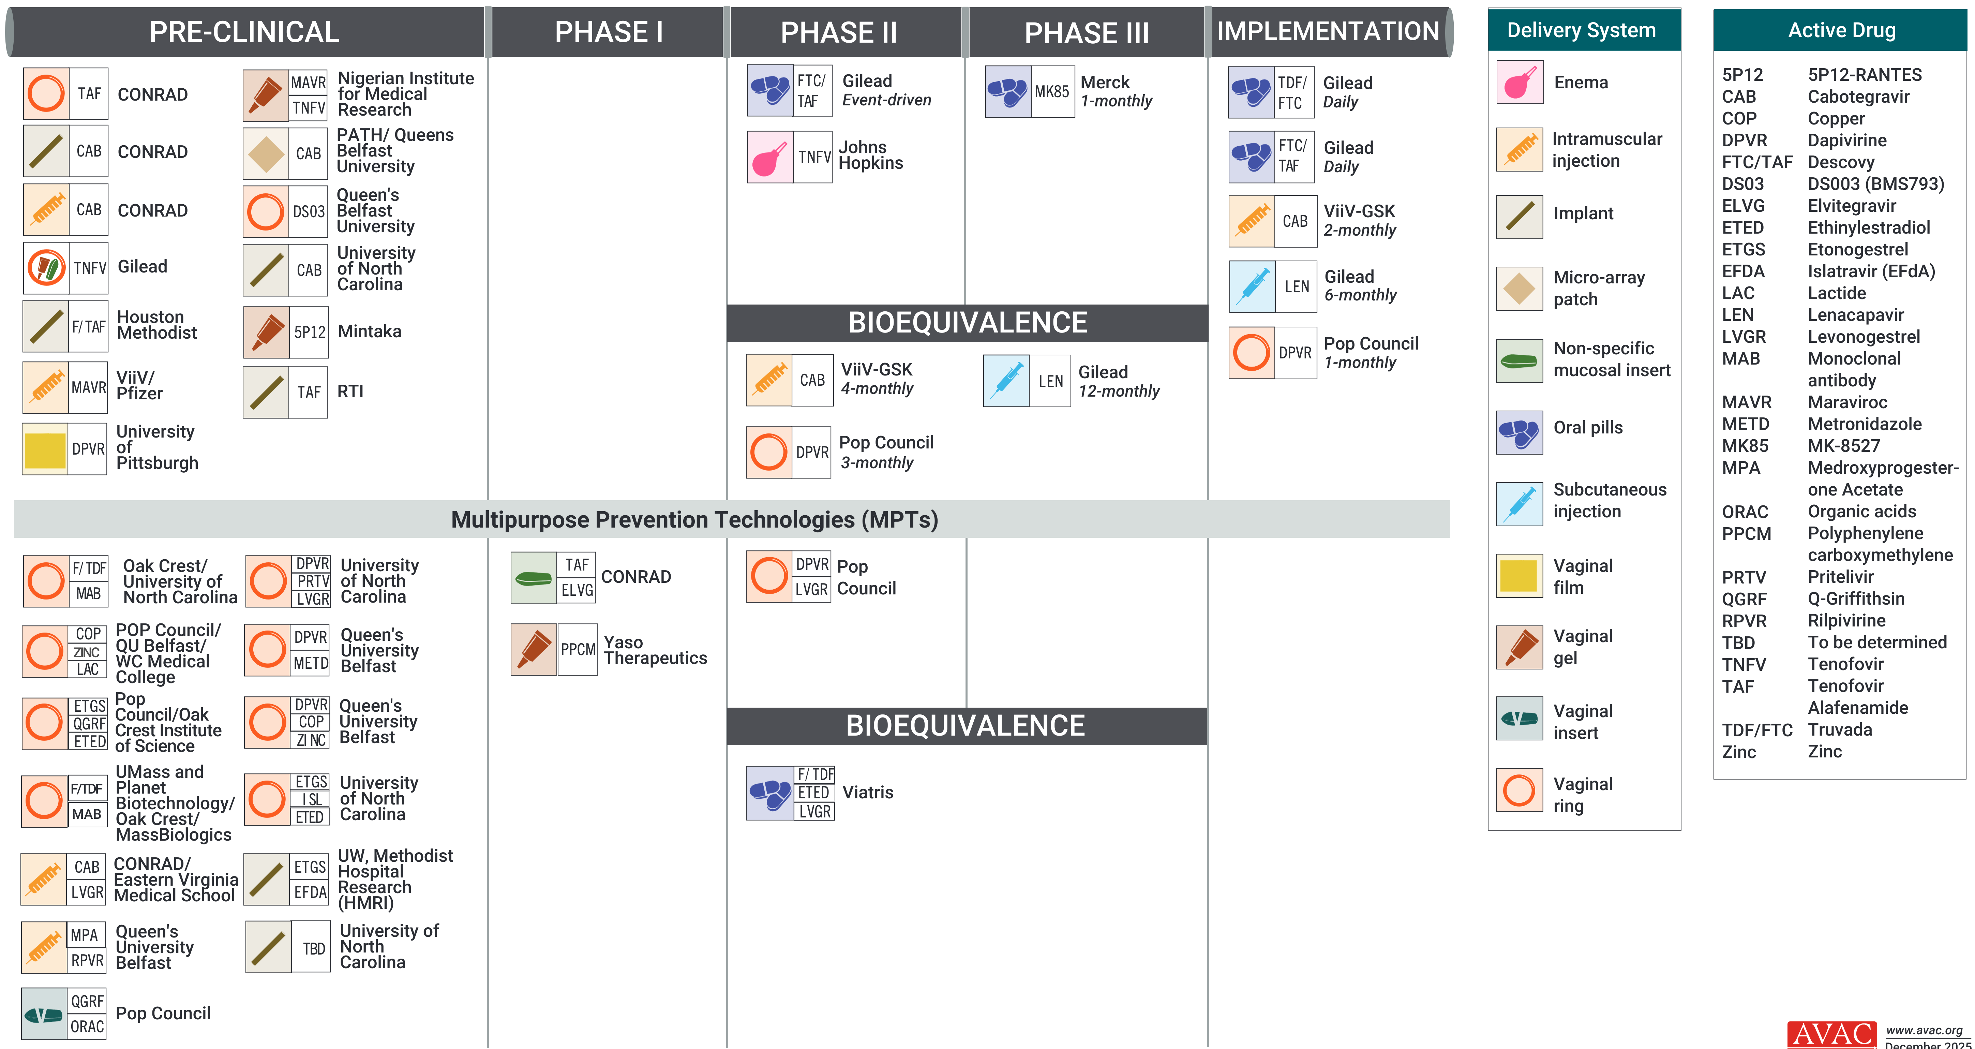
ARV-Based and MPT R&D Pipeline

Slide 7
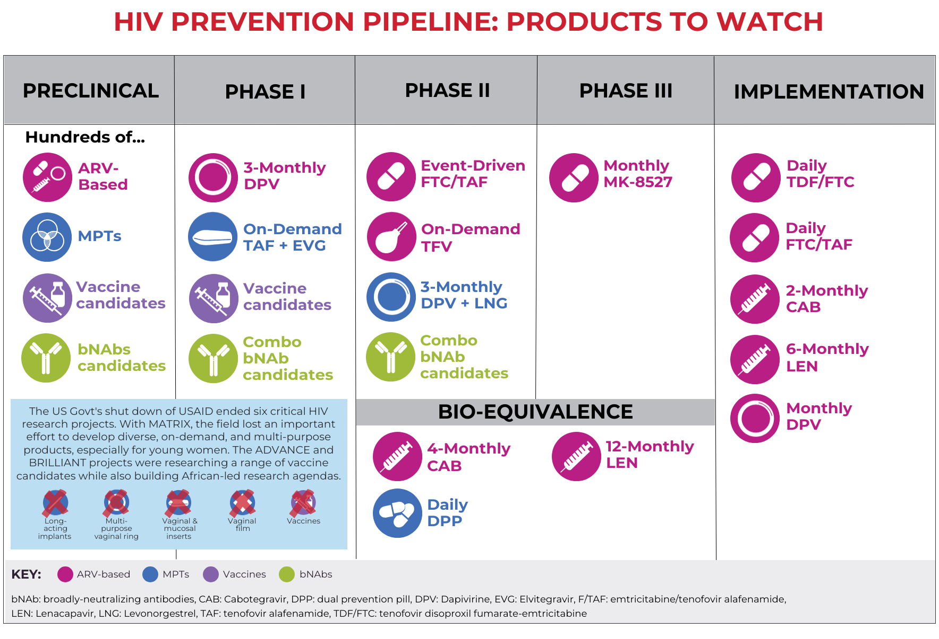
HIV Prevention Pipeline: Products to Watch

Slide 8
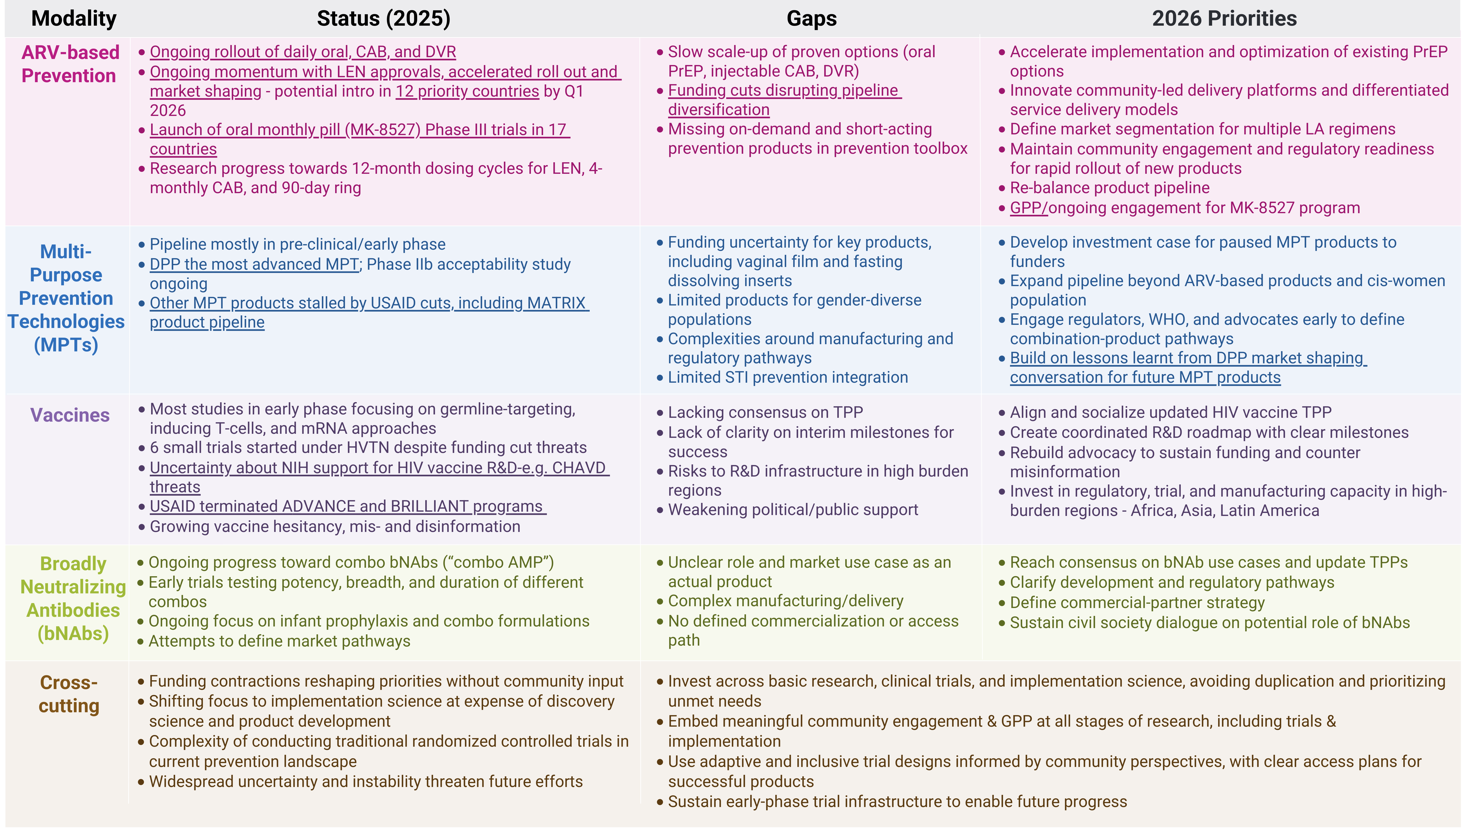
People’s Research Agenda Summary Table

Slide 9
PrEP

Slide 10
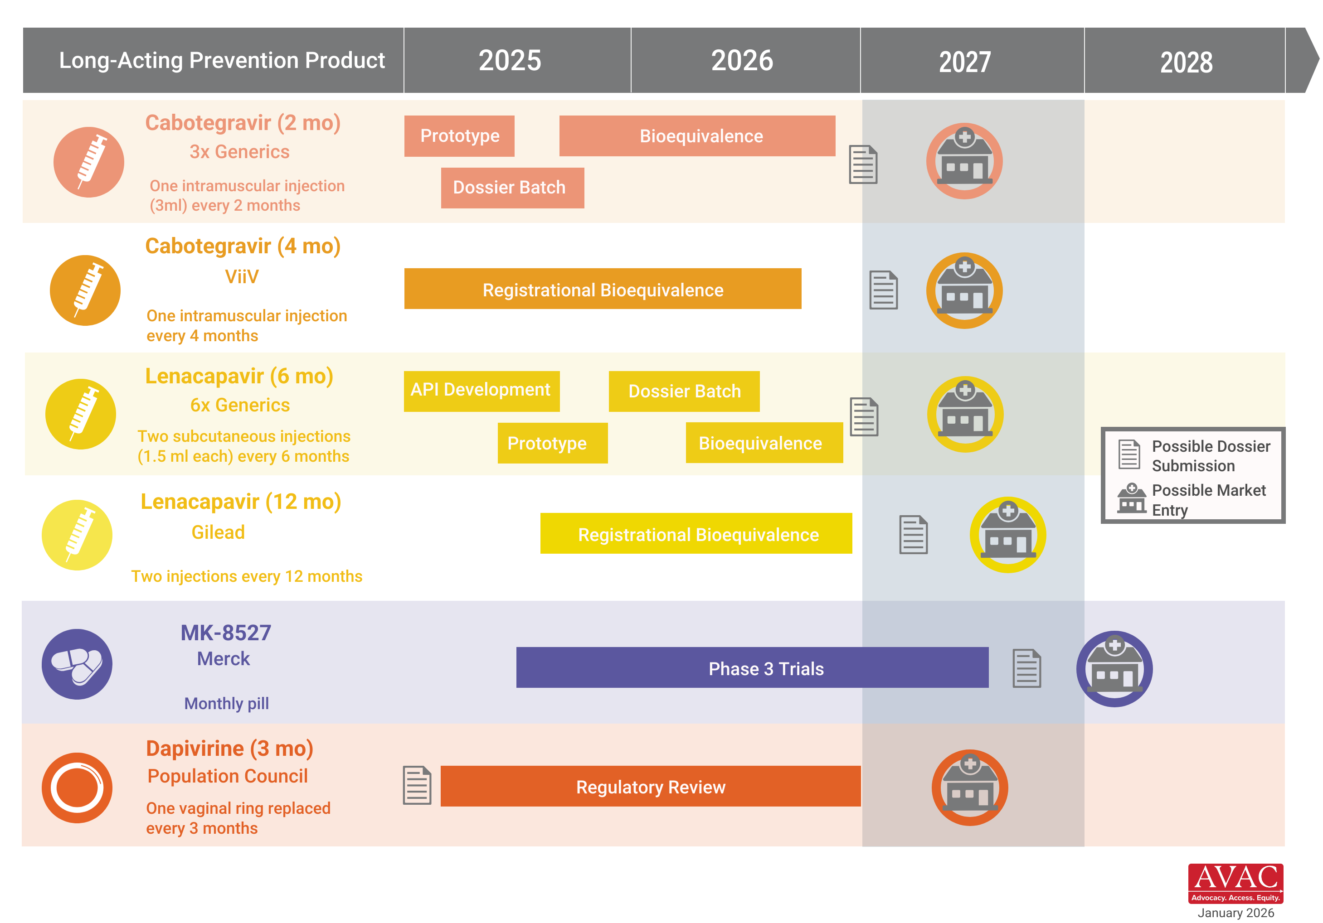
Innovation Pile-Up in Next-Generation PrEP

Slide 11
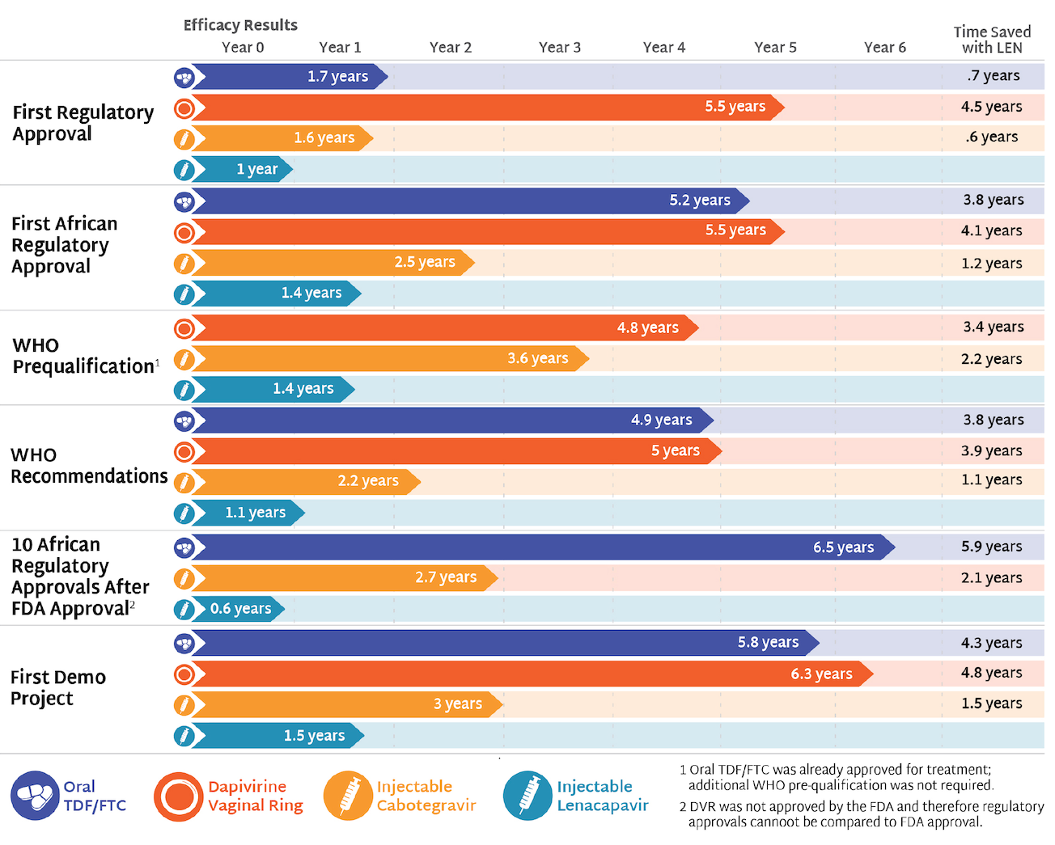
Speeding Up Access to PrEP

Slide 12
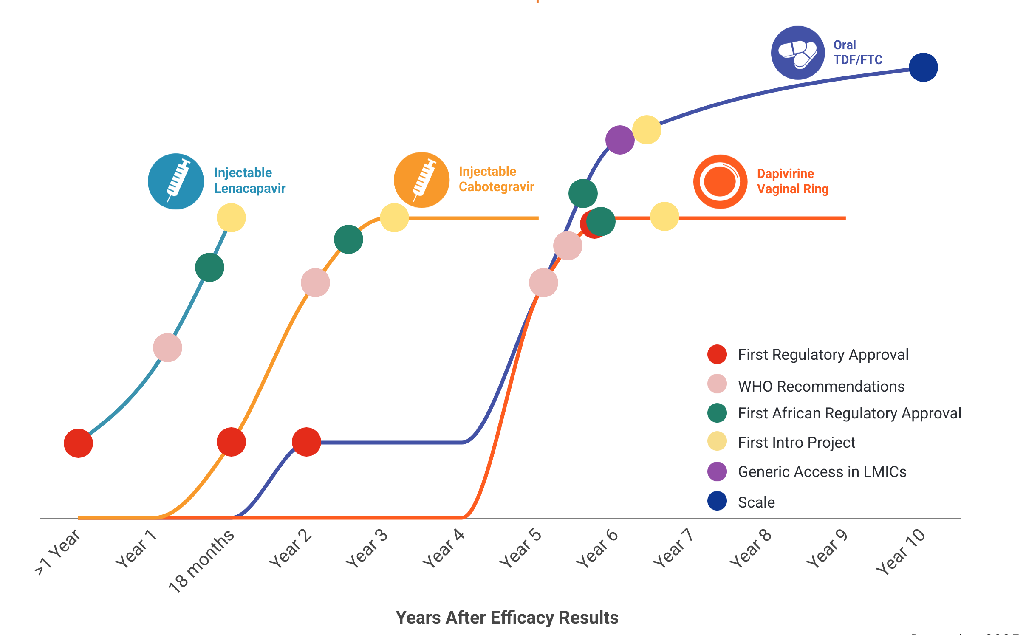
Learn Lessons, Accelerate Access, Reduce Time to Impact
In the first year since efficacy results were reported, LEN for PrEP has achieved critical milestones in record time compared to oral PrEP, DVR, and CAB; speed, scale and equity are still needed to deliver impact

Slide 13
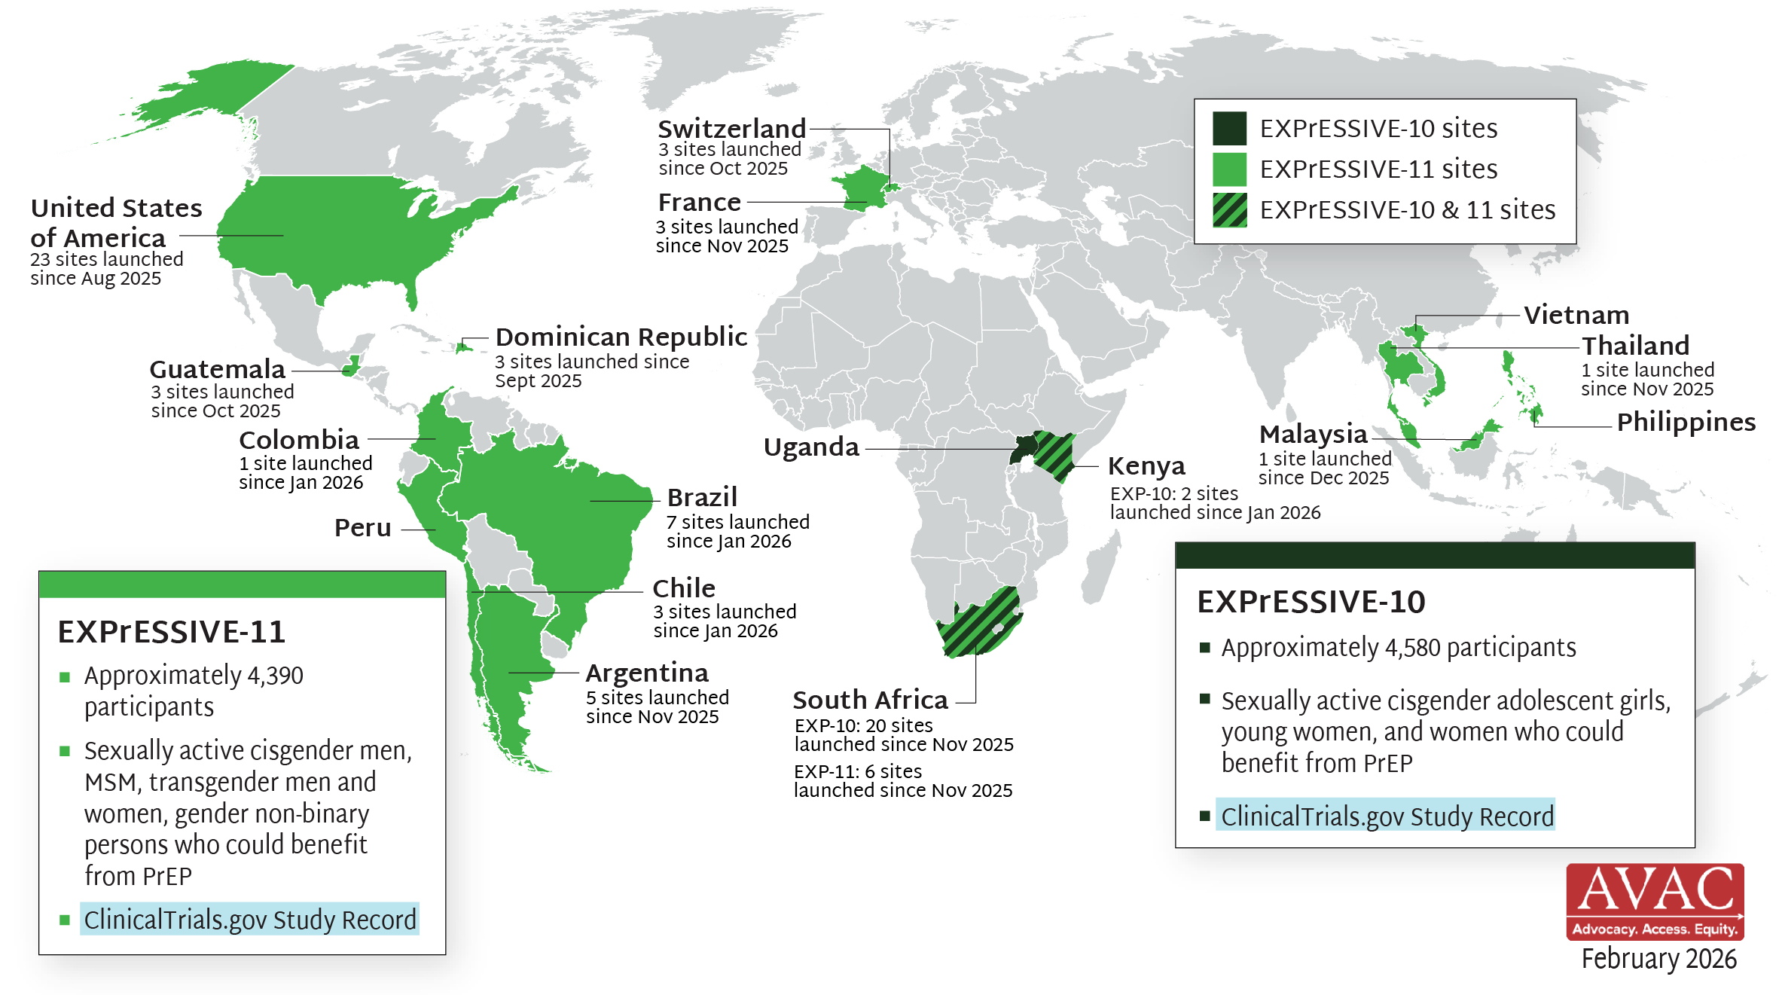
EXPrESSIVE Phase III Program Countries for MK-8527
17 countries hosting sites for Phase III program of monthly PrEP pill, MK-8527; EXPrESSIVE-11 launched Aug 2025; EXPrESSIVE-10 launched Nov 2025

Slide 14
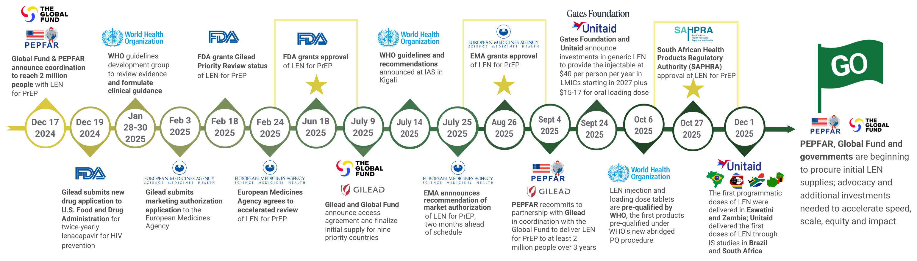
Where We Are Now with LEN for PrEP

Slide 15
Lenacapavir Regulatory Approval
15 regulatory approvals, 9 pending approvals as of February 2026

Slide 16
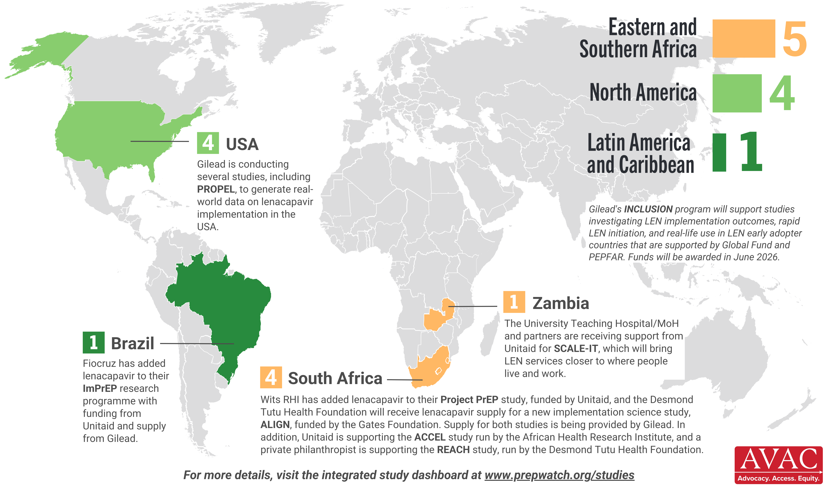
Lenacapavir Implementation Studies
10 implementation studies ongoing in 4 countries, as of February 2026

Slide 17
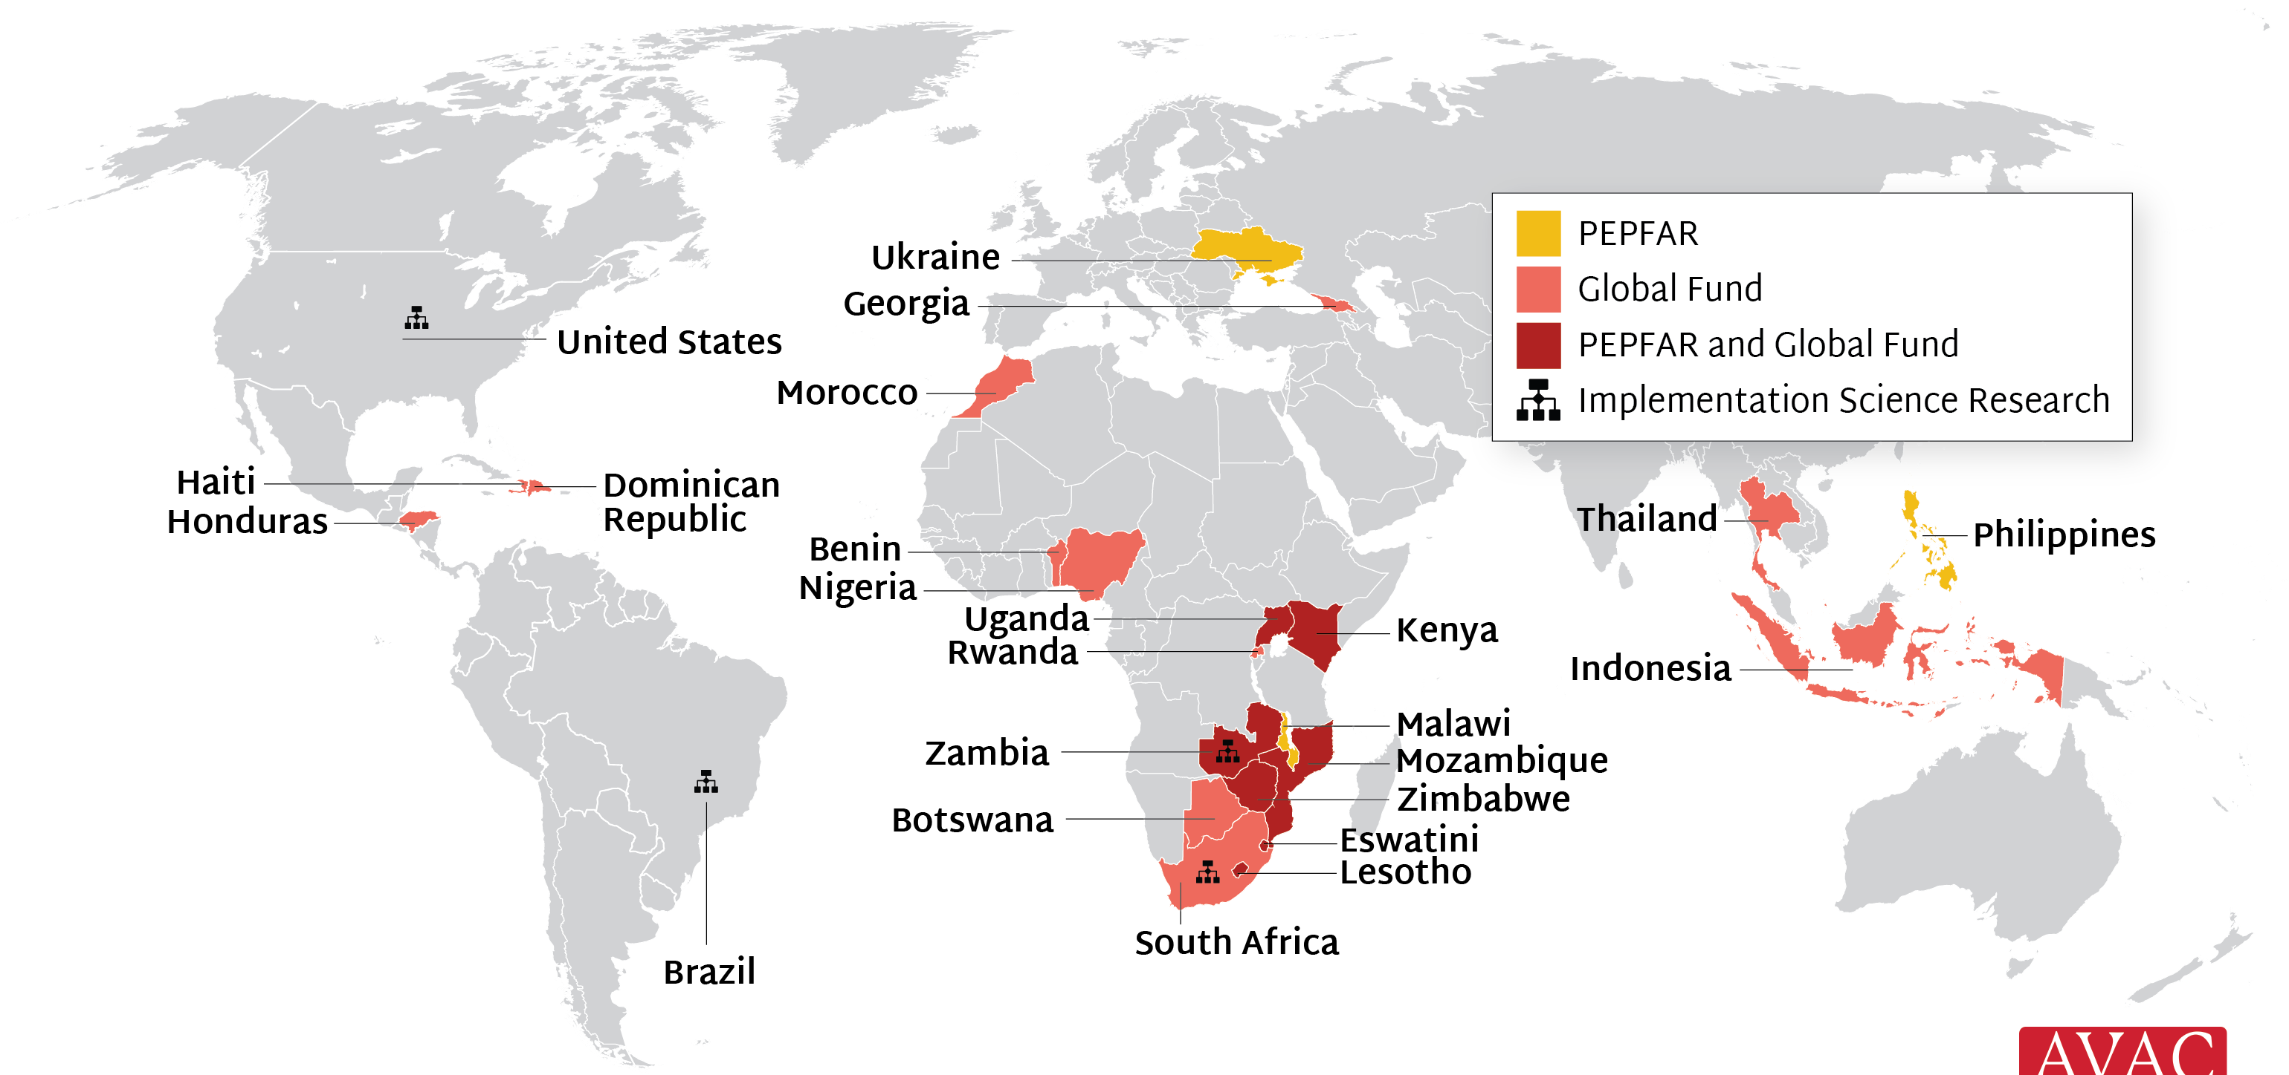
Source of LEN for PrEP Supply to Early Adopter Countries
PEPFAR and Global Fund are supporting 22 countries with early LEN access; Unitaid, Gates and Gilead are supporting 4 implementation science efforts

Slide 18
Cabotegravir Implementation

Slide 19
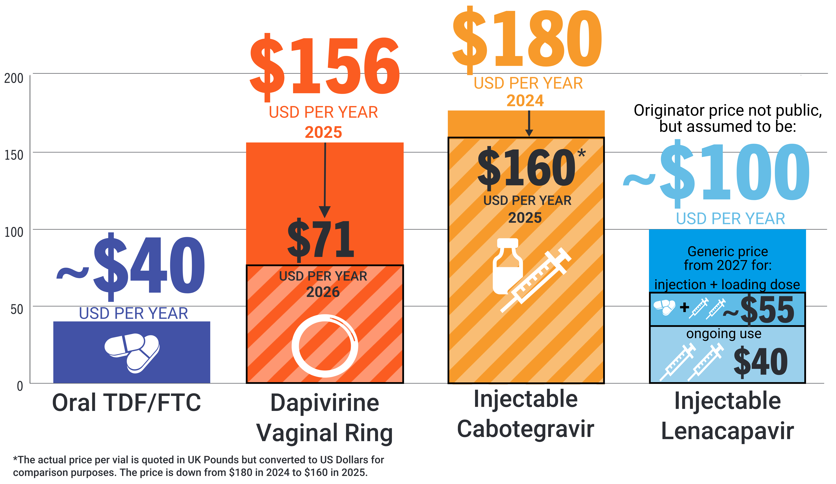
PrEP Prices for LMICs
Price comparison per person per year

Slide 20
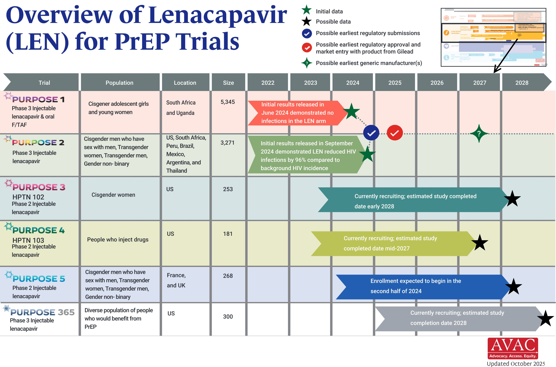
Overview of Lenacapavir Trials

Slide 21
Multipurpose Prevention Technologies (MPTs) & STIs

Slide 22
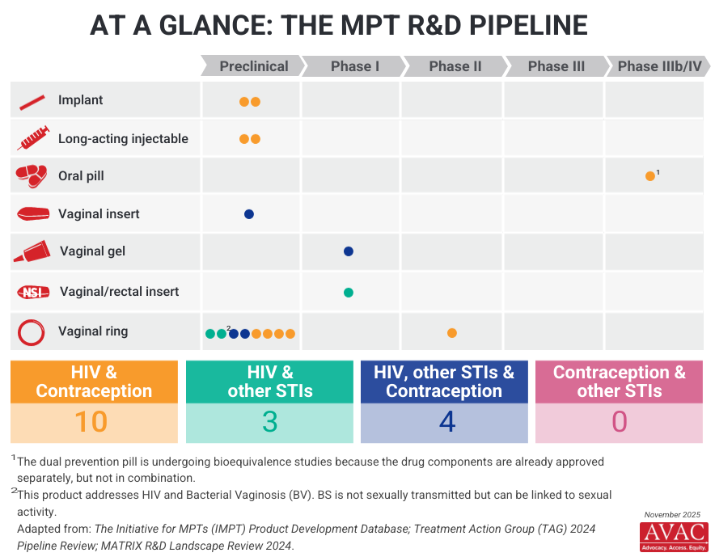
Multipurpose Prevention Technology (MPT) R&D Pipeline

Slide 23
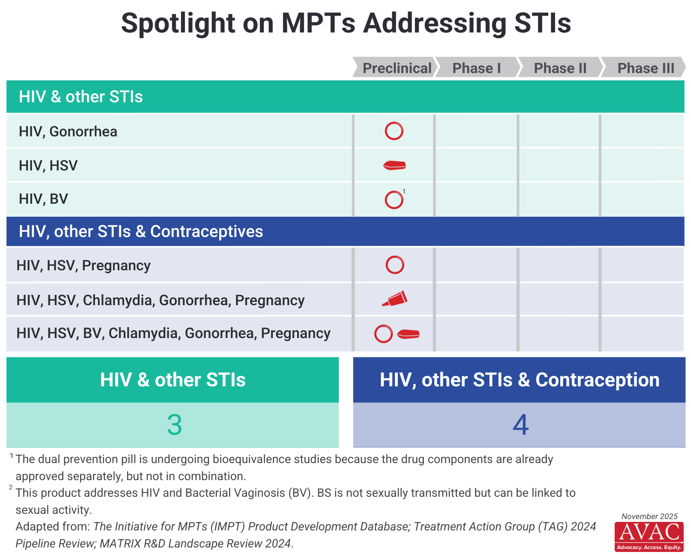
Spotlight on MPTs Addressing STIs

Slide 24
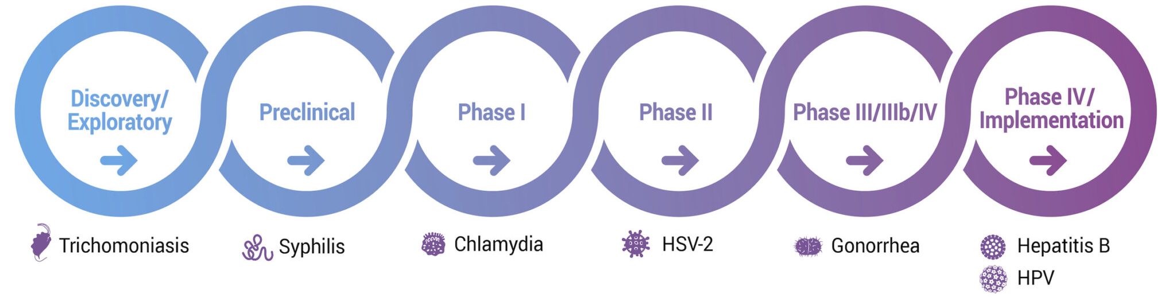
Current Status of Vaccine Development
For more, visit STIWATCH.org

Slide 25
Preventive Vaccines

Slide 26
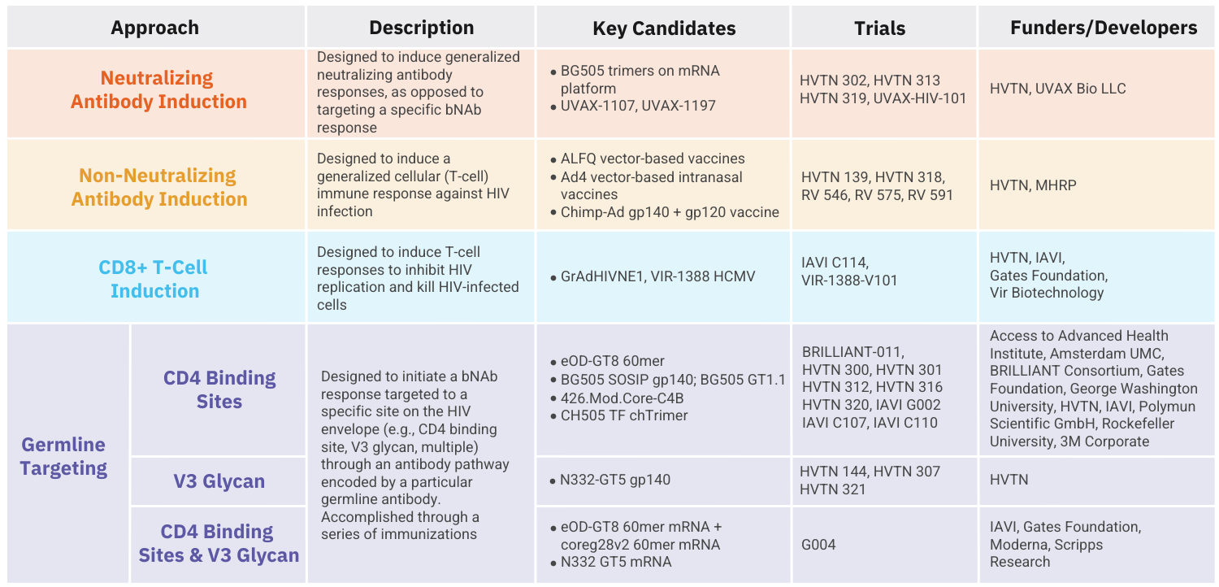
HIV Vaccine Clinical Trials Pipeline
All vaccine candidates shown above are currently in Phase I trials. More details can be found in AVAC's Pipeline Tracker.

Slide 27
bNAbs

Slide 28
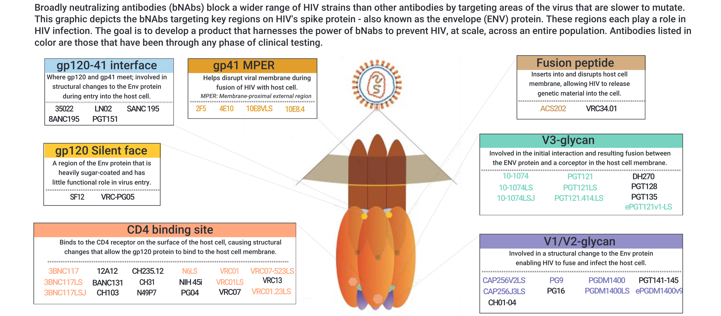
Broadly Neutralizing Antibodies and HIV

Slide 29
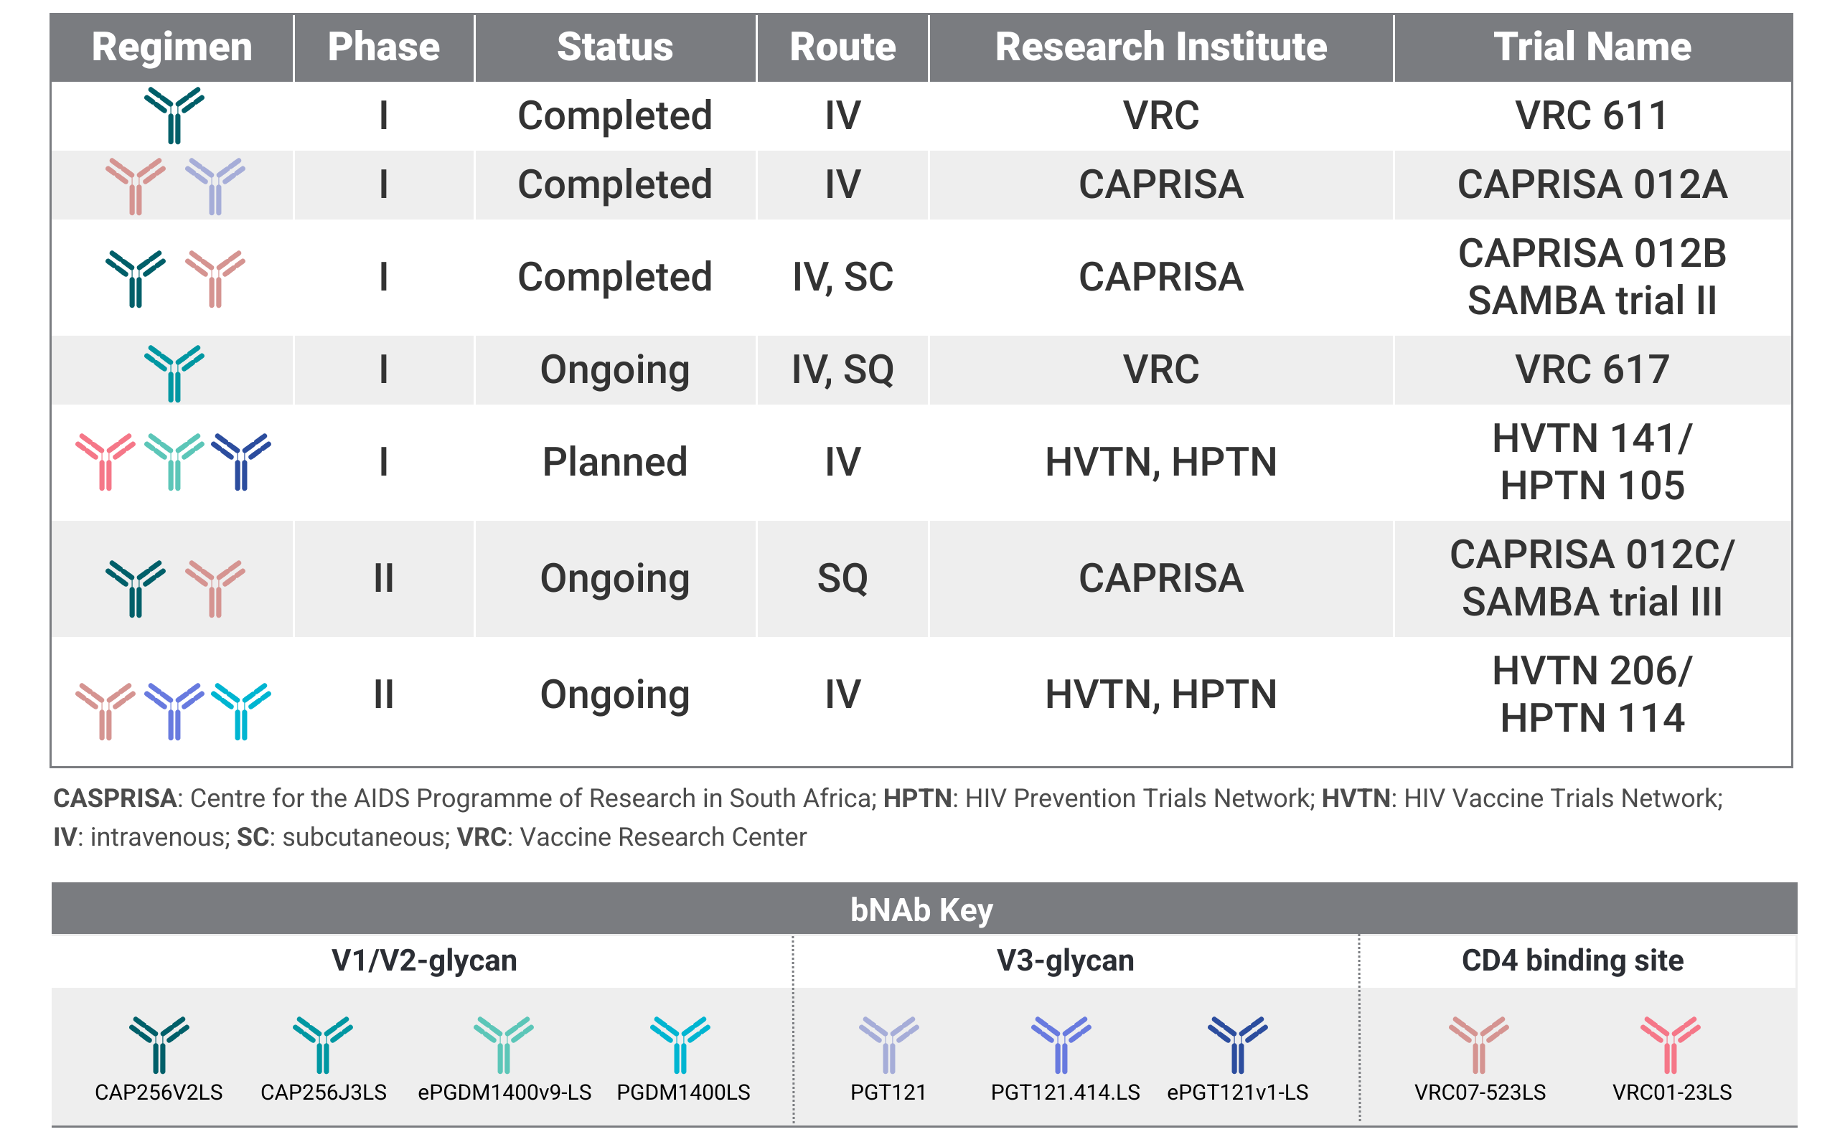
Broadly Neutralizing Antibody (bNAb) Combinations

Slide 30
Impact of US Funding Cuts

Slide 31
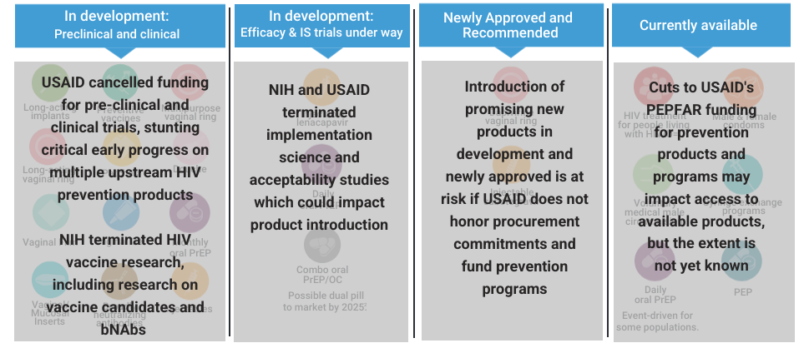
HIV Prevention Pipeline: Impact of USAID & NIH Cuts

Slide 32
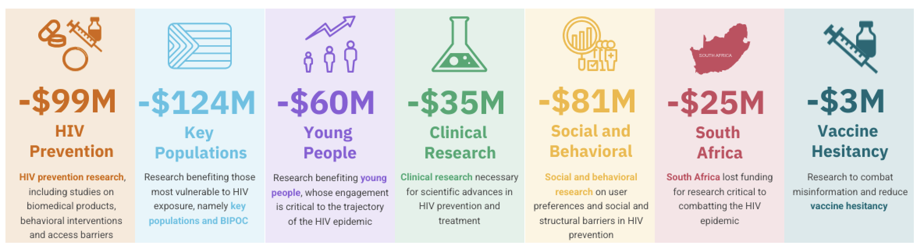
The Cost of Cutting HIV Research
NIH terminated 191 HIV-specific grants in 2025, slashing over $200 million from key HIV prevention research grants¹
¹Grants may cover more than one research area, so total across categories shown here exceeds $200 million in total funding lost

Slide 33
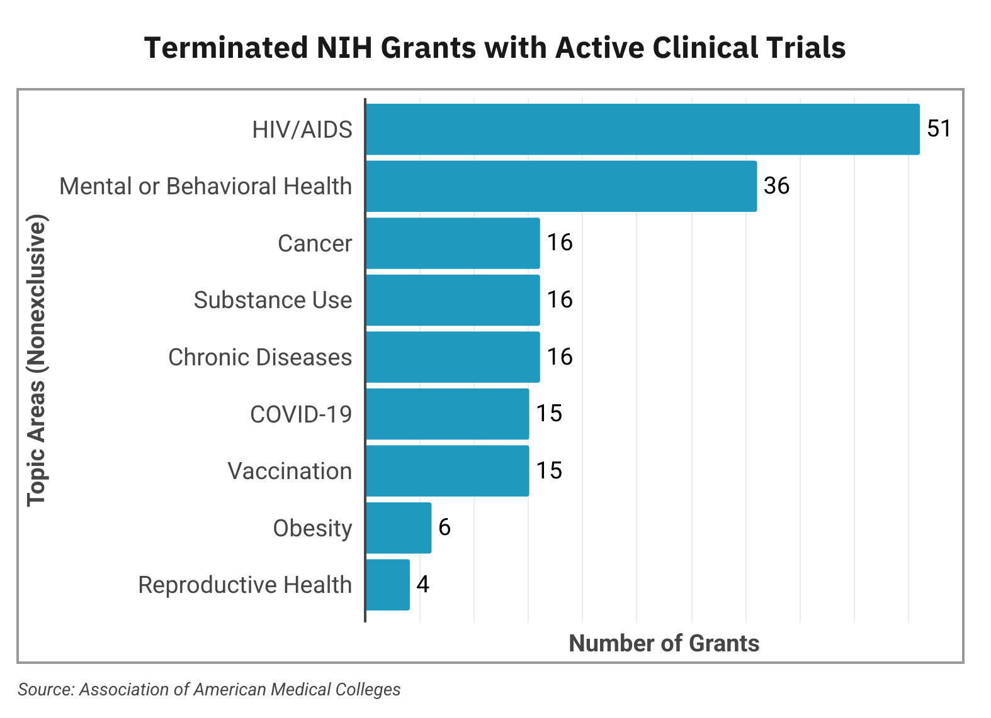
NIH: Cuts to Clinical Trials
Total NIH termination of grants—unprecedented in history of agency
  $19B lost funding = 777 terminated grants
  $643M = 113 active clinical trials terminated
  56% ($~360M) of terminated clinical trials related to HIV

Slide 34
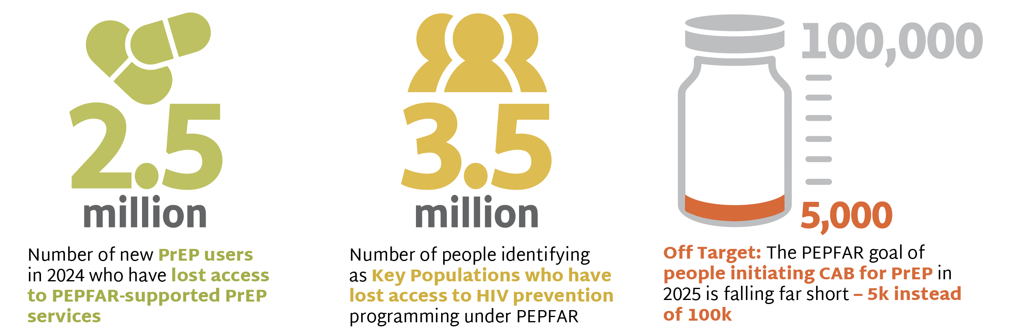
PrEP Delivery Imperiled

Slide 35
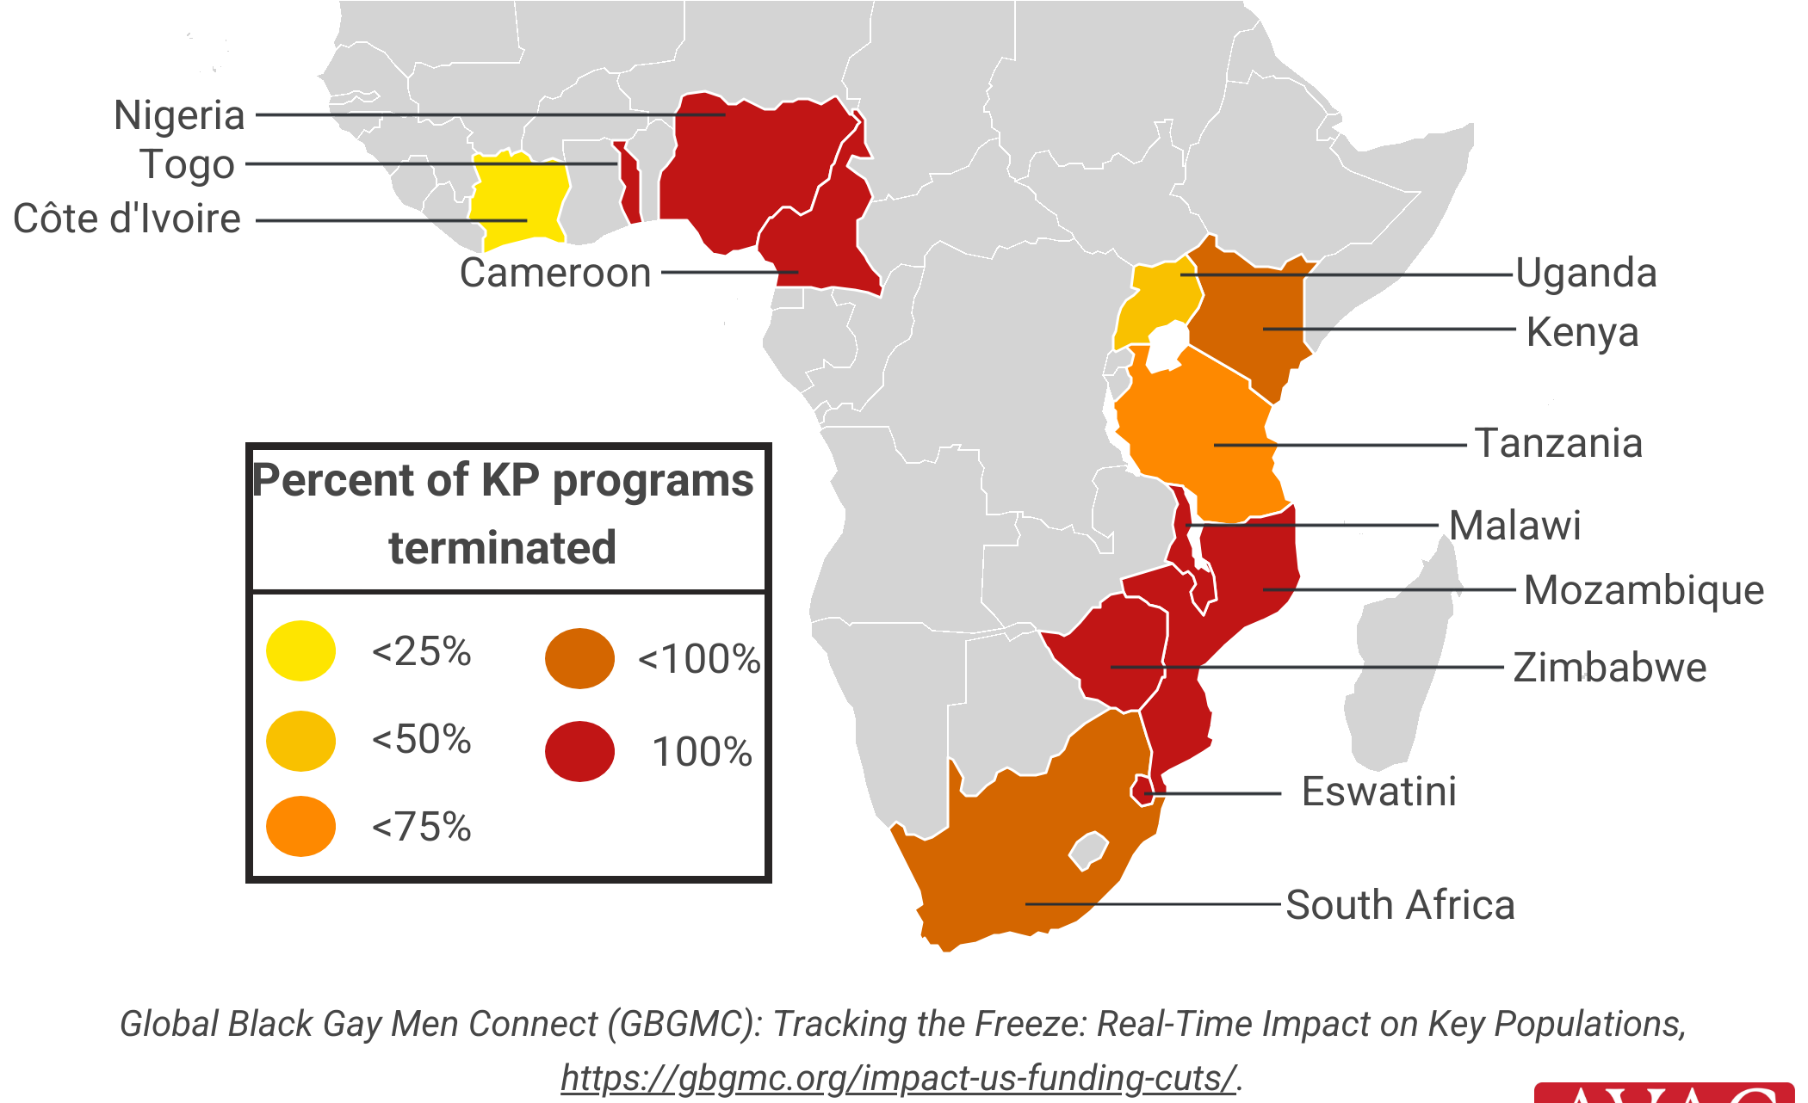
Impact of US Funding Cuts on Services for Key Populations
Percentage of KP-serving implementing partners that have reported full or partial termination of the provision of KP services due to US funding cuts as of April 2025

