Slide 1
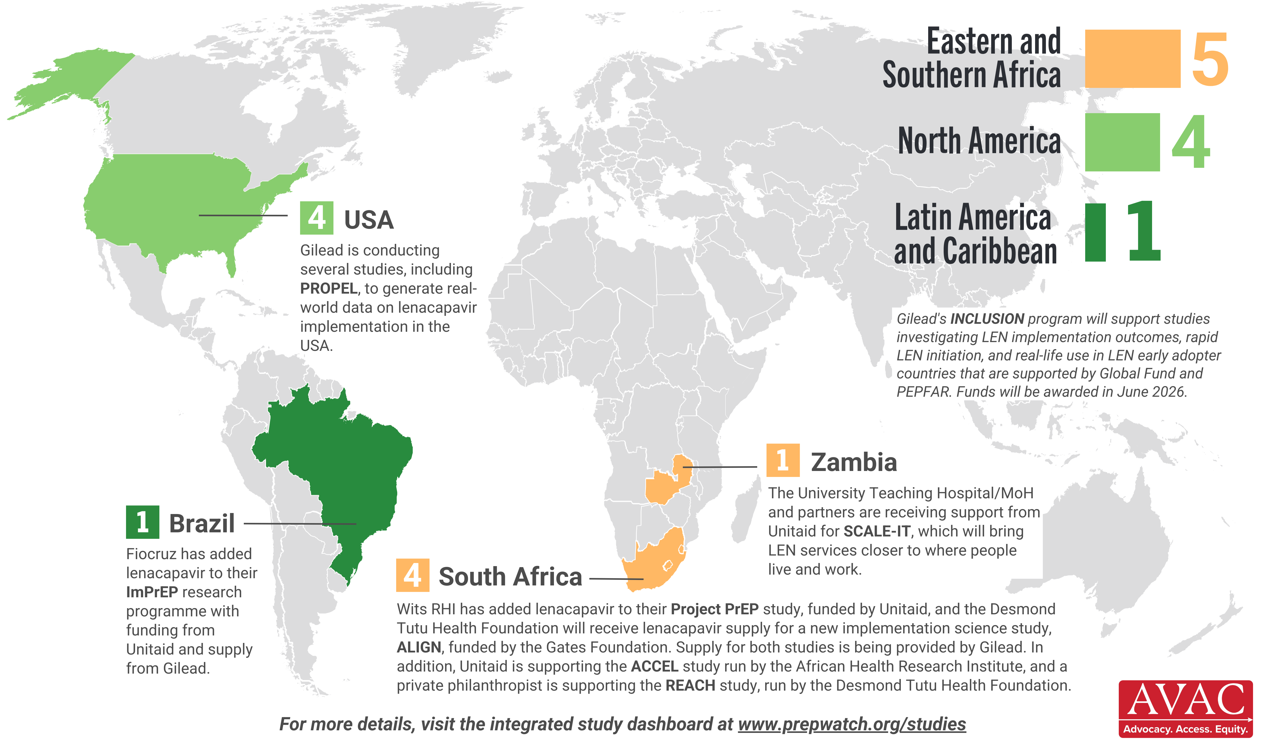
Lenacapavir Implementation Studies
10 implementation studies ongoing in 4 countries, as of February 2026

