Slide 1
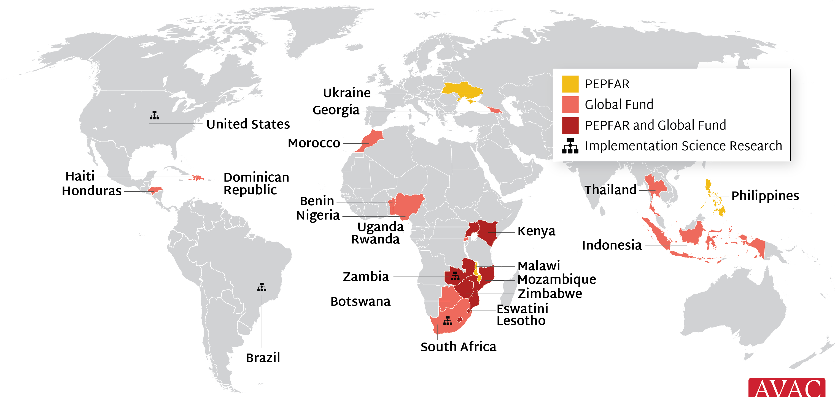
Source of LEN for PrEP Supply to Early Adopter Countries
PEPFAR and Global Fund are supporting 22 countries with early LEN access; Unitaid, Gates and Gilead are supporting 4 implementation science efforts

