Slide 1
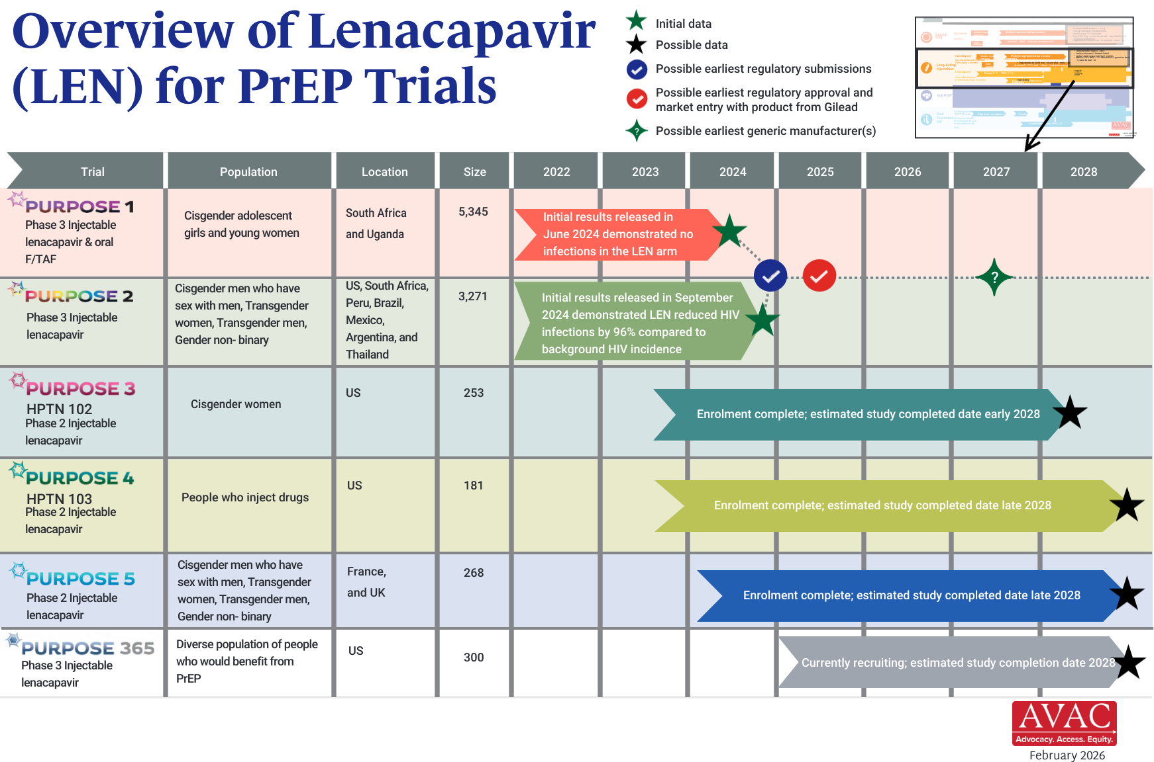
Overview of Lenacapavir Trials
Updated Feb 2026

