Slide 1
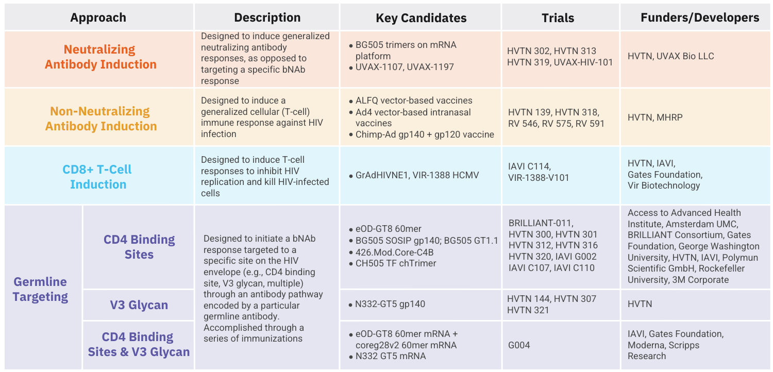
HIV Vaccine Clinical Trials Pipeline
All vaccine candidates shown above are currently in Phase I trials. More details can be found in AVAC's Pipeline Tracker.

