Slide 1
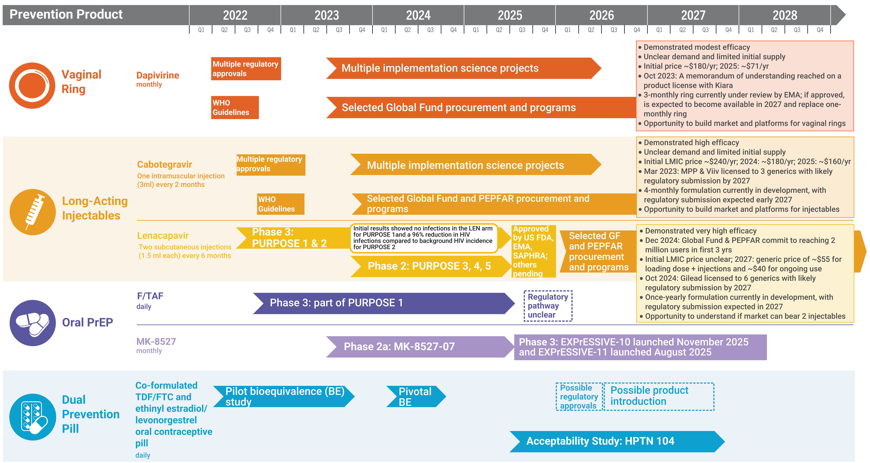
Years Ahead in HIV Prevention Research: Time to Market

