Slide 1
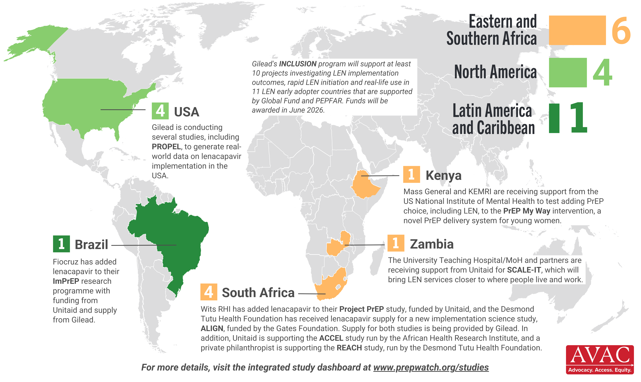
Lenacapavir Implementation Studies
11 implementation studies ongoing in 5 countries, as of March 2026

