Slide 1
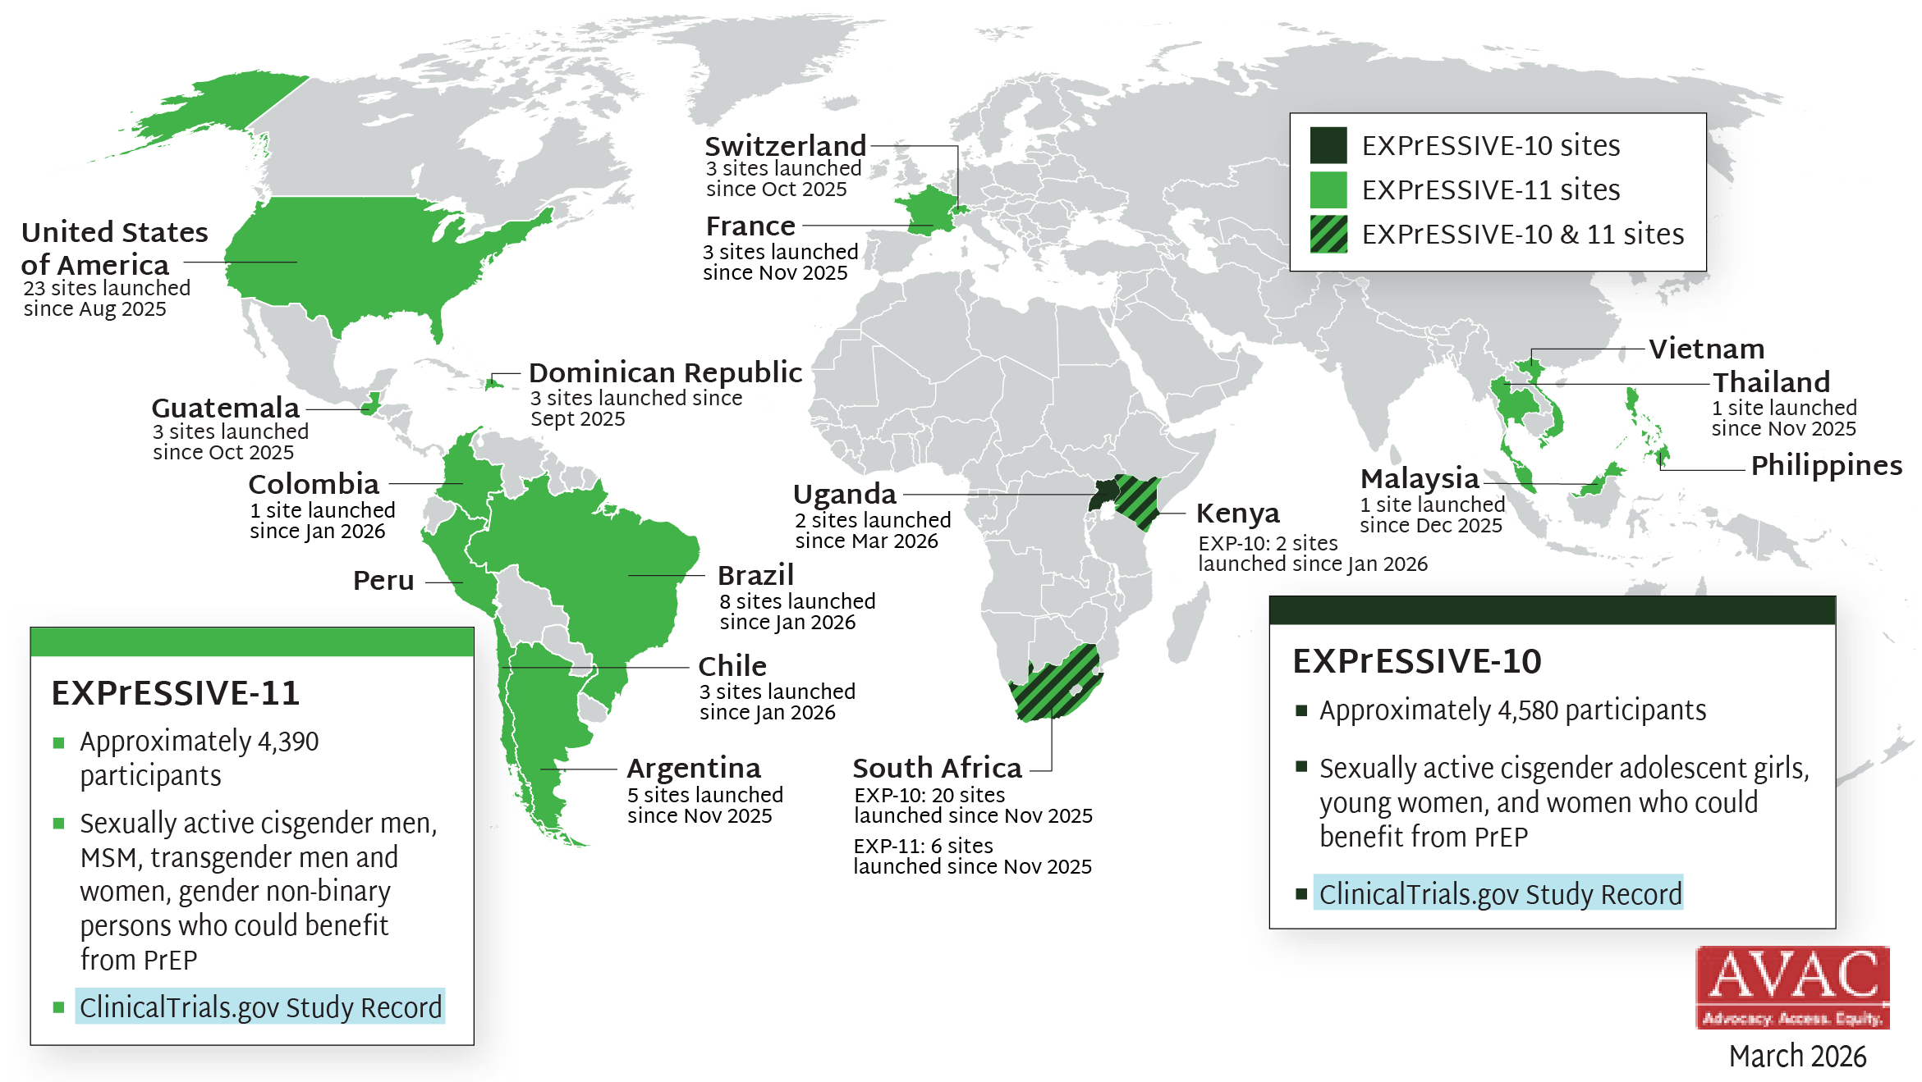
EXPrESSIVE Phase III Program Countries of MK-8527
17 countries hosting sites for Phase III program of monthly PrEP pill, MK-8527; EXPrESSIVE-11 launched Aug 2025; EXPrESSIVE-10 launched Nov 2025

