Slide 1
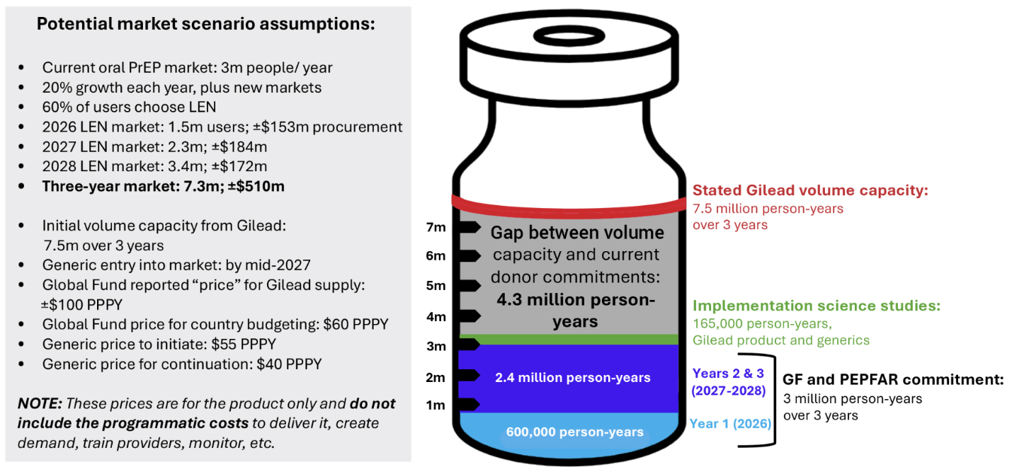
Potential Lenacapavir Supply: 2026-28
Updated July 2026

