Slide 1
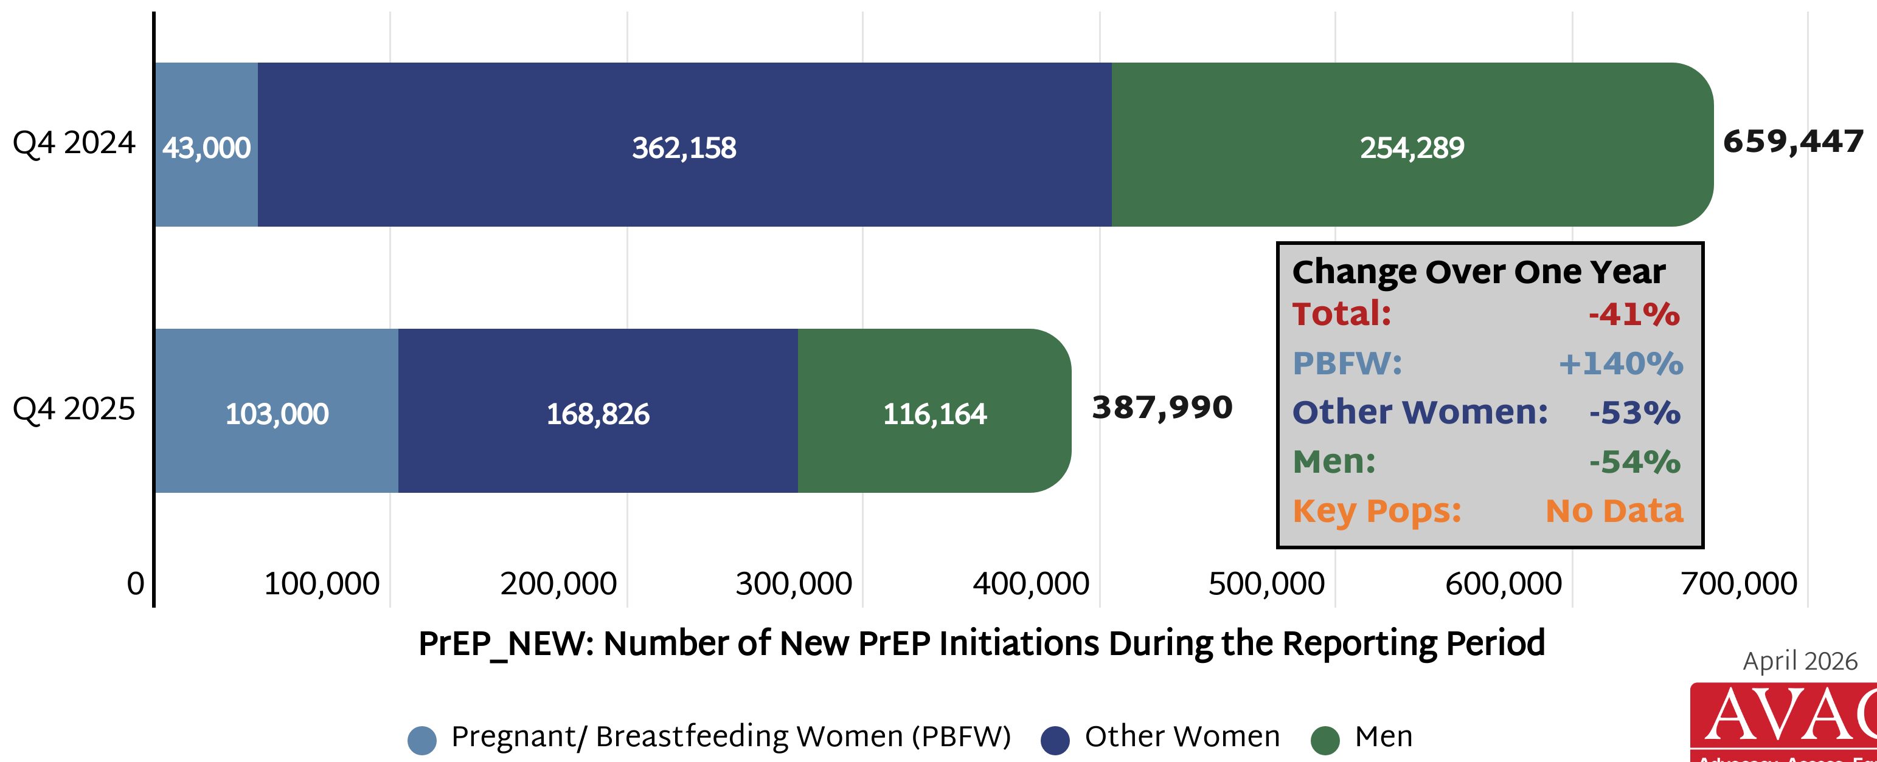
Decline in PEPFAR Supported PrEP Initiations
Comparison of PEPFAR data from Q4 2024 (July – Sept) to Q4 2025 (July – Sept)

