Slide 1
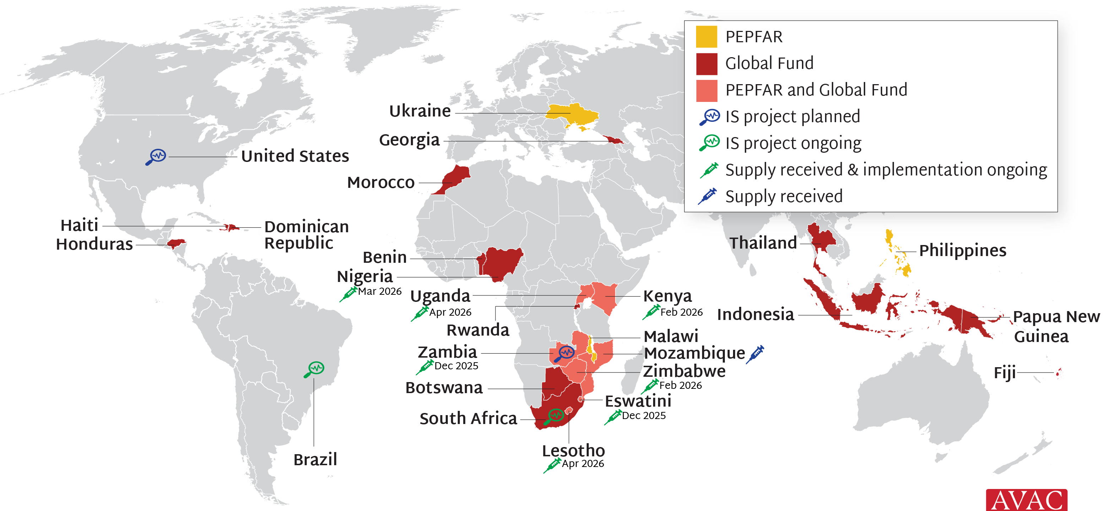
Lenacapavir for PrEP Rollout
PEPFAR and Global Fund are supporting 24 low- and middle-income countries (LMICs) with early access to programmatic supply of LEN. The first supply arrived in Eswatini and Zambia in November 2025 and the rest will be arriving throughout 2026 and early 2027. The Gates Foundation, Gilead, the NIH and Unitaid are also supporting 11 implementation science (IS) projects in 5 countries.

